Slide 1

Exponential Functions
Exponential functions are a fundamental mathematical concept that describes rapid growth or decay over time. They are characterized by their unique properties and widespread applications in various fields, from finance and biology to physics and computer science.
OI
by ONYEDIKA IK

Slide 2
Introduction to Exponential Functions
Definition
Example
An exponential function is a function where the independent variable appears as an exponent. It takes the form f(x) = a^x, where 'a' is a constant base and 'x' is the independent variable.
For example, f(x) = 2^x is an exponential function. When x = 0, f(x) = 1. When x = 1, f(x) = 2. When x = 2, f(x) = 4, and so on.

Slide 3
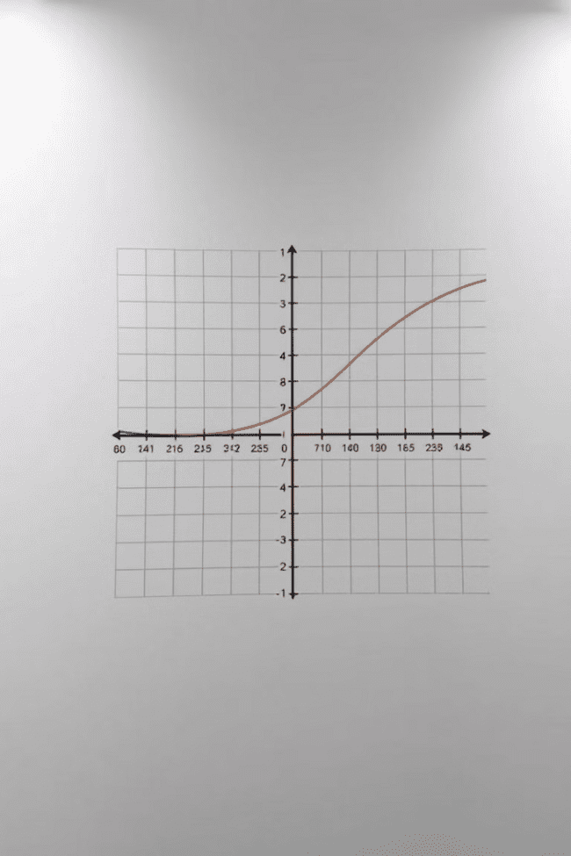
Characteristics of Exponential Functions
1
Rapid Growth or Decay
2
Asymptotes
Exponential functions are known for their rapid growth or decay as the independent variable changes. The growth or decay is exponential, meaning it increases or decreases at an increasing rate.
Exponential functions have a horizontal asymptote, which is a line that the graph approaches but never touches. The location of the asymptote depends on the base and the function's transformation.
3
Domain and Range
The domain of an exponential function is all real numbers, while the range depends on the base and the function's transformation. It can be either all positive numbers or all negative numbers.

Slide 4
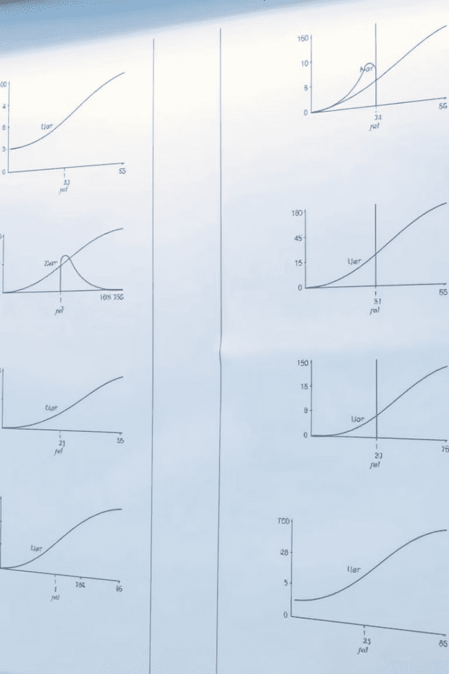


Graphs of Exponential Functions
Base Greater than 1
Base Between 0 and 1
When the base is greater than 1, the graph of the exponential function increases rapidly as the independent variable increases. The larger the base, the steeper the growth.
When the base is between 0 and 1, the graph of the exponential function decreases rapidly as the independent variable increases. The smaller the base, the steeper the decay.

Slide 5
Properties of Exponential Functions
Multiplication Property
Division Property
Power of a Power Property
For any real numbers x and y and any positive base a, the product of two powers with the same base is equal to the base raised to the sum of the exponents: a^x * a^y = a^(x+y)
For any real numbers x and y and any positive base a, the quotient of two powers with the same base is equal to the base raised to the difference of the exponents: a^x / a^y = a^(x-y)
For any real numbers x and y and any positive base a, the power of a power is equal to the base raised to the product of the exponents: (a^x)^y = a^(x*y)

Slide 6
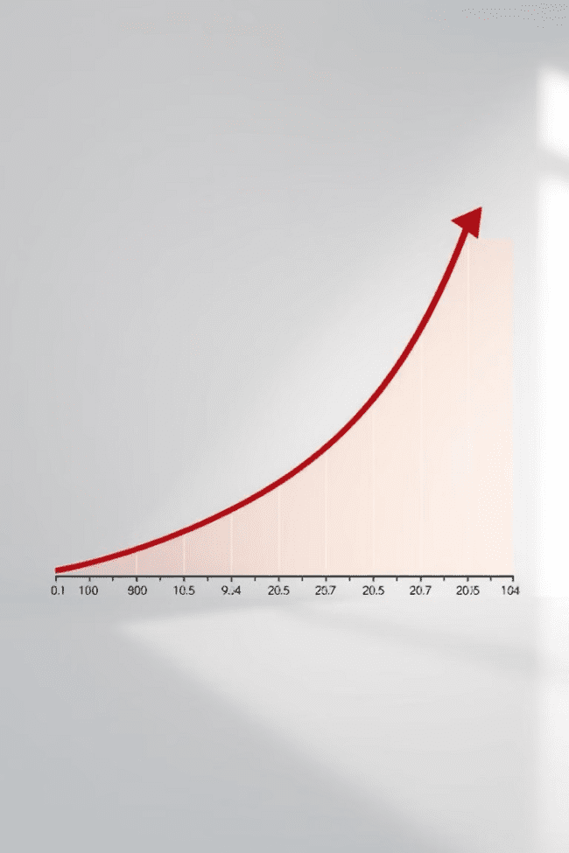
Exponential Growth
1
Population Growth
Population growth can often be modeled using exponential functions, especially when resources are abundant and there are few constraints on reproduction.
2
Compound Interest
Compound interest, where interest is earned on both the principal and accumulated interest, results in exponential growth of investments over time.
3
Viral Spread
The spread of viruses or information through social networks can also be described by exponential growth models, as each infected individual can potentially infect many others.

Slide 7
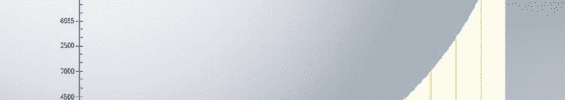



Exponential Decay
Radioactive Decay
Drug Concentration
Depreciation
Radioactive isotopes decay exponentially over time, with their half-life representing the time it takes for half of the radioactive material to decay.
The concentration of drugs in the body typically decays exponentially over time as the body metabolizes and eliminates the drug.
The value of assets, such as cars or equipment, can depreciate exponentially over time due to wear and tear or obsolescence.

Slide 8



Compound Interest and Exponential Growth
Formula
1
A = P(1 + r/n)^(nt)
Variables
2
A = final amount, P = principal, r = interest rate, n = number of times interest is compounded per year, t = time in years
Example
3
If you invest $1,000 at 5% annual interest compounded monthly, after 10 years you'll have about $1,647.01. This is a result of exponential growth.

Slide 9
Half-Life and Exponential Decay
Definition
1
The half-life of a radioactive isotope is the time it takes for half of the radioactive material to decay. This process is exponential decay.
Formula
2
N(t) = N0 * (1/2)^(t/T)
Example
3
Carbon-14 has a half-life of 5,730 years. If we start with 100 grams of Carbon-14, after 5,730 years, 50 grams will remain. After another 5,730 years, only 25 grams will remain.

Slide 10

Applications of Exponential Functions
1
2
Finance
Biology
Compound interest, loan calculations, and financial modeling.
Population growth, bacterial growth, and radioactive decay.
3
4
Physics
Computer Science
Radioactive decay, heat transfer, and wave propagation.
Algorithm analysis, data compression, and network growth.

