Slide 1
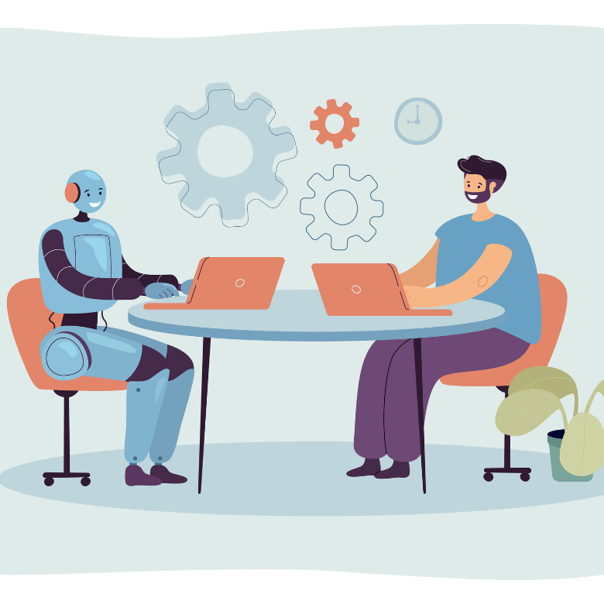
Will AI take your job?
Notes:
To get an editable version of this presentation:
1. Click File > Make a copy > Entire presentation
OR
2. Click File > Download > Microsoft Powerpoint

Slide 2

Let’s get started
with a warm-up
ESL Brains

Slide 3

List three ways people use AI at work and
three ways they use it in their personal life.
Notes:
Possible answers: At work, AI is used to write emails, simplify information or write meeting summaries. In personal life, AI is used to get recommendations on what to watch or listen to, practise a language or organize daily tasks.

Slide 4

Do you agree?
ESL Brains

Slide 5
Read the quotes and say which one you agree with the most. Say why.
“AI won’t replace humans, but humans with AI are going to replace humans without AI.” — Karim Lakhani, Harvard Business School professor
“Artificial intelligence will replace tasks, not jobs.”
— Dr Erik Brynjolfsson, Stanford University professor
“AI was supposed to do the boring tasks; it’s doing the fun ones instead.”
— Christian Behler, writer and software developer

Slide 6

In a moment, you’ll watch a video about:
AI’s impact on jobs

Slide 7

Watch the video (to 01:50) and complete the table.
Tasks AI is likely to take over | Skills and tasks AI is not likely to learn

Slide 8
Let’s check the answers.
Tasks AI is likely to take over | Skills and tasks AI is not likely to learn
repeatable actions, data entry and analysis, tasks related to sorting through documents, memorization, using basic words and phrases to communicate
human interaction, teamwork (innovating together)
Notes:
TIMESTAMPS:
00:55; 01:04; 01:37; 01:41
01:16; 01:27
You could also ask students to suggest more items for each category in the table.

Slide 9

Let’s discuss!
ESL Brains

Slide 10
Discuss reasons why these professions could be replaced by AI.
accountants
data scientists
medical staff
digital marketers
graphic designers
software coders

Slide 11
Watch the second part of the video (from 01:50), compare it with your ideas and write down reasons provided for some of the professions.
accountants
data scientists
medical staff
digital marketers
graphic designers
software coders

Slide 12
Let’s check the answers.
accountants
data scientists
medical staff
digital marketers
graphic designers
software coders
data entry and analysis is very easily done by AI
AI is very good at sorting through numbers and figures
AI is really good at creating visuals
creating visuals, creating charts is something that AI can do really well
Notes:
TIMESTAMPS:
02:02
02:10
02:50
03:13

Slide 13
Let’s talk!
ESL Brains

Slide 14
Discuss the questions.
Do you agree with the opinions in the video? Why/Why not?
Do you think professionals working in your area are likely to be replaced by AI? Give more details.
Do you agree that ‘learning how to learn’ can keep you safe from losing your job to AI?
Do you know anyone who has lost their job to AI? If yes, give more details. If not, why do you think that is?

Slide 15

Let’s learn some vocabulary!
ESL Brains

Slide 16
part 1/2
Read the comments (A–B) and match the words in bold with their definitions (1–8).
AI can already carry out tasks that used to require human workers, posing a threat to many professionals. We can also see AI widening the gap in the job market: junior and other entry-level positions are increasingly taken over by AI. As a consequence, people with no work experience find it much harder to get a job than experienced professionals. If you want to stay employed, you should take responsibility for developing new skills and be prepared to change careers whenever necessary.
have the ability or possibility to improve or succeed in the future
help to cause something
change something to make it more suitable for a new situation
create a risk or danger to someone or something
do a job or piece of work
increase the distance or difference between two or more things
accept that it is your job to do something
depend on someone or something

Slide 17
part 2/2
Read the comments (A–B) and match the words in bold with their definitions (1–8).
The world is changing fast and AI is simply part of that change. Used correctly, AI has the potential to improve both efficiency and job satisfaction. Instead of replacing us, AI can contribute to better working conditions. We’re lucky that we can rely on it for simple and repetitive tasks because it allows us to do more complex and meaningful work. The key is being willing to adapt to new technologies and learning how to make the most of them.
have the ability or possibility to improve or succeed in the future
help to cause something
change something to make it more suitable for a new situation
create a risk or danger to someone or something
do a job or piece of work
increase the distance or difference between two or more things
accept that it is your job to do something
depend on someone or something

Slide 18
part 1/2
Let’s check the answers.
AI can already carry out tasks that used to require human workers, posing a threat to many professionals. We can also see AI widening the gap in the job market: junior and other entry-level positions are increasingly taken over by AI. As a consequence, people with no work experience find it much harder to get a job than experienced professionals. If you want to stay employed, you should take responsibility for developing new skills and be prepared to change careers whenever necessary.
have the ability or possibility to improve or succeed in the future
help to cause something
change something to make it more suitable for a new situation
create a risk or danger to someone or something
do a job or piece of work
increase the distance or difference between two or more things
accept that it is your job to do something
depend on someone or something

Slide 19
part 2/2
Let’s check the answers.
The world is changing fast and AI is simply part of that change. Used correctly, AI has the potential to improve both efficiency and job satisfaction. Instead of replacing us, AI can contribute to better working conditions. We’re lucky that we can rely on it for simple and repetitive tasks because it allows us to do more complex and meaningful work. The key is being willing to adapt to new technologies and learning how to make the most of them.
have the ability or possibility to improve or succeed in the future
help to cause something
change something to make it more suitable for a new situation
create a risk or danger to someone or something
do a job or piece of work
increase the distance or difference between two or more things
accept that it is your job to do something
depend on someone or something

Slide 20
Do you agree?
ESL Brains

Slide 21
Discuss which view (A or B) you agree with the most and why.
AI can already carry out tasks that used to require human workers, posing a threat to many professionals. We can also see AI widening the gap in the job market: junior and other entry-level positions are increasingly taken over by AI. As a consequence, people with no work experience find it much harder to get a job than experienced professionals. If you want to stay employed, you should take responsibility for developing new skills and be prepared to change careers whenever necessary.
The world is changing fast and AI is simply part of that change. Used correctly, AI has the potential to improve both efficiency and job satisfaction. Instead of replacing us, AI can contribute to better working conditions. We’re lucky that we can rely on it for simple and repetitive tasks because it allows us to do more complex and meaningful work. The key is being willing to adapt to new technologies and learning how to make the most of them.

Slide 22

Let’s write!
ESL Brains

Slide 23

part 1/2
Choose two professions (A–O) in the next slide and write a short opinion about them based on the points below. Use at least three of the phrases in the box in each opinion.
EXAMPLE
AI has already contributed to the work of translators, helping them save time on simple texts such as short emails or instructions. However, translators relying on AI tools is also widening the gap between cheap, fast translations and high-quality professional work. In my opinion, replacing translators entirely would pose a threat to quality as there are aspects such as meaning and culture which will always need a human translator.
how AI has affected this profession so far
whether the profession is likely to be completely replaced by AI
tasks that are done by the professionals which will likely be carried out by AI, even if the job isn’t likely to disappear
adapt to pose a threat to
carry out tasks rely on
contribute to take responsibility for
have the potential to widen the gap

Slide 24
part 2/2
Choose two professions (A–O) and write a short opinion about them based on
the points below. Use at least three of the phrases in the box in each opinion.
paramedic
translator
fitness trainer
actor
civil engineer
dentist
travel agent
firefighter
musician
hairdresser
artist
chef
recruiter
police officer
sales rep
how AI has affected this profession so far
whether the profession is likely to be completely replaced by AI
tasks that are done by the professionals which will likely be carried out by AI, even if the job isn’t likely to disappear
adapt to pose a threat to
carry out tasks rely on
contribute to take responsibility for
have the potential to widen the gap

Slide 25
Do you agree?
ESL Brains

Slide 26
Work in pairs. Listen to your partner’s opinions about the professions below and respond by agreeing or disagreeing and explaining why. Then, swap roles.
paramedic
translator
fitness trainer
actor
civil engineer
dentist
travel agent
firefighter
musician
hairdresser
artist
chef
recruiter
police officer
sales rep
how AI has affected this profession so far
whether the profession is likely to be completely replaced by AI
tasks that are done by the professionals which will likely be carried out by AI, even if the job isn’t likely to disappear
adapt to pose a threat to
carry out tasks rely on
contribute to take responsibility for
have the potential to widen the gap
Notes:
You can also ask students to choose more professions to talk about based on the points in the slide.

Slide 27

Let’s think!
ESL Brains

Slide 28

Choose two professions (A–F) and imagine they have been replaced by AI.
Say what the outcomes of the replacement could be, considering the points in the boxes.
EXAMPLE
If journalists were replaced by AI, it could contribute to more free news websites, but the quality of news articles would probably be lower. Moreover, relying on AI-generated content could pose a threat to democracy because citizens would be making political decisions based on unreliable information.
journalist
photographer
therapist
teacher
historian
composer
price of some services
the quality of services
ethical concerns
availability of the services
people’s lifestyle

Slide 29

Let’s revise!
ESL Brains
Notes:
The following section contains a task which may be used either as homework or a revision task. This task is only available in the Teacher’s Version of the PDF.

Slide 30
Complete the gaps with the words in the boxes in the correct form.
adapt
carry out
contribute
have
pose
rely
take
widen
Could __________ too much on AI reduce people’s thinking skills?
Who should __________ responsibility for bad decisions made with AI tools?
Will AI become expensive and therefore __________ the gap between those who can pay for it and those who can’t?
Could the use of AI in areas like hiring or promotion __________ a threat to people’s chances at work?
Could AI reduce working hours and __________ to better work–life balance?
Do you think AI __________ the potential to create completely new professions?
What advice could you give to workers who struggle to __________ to AI at work?
Are there any tasks AI should never be allowed to __________ ?

Slide 31
Let’s check the answers.
adapt
carry out
contribute
have
pose
rely
take
widen
Could __________ too much on AI reduce people’s thinking skills?
Who should __________ responsibility for bad decisions made with AI tools?
Will AI become expensive and therefore __________ the gap between those who can pay for it and those who can’t?
Could the use of AI in areas like hiring or promotion __________ a threat to people’s chances at work?
Could AI reduce working hours and __________ to better work–life balance?
Do you think AI __________ the potential to create completely new professions?
What advice could you give to workers who struggle to __________ to AI at work?
Are there any tasks AI should never be allowed to __________ ?
relying
take
widen
pose
contribute
has
adapt
carry out

Slide 32
Choose three questions and answer them.
Could relying too much on AI reduce people’s thinking skills?
Who should take responsibility for bad decisions made with AI tools?
Will AI become expensive and therefore widen the gap between those who can pay for it and those who can’t?
Could the use of AI in areas like hiring or promotion pose a threat to people’s chances at work?
Could AI reduce working hours and contribute to better work–life balance?
Do you think AI has the potential to create completely new professions?
What advice could you give to workers who struggle to adapt to AI at work?
Are there any tasks AI should never be allowed to carry out?

Slide 33
THANKS!
ESL Brains

