Slide 1

Problem solving
with 5 Whys
Notes:
To get an editable version of this presentation:
1. Click File > Make a copy > Entire presentation
OR
2. Click File > Download > Microsoft Powerpoint

Slide 2

Let’s get started
with a warm-up
ESL Brains

Slide 3

Discuss in pairs.
Describe one problem you’ve recently had to solve at work and how you have done it.
How do you approach solving problems?
Do you prefer to solve problems individually or in a team?
How often do you look for the root cause of a problem?

Slide 4

In a moment, you’ll watch a video about:
a problem-solving method developed by Sakichi Toyoda

Slide 5

Answer the questions.
What does the technique involve?
Why do we use that technique?
What example of a problem to solve does the speaker give?

Slide 6
Let’s check the answers.
What does the technique involve?
Why do we use that technique?
What example of a problem to solve does the speaker give?
Asking 5 why questions
To discover the root cause of a problem
The IT team in your organization has just rolled out new software for tracking everyone's expenses. But, no one on your team is using it, even though they've all been trained to do so.

Slide 7
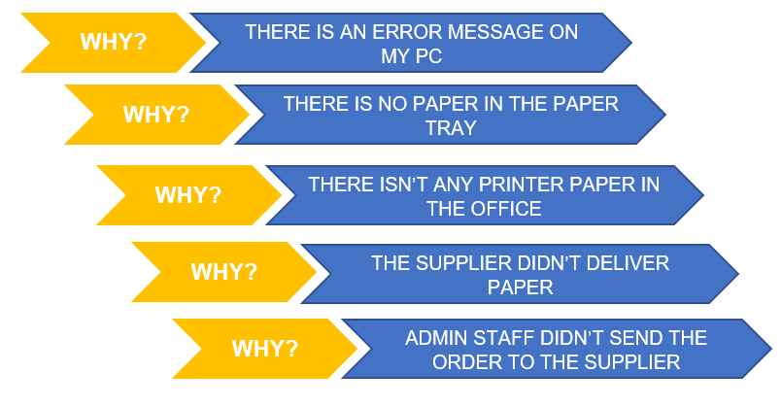
Look at the example below and then complete the graph in the next slide by asking 5 why questions to get to the root cause.
EXAMPLE
PROBLEM: I CAN’T PRINT MY DOCUMENTS AT WORK.

Slide 8
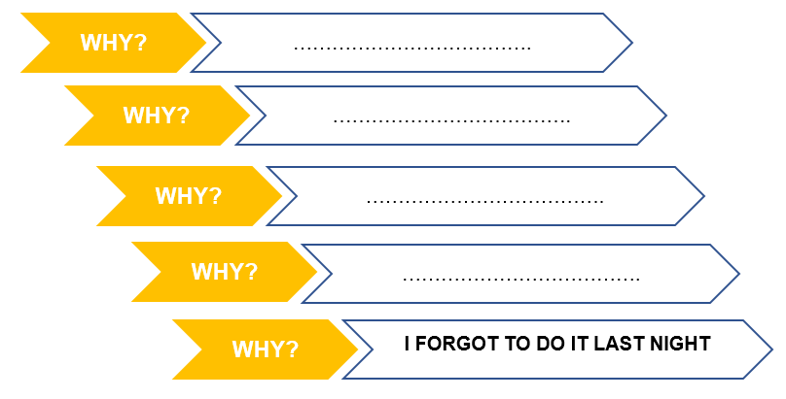
Ask 5 why questions to get to the root cause.
PROBLEM: I RAN THROUGH A RED LIGHT WHILE GOING TO WORK

Slide 9
Let’s see a sample analysis.
PROBLEM: I RAN THROUGH A RED LIGHT WHILE GOING TO WORK
I WAS IN A HURRY FOR A MEETING
I WOKE UP LATE
MY ALARM DIDN’T GO OFF
I DIDN’T CHARGE MY PHONE

Slide 10
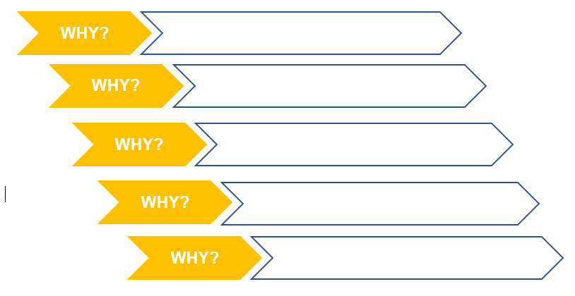
Write down a problem you’ve had recently. In groups of three, analyse your problems together by asking “why…?”. If the answer you get doesn’t identify the root cause, continue asking “why…?” until you agree that the problem’s root cause has been identified.
PROBLEM: ____________________________________

Slide 11
THANKS!
ESL Brains

