Slide 1
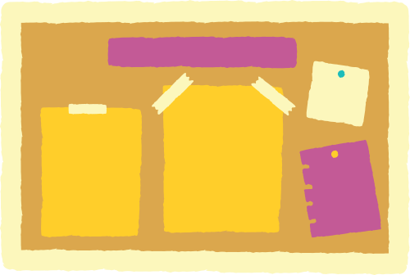


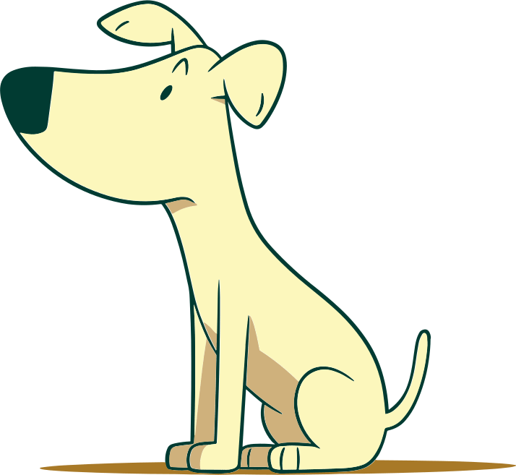



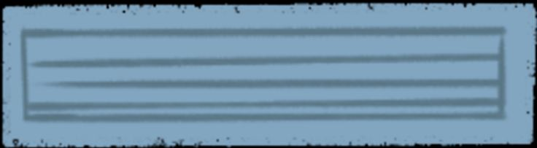


Where ıs
Where ıs
Dog?
Dog?
Prepositions of place

Slide 2


Lesson Goal
Identificar la ubicación de objetos a través del uso de preposiciones de lugar.

Slide 3
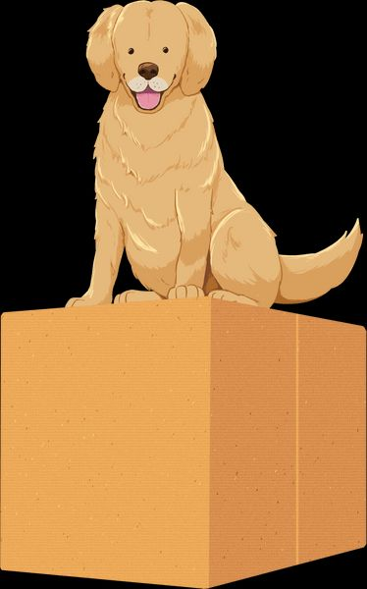
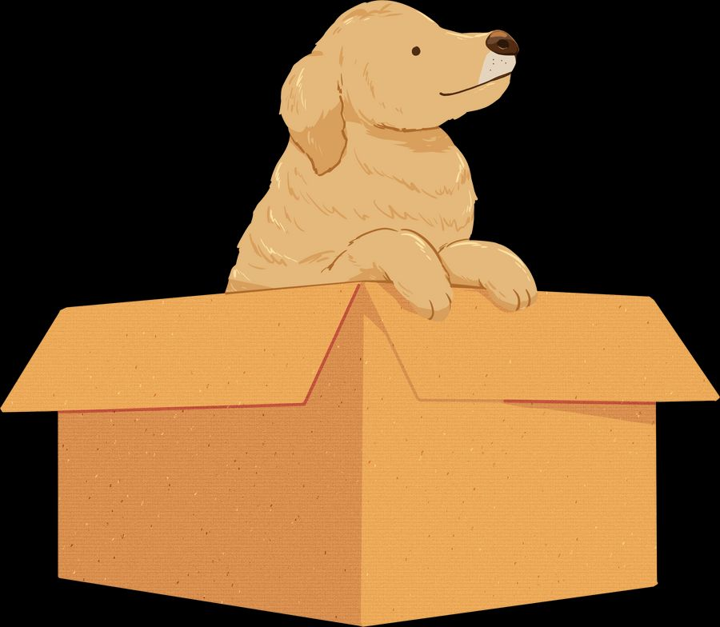
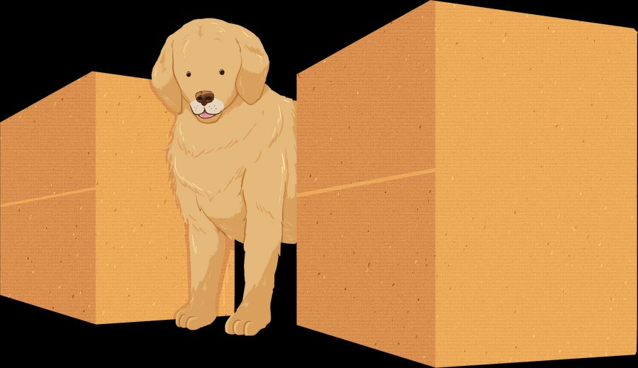
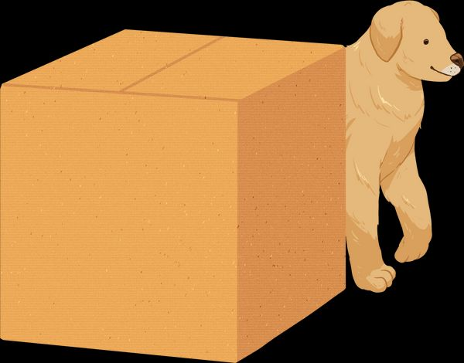
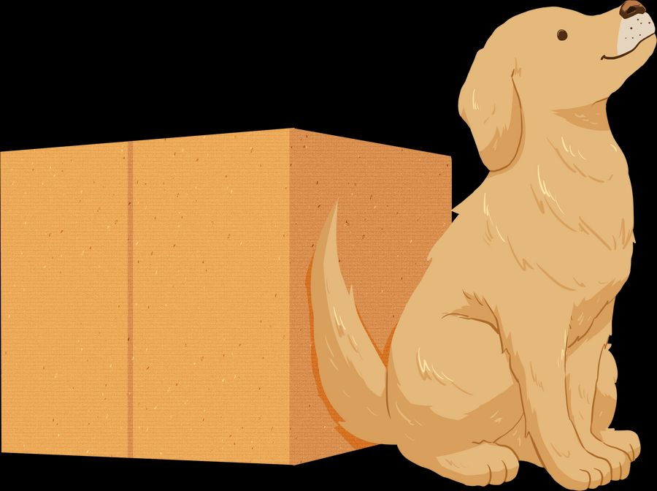
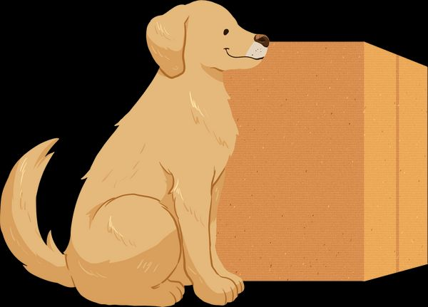
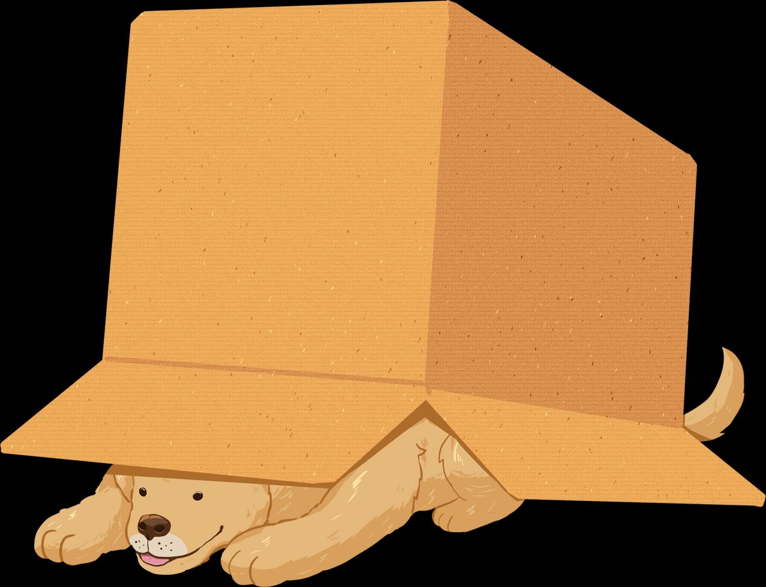
Preposition of place Review
Between
On
In
In front
under
Behind
Next to

Slide 4
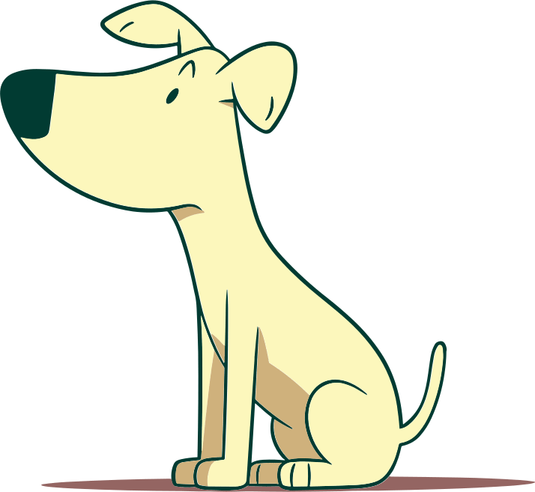
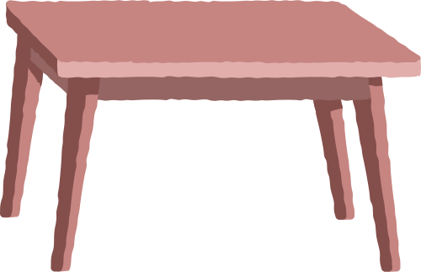
Where ıs Dog?

Slide 5
Dog is on the table.

Slide 6
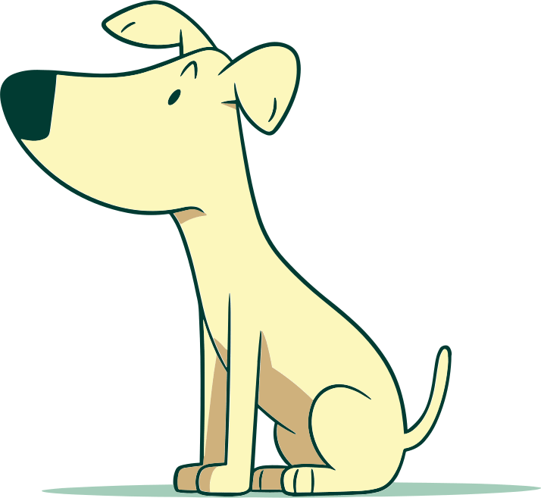
Where ıs Dog?

Slide 7
Dog is under the table.

Slide 8
Where ıs Dog?

Slide 9
Dog is Next to the table.

Slide 10


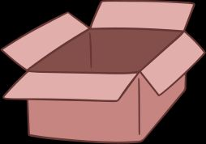
Where ıs Dog?

Slide 11
Dog is in the box.

Slide 12

Where ıs Dog?

Slide 13
Dog is Behind the house

Slide 14
Where ıs Dog?

Slide 15
Dog is In front of the house

Slide 16
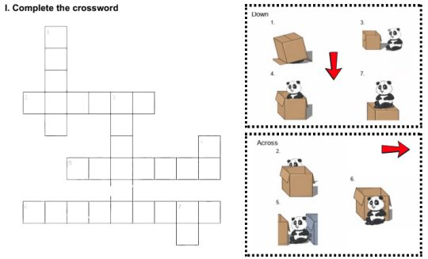

Let’s Practice

Slide 17
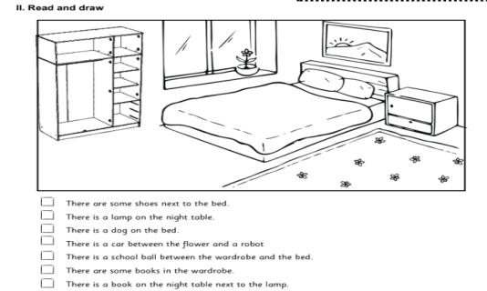

Let’s Practice

Slide 18

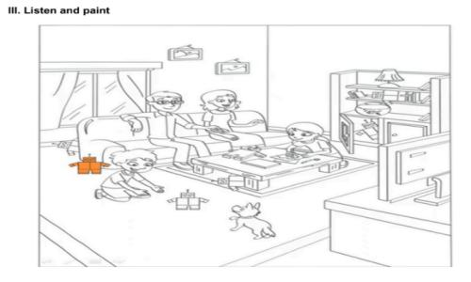

Let’s Practice
v

Slide 19
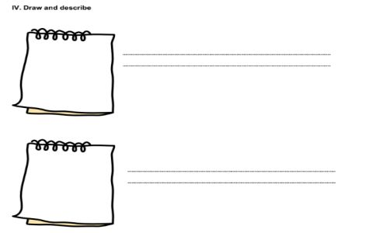

Let’s Practice

Slide 20
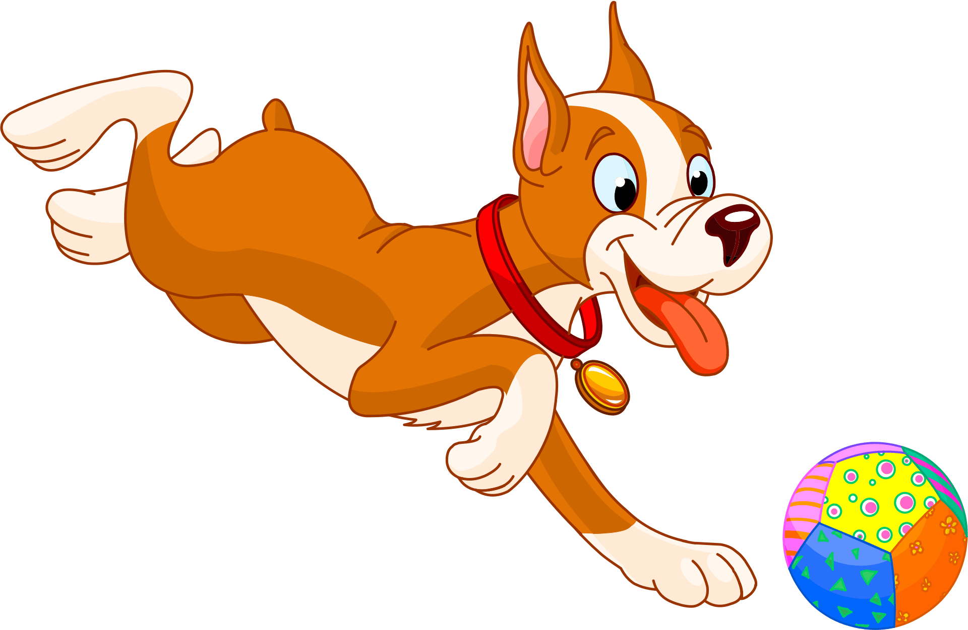
Let’s Play!

Slide 21

Exit Ticket
Exit ticket
What did you learn today?

