Slide 1

Efficiency
Marco F

Slide 2
Allocative Efficiency
Measures whether resources are distributed to those people who really want it
Condition: P= MC (in other words, where equilibrium is being achieved since P=Demand and MC=Supply)

Slide 3
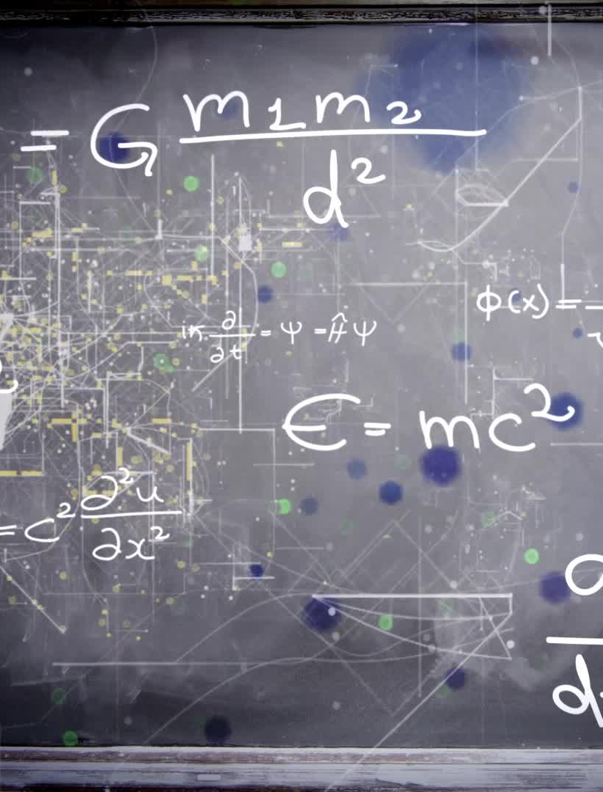
Productive Efficiency
Exists when production is achieved at lowest average cost
Condition: MC=AC (since the MC curve must pass through the lowest point of the AC curve)
A firm is productively efficient in the short run if it operates on the bottom of its SRAC curve
A firm is productively efficient in the long run if it operates on the bottom of its LRAC curve

Slide 4
Dynamic Efficiency
When resources are allocated efficiently over time
Investing in technology, research and development can lead to firms becoming more dynamically efficient as they can produce more with a lower average cost
Condition: can only achieve when firms are making super-normal profits

Slide 5
X-Inefficiency
Occurs when a firm is not producing at the lowest possible cost for a given level of output
Occurs due to:
Management of a firm is poor at controlling costs (e.g., employ too many workers)
Stakeholders within the firm are able to extract benefits that are greater than the firm needs to pay (e.g., trade unions negotiating higher rates of pay than the market wage rate)

Slide 6
Efficiency and inefficiency in different market structures
Firms in competitive markets tend to be more efficient than those markets where a few firms dominate
Important:
Perfectly competitive market is the only market structure that will achieve both productive and allocative efficiency in the long run
Perfectly competitive market in the short run and the other market structures won’t achieve allocative and productive efficiencies

Slide 7
Efficiency and types of competition
Price
Design of a product
Quality, reliability, customer service
Availability of a product
Promotion such as advertising

