Slide 1
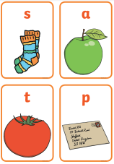
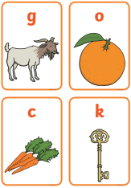
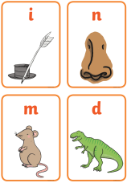
The Importance of Teaching Phonics

Slide 2
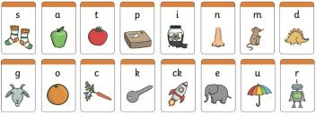

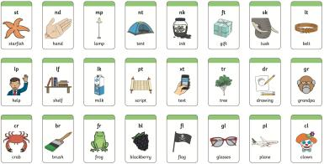
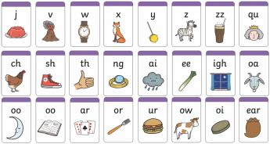

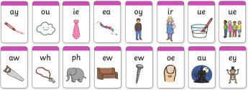


Slide 3
Did You Know…?
The English language has:
26 letters
44 sounds
over 100 ways to spell those sounds
It is one of the most complex languages to learn to read and spell.

Slide 4
The Jargon – A Quick Guide
phonics (also known as ‘synthetic phonics’) – The teaching of reading by developing awareness of the sounds in words and the corresponding letters used to represent those sounds.
phoneme - Any one of the 44 sounds which make up words in the English language.
grapheme – How a phoneme is written down. There can be more than one way to spell a phoneme. For example, the phoneme ‘ay’ is spelt differently in each of the words ‘way’, ‘make’, ‘fail’, ‘great’, ‘sleigh’ and ‘lady’.
blending – Putting together the sounds in a word in order to read it, e.g. ‘f – r – o – g, frog’
segmenting – Breaking a word into its constituent sounds in order to spell them, e.g. ‘frog, f – r – o – g’’

Slide 5
What Is Phonics?
Phonics is a method for teaching reading and writing.
It develops phonemic awareness – the ability to hear, recognise and use the sounds within words.
Learners are also taught the correspondence between sounds and the graphemes (spelling patterns) that represent them.
Phonics is currently the main way in which children in British primary schools are taught to read in their earliest years.
Children will also be taught other skills, such as whole-word recognition (see ‘tricky words’), book skills and a love and enjoyment of reading.

Slide 6
Why Are Children Taught Phonics?
Phonics, taught in a structured way, is generally accepted to be the most effective way to teach reading and writing.
Children learn to hear and recognise sounds in words and spell them correctly.
This assists with their confidence, accuracy and fluency.
Phonics should not be taught in isolation — children also need to learn other reading and comprehension skills alongside phonic knowledge.

Slide 7
The Importance of Listening Skills
Phonics learning relies on children being able to hear and distinguish the sounds within words.
Children with poor listening and/or attention skills can struggle with phonics learning.
Listening skills begin at birth and there are lots of things that parents and carers can do to support these skills.
Children are also taught listening and attention skills during their early years education (age 0-5).
The first phase of formal phonics education (Phase 1) also focuses on key listening skills. Without these skills, children may struggle to master the next stage of their phonics learning.

Slide 8
Letters and Sounds
Letters and Sounds is a resource for the teaching of phonics which was issued by the Department for Education in 2007.
It remains the most common way to teach phonics in British primary schools.
It is divided into six sections, or phases, intended to begin in the preschool years and finish at the end of year 2 (age 7).

Slide 9
Phase One
Phase 1 has seven aspects, with a focus on listening skills.
1: Environmental sounds
2: Instrumental sounds
3: Body percussion
4: Rhythm and rhyme
5: Alliteration
6: Voice sounds
7: Oral blending and segmenting

Slide 10



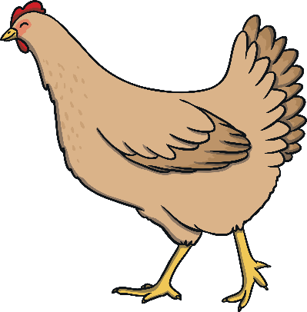

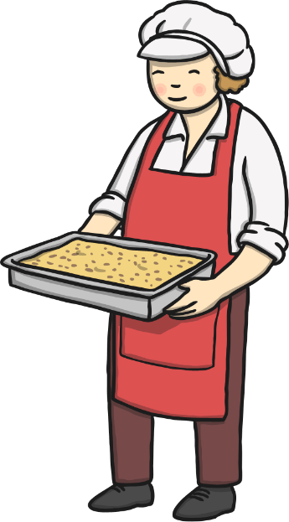




Find the Rhymes

Slide 11


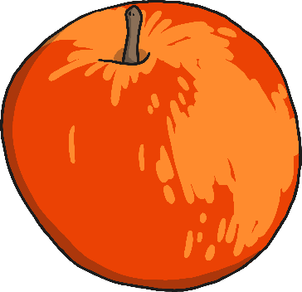
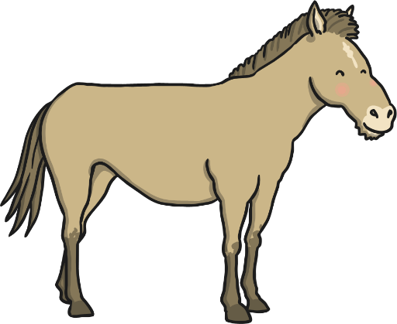
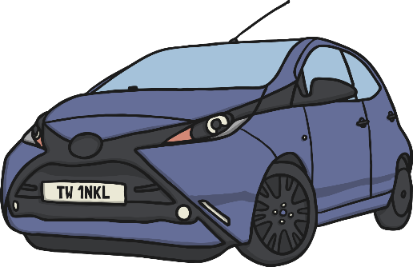



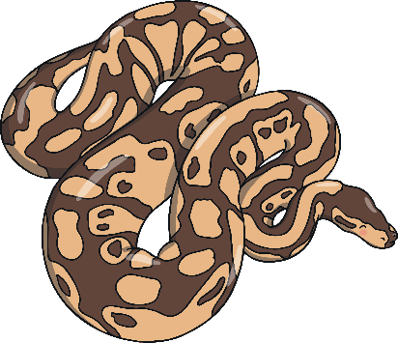
Find the Starting Sounds
Can you find three things beginning with ‘sss’?
How many things begin with ‘h’?

Slide 12
Phase Two
In Phase 2, children begin to learn some letter sounds and to match them to graphemes.
Most of the first sounds are single-letter sounds but there are also several digraphs, where one sound is represented by two letters, e.g. ‘ck’, ‘ll’, ‘ss’.
Children also begin to blend the sounds to make words. By the end of Phase 2, children will be able to read some ‘vowel-consonant’ (vc) and ‘consonant-vowel-consonant’ (cvc) words, e.g. up, in, cat, pin.
Five sets of letters are introduced – one set per week.
Children will also learn to read the ‘tricky’ words the, to, go, I, no, which cannot be read phonetically.

Slide 13

Teaching Phonics in School
Children are taught reading and spelling daily throughout the week, and each session will follow a structured format.
The activities used to teach will vary and can be adapted. They are multisensory and appeal to different learning styles. They involve games and individual and group activities as well as teacher-led sessions.
Teachers will assess children’s understanding throughout each session and will also assess knowledge of sounds to see whether a child is ready to move on to the next phase.

Slide 14
Phase Three
Phase 3 usually lasts around 12 weeks. Children are taught another 25 graphemes.
The final single-letter sounds are taught, together with more consonant digraphs (e.g. zz, qu) and several vowel digraphs (e.g. ai, ee, igh).
Children also continue to learn how to blend and segment CVC words using the new sounds, e.g. tail, sheet, night – note that these words still only have three sounds.
Children will then move on to blending and segmenting two-syllable words such as cooker, eating, broken.
Tricky words also continue to be taught.

Slide 15
Phase Four
By Phase 4, children are able to represent each of 42 phonemes with a grapheme. Children will be able to read CVC words and begin to segment them to spell them.
Phase 4 is consolidation of children’s knowledge. Children also move on to blending and segmenting using adjacent consonants, e.g. st, sp, tr, br, spr, str in words such as string, blow, train.
Phonics teaching continues to be regular and structured and children play games to consolidate their learning.

Slide 16

Buried Treasure
What have the pirates hidden in the chest?

Slide 17





brick

Slide 18



Yes or No?
Can a clock clap hands?
Can a spoon grab a fork?
Do trains run on tracks?

Slide 19
Phase Five
Children will broaden their knowledge of graphemes and phonemes.
They will learn alternative ways of spelling the phonemes they have already learnt.
They will learn strategies to help them choose the correct grapheme for spelling.
Children will be reading with more and more fluency, no longer needing to ‘sound out’ most familiar words.

Slide 20
The Year 1 Phonics Check
In June, all year 1 children are expected to complete the year 1 phonics screening check.
The aim is to check that a child is making progress in phonics. They are expected to read a mixture of real words and ‘nonsense’ words.
If a child has not reached the expected standard, schools must give additional support to help the child to make progress in year 2.

Slide 21
Phase Six and Beyond
Phase 6 is mainly taught as children progress through year 2 (age 6-7).
Children are becoming fluent readers and more accurate spellers. They learn more spelling patterns such as the use of prefixes and suffixes, contracted forms of words (e.g. can’t, won’t) and other words in common usage such as days of the week.
At this stage, children can read hundreds of words automatically. They are now reading for pleasure and reading to learn rather than learning to read.
They can decode words quickly and silently and only need to sound out longer or more unfamiliar words.

Slide 22
Other Schemes
Some schools do not follow the ‘Letters and Sounds’ scheme or they supplement it using other phonics schemes.
Examples include ‘Letterland’, ‘Jolly Phonics’ and ‘Read Write Inc.’.
All these schemes have the same ultimate aim, which is to use a synthetic phonics approach to teach children to read quickly, fluently and with understanding.
Your child’s school will be able to provide further information about the teaching schemes they use.

Slide 23
Helping Your Child at Home
Work on listening skills.
Practise segmenting and blending.
Look for familiar sounds and words in the world around you.
Support your child to complete homework.
Practise new sounds and graphemes.
Read to and with your child every day.

Slide 24
References:
Information and images sourced from Twinkl 2021.
https://www.twinkl.com.hk/search

