Slide 1

Introduction to Python Programming
Kiavash Jamshidi

Slide 2
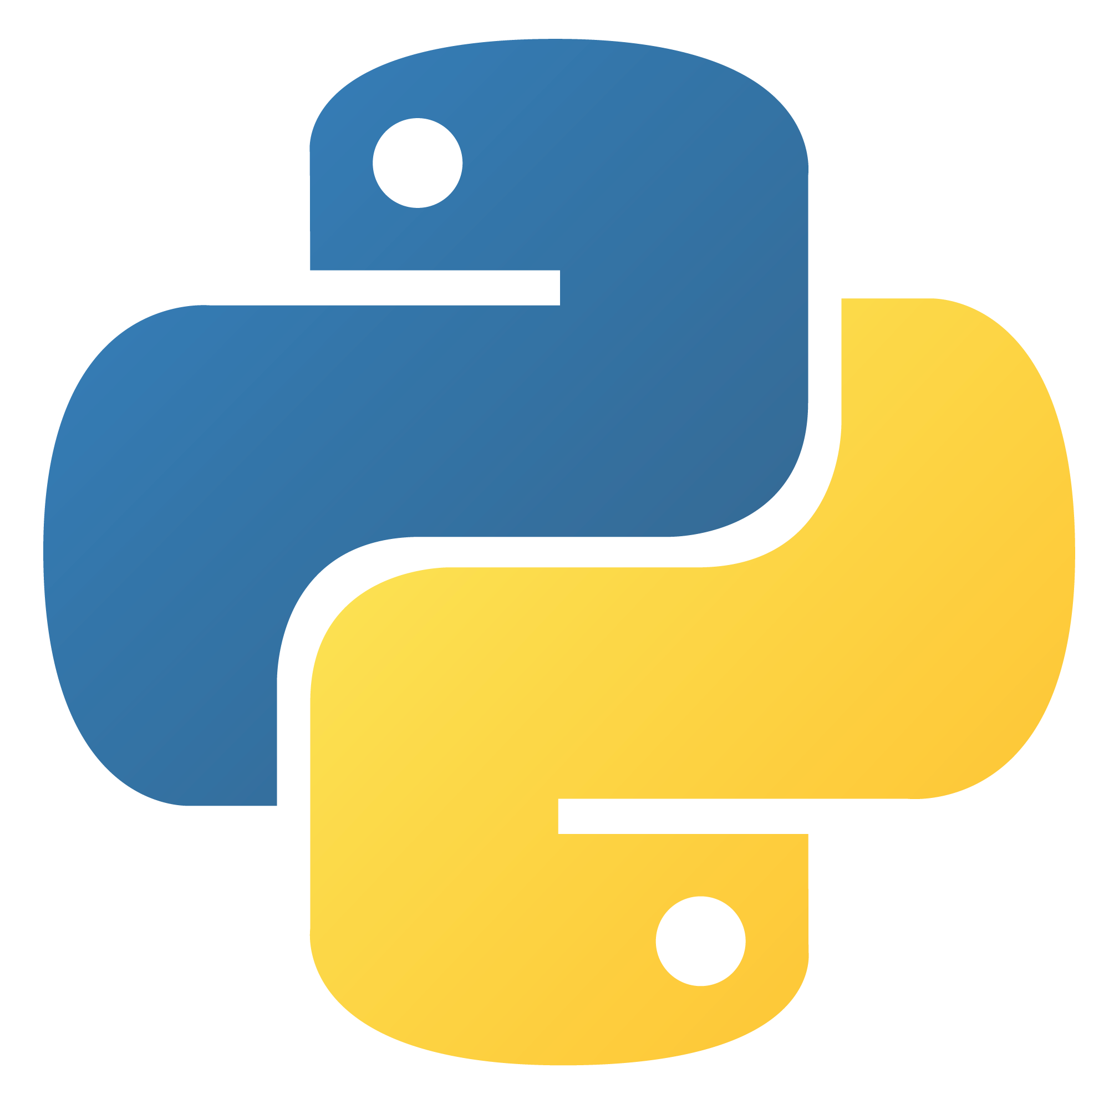
Why Python?
Python is a versatile and beginner-friendly programming language.
Widely used in web development, data analysis, artificial intelligence, and more.
Known for its readability and clean syntax.
An excellent choice for beginners.

Slide 3
Installing Python on Windows
Download Python from the official website:
  Visit https://www.python.org/downloads/
Choose Version:
  Select the latest version for Windows.
Download Installer:
  For Windows, download the "Windows Installer" (usually a .exe file).
Run Installer:
  Double-click the downloaded file.
Customize Installation (Optional):
  You can customize the installation path and add Python to the system PATH.
Installation Complete:
  Check "Add Python x.x to PATH" during installation.
Verify Installation:
  Open Command Prompt and type python. You should see the Python version.

Slide 4
Installing Python on Linux
Open Terminal:
  Press Ctrl + Alt + T to open a terminal window.
Check Python Version:
  Check if Python is preinstalled with python --version or python3 --version.
Install Python (if needed):
  Use the package manager for your distribution:
    Debian/Ubuntu: sudo apt-get install python3
    Fedora: sudo dnf install python3
    Arch Linux: sudo pacman -S python
Verify Installation:
  Type python3 in the terminal. You should see the Python version.

Slide 5
Installing an IDE
IDE Selection:
  Consider using an IDE for easier coding. Popular choices include:
    Visual Studio Code
    PyCharm
    IDLE
Download and Install IDE:
  Visit the IDE's website, download, and follow the installation instructions.
IDE Features:
  IDEs provide code suggestions, debugging tools, and project management features.
Getting Started:
  Open the IDE, create a new Python file, and start coding!

Slide 6
Variables and Data Types in Python
Welcome to the world of Python programming!
In this session, we'll explore the fundamental concepts of variables and data types.
Why is this important? Understanding how to work with data is at the core of programming.

Slide 7
Variables
What are Variables?
  Variables are like labeled containers.
  We use them to store information for the computer.
Why Do We Need Variables?
  To manage and use data in our programs.
  Like having labeled boxes for different things.
Variable Components
  Variables have two parts:
    Name/Label: The container's name (e.g., "age").
    Value: The actual data inside (e.g., "25").

Slide 8
Data Types in Python
Python has four fundamental data types:
  Integer (int): Used for whole numbers (e.g., 5, -10, 0).
  Float: Used for decimal or floating-point numbers (e.g., 3.14, -0.5).
  String (str): Used for text or characters (e.g., "Hello, Python!").
  Boolean (bool): Used for true or false values (e.g., True, False).
These data types help Python understand and manipulate different kinds of information.
We'll explore how to use them in practical programming shortly.

Slide 9
Math in Python
Python supports basic math operations:
Addition (+)
Subtraction (-)
Multiplication (*)
Division (/)
Modulus (%) - Get the remainder
Exponentiation (**) - Raise to a power
You can use parentheses to control the order of operations.
Practice basic math operations in Python to get comfortable with calculations.

Slide 10
String Manipulation in Python
Strings are sequences of characters.
Python offers various string manipulation techniques:
  Concatenation: Combining strings with +.
  Repetition: Repeating a string with *.
  Indexing: Accessing individual characters by position.
  Slicing: Extracting parts of a string.
Example:
greeting = "Hello, "
name = "Alice”
message = greeting + name

Slide 11
User Input with input()
input() is used to take user input.
It waits for the user to type something and press Enter.
Input is typically stored in a variable for later use.
name = input("Enter your name: ")
Be sure to provide a prompt message inside input() to guide the user.

Slide 12
Output with print()
Output with print()
print() is used to display information to the user.
You can print variables, strings, and the result of expressions.
name = "Alice”
print("Hello, " + name)
Python automatically adds a newline after print() unless you specify the end parameter.

Slide 13
String Formatting
String Formatting:
  You can format output using f-strings or the .format() method.
name = "Alice"
age = 30
print(f"Name: {name}, Age: {age}")
print("Name: {}, Age: {}".format(name, age))

Slide 14
Introduction to If Statements
If statements are used for decision-making in Python.
They allow your program to make choices based on conditions.
x = 10
if x > 5:
print("x is greater than 5")
If the condition in the if statement is true, the code inside the block (indented) will execute.

Slide 15
Introduction to the else Statement
The else statement is used to provide an alternative action when the if condition is not met.
x = 3
if x > 5:
print("x is greater than 5")
else:
print("x is not greater than 5")
If the condition in the if statement is true, the code inside the if block executes. Otherwise, the code inside the else block executes.

Slide 16
Extending with elif (Else If)
The elif statement allows you to add more conditions if the initial if condition is not met.
x = 3
if x > 5:
print("x is greater than 5")
elif x == 5:
print("x is equal to 5")
else:
print("x is less than 5")
Python evaluates the conditions one by one until it finds a true condition or reaches the else block.
Conditional statements with else and elif enable your program to handle various scenarios.

Slide 17
While Loops
While loops are used for repeated execution of a block of code based on a condition.
The code inside the loop will keep executing as long as the condition remains true.
count = 0
while count < 5:
print("This is iteration", count)
count += 1
In this example, the code inside the loop prints a message and increments the count variable until count is no longer less than 5.

Slide 18
Infinite Loops
Be cautious when using while loops to avoid infinite loops, which have no exit condition.
while True:
print("This is an infinite loop!")
An infinite loop can make your program unresponsive or consume all available resources.
Always ensure there's a condition that can be met to exit the loop.

Slide 19
For Loops
Python provides a convenient way to generate a sequence of numbers using the range() function.
for i in range(5):
print(i)
This loop will print the numbers from 0 to 4.
For loops are versatile and can be used for various purposes, including iterating through data and performing repetitive tasks.

Slide 20
The continue Statement
The continue statement is used within loops (e.g., for or while) to skip the current iteration and move to the next one.
It's often used in conjunction with conditional statements to selectively skip certain iterations.
for number in range(1, 6):
if number == 3:
continue
print(number)
In this example, when number is 3, the continue statement skips the current iteration, and the loop continues with the next value.

Slide 21
The break Statement
he break statement is used to exit a loop prematurely when a certain condition is met.
It helps you terminate the loop before it reaches its natural end.
for number in range(1, 6):
if number == 4:
break
print(number)
In this example, when number is 4, the break statement exits the loop immediately.

Slide 22
Lists
Lists are used to store collections of items in Python.
You can create a list by enclosing items in square brackets and separating them with commas.
fruits = ["apple", "banana", "cherry"]
This creates a list called fruits with three items.

Slide 23
Accessing and Modifying Lists
Lists are ordered, and you can access items by their index (position) in the list.
fruits = ["apple", "banana", "cherry"]
first_fruit = fruits[0]
Lists are mutable, meaning you can change their contents.
fruits[1] = "grape"
fruits.append("orange")
fruits.remove("cherry")
Lists provide a flexible way to work with collections of data.

Slide 24
Common List Methods
Lists in Python come with a variety of built-in methods to manipulate and interact with the data they contain.
append(item): Adds an item to the end of the list.
fruits.append("orange")
remove(item): Removes the first occurrence of an item from the list.
fruits.remove("banana")
pop(index): Removes and returns an item from the list by its index.
popped_fruit = fruits.pop(0)
insert(index, item): Inserts an item at a specified position in the list.
fruits.insert(1, "grape")
len(list): Returns the number of items in the list.
num_fruits = len(fruits)
count(item): Returns the number of occurrences of an item in the list.
count_apples = fruits.count("apple")

Slide 25
Using a For Loop for Iteration
To access and process each item in a list, you can use a for loop.
The loop iterates through the list, allowing you to work with one item at a time.
fruits = ["apple", "banana", "cherry"]
for fruit in fruits:
print(fruit)

Slide 26
Index-Based Iteration with range()
You can also use the range() function to iterate through a list by index.
This approach gives you more control over the iteration process.
fruits = ["apple", "banana", "cherry"]
for i in range(len(fruits)):
print(fruits[i])
In this example, the loop uses the range() function and len() to iterate through the list by index.

Slide 27
What Are List Comprehensions?
List comprehensions provide a concise way to create lists in Python.
They allow you to generate new lists by applying an expression to each item in an existing iterable (e.g., a list).
squares = [x**2 for x in range(1, 6)]
In this example, the list comprehension generates a list of squares of numbers from 1 to 5.

Slide 28
Benefits of List Comprehensions
List comprehensions offer several advantages:
  Conciseness: Achieve the same result with less code.
  Readability: Express your intentions clearly and compactly.
  Efficiency: List comprehensions are often faster than traditional loops.
even_numbers = [x for x in range(1, 11) if x % 2 == 0]
In this example, we filter and create a list of even numbers using a list comprehension.

Slide 29
Using sorted() for Sorting Lists
The sorted() function is used to sort a list in ascending order by default.
It doesn't modify the original list but returns a new sorted list.
numbers = [4, 1, 3, 2]
sorted_numbers = sorted(numbers)
In this example, sorted() creates a new list sorted_numbers containing the sorted values.

Slide 30
Sorting Lists with .sort() Method
Lists in Python have a built-in method called .sort().
It sorts the list in place, meaning it modifies the original list directly.
numbers = [4, 1, 3, 2]
numbers.sort()
In this example, the .sort() method sorts the list numbers in place, and the original list is now sorted.

Slide 31
Defining Functions in Python
Functions in Python are blocks of reusable code.
You can define a function using the def keyword followed by the function name and parameters.
def greet(name):
print("Hello, " + name)
In this example, we've defined a function called greet that takes a name parameter.

Slide 32
Calling Functions
After defining a function, you can call it to execute the code within it.
To call a function, use its name followed by parentheses and provide any required arguments.
greet("Alice")
This code calls the greet function and passes "Alice" as the argument.

Slide 33
Returning Values from Functions
Functions can also return values using the return statement.
A return value is the result or output of a function's operation.
def add(x, y):
result = x + y
return result
In this example, the add function takes two parameters, x and y, and returns their sum.

Slide 34
Understanding Local Variables
Local variables are declared inside a function and have local scope.
They are only accessible within the function where they are defined.
def my_function():
x = 10 # This is a local variable
print(x)
my_function()
In this example, x is a local variable within the my_function, and it can't be accessed outside of it.

Slide 35
Exploring Global Variables
Global variables are declared outside of any function and have global scope.
They can be accessed from anywhere in the program, both inside and outside functions.
x = 10 # This is a global variable
def my_function():
print(x) # Accessing the global variable
my_function()
In this example, x is a global variable, and it can be accessed within the function my_function.

Slide 36
What Are Modules?
Modules in Python are files containing Python code.
They can include functions, variables, and classes that you can reuse in your programs.
# Importing the math module
import math
In this example, we import the math module to access mathematical functions and constants.

Slide 37
Using Functions from Modules
Once you've imported a module, you can use its functions and features by prefixing them with the module name.
import math # Using math functions
result = math.sqrt(16)
In this example, we use the sqrt function from the math module to calculate the square root.

Slide 38
Creating Dictionaries
Dictionaries in Python are collections of key-value pairs.
You can create a dictionary using curly braces {} or the dict() constructor.
# Using curly braces
person = {"name": "Alice", "age": 30}
# Using the dict() constructor
person = dict(name="Alice", age=30)
In these examples, we've created a dictionary person with keys "name" and "age" and their respective values.

Slide 39
Accessing and Modifying Dictionaries
You can access dictionary values by using square brackets and the key.
person = {"name": "Alice", "age": 30}
name = person["name"]
To modify a dictionary, you can assign a new value to a specific key.
person["age"] = 31
Dictionaries are mutable, allowing you to add, modify, or remove key-value pairs.

Slide 40
Sets: Creating, Adding, and Removing
What is a Set?
  A set is a collection of unique and unordered elements in Python.
  Think of it as a bag of distinct items.
Why Use Sets?
  Sets are great for handling unique data, like unique names, IDs, or categories.
  They are also useful for mathematical operations, like union and intersection.

Slide 41
Creating, Adding, and Removing Elements
Creating a Set:
  Use curly braces {} or the set() constructor.
  Example: my_set = {1, 2, 3} or my_set = set([4, 5, 6]).
Adding Elements:
  Use the .add() method to insert a new element.
  Example: my_set.add(7) adds 7 to the set.
Removing Elements:
  Use the .remove() method to delete an element.
  Example: my_set.remove(2) removes 2 from the set.
  Be cautious: If the element doesn't exist, it raises an error.
Bonus: Checking Existence
  You can use the in keyword to check if an element exists in a set.
  Example: if 3 in my_set: print("3 exists in the set").

Slide 42
Tuples
Definition: A tuple is an ordered collection of elements, similar to a list, but unlike lists, tuples are immutable, meaning their elements cannot be changed once defined.
Tuples are defined using parentheses (), and elements are separated by commas.
Key characteristics:
  Ordered: Tuples maintain the order of elements.
  Immutable: Elements cannot be changed, added, or removed after creation.
  Heterogeneous: Tuples can contain elements of different data types.
my_tuple = (1, 2, 3, "Python", 3.14)

Slide 43
Accessing, unpacking, slicing
1. Accessing Elements:
first_element = my_tuple[0] # Access the first element (index 0)
2. Slicing:
my_tuple = (1, 2, 3, 4, 5)
sliced_tuple = my_tuple[1:4] # Results in (2, 3, 4)
3. Tuple Unpacking:
coordinates = (42.3601, -71.0589)
latitude, longitude = coordinates

Slide 44
Working with Files: Open, Read, Write, and Close
Why Files Matter:
  Files store information that programs can read from or write to.
  Common use cases include reading text files, storing data, and more.
Python and Files:
  Python offers simple and powerful tools for file operations.

Slide 45
Opening, Reading, Writing, and Closing Files
Opening a File:
  Use the open() function to open a file for reading or writing.
  Example: file = open("my_file.txt", "r") opens "my_file.txt" for reading.
Reading from a File:
  Use methods like .read(), .readline(), or .readlines() to retrieve data.
  Example: data = file.read() reads the entire content.
Writing to a File:
  Use the .write() method to add content to a file.
  Example: file.write("Hello, World!") adds text to the file.
Closing a File:
  Always close a file with .close() after you're done.
  Example: file.close().

Slide 46
Exception Handling: Using try and except
Why Exception Handling?
  Programs may encounter errors during execution.
  Exception handling allows us to gracefully handle these errors and prevent program crashes.
Python and Exceptions:
  Python provides a robust way to handle exceptions using try and except.

Slide 47
Using try and except Blocks
try and except Blocks:
  Use try to enclose code that might raise an exception.
  Use except to specify how to handle exceptions if they occur.
try: # Code that may raise an exception
result = 10 / 0 # Division by zero will raise a 'ZeroDivisionError’
except ZeroDivisionError: # Handle the specific exception
result = "Error: Division by zero is not allowed"
Common Exceptions:
  There are many built-in exceptions like ZeroDivisionError, FileNotFoundError, and TypeError.
  You can catch and handle specific exceptions to provide informative error messages or take appropriate actions.
Handling Multiple Exceptions:
  You can handle different exceptions with multiple except blocks.
  Use a more general except block at the end for catching unexpected exceptions.

Slide 48
Virtual Environments
Why Virtual Environments?
  Python projects often rely on different libraries and packages.
  Virtual environments help keep project dependencies isolated and organized.
Virtual Environment (Virtualenv):
  A virtual environment is like a separate workspace for Python projects.
  It allows you to have independent libraries and packages for each project.
Creating a Virtual Environment:
  Use virtualenv to create a new virtual environment.
  Example: virtualenv myenv creates a new environment named "myenv."
Activating a Virtual Environment:
  Activate the virtual environment to use it.
  On Windows: myenv\Scripts\activate
  On macOS/Linux: source myenv/bin/activate

Slide 49
Managing Packages with pip
Installing Packages with pip:
  pip is a package manager for Python.
  Use it to install libraries and packages within a virtual environment.
  Example: pip install package_name
Deactivating a Virtual Environment:
  Use deactivate to exit the virtual environment.
  This returns you to the global Python environment.
Benefits:
  Isolation: Keeps project dependencies separate.
  Version Control: Easier management of package versions.
  Collaboration: Simplifies sharing code with others.

Slide 50
Interpreter vs. Compiler
Interpreter:
  An interpreter is a program that directly executes source code line by line.
  It translates and runs the code simultaneously.
  Errors are detected and reported as they occur, which can be helpful for debugging.
  Examples: Python, JavaScript, Ruby.
Compiler:
  A compiler is a program that translates the entire source code into machine code or an intermediate code first.
  It doesn't execute the code directly; instead, it produces an executable file.
  Errors are detected only after the entire code is compiled, which can make debugging challenging.
  Examples: C, C++, Java.
Key Differences:
  Execution: Interpreter executes code line by line, while a compiler translates the entire code before execution.
  Errors: Interpreters catch and report errors as they occur, while compilers often detect errors after the entire code is compiled.
  Performance: Compilers may produce faster-running code as they optimize during compilation.
  Examples: Different programming languages use either interpreters or compilers, depending on their design and goals.
Hybrid Approaches:
  Some languages use both, with an initial compilation step followed by interpretation. Example: Python (bytecode compilation).

