Slide 1
All about Computer Programming

Slide 2
What you will learn
What computer programming is
Computer programming - Task Vs. Instruction
Programming Syntax
Types of Computer Programming

Slide 3

Computer Programming - what’s that?
A sequence of instructions that a computer can understand to perform tasks
  A calculator is considered a computer
Example: Pressing “2 + 3” on a calculator
  The instruction will look like either of the following:
  result = add(2,3);
  result = add(3,2);

Slide 4
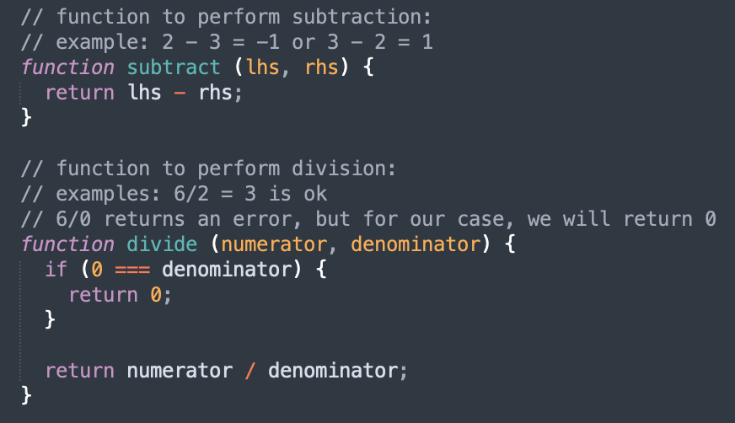
Computer Programming - Tasks Vs. instructions
A computer has to execute many tasks
  Example: A calculator can perform many tasks like +, -, *, /, etc.
  Each task is also known as function/methods
Each function may contain >1 instruction(s)
  Example: Division of 2 numbers
Each function with its own set of instructions

Slide 5
Test your understanding!
Share an example of a task and instructions in your day-to-day life!

Slide 6
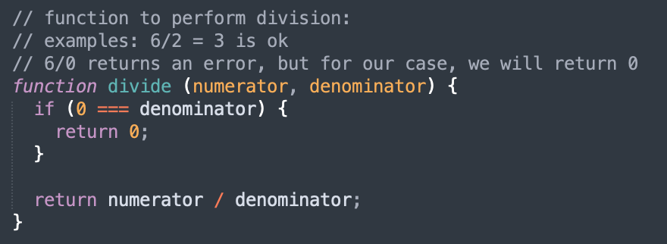
Programming Syntax
An instruction may be made up of the following:
  Variable(s)
  Flow control logic
Flow control logic
Variables

Slide 7
Programming Syntax - Variable
Boolean
(e.g. 1/0 or true/false)
String
Can be read-only or editable
Char
Global:
Can be accessed by anywhere
Variable
Can be global or local
Class/Object
Has a data type
Local:
Can only be accessed to a function
Numeric
Data structure (e.g. array, dictionary)
Fortunately, we don’t have to declare the data type in Javascript!

Slide 8
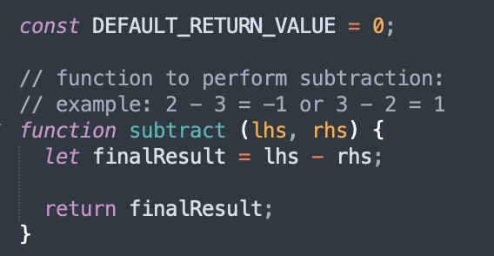
Programming Syntax - Variable Example
DEFAULT_RETURN_VALUE is a global read-only variable
finalResult is a local editable variable
lhs and rhs are numeric data types

Slide 9
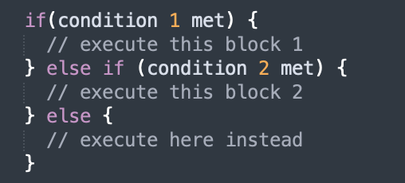
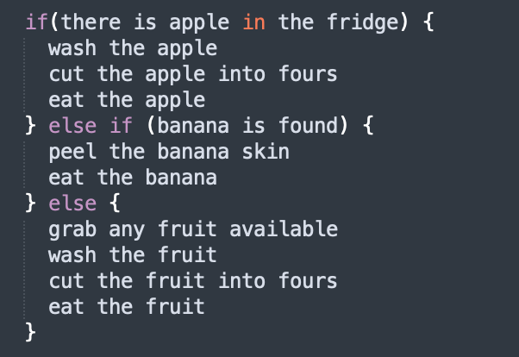
Programming Syntax - Flow control logic
if/else block:
if-block
Only 1 block will get executed at any point of time
Which block will get executed depends on which condition is met
else if-block
else-block

Slide 10
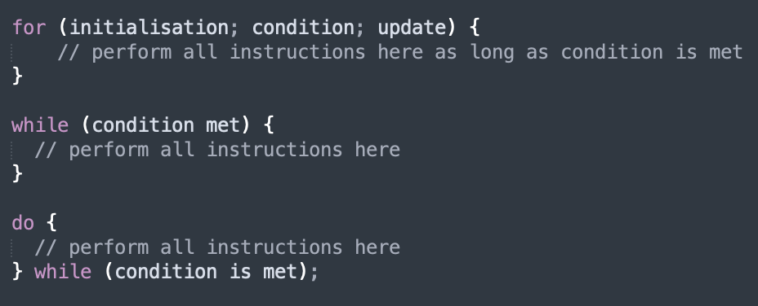
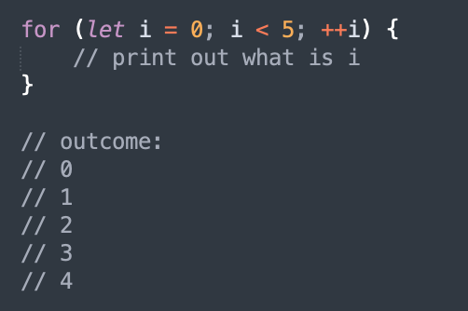
Programming Syntax - Flow control logic
Loops - for, while, do-while:
The for-loop is most common loop used
Q) Why isn’t 5 printed?

Slide 11
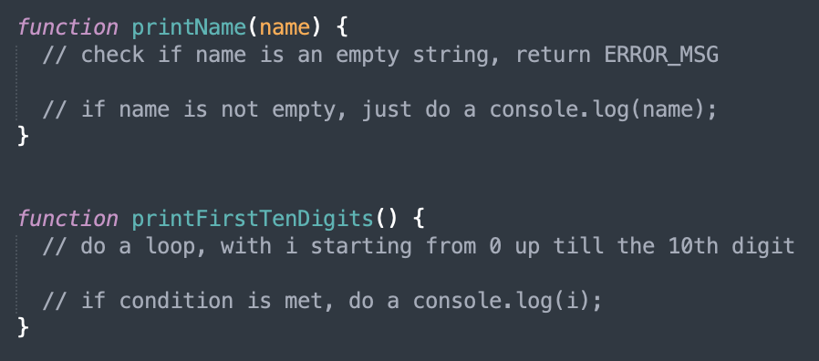
Test your understanding!
Open the Visual Studio Code, create a new file, and save it as lesson_01.js
Declare a global read-only String variable, ERROR_MSG, and set its value to “Incorrect value provided”
Solve the 2 functions:

Slide 12
Computer Programming - Types
Procedural Programming
Functional Programming
Object-oriented Programming (OOP)
Scripting
Logic Programming

Slide 13
Summary
Computer programming is a sequence of instructions for a computer to perform tasks
Tasks Vs. Instructions
  A set of instructions forms a task!
Instructions are made up of variable(s) & logic
  A variable has a data type, can be global/local & read-only or editable

