Slide 1

PHRASES
AND
CLAUSES

Slide 2

What is a phrase?
is a collection of words that may have nouns or verbals, but it does not have a subject doing a verb.
in the east (no verb at all)
on a wall (no verb at all)
running breathlessly back and forth (no subject –
what is running?)
grinning sheepishly (no subject – who/what is
grinning?)
Notes:
Obviously, if the phrase lacks either a subject or verb, it can’t have a subjectverb combination, or a subject “doing” a verb

Slide 3
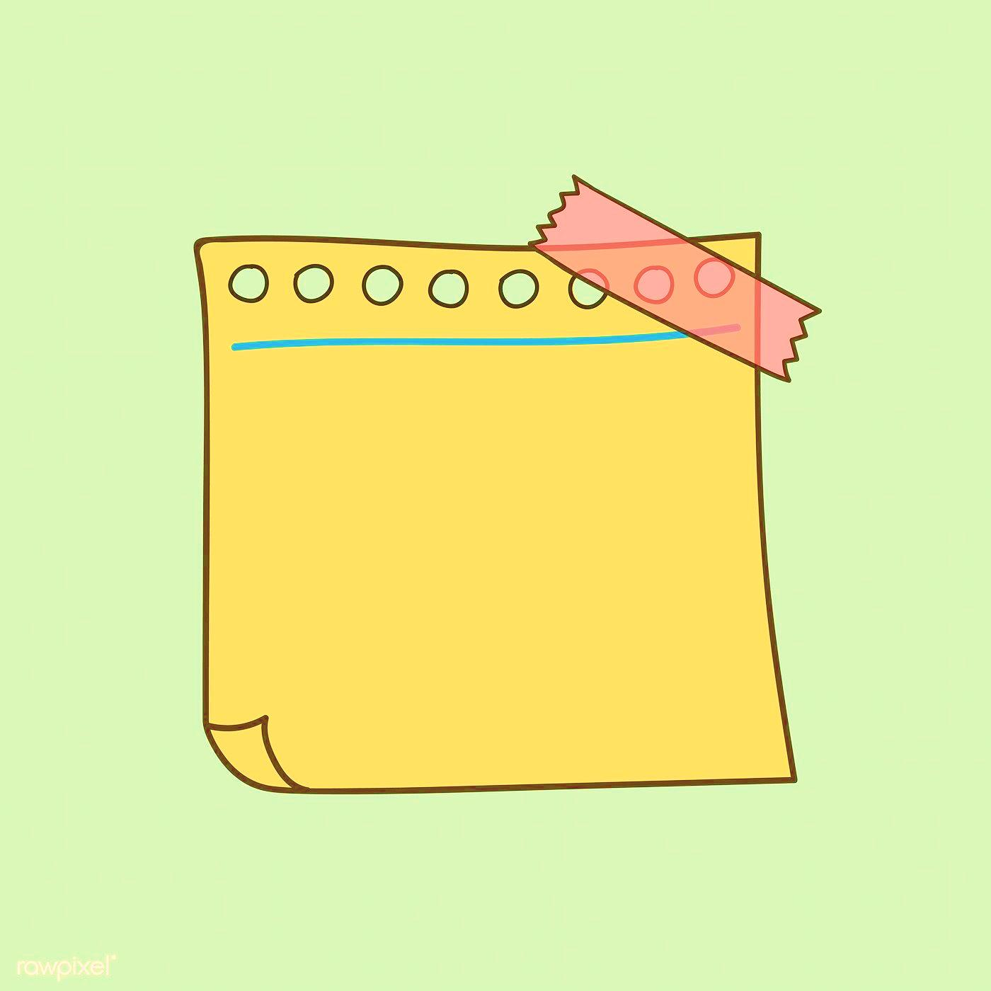
What is a Clause?
a clause is a group of words that contains a subject and a verb. There are two types.

Slide 4
1. Independent Clause
expresses a complete thought and has a subject and verb.
It is the main thought of a sentence and can be used alone as a simple sentence.
Examples:
Angel wept.
Craig passed out.
Chris worked all semester long on his research project.

Slide 5
2. Dependent Clauses
has a subject and verb but cannot be used as a simple sentence.
A dependent clause is introduced by a dependent word.
Examples
Unless you want to go.
Because I care.
Before you lose your cool.

Slide 6
DEPENDENT OR INDEPENDENT
I like young people.
because she smiled at him
The lunch was too big for me.
when everybody left the room

Slide 7
Let’s identify!
It is the only solution
With their friends
Unless they could borrow the car
from the stairs
Before taking any medicine, I always speak to my doctor.
Notes:
P
Ic
Dc
phr
clause

