Slide 1
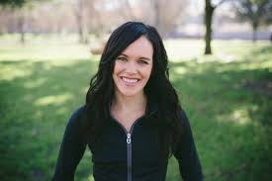
Lady (n)

Slide 2
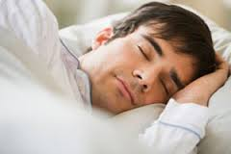
Sleep (v-n)

Slide 3

Clock (n)

Slide 4
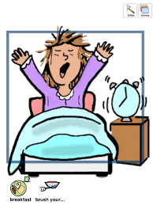
Wake (v)

Slide 5
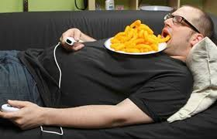
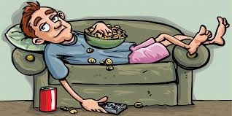
Lazy (adj.)

Slide 6
Lady
Sleep
Clock
Wake
Lazy

Slide 7
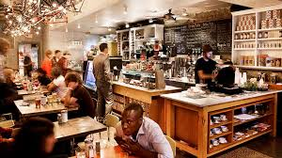
Café (n)

Slide 8
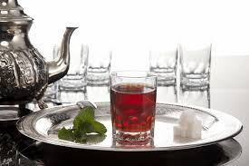
Tea (n)

Slide 9
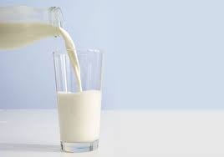
Milk (n)

Slide 10
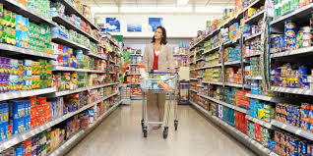
Supermarket (n)

Slide 11
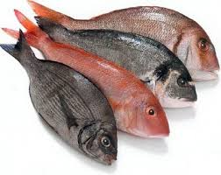
Fish (n)(v)

Slide 12
Café
Tea
Milk
Supermarket
fish

Slide 13
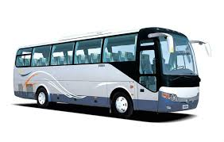
Bus (n)

Slide 14
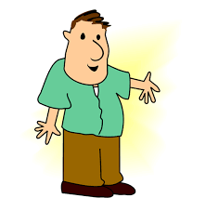
Guy (n)

Slide 15
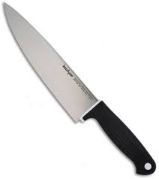
Knife (n)

Slide 16
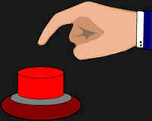
Press (v)

Slide 17

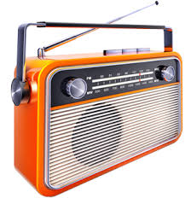
Radio (n)

Slide 18
Bus
guy
Knife
press
radio

Slide 19
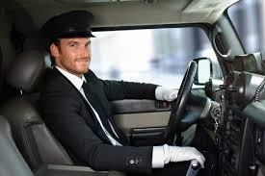
Driver (n)

Slide 20
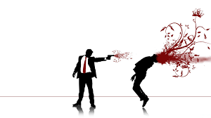

Kill (v)

Slide 21
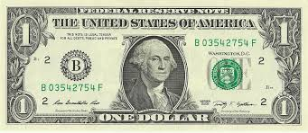
Dollar (n)

Slide 22
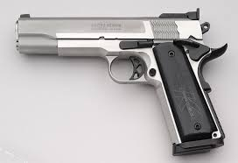
Gun (n)

Slide 23
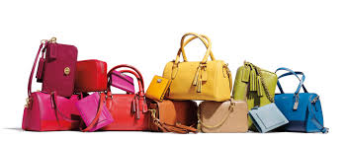
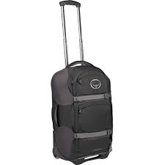
Bag (n)

Slide 24
Driver
Kill
Dollar
gun
Bag

Slide 25
Lady
Sleep
Clock
Wake
Lazy
Café
Tea
Milk
Supermarket
fish
Bus
guy
Knife
press
radio
Driver
Kill
Dollar
gun
Bag

