Slide 1


a
an
Notes:
5 x 4
4 x 5

Slide 2

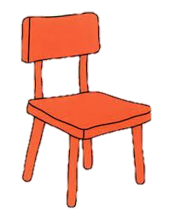


a
an
___ chair
___ octopus
a
a
___ lion
___ robot

Slide 3

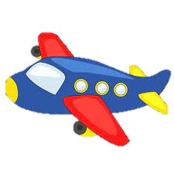

an
___ eye
an
___ airplane
a
___ strawberry

Slide 4




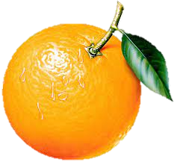
an
a
___ owl
___ girl
a
an
___ bee
___ orange
Find more maps at slidescarnival.com/extra-free-resources-icons-and-maps

Slide 5




an
a
___ ant
___ spider
a
a
___ car
___ snowman

Slide 6
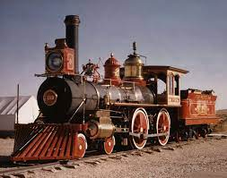

an
This is _____ old train.
a
It is ____ mushroom.

Slide 7
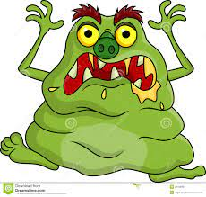

an
This is _____ ugly monster.
a
This is _____ red bike.
Find more maps at slidescarnival.com/extra-free-resources-icons-and-maps

Slide 8
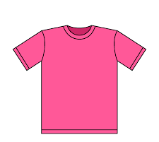
a
This is _____ pink shirt.

Slide 9
Thank you!

