Slide 1
Are you ready?

Slide 2
Lesson this, that, these, those
Here is where your presentation begins

Slide 3
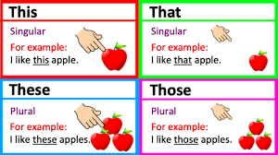
this- use when one (1) thing is near.
these–use when many things are near.
that- use when one (1) thing is far.
those- use when many things are far.
Example:

Slide 4
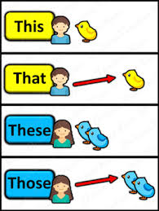

Slide 5
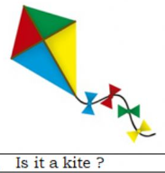

This is a kite.
That is a kite.

Slide 6
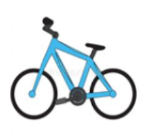
These are bikes.
Those are bikes.

Slide 7
Let’s try!
Circle your answer.

Slide 8

This
____ is a computer.
This
That
Those
These

Slide 9
That
____ is a computer.
This
That
Those
These

Slide 10

____ are bags.
Those
This
That
Those
These

Slide 11
____ are bags.
These
This
That
Those
These

Slide 12

This
____ is a clock.
This
That
Those
These

Slide 13
That
____ is a clock.
This
That
Those
These

Slide 14
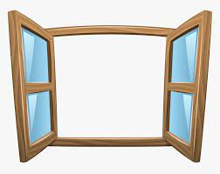
This
____ is a window.
This
That
Those
These

Slide 15
____ are windows.
Those
This
That
Those
These

Slide 16

____ are flowers.
These
This
That
Those
These

Slide 17
That
____ is a flower.
This
That
Those
These

Slide 18

____ are fishes.
These
This
That
Those
These

Slide 19
That
____ is a fish.
This
That
Those
These

Slide 20
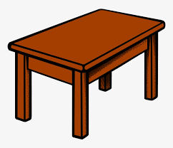
____ is a table.
This
This
That
Those
These

Slide 21
____ are tables.
Those
This
That
Those
These

Slide 22
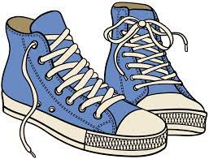
____ are shoes.
These
This
That
Those
These

