Slide 1
CHEMICAL EQUATION
Teacher Rich

Slide 2
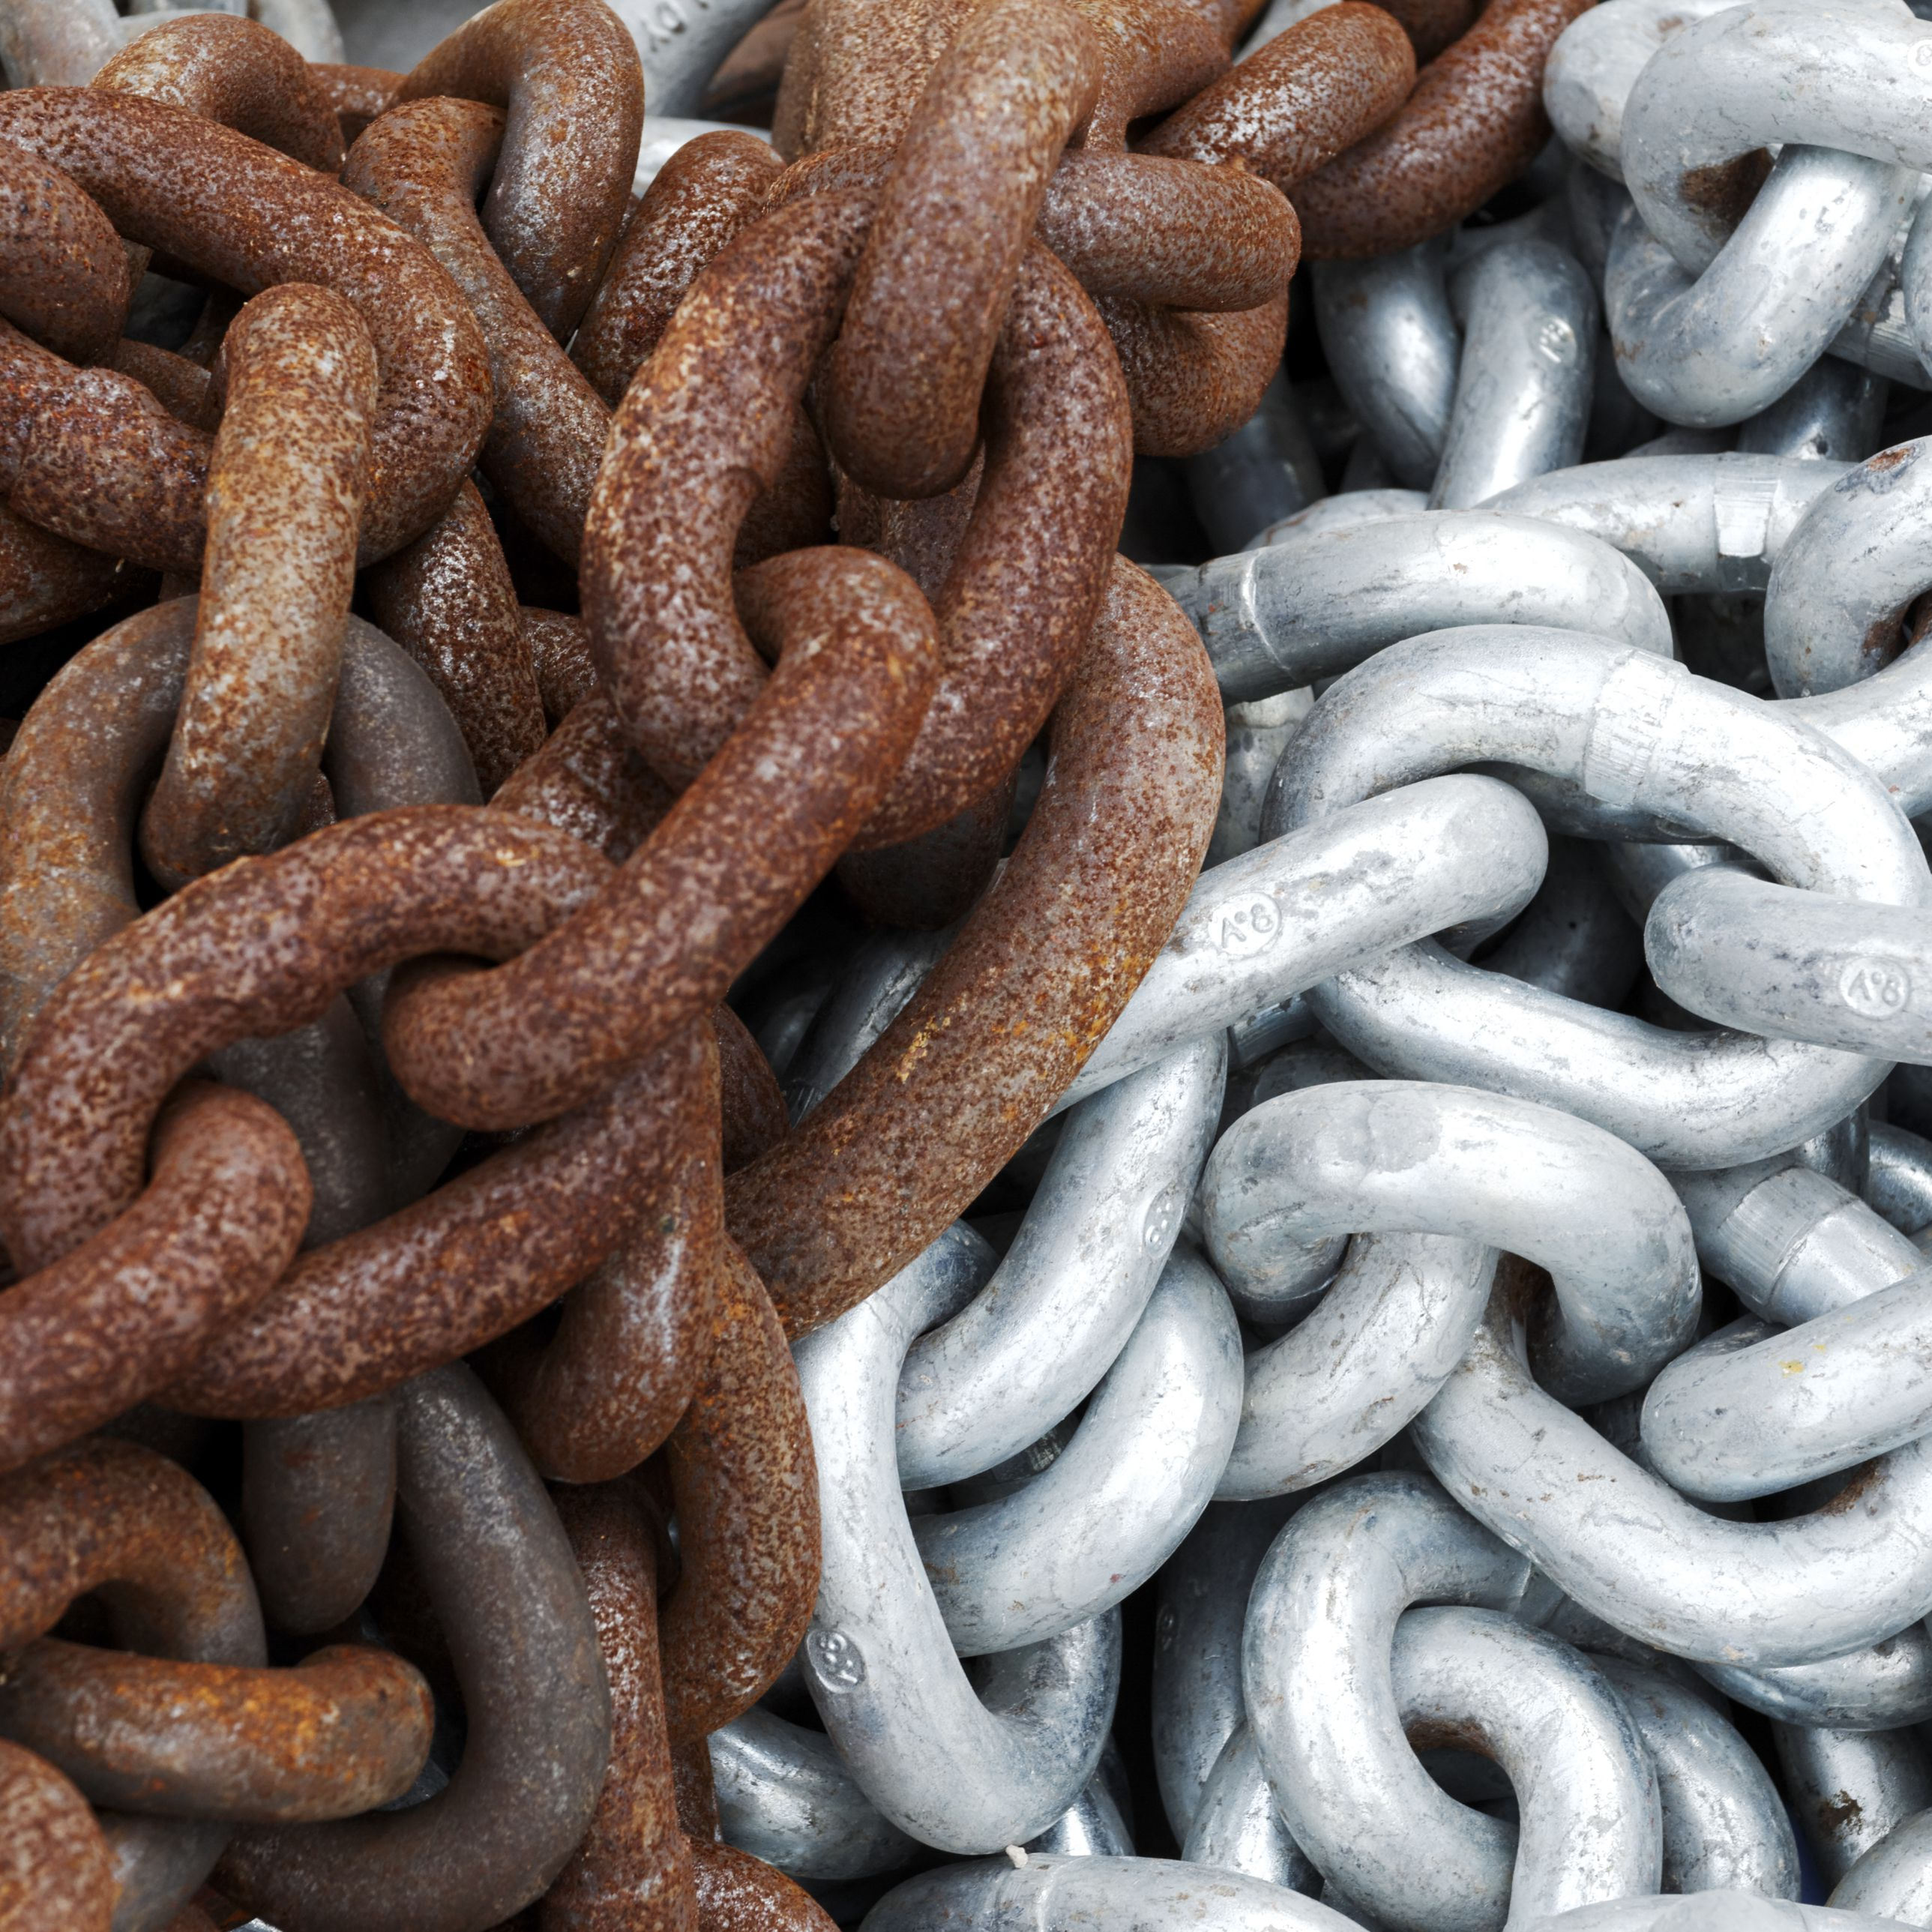
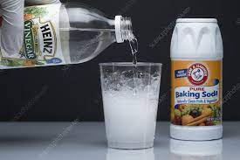
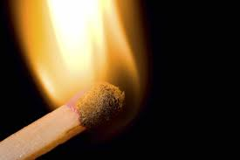
Chemical Reactions
-It is a process where a set of substances undergo a chemical change to form one or more new substances. Chemical reactions not only happen in laboratories but everywhere around us.
Rusting of iron
Vinegar and baking soda = sodium acetate
burning

Slide 3
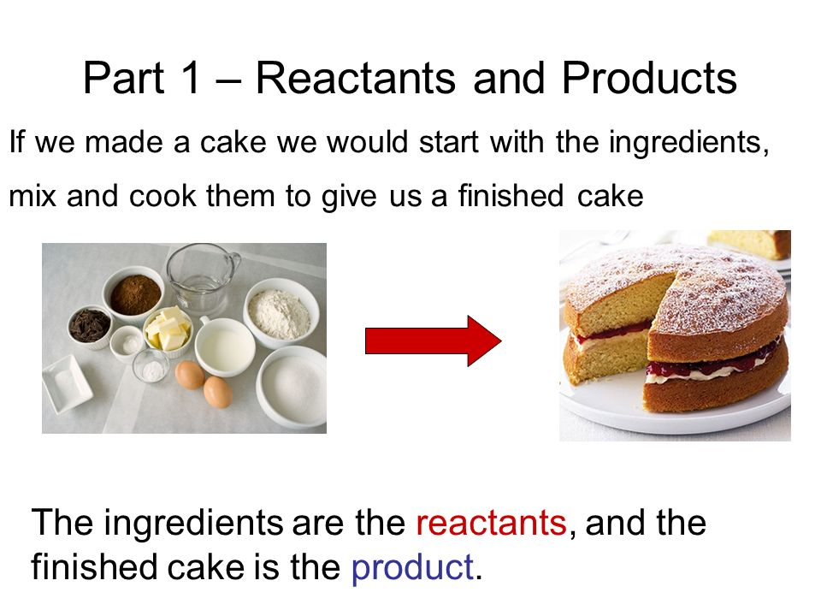
Reactants
01
02
Products
Substances that start a chemical reaction.
Substances that start are produced in a chemical reaction.
Hydrogen + Oxygen
Water
Reactants Products
Notes:
A chemical reaction can be presented by a general equation as shown below.

Slide 4
Element- is a pure substance that cannot be broken down by physical or chemical. An element is made up of one type of atom (proton, neutron and electron)
Examples: Carbon (C)
Oxygen (O)
Iron (Fe)
Both the reactants and products can be elements or compound.
Compound- is a pure substance that have two or more substance chemically combined. Elements combined during a chemical change, a particle of compound is called “molecule”.
Examples:
Dihydrogen monoxide
Hydrogen + Oxygen = Water (H2O)
Sodium chloride
Sodium + Chlorine = Salt (NaCl)

Slide 5
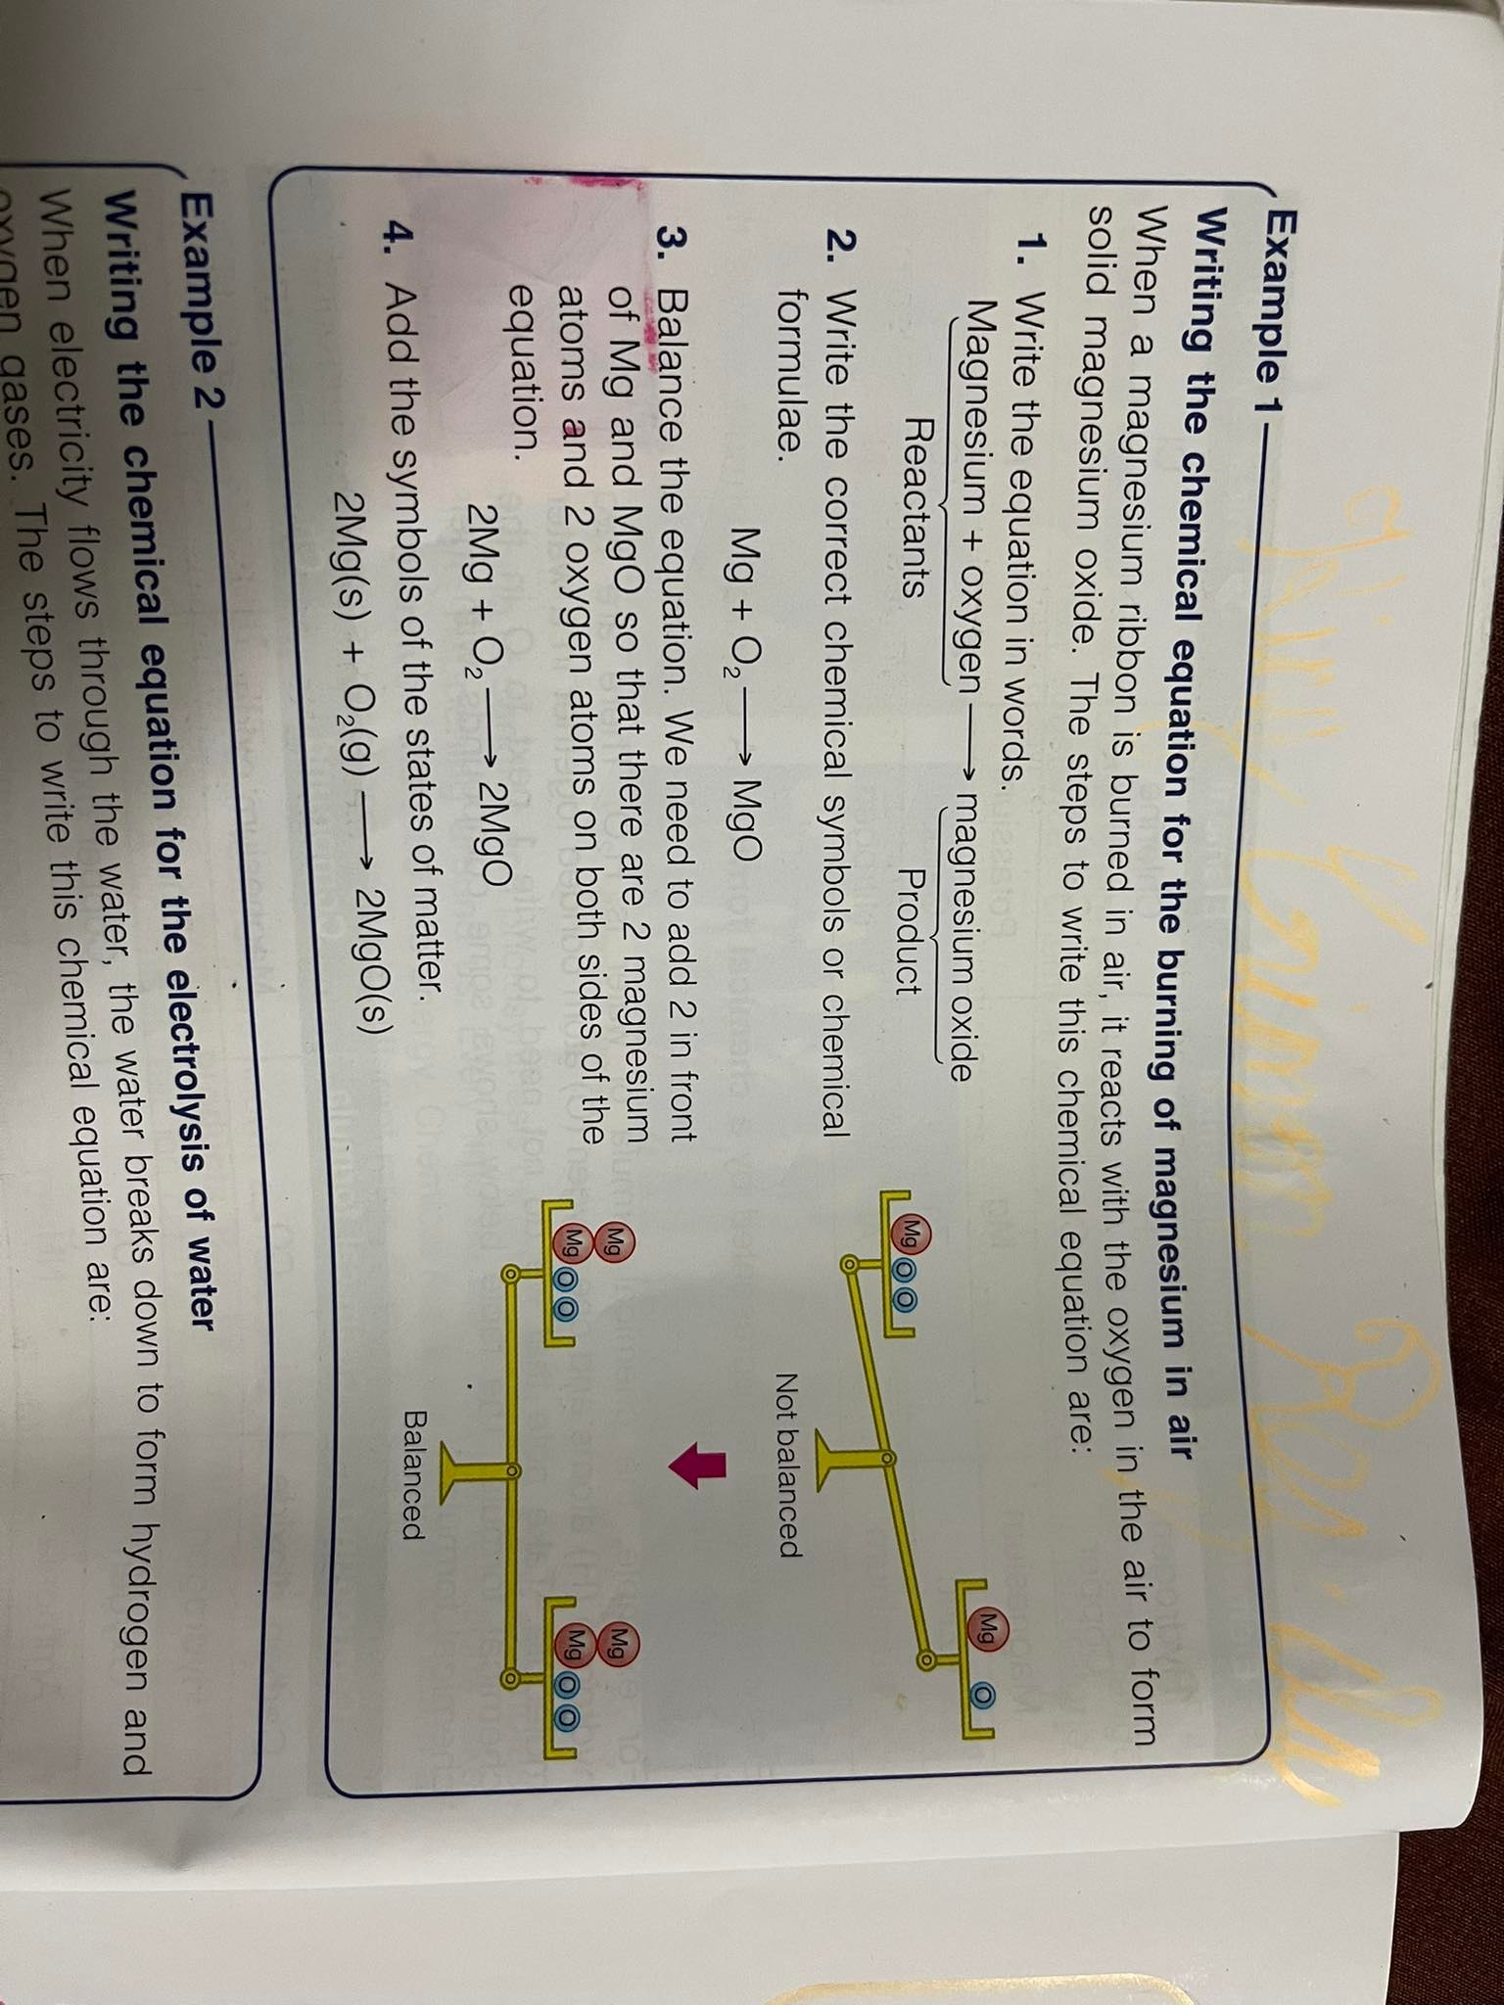

Slide 6
Mg + O2 MgO
Unbalance equation
REACTANTS | PRODUCTS
Mg - 1 | Mg-1
O-2 | O-1
2Mg + O2 2MgO

Slide 7
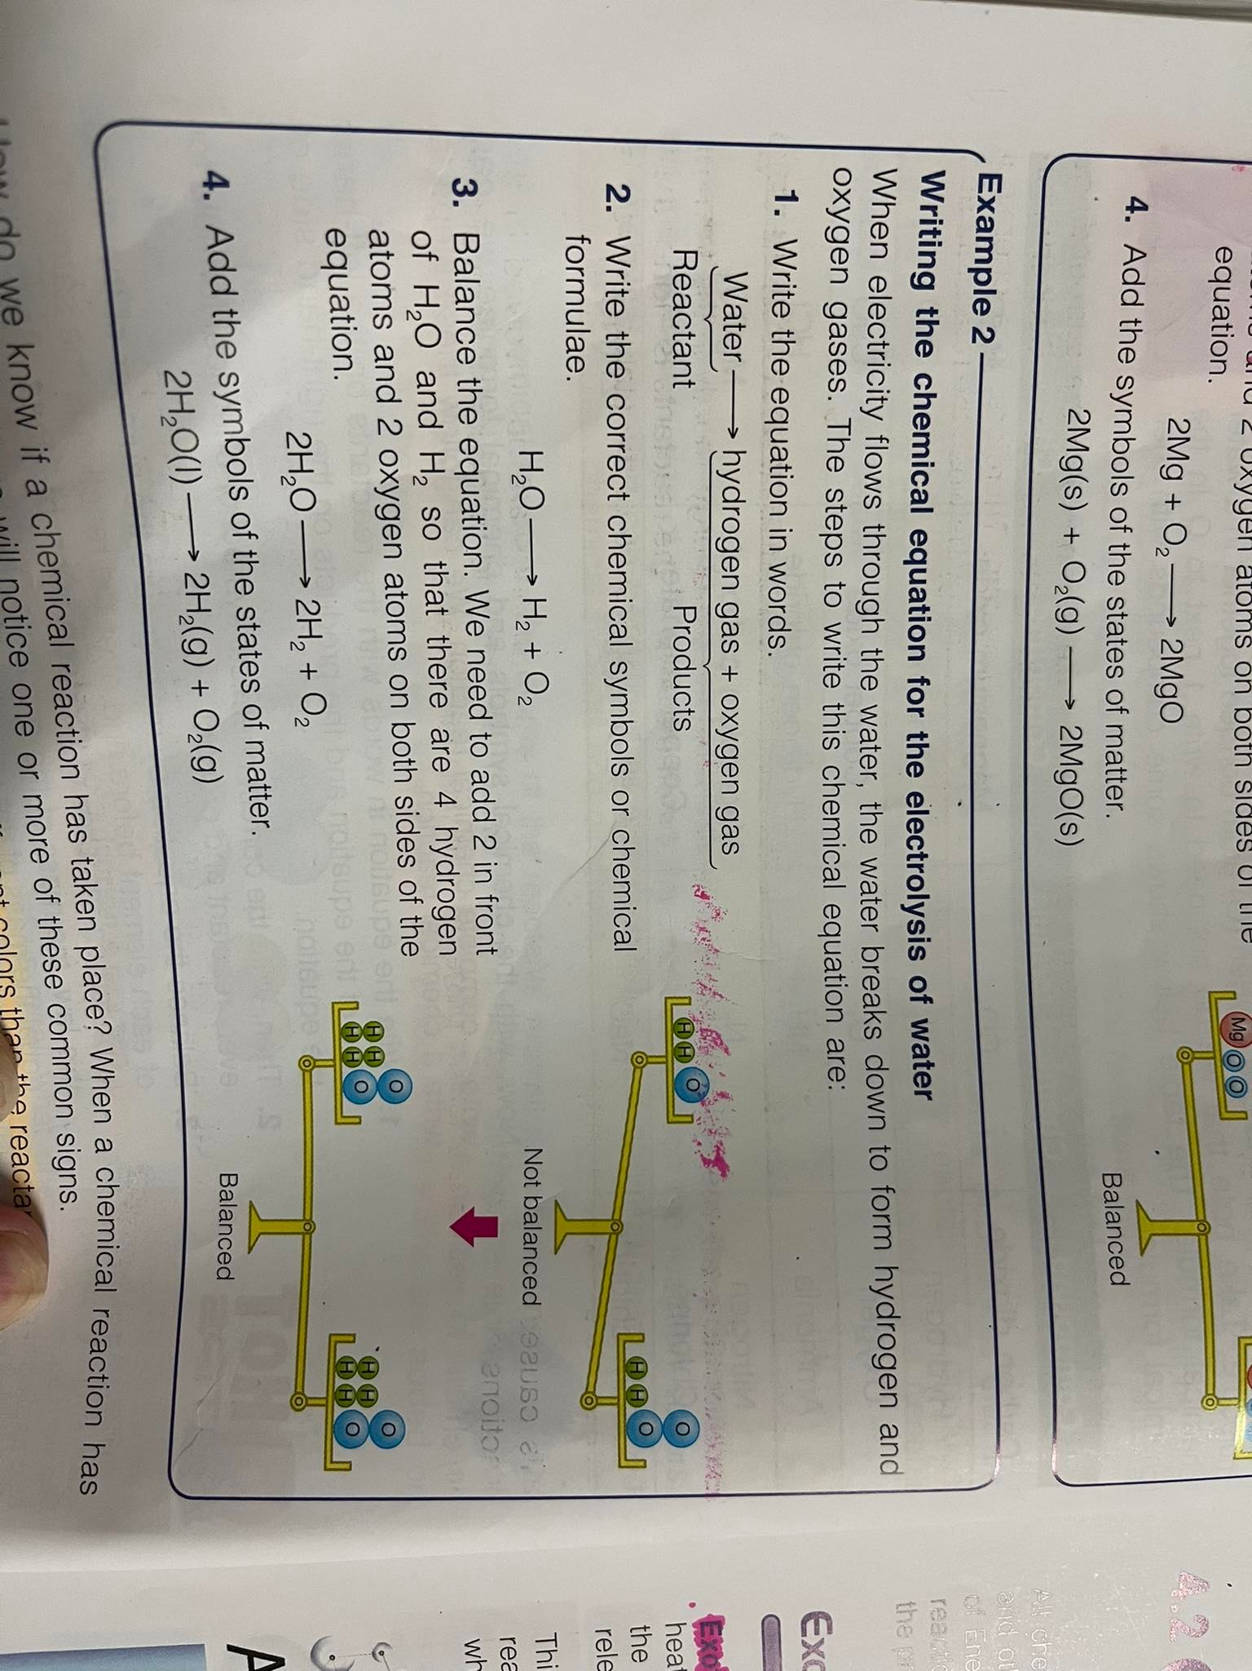

Slide 8
H2O H2 + O2
Unbalance equation
REACTANTS | PRODUCTS
H-2 | H-2
O-1 | O-2
2H2O 2H2 + O2

Slide 9
C3H8 + O2 CO2 + H2O
Unbalance equation
REACTANTS | PRODUCTS
C - 3 | C-1
H-8 | H-2
0-2 | O-3

Slide 10
C3H8 + O2 CO2 + H2O
C3H8 + 5O2 3CO2 + 4H2O
REACTANTS | PRODUCTS
C - | C-
H- | H-
0- | O-

Slide 11
CO₂ + H₂O → C₆H₁₂O₆ + O₂
6CO₂ + 6H₂O → C₆H₁₂O₆ + 6O₂
REACTANTS | PRODUCTS
C-1 | C-6
H-2 | H- 12
O- 3 | O- 8

Slide 12
THANKS!
Please keep this slide for attribution

