Slide 1
IELTS listening

Slide 2
What will be in the test
Section 1 and 2 develop the listening skills needed for survival in an English-speaking country, in situations such as shopping, accommodation, etc.
Section 3 and 4 have a more academic context such as a lecture, with an educational or training focus.
Normally people find the later section harder
You can write answer in the question paper and they will give you 10 mins to transfer your answer.
Most of the time question comes in order

Slide 3
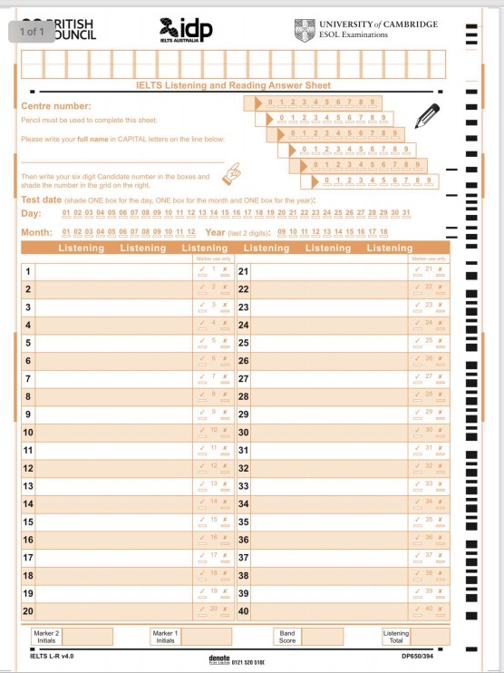
Sample
Test last 40 min with the last 10 is for answer transfer

Slide 4
KEEP PRACTICING WITHOUT ANYTHING ELSE WON'T DO

Slide 5
What the test makes you do
Listen actively for LONG period of rime
Listening, reading and answering at the same time
Listen only once

Slide 6
How to study
Increase your vocabulary bank
Listening for pleasure
Active listening
Listen reflectively( When practice paper)
Practice reading
Reflect on how you did
Notes:
When practice try guessing the vocab that you dont know from the context

Slide 7
Type of questions
Summary Completion
Form Filling
Multiple Choice Questions
Labelling a Map or Plan

Slide 8
Summary Completion
Read the sentence and try to understand the gist of it
Remember that the question are just a paraphrase version of what you will be hearing
Predict
VERY IMPORTANT: do what the question ask you to do

Slide 9
Form Filling
Normally answer consist of one or two words long
One common trick they use is for the person to give one piece of information(false info) and then give the correct one later on
So BEWARE and listen closely

Slide 10
MCQs
Short answers
Completing the sentence
Matching pictures(not often)
Common ways they trick
They like to say all 3 choices so don’t choose the first one you hear. Listen CLOSELY
Paraphrasing voicelines
Words with similar meaning

Slide 11
Maps, diagrams
Often they explaining where each booth are or where some place are
Common problems
They give too much info and you got lost
Spelling
Visualisation(from the directions they give)

Slide 12
Exercise, predicting the answer
Elon first thought about making _____________ when at college, when he thought about the most challenging issues facing the planet.
ANSWER: Electric car

Slide 13
Paraphrasing
The student requested that the professor excuses her absence, but the professor refused.
International Center is hosting English Conversation classes. They help non-native speakers of English practice their English speaking skills.
The car that was pulled over by the police officer yesterday just had an accident. That driver is not careful.
Of the more than 1000 bicycling deaths each year, three-fourths are caused by head injuries. Half of those killed are school-age children. One study concluded that wearing a bike helmet can reduce the risk of head injury by 85 percent. In an accident, a bike helmet absorbs the shock and cushions the head. From "Bike Helmets: Unused Lifesavers," Consumer Reports (May 1990): 348.
Notes:
Make her look for parts that not suppose to change

Slide 14
Sample answers
The professor denied the student’s request for an excused absence.
English non-native speakers can improve their English by taking classes at International Center.
The careless driver who was pulled over yesterday just got into an accident.
Three-fourths of the more than 1000 biking deaths each year are due to head injuries. School-aged children account for half of those slain. According to one study, wearing a bike helmet can lower the chance of brain injury by 85%. In the event of an accident, a bike helmet absorbs the impact and protects the rider's head. Consumer Reports (May 1990): 348, "Bike Helmets: Unused Lifesavers."

Slide 15
Tips during test
Read the question carefully
Make sure to listen carefully to the ending such as -s
Take a guess on the answer before the actual answer comes
Paraphrase the question to your own understanding since normally the question ask is the paraphrase of the track
When they give you time to check your answer, you should be reading and understanding next sets of questions unless you are sure you were wrong.

