Slide 1



Exponents
Teacher Sam :)

Slide 2
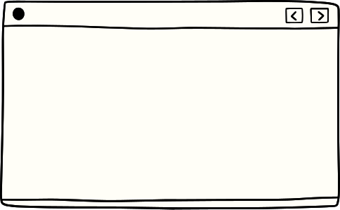
Exponent
n
a
Parts
Ways to Read:

Slide 3
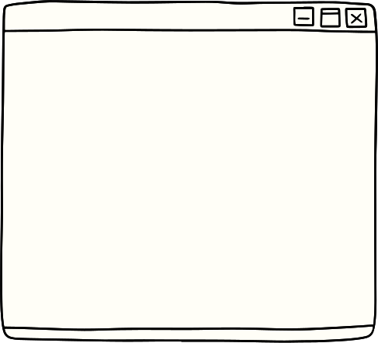
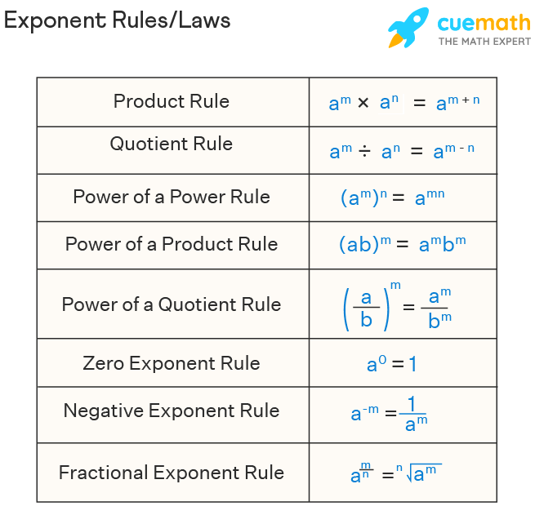

PRODUCT RULE
QUOTIENT RULE
POWER OF A POWER RULE
POWER OF A PRODUCT RULE
Rules of Exponent
POWER OF A QUOTIENT RULE
ZERO EXPONENT RULE
NEGATIVE EXPONENT RULE
FRACTIONAL EXPONENT RULE

Slide 4




PRODUCT RULE
Power of a Power Rule
To find the product of two numbers with the same base, add the exponents.
Power of a power rule states that if a base raised to a power is being raised to another power, the exponents are multiplied and the base remains the same.
QUOTIENT RULE
Power of a Product Rule
The quotient rule states that when exponents with the same base are being divided, we simply just subtract the exponents to simplify the expression.
This rule states that if two powers are being multiplied, and if their bases are equal, then the product of the powers will have the same base as the powers being multiplied, and it will be raised to an exponent equal to the sum of the exponents over the powers being multiplied

Slide 5
Power of a Quotient Rule
Negative Exponent Rule
Power of a quotient is equal to the power of each term in the numerator and denominator raised individually
Negative exponent rule tells us that a number with a negative exponent should be put to the denominator, and vice versa
Zero Exponent Rule
Fractional Exponent Rule
Any non-zero number to the zero power equals one. Zero to any positive exponent equals zero
In the case of fractional exponents, the numerator is the power and the denominator is the root.

