Slide 1

English Literature Analysis Preparation Outline
Overview of Exam Papers
Paper 1: Poetry and Modern Prose
- Section A: Unseen Poetry
- Section B: Anthology Poetry
- Section C: Modern Prose (e.g., Animal Farm)
Paper 2: Drama and Non-Fiction Prose
- Section A: Modern Drama
- Section B: Literary Heritage Prose or Non-Fiction Text

Slide 2
Types of Questions
1. Analysis of Character/Theme
Task: Analyze how a specific character or theme is developed through the text.
Example: How does George Orwell portray the pigs as a different class of citizen compared to the other animals?
2. Close Reading and Language Analysis
Task: Focus on how specific language, imagery, or structure shapes meaning.
Example: How does the use of figurative language enhance the theme of corruption in Animal Farm?
3. Contextual Analysis
Task: Discuss how the context (historical, political, social) influences the text.
Example: Explore how the Russian Revolution is reflected in Animal Farm.

Slide 3
Types of Questions (cont.)
4. Comparison Questions (Paper 1)
Task: Compare themes, characters, or language between two texts (usually in poetry).
Example: Compare the presentation of power in two poems from the Edexcel anthology.

Slide 4
Key Literary and Structural Devices to Know
Literary Devices:
- Metaphor, Simile, Personification
- Symbolism (e.g., the windmill in Animal Farm as a symbol of manipulation)
- Allegory (understand how Animal Farm functions as an allegory for the Russian Revolution)
- Irony (e.g., Orwell's satirical tone)
- Alliteration, Onomatopoeia
Structural Devices:
- Narrative Perspective (e.g., third-person in Animal Farm)
- Foreshadowing
- Flashback
- Juxtaposition (e.g., the contrast between the pigs and the other animals)
- Repetition (e.g., Squealer’s repeated justifications)

Slide 5
Exam Techniques: PEEL Paragraphs
P: Point - State your point clearly.
E: Evidence - Provide a direct quote or example from the text.
E: Explanation - Explain how this evidence supports your point.
L: Link - Link back to the question or argument.

Slide 6
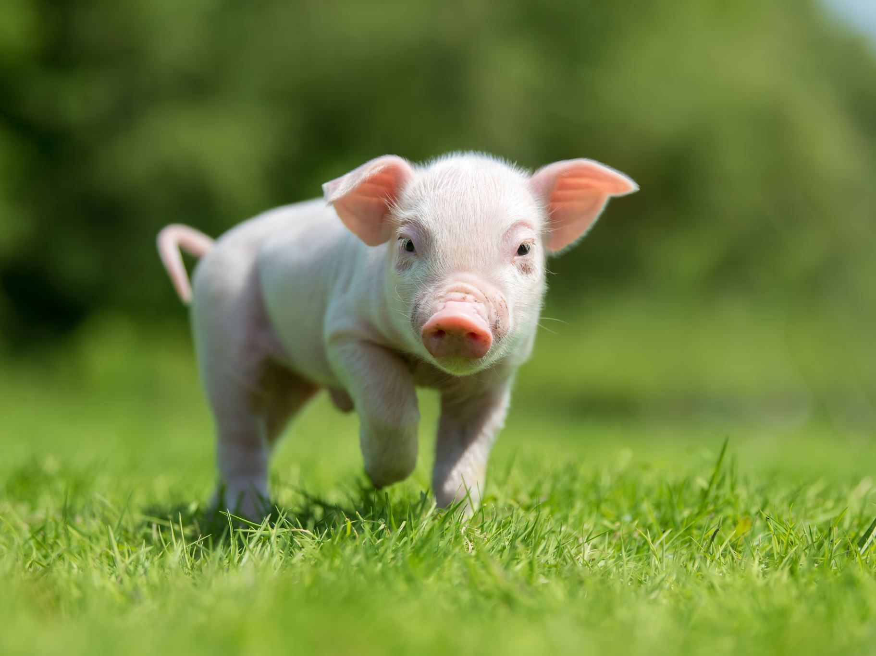
Sample Question and Answer with Quotes and Techniques
Question: How does the author portray the pigs as a different class of citizen to others in Animal Farm?
Point: In Animal Farm, Orwell portrays the pigs as a distinct upper class by highlighting their gradual accumulation of privileges.
Evidence 1: "Napoleon is always right."
Technique: Repetition and Indoctrination – The repetition emphasizes blind loyalty.
Reader’s Impression: The reader feels uneasy as the mantra showcases mental control, reinforcing the pigs' superior class.
Evidence 2: "All animals are equal, but some animals are more equal than others."
Technique: Paradox – Highlights the absurdity of the pigs’ logic to maintain dominance.
Reader’s Impression: The reader feels the betrayal of the pigs and twisted logic to oppress others.
Evidence 3: "The pigs moved into the farmhouse and began sleeping in beds."
Technique: Symbolism – The farmhouse symbolizes comfort and privilege previously forbidden.
Reader’s Impression: The pigs becoming more human establishes their class separation from other animals.

Slide 7
Tips for Success
1. Understand the Context: Connect the text to its historical, political, or social background.
2. Use Specific Quotes: Memorize key quotes that are flexible for multiple themes.
3. Practice Timed Responses: Write thoughtful responses within the time limit.
4. Balance Analysis and Evidence: Avoid plot summary, focus on analysis.
5. Plan Before Writing: Spend time planning using PEEL.

