Slide 1

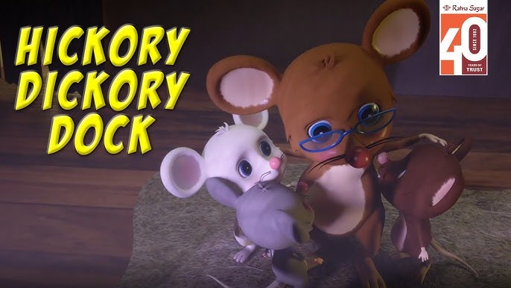
Fun with Animals & Sentences!
Welcome to Class with Teacher Daisy! ⭐

Slide 2


What is it?
Look at the shadow...
Can you guess what it is?
? ? ?

Slide 3

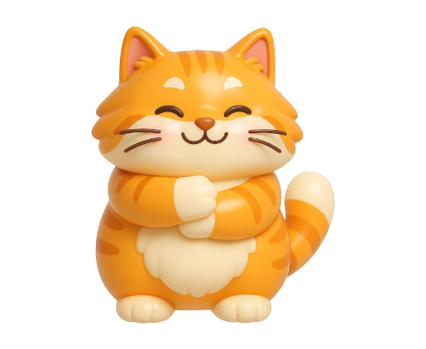
It is a Cat!
Wonderful!
It is a Cat.
C - A - T

Slide 4

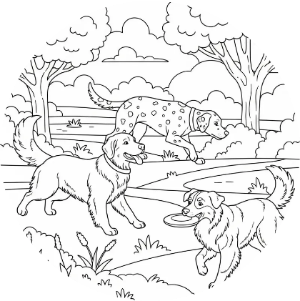
What is it?
Check this out!
What is this animal?
Do you know its name?

Slide 5

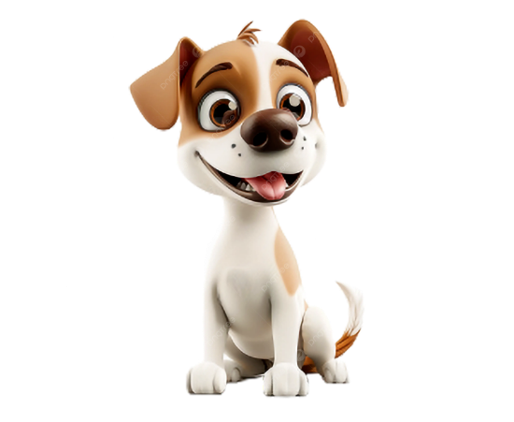
It is a Dog!
Great Guess!
It is a Dog.
D - O - G

Slide 6



Grammar Rule Time
Use 'A' or 'An'?
Rule for 'A'
Rule for 'An'
Consonants
(B, C, D, F, G...)
Vowels

Slide 7



Let's Practice 'A'
A Dog (starts with 'D')
A Cat (starts with 'C')
A Bird (starts with 'B')

Slide 8






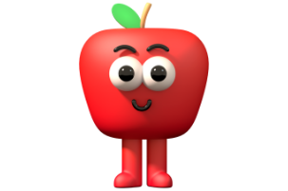
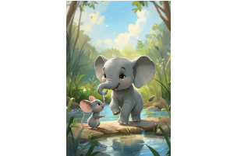
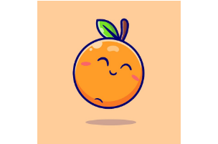
Let's Practice 'An'
An Apple
An Elephant
An Orange

Slide 9

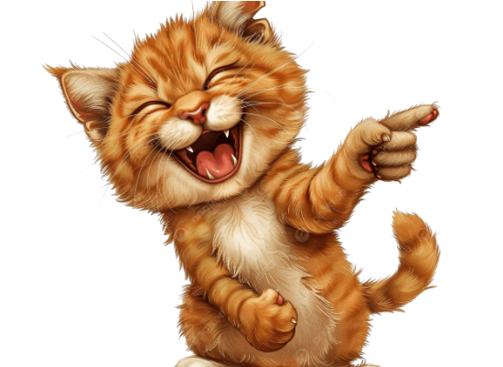
This vs. That
This is... (Near)
"This is a cat."
Use 'This' when you touch or point close!

Slide 10

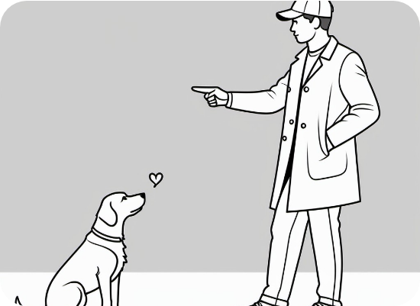
This vs. That
That is... (Far)
"That is a dog."
Use 'That' when you point far away!

Slide 11
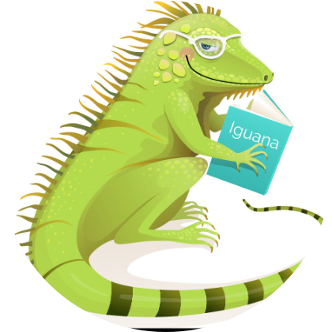
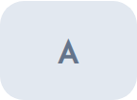

Quick Quiz!
Fill the gap!
Iguana

Slide 12





Great Job! ⭐
You are a superstar student!
See you next time,
Teacher Daisy!

