Slide 1



Why You Should Care
Finance affects every business decision → Think ROI & IRR!
Understanding the economy helps project managers interpret financial updates
CME is used in tandem with investors’ risk / return objective to derive the Strategic Asset Allocation (SAA)
Notes:
Explain why market expectations matter to business planning.

Slide 2
Quiz time
Q1. What is the main purpose of developing Capital Market Expectations (CME)?
A. To predict next week’s stock prices
B. To set realistic long-term return assumptions
C. To reduce company expenses
D. To track competitors’ sales growth
Q2. Why do investors prefer forward-looking data instead of past returns?
A. Because past data is easier to get
B. Because markets never repeat themselves exactly
C. Because history has no value
D. Because it’s required by law
Q3. How does CME help in portfolio management?
A. It tells you which single stock will perform best
B. It helps decide asset mix (stocks, bonds, cash, etc.)
C. It guarantees profit each year
D. It replaces financial statements

Slide 3
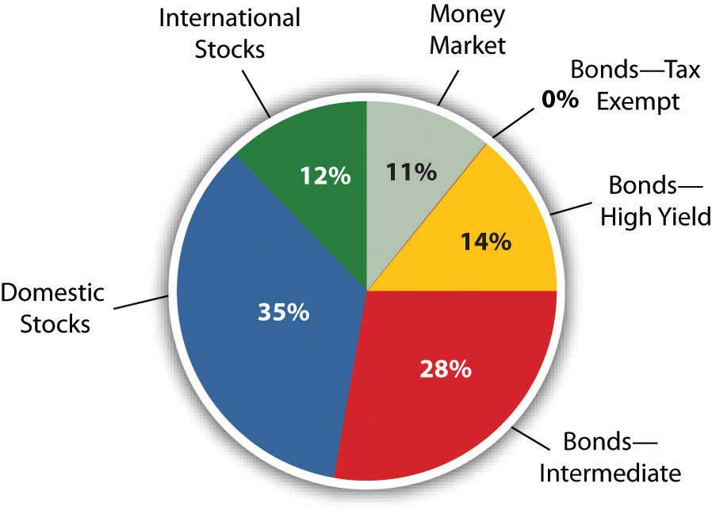
Strategic Asset Allocation
A strategic asset allocation strategy involves choosing asset class allocations and rebalancing periodically to match the asset class allocations
Factors that affect strategic asset allocation weights include risk tolerance, time horizon, and return objectives
Rebalancing occurs when weights of asset class deviate materially (i.e falls out of rebalancing band)
Private Equity /Credit (0%)
Domestic stocks

Slide 4
Rebalancing your portfolio
Market Value:
$50 M in Equity
$40 M in Fixed Income
$10 M in Alternatives
Market Value:
$60 M in Equity
$20 M in Fixed Income
$20 M in Alternatives
Market Value:
$50 - 55 M in Equity
$35 - 40 M in Fixed Income
$10 - 15 M in Alternatives

Slide 5
Quiz time
Q1. What triggers a portfolio to be rebalanced?
A. When you expect market to have high volatility
B. When asset weights drift away from targets
C. When markets are non-volatile
D. When interest rates fall
Q2. If equities rise sharply, what would you typically do when rebalancing?
A. Buy more equities
B. Do nothing
C. Sell some equities and buy undervalued assets
D. Sell everything to cash in profits
Q3. What does SAA mainly depend on?
A. Risk tolerance and time horizon
B. Market rumors
C. Political preferences
D. Past performance

Slide 6



Characteristics of Good Forecasts
Objective and Unbiased
Efficient
Consistent
Well-researched forecasts free from personal biases and preconceptions
Minimize forecast errors through rigorous methodology and analysis
Maintain cross-sectional and intertemporal consistency across all projections
Acquirer Vs. Target
Target perspective:
Overstating Revenue forecast, forward EBITDA, and FCFF to prop up Enterprise Valuation
Acquirer perspective:
Overstating Liabilities & WACC, whilst understating synergy, projected growth and normalized EBITDA

