Slide 1
English poem writing
Metaphor : mood and weather (Year 5)
www.aimhigheracadmiec (Thany)

Slide 2
1)Match the emojis to the weather.
2) what word would describe that feeling/ emotion?
You can use more than one emoji, as long as they seem to represent the same feeling

Slide 3









Slide 4
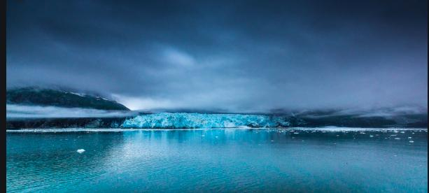
What is the feeling?

Slide 5
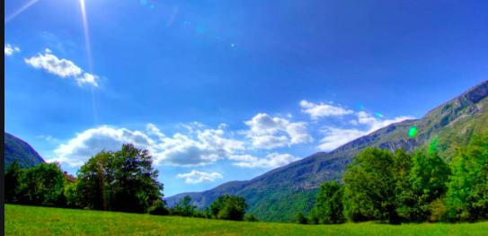
What is the feeling?

Slide 6
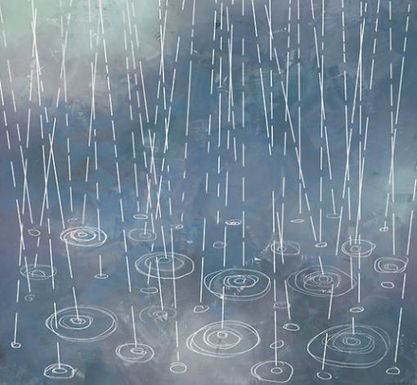
What is the feeling?

Slide 7
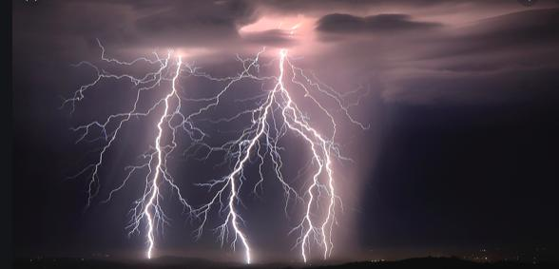
What is the feeling?

Slide 8
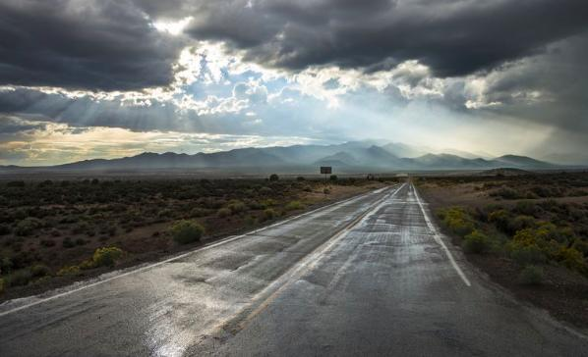
What is the feeling?

Slide 9
Example poem and analysis
for those who have learnt what metaphor and simile are, give this poem a try!

Slide 10
You on different days, a poem by DJ
Sometimes you are a storm
striking anyone who cross you
You are dangerous
I am terrified
repetition
Metaphor
Storm = many lightening
Scary
Dark sky
Because you are angry
Maybe physically or somebody who challenge you

Slide 11
You on different days, a poem by DJ
Some days you are a sunny day
I see bright sky
Peaceful
Heavens
repetition
Metaphor
Sunny day
Beautiful
Bright sky
Peaceful both for you and people around you
Because you are happy
It feels like heavens ,both for you and people around you

Slide 12
You on different days, a poem by DJ
The other time I noticed you were bored
Like a sky on a cloudy day
Lifeless
Silent
Simile, comparing your feeling to the weather
Figurative language
It does not mean you are not alive, but it means everything stops

Slide 13
You on different days, a poem by DJ
Metaphor
Rain means sadness
The water is your tears
Because you are sad
Then, you are like a rainy day
Weeping, sobbing
Making me sad
That day feels bad
Action words to show
Readers what ‘you’ could feel ‘inside’ or ‘outside’

Slide 14
You on different days, a poem by DJ
Metaphor
glacier means indifference or coldness of a person
The big glacier is not affected by others. And it feels cold to touch.
Once in a while, you are a glacier
Heartless, cold
Numbing
That is the most frightening.
Figurative words to suggest what you could feel
Metaphor of what the narrator could feel

