Slide 1

Solving Nonlinear Equations
This presentation explores the fascinating world of nonlinear equations, delving into their characteristics, methods of solving, and applications in various fields.
oi
by onyi ik

Slide 2
Introduction to Nonlinear Equations
Definition
Examples
Nonlinear equations are mathematical expressions that do not follow a linear relationship between variables. This means the equation's graph does not form a straight line.
Common examples include quadratic equations (ax^2 + bx + c = 0), exponential functions (y = a^x), and trigonometric functions (sin(x), cos(x)).

Slide 3

Properties of Nonlinear Functions
Multiple Solutions
Non-Uniform Rate of Change
Complex Behavior
Nonlinear equations can have multiple solutions, unlike linear equations, which typically have only one.
Nonlinear functions can exhibit complex behavior, including oscillations, bifurcations, and chaotic dynamics.
The rate of change in a nonlinear function is not constant, leading to curves with varying slopes.

Slide 4
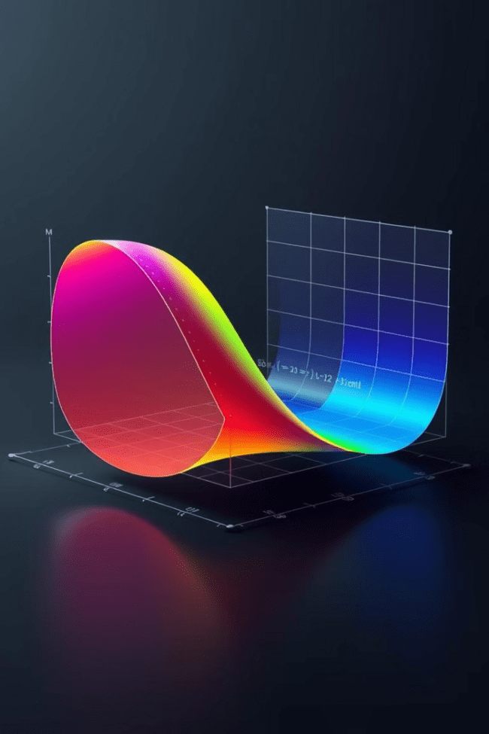



Graphical Representation of Nonlinear Equations
Visual Insight
Graphing nonlinear equations provides a visual understanding of their behavior and solutions.
Solution Intersection
Solutions to nonlinear equations are represented by the points where the graph intersects the x-axis.
Qualitative Analysis
Graphical analysis helps determine the number of solutions, their approximate values, and the equation's overall behavior.

Slide 5
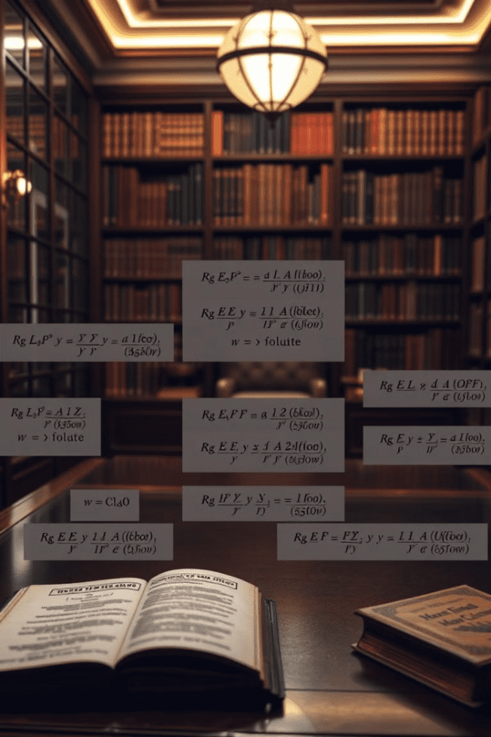
Analytical Methods for Solving Nonlinear Equations
Algebraic Methods
Calculus Methods
These methods involve manipulating the equation to isolate the unknown variable. They are applicable to certain types of nonlinear equations.
Techniques like differentiation and integration can be used to find solutions for some nonlinear equations. These methods are particularly useful when dealing with equations involving derivatives or integrals.

Slide 6
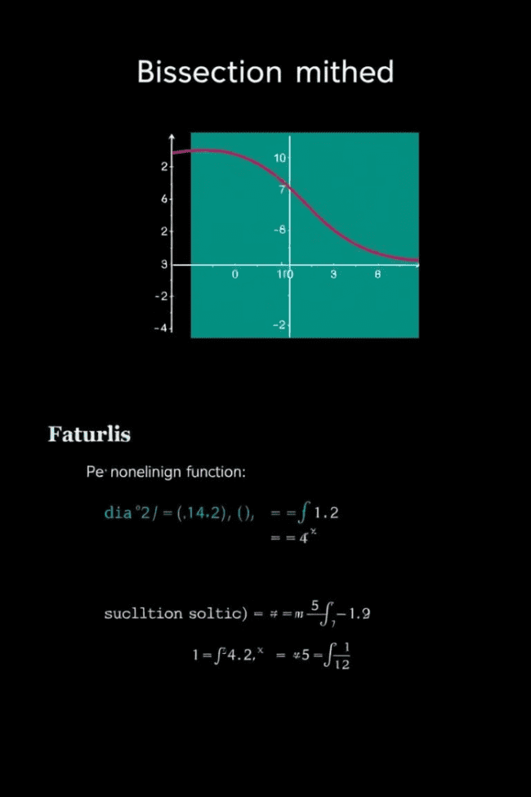
Bisection Method
1
Bracket the Solution
Identify an interval containing the solution, where the function changes sign.
2
Divide the Interval
Divide the interval in half, finding the midpoint.
3
Evaluate at Midpoint
Determine the sign of the function at the midpoint.
4
Repeat until Convergence
Repeat the process, narrowing the interval until the desired accuracy is achieved.

Slide 7




Newton-Raphson Method
Initial Guess
1
Choose an initial estimate for the solution.
Tangent Line
2
Calculate the tangent line to the function at the guess.
Iterative Refinement
3
Repeat the process, using the intersection of the tangent line with the x-axis as the next guess.
Convergence
4
The method converges to the solution when the difference between consecutive guesses is sufficiently small.

Slide 8
Secant Method
Two Initial Points
1
Start with two initial guesses for the solution.
Secant Line
2
Draw a line (secant) through the two points and find its intersection with the x-axis.
Iterative Improvement
3
Use the x-intercept as a new guess and repeat the process with the previous guess and the new one.
Solution Approximation
4
The method converges to the solution as the secant lines approach the tangent line at the solution.

Slide 9
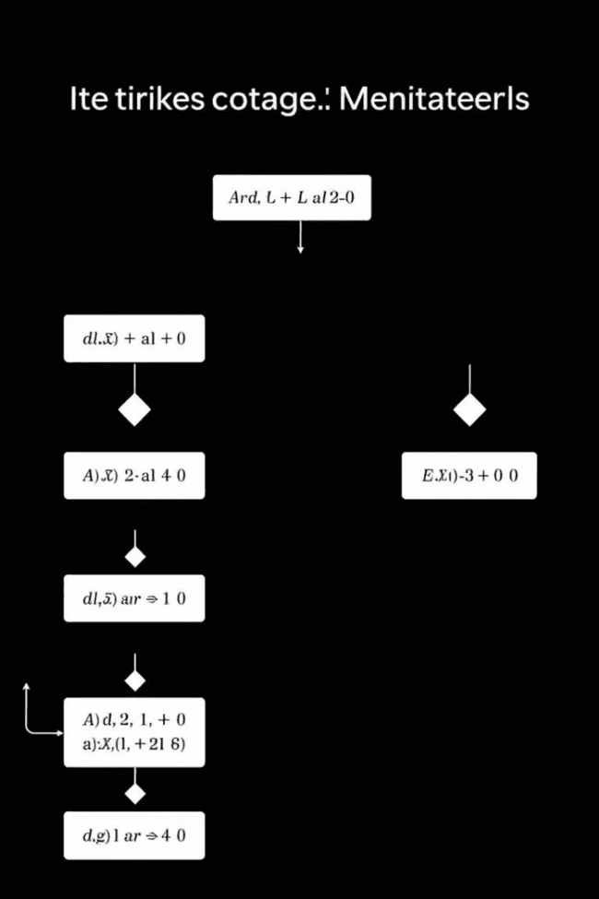



Iterative Techniques for Nonlinear Equations
Numerical Methods
These methods involve repeated calculations to approximate the solution. They are often used when analytical methods are not feasible or too complex.
Advantages
Iterative techniques can be applied to a wide range of nonlinear equations, including those without closed-form solutions.
Computational Efficiency
Iterative methods are well-suited for implementation on computers, allowing for efficient solution finding.

Slide 10
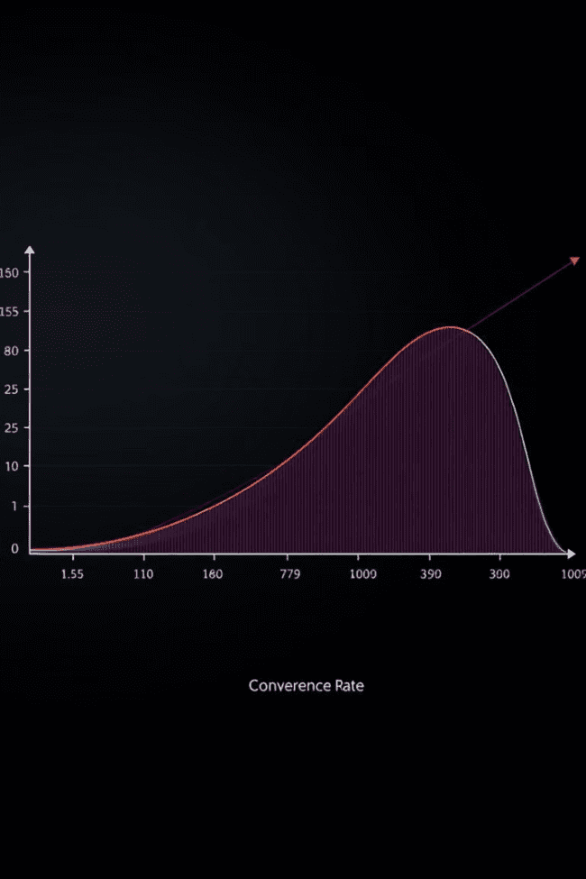
Convergence and Stability of Iterative Methods
1
Convergence
An iterative method is said to converge if the sequence of approximations approaches the true solution.
2
Stability
A method is stable if small errors in the initial guess or calculations do not significantly affect the final solution.
3
Factors Influencing Convergence
The initial guess, the function's properties, and the method's parameters can all influence convergence and stability.

