Slide 1
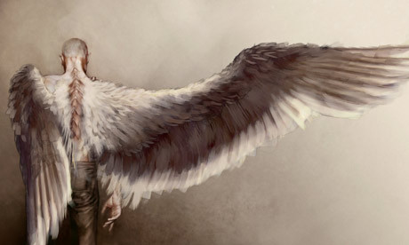
Skellig
Lesson One

Slide 2
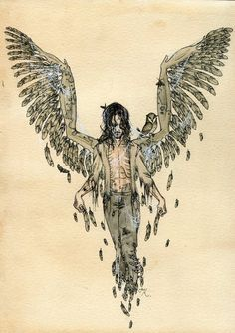
Today’s Lesson
01
02
03
Chapters 1- 4
Writing Task
Discussion
04
Homework

Slide 3




FIRST IMPRESSIONS

Slide 4
CHAPTER ONE
Question Two
Question Four
Protagonist – main character
Question One
Look at the first sentence of chapter one. How does the writer grab the reader’s interest?
What impression do you get of the protagonist in the opening paragraph of the chapter?
Question Three
Describe the house that the family are moving into in chapter one.
Look at the last sentence of the chapter. What effect does it have on the reader?

Slide 5
What do you learn about the creature?
He was lying there in the darkness behind the tea chests, in the dust and dirt. It was as if he’d been there forever. He was filthy and pale and dried out and I thought he was dead. I couldn’t have been more wrong. I’d soon begin to see the truth about him, that there’d never been another creature like him in the world.

Slide 6
CHAPTERS TWO - THREE
Question Two
Question Four
Question One
Describe what the garage is like in chapter two.
What impression do you get of Mum in chapter two?
Question Three
What impression do you get of Mum in chapter three?
Who is Doctor Death?

Slide 7
What impression do you get of the creature?
I thought he was dead. He was sitting with his legs stretched out, and his head tipped back against the wall. He was covered in dust and webs like everything else and his face was thin and pale. Dead bluebottles were scattered on his hair and shoulders. I shone the torch on his white face and his black suit.

Slide 8
CHAPTER FOUR
Question Two
Question One
Why does Michael struggle to sleep at the start of the chapter?
How does Michael feel about his baby sister?

Slide 9
Writing Task
Think about:
TASK:
-how you feel about what you found
-why you haven’t told anybody else
-how you’re feeling about your new house
-how you feel about your baby sister.
Imagine you are Michael at the end of the chapter three. Write about how you are feeling after your discovery in the garage.
Remember:
-you are writing as if you are Michael, using ‘I’
-write in sentences and paragraphs

Slide 10
What is your first impression of the book?
What do you like about the book so far?
What do you want to know?
Think about what you have enjoyed reading about so far and how the book has made you feel. Give examples from the text to help explain your answer.
What are you intrigued about? What would you like to know more about?

Slide 11
Homework
Think about:
TASK:
-how you felt when you woke up
-your journey to school and how you felt
-who you met when you first arrived at school
-how you felt during the day
-how you felt when the day ended
Think about your first day at school. Write about how you felt. Use the writing planner to help you.
Write at least three paragraphs.
Remember:
-plan your writing using the writing planner
-write in paragraphs
-use adjectives to add detail for the reader

Slide 12
Skellig
Lesson Two

Slide 13
Today’s Lesson
01
02
03
Chapters 5- 8
Writing Task
Your thoughts about Mina
04
Homework

Slide 14
CHAPTERS FIVE- SIX
Question Two
Question One
Who is Mrs Dando?
What does Dad find behind the fire that he removes from the house?
Question Three
How does Michael feel when he goes into the garage in chapter six? Which lines tell you how he feels?

Slide 15
CHAPTER SEVEN
Question Two
Question One
What do you find out about the figure in the garage in chapter seven?
Who is Mina?

Slide 16
CHAPTER EIGHT
Question Two
Question One
What impression do you get of Michael and his family in chapter eight?
Why does Michael not eat all of his food?

Slide 17
What is your first impression of Mina?
What do you think Mina is like?
What do you want to know abot Mina?
Think about what you have learned about Mina so far. How does this make you feel about her? Give examples from the text to help explain your answer.
What are you intrigued about? What would you like to know more about?

Slide 18
Writing Task
Think about:
TASK:
-the time you’ve spent with your family
-meeting Mina
-speaking to the figure in the garage
Imagine you are Michael. Write about how you feel at the end of chapter eight.
Remember:
-you are writing as if you are Michael, using ‘I’
-write in sentences and paragraphs

Slide 19
Writing a Review
Tips for Writng a Review:
TASK:
Use the guidance sheet to help you plan and then write your review.
Now that you have read all of the book, you are ready to write a review of it.

