Slide 1
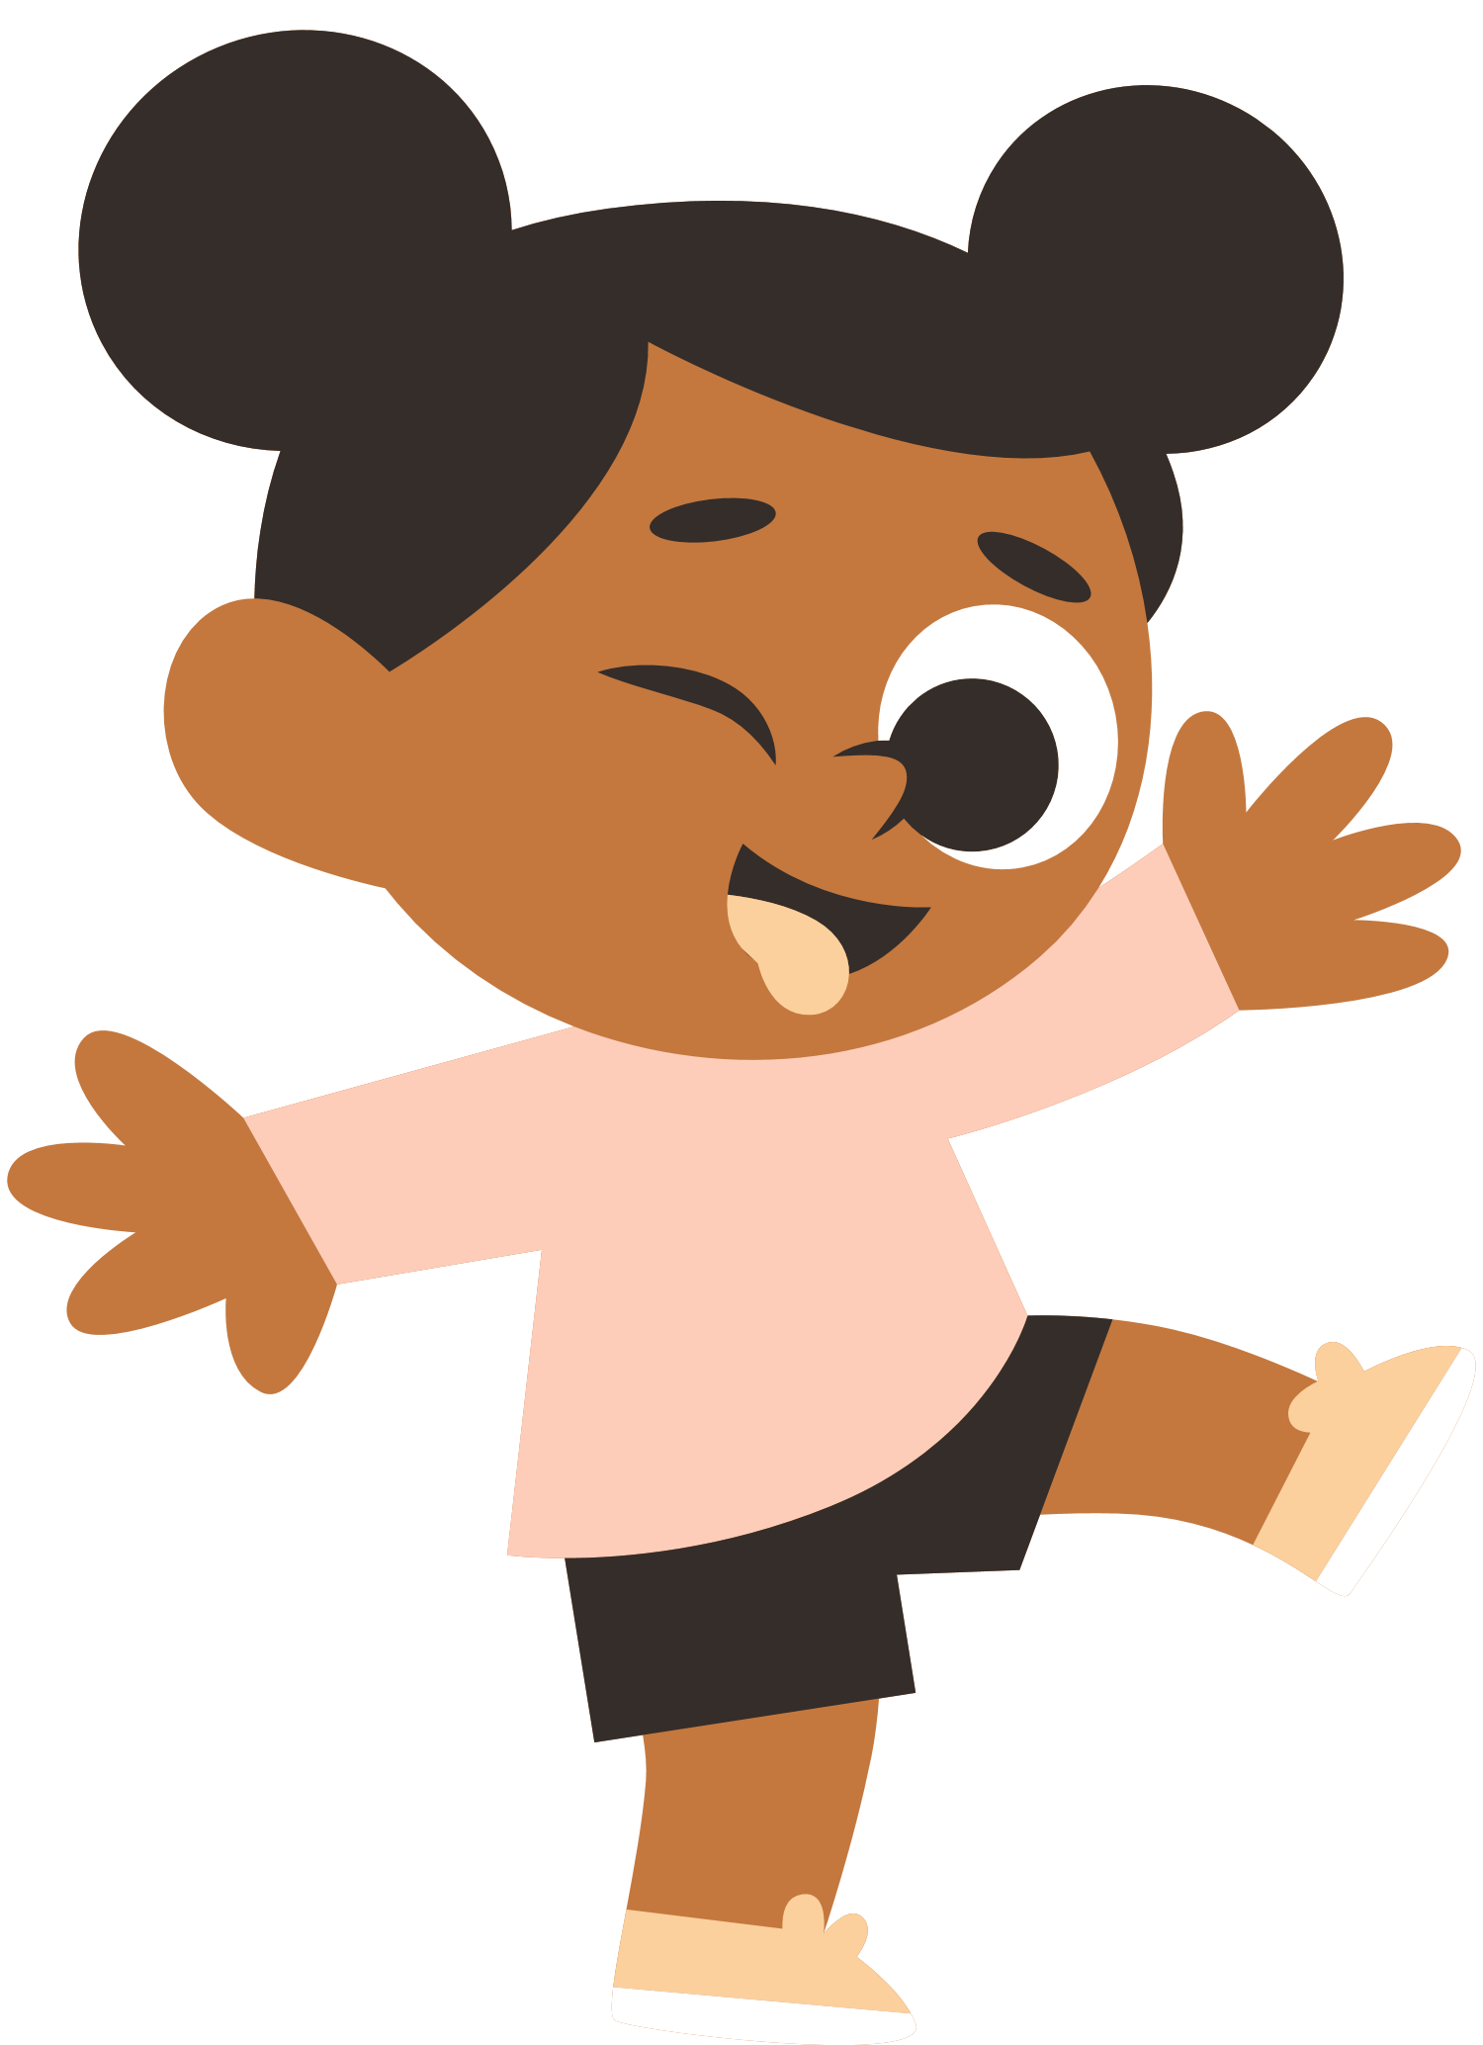
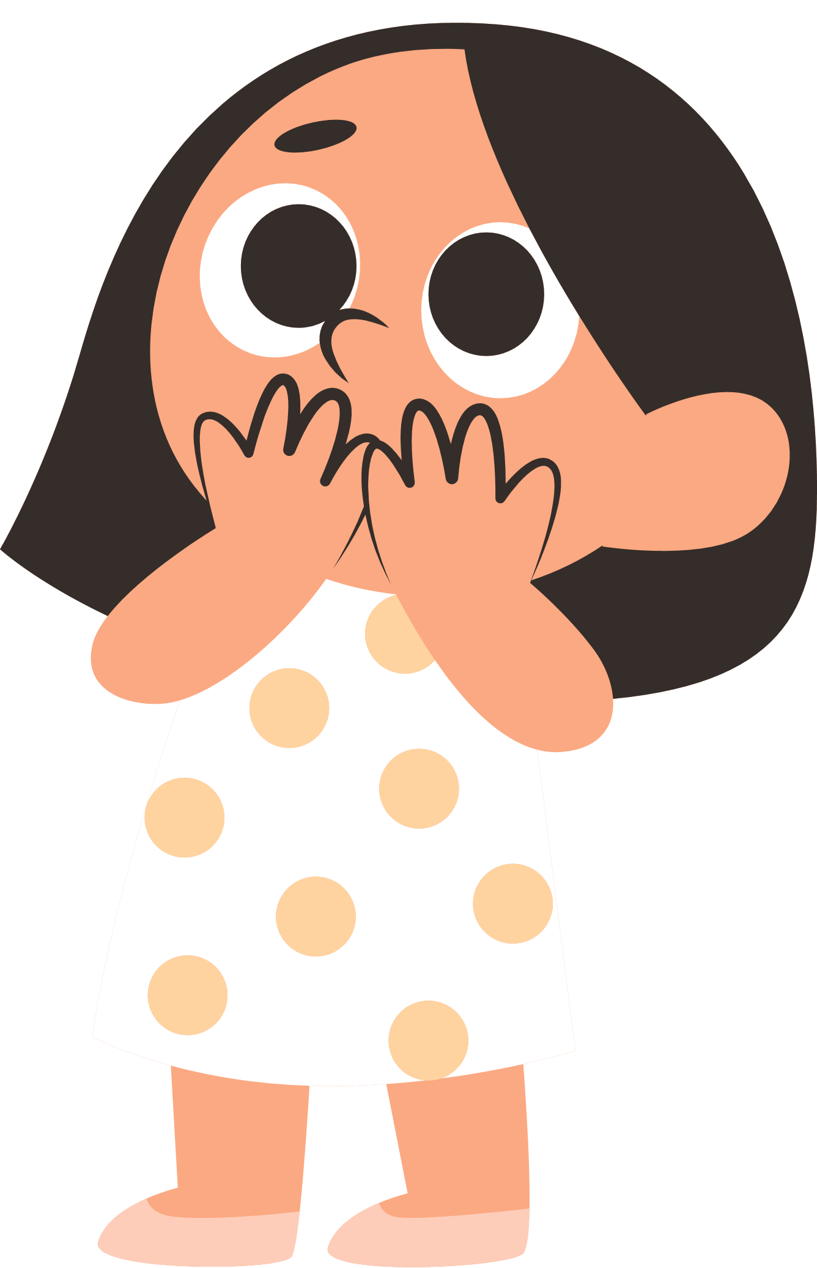
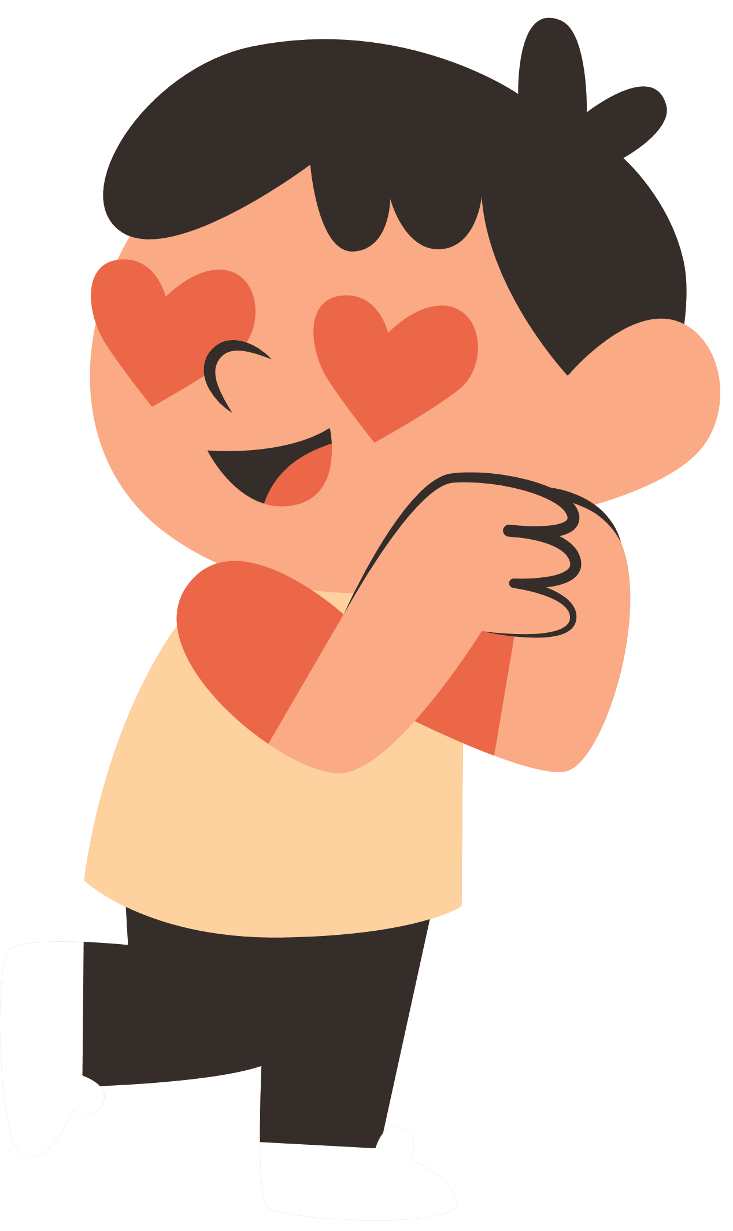
DAILY USEFUL EXPRESSIONS
Daily Useful Expressions
Beginner to Elementary

Slide 2

Excuse me, I have a question.

Slide 3
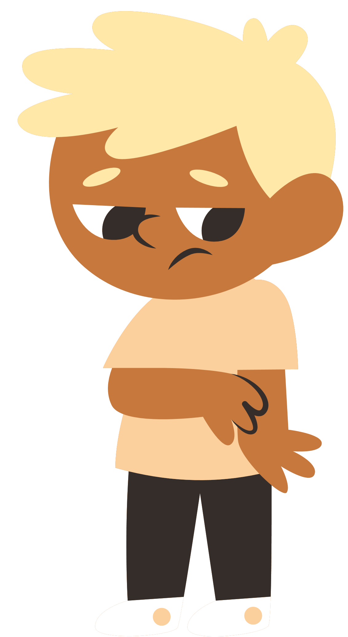
I’m sorry.

Slide 4
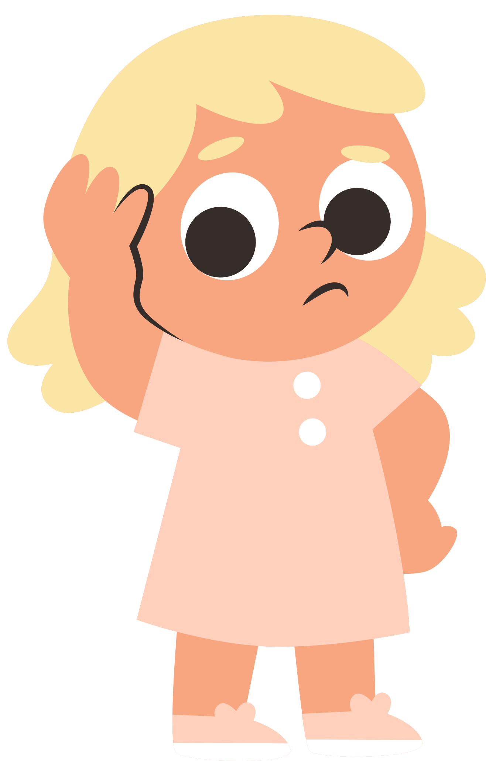
I don’t understand.

Slide 5
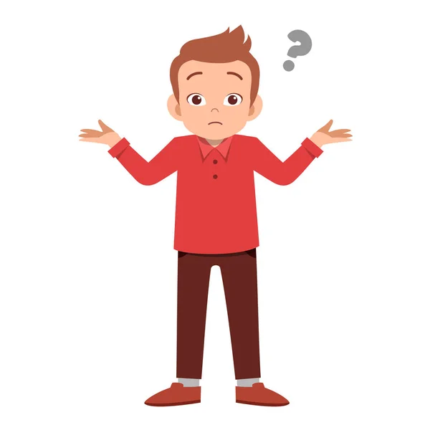
I don’t know.

Slide 6
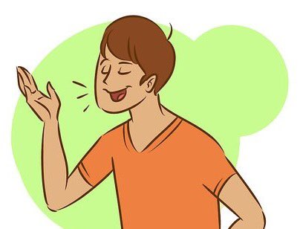
Please speak slowly.

Slide 7
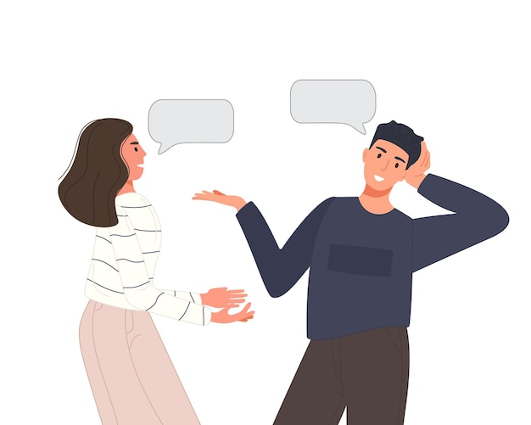
Can you repeat that?

Slide 8

Okay, I see.

Slide 9
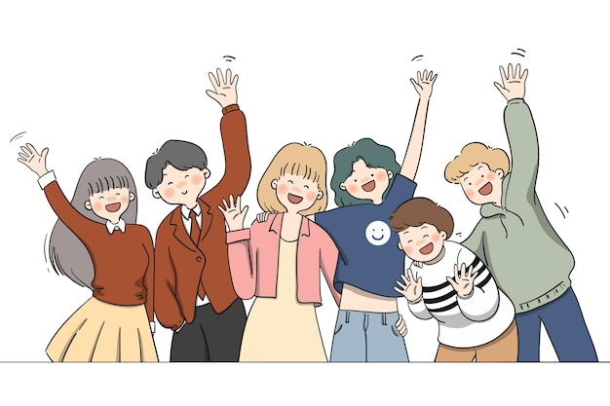
Thank you! Goodbye.
See you later!

