Slide 1

A Point of View : Solution construct
– Creating a Tailor Made solution for Client

Slide 2
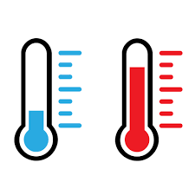

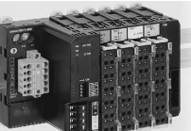






Machine Parameter types & All parameters that will be captured
My company scope of implementation
Tank Hydraulic Oil
Electrical Panel Room Temp.
Water-in Hydraulic oil cooling
Water-out Hydraulic oil cooling
Cylinder-oil out temp (All cylinders)
Siemens SITRANS Ts500
X 12
Forming Press Equipment @ Client
Pilot DC valve feedClientck
P1/P2 valve feedClientck ( 3 setup)
Additional valve feedClientck
Siemens SITRANS LVL200
X 1
(** Detailed solutioning explained in next 3 slides)
Siemens SITRANS P300
X 1
Hyd Main pump flow
Pilot line flow
Circulation
P1 line
P2 line
Water Inlet(Hydraulic Oil Cooling)
Water Outlet (Hydraulic Oil Cooling)
Oil inlet flow
Oil outlet flow
Temperature
Level
Pressure
Flow
Differential Pressure Switch
Vibration
Current
Voltage
Contamination
Position
Comm status
On/Off FeedClientck
Gap
Offset
Profile/Ovality
1 Seimens S7-1500
Siemens SITRANS F M MAG 5000
X 11
MS Azure Cloud
Data processing
Data science
KROHNE OPTIFLUX 4300
X 1
WIKA PSD-4
X 3
SKF CMSS 793V
X 21
Oil contamination level
Forming Pipe Edge Gap(Set)
CR Magnetics/LEM CR5210/HO 150-P
X 11
Pilot Filter clogging DI
Circulation Filter clogging DI
Lub Filter clogging DI
Schneider iEM3255
X 8
Parker iCountPD
X 1
Hyd Pump motor DE & NDE with Temperature
Hyd Pump Vibration with Temperature
Micro Epsilon ILD1420-25/ILD1420, 21, 22
X 4
Forming Profile Offset(Set)
Siemens SIMATIC ET 200SP
X 2
Centralised / Management Reporting
Hyd Oil level (Analog)
Honeywell 914CE Series
X 12
Pipe Profile /Ovality(Set)
Hyd Main pump pressure
Pilot line pressure
Hydraulic Oil Cooling Water & oil Inlet, outlet Pressure
Bottom Cylinder Inlet Pressure
Top Cylinder Inlet Pressure
Central Lubrication Pressure
Grease Cent Lub system
Pilot Pressure Inlet to Filter
Keyence LJ-V7000 Series
X 2
Manipulator-L&R Motor Current
Hydraulic Pump Motor (7 Motors)
Cognex In-Sight 7000
X 1
Existing 25 Sensors (from ClientLLUFF, IFM, REXROTH, ABB, VIPA, GE etc)
PLC
Profibus Communication error
Ethernet Communication error
Factory Premises

Slide 3
Machine Parameter types & All parameters that will be captured for Crimping machine
My Company scope of implementation
Electrical Panel Room Temp
Water-in Heat Exchanger
Water-out in HE
Hydraulic oil inlet into HE
Hydraulic oil outlet from HE
Forming Press Equipment @ Client
Pilot DC valve feedClientck
P1/P2 valve feedClientck ( 3 setup)
Additional valve feedClientck
(** Detailed solutioning explained in next 3 slides)
pilot line pressure
Hot Hydraulic oil inlet Pressure into HE
Coolied hydraulic oil outlet Pressure from He
Main cylinder pressure (top& bottom) Left side
Main cylinder pressure (top& bottom) right side
Die Lifting cylinders (top& bottom) left side
Die Lifting cylinders (top& bottom) right side
Plate holding cylinders(top& bottom) Left side
Plate holding cylinders(top& bottom) Right side
Central lubrication System
Inline Filter pressure difference & Clogging indication
Reciprocating Line Filter Pressure Difference & Clogging indication
Cooling Water Inlet Pressure
Cooling Water outlet Pressure
Surface Inspection
Speed
Flow
visual
Pressure
Temperature
Pressure
Vibration
position
profile
oil contamination
Length
SMC Digital Flow Switch
1 Seimens S7-1500
MS Azure Cloud
OMRON Welding Bead Sensor
Data processing
Data science
Siemens Sitrans P300
Model Name/Number: Sitrans Ts500 from Siemens
Real time length of plate Crimped l
Forming Pipe Edge Gap(Set)
Cognex 3D-L4000 or SICK TriSpectorP1000
Die Block
pump
SICK DX35
Cognex 3D-L4000 or SICK TriSpectorP1000
tool position
die position
plate holding cylinders position
Parker iCount PD
Siemens Sitrans P DS III
Centralised / Management Reporting
crimping arc profile
Siemens Sitrans P300
Real time length of plate Crimped)
Dent
Rust
Scratch
Surface waviness(camber)
crimping arc profile

Slide 4

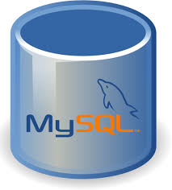




Factory / Shop Floor
MS Azure Cloud
Temp Sensor
AI module
Remote I/O
Analog Input (e.g. 0~10 V or 4~20 mAmp)
PLC
(** Detailed solutioning explained in next 3 slides)
Pressure Sensor
Ethernet / RJ45
~250 ms
(picks up TAG value from the PLC
Siemens S7 1500 PLC
Ladder Logic (calibration of the Analog signals & store the O/P in a TAG)
Edge Desktop
MS Azure Cloud
Level Sensor
Data processing
Data science
Vibration Sensor
OPC UA Client
Contamination Sensor
OPC UA Server
OR
DI Module
SIMATIC S7 Client
~MQTT or any standard protocol
Proximity Sensor
OR
Digital Input
SIMATIC S7 Server
Limit Switch
Remote I/O
Centralised / Management Reporting
Etc…etc
Real time monitoring Dashboard (SCADA) for supervision
cabbles

Slide 5

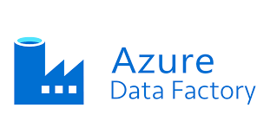


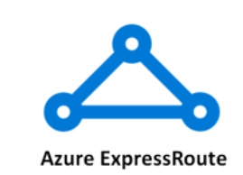


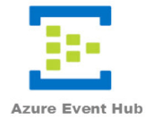
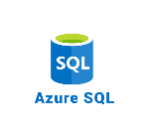

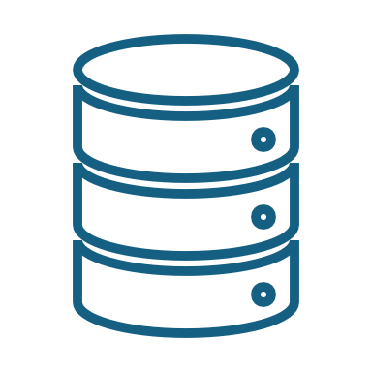

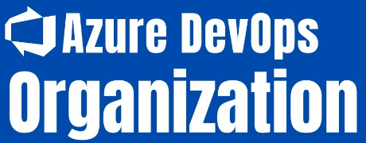
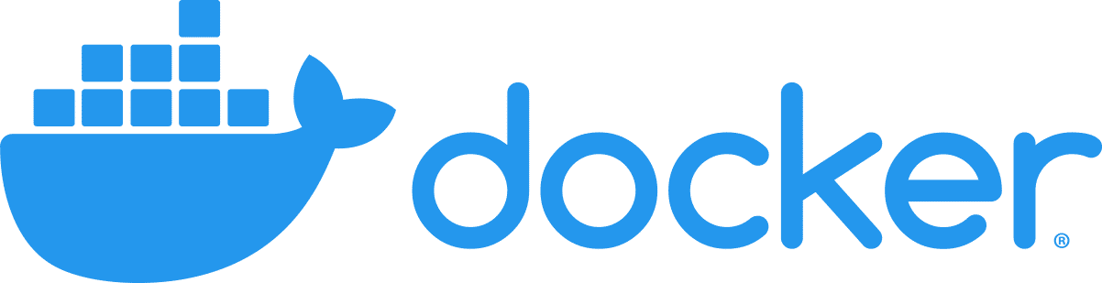
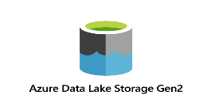

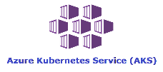





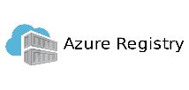
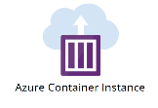


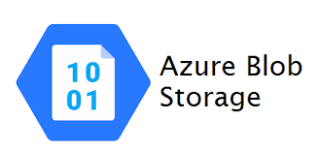
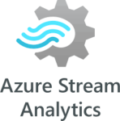






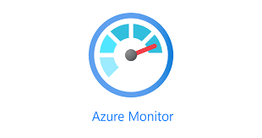

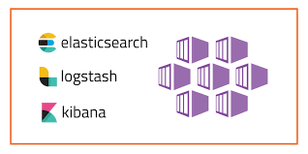
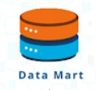


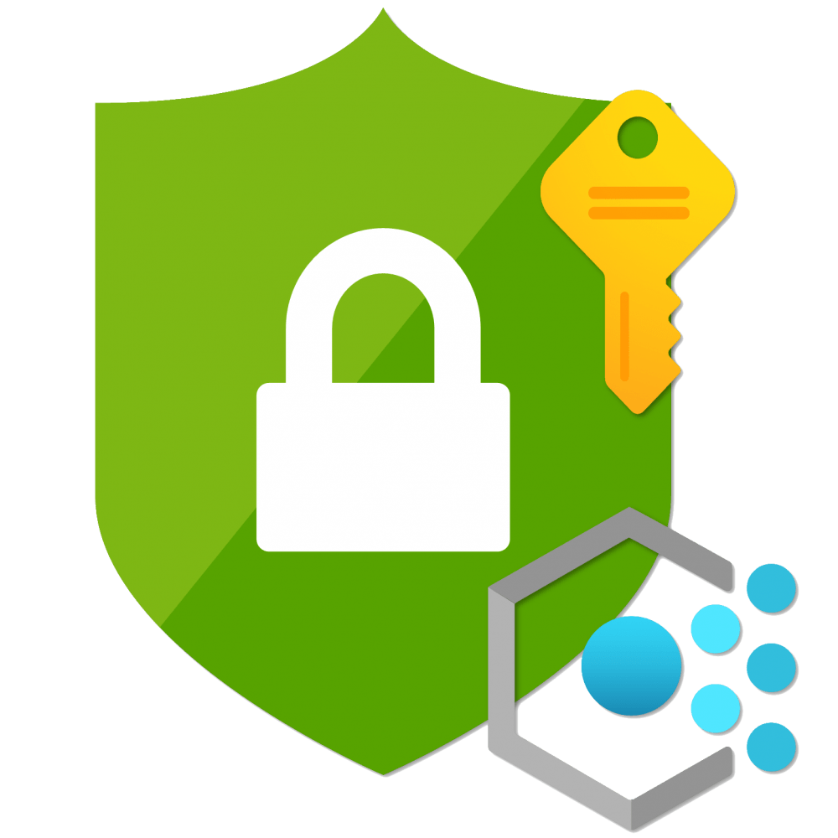



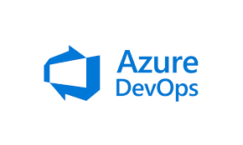

A detailed technical solution architecture of building a Microsoft Azure data platform to propel Data Analytics & AI @ Scale
1
2
3
4
5
Recommended Architecture
Data Prep Routines
Data Ingestion
Data Landing
Data Harmonization
(Bronze)
Networking and Firewall
Data Segregation
(Silver)
Advanced Analytics and Data Science Zone
P
Data Assets
Model Training
6
Model Packaging
Data quality checks metadata
Domain 1
COLD Path data processing & Visualization
Domain 1
Domain 2
Domain 2
Domain…n
7
End
Consumers
Model Check-In & Containerization
Prepare
Domain ….n
Unify
Reusable Assets
8
Model Execution
Data Ingestion Pipeline
IAM Policies
Cloud Datawarehouse (Gold)
Raw
Data Governance
10
Data Operations
Trusted Data
9
11
Model Output
Data Privacy and Security
Domain 1
Domain…n
HOT Path data processing & Visualization
Domain 2
Insights
Visualization Layer
Insights
Operations Manager
SRE Manager
Plant supervisor
Machine Maintenance Lead
Data Analysts
Data Scientists
Data Stewards
Data Engineers
Notes:
Done

Slide 6
Solution Design Notes for Data platform
Architecture Layer | Technical Solution | MS Azure | Google Cloud Platform | AWS
Connectivity between on-premise and cloud | The connectivity established between on-premise to cloud should be secured & have capabilities to Ensure Zero data leakage Ensure In-transit data encryption (if applicable Clientsed on Phase 1 discussions) Ensure Data transmission is happening over a private tunnel only Perform integration testing related to & including Access checks, Sanity testing, Source data load check along with its file size, Data Quality, Data consistency, Data Cleansing, Data Format. | Azure VPN gateway Azure Express Route | API Gateway Cloud VPN Cloud Router | AWS Direct connect AWS transit ateway AWS customer gateway
Data Ingestion | Data ingestion pipelines will have following deliverables/capabilities Frameworks for Real time Event publishing | API & Webhooks| Streaming of IoT Data Templatized, metadata driven, build once, use multiple features Verification related to & including - Clienttches are up and running, logs, scheduler job timelines, recon, Meta data, Data completeness, Data consistency, Data Quality, Data integrity, Profiling, Deduplication checks | Azure Data explorer, Azure Data factory for change data capture . Azure Data explorer, Kafka Sink for real time streaming Azure IoT, Azure Event Hubs | Data flow Pub/Sub for event handling Cloud IoT core | AWS Glue for change data capture Amazon managed service for kafka for real time streaming
Data Harmonization | Once the data ingestion pipelines have landed the data (raw data as coming from system of records) into the landing zone, subsequent solution block will have around 10 20+/- pipelines in Bronze zone: Pipelines to convert any source data format(.csv or .json or .xml) into parquet or avro or Iceberg or Hudie format. Capability to prepare parquet files in respective partitioned and indexed zones Verification related to & including to Business transformation, Data Quality, Data Integrity, Record Count, Data Completeness, Logs checks. | Azure data factory as tool Python programming language | Data flow Cloud Data Fusion Python Programming Language | AWS Glue as tool Python programming language
Data Segregation | Once all the parquet files are prepared from the Data harmonization zone, there will be a need to segregate the data into different data domains for Asset management & stock broking, retail trading, proprietary trading, life assurance & retirals, core Clientnking etc. This will not only reduce single point of failure but also enable data scientists to have different individuals focusing on each data domain- which in turn can enable the platform to embrace “Role Clientsed data access control” mechanism. There will be close to 30~ 40 +/- pipelines segregating the data in different data domain buckets/folders and this is silver zone. Data segregation correctness, user role specific, data load validation, Data Correctness, Data Integrity, performance testing , | Azure Data factory Python programming language Azure FaaS (for implementing event driven architecture) | Data flow Python Programing Language Big Query | AWS Glue as tool Python programming language AWS Lambda (for implementing even driven architecture)
Model training | Once the data has is placed in segregated folders (per data domain) in silver zone, data scientists can start explorative data analysis on training their individual models with the data set available. <<SI>> team will do the technical capability building by setting up Azure ML Studios, and Databricks services Train sample Models (1 or 2) as a pilot & establish the capability including hand over of relevant documentation to BOV data scientists | Azure ML Studio workspace Juypter notebooks Databricks | Cloud ML engine Tensor Flow enterprise VertexAI Jupyter Notebook | AWS Sagemaker Jupyter notebooks Databricks AWS EMR
1
2
3
4
5
Solution capabilities
Notes:
Done

Slide 7
Solution Design Notes for Data platform
Architecture Layer | Technical Solution | MS Azure | GCP | AWS
Model packaging | After Client data scientists have trained their individual respective models and are satisfied with the model scores being generated, the models need to be packaged into docker containers using git. <<SI>> team will set up the repositories (for check in), user ids and relevant pipelines. | git Docker Azure Kubernetes Azure devops | git Docker GKe Kubernetes Engine | git docker
Model check in | After the docker images (for models) are ready to be run as executables, they need to be checked in into a registry so that they can be accessed by a “pull” pipeline or via an API. <<SI>> team will perform this for 1 or 2 sample models, expose the APIs and ensure that the process is streamlined for rest of the models & usage documentation available to BOV team | Azure container registry Azure Container instance for execution |  | AWS Elastic container registry AWS Fargate for execution platform
Model execution pipeline | For trained/ tested/ checked-in models, <<SI>> team will configure ETL pipelines so that they can run on a scheduled or an event driven architectural pattern or an ad-hoc need Clientsis to generate the output needed by CRM team to consume as output. | Azure Databricks in Data Analytics mode pySpark programming language | Data Bricks Pyspark | Databricks in Data Analytics mode pySpark programming language
Model output | This is the published zone where the output of the models will be placed for CRM systems to consumes. This zone will be built per data domain and scores/output from models will be placed in the form of files, so that CRM can consume the outputs. Integration protocols (file Clientsed or DB Clientsed, or API Clientsed etc.) between Analytics Data Lake and CRM application will be finalized during Phase 1 discussion- <<SI>> team is going to define the patterns and set up the integrations only. | Azure Data lake storage | Google Cloud Storage | AWS S3
Data Lake Operations | Audit logs will be captured in a centralized place. <<SI>> to define the “location” & assist log capturing strategy as below. Discuss relevant Alerts, thresholds, monitoring metrices and alarms that needs to be configured during Phase 1 Assist in real implementation of solutioning which Clientsically will constitute of setting up above rules and respective point of contacts. BOV should set up an early warning system to enable predictive, prescriptive and proactive incident management system | Azure Monitoring service Azure notification Elastic Search (optional) Unravel (optional) | Cloud IAM Cloud Monitoring Cloud Deployment Manage Elastic Search (optional) Unravel (optional) | AWS cloudwtach AWS SNS, SQS, SES AWS ELK(optional) Unravel(optional)
Data privacy and security | Define Data privacy and security process for DSAR Define Security requirements Tool evaluation on how to implement security policies is out of scope but can be taken in scope Clientsed on phase 1 requirements | Azure active directory | Cloud KMS and EKM | AWS Native services
6
7
8
9
10
11
Notes:
Done

