Slide 1

Number Workout – Show all your working out
4321 – 1234
240 ÷ 16
-3² x 4 – 7
34 x 23
Find the LCM of 60
And 90
Express 525 as a product of its prime factors
90 ÷ 1.8
0.24 x 1.92

Slide 2
Number Workout – Answers
4321 – 1234 = 3087
240 ÷ 16 = 15
-3² x 4 – 7 = 29
34 x 23 = 782
LCM of 60
And 90
180
Express 525 as a product of its prime factors
3 x 5² x 7
90 ÷ 1.8 = 50
0.24 x 1.92 = 0.4608

Slide 3
Revision
Learning Objectives
Be able to identify what our strengths and weaknesses are.
Key Words
Ratio, Fraction, estimate, sequences, index laws, percentages.

Slide 4
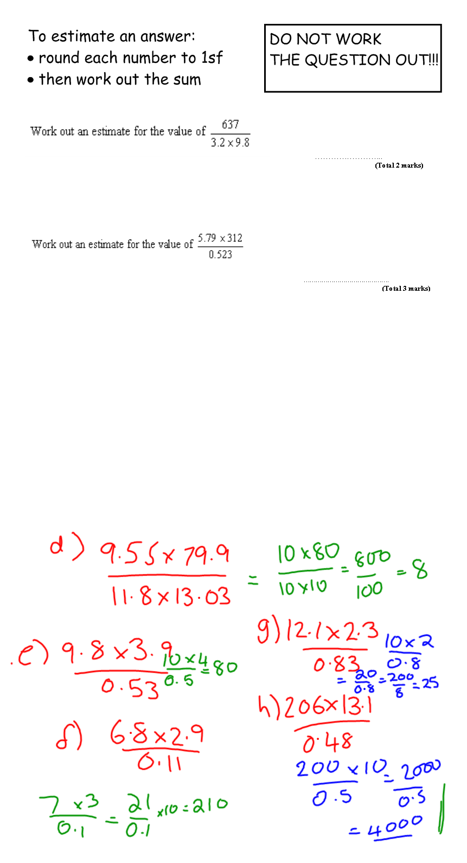






20
$\frac{600}{3 x 10}$ = $\frac{600}{3 0}$ = 20
3600
$\frac{6 x 300}{0.5}$ = $\frac{1800}{0.5}$ = 3600
If you work out any of the values and do not show your rounding you will get zero marks!!!!

Slide 5
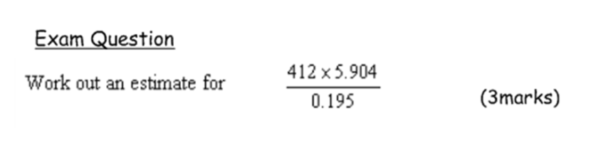
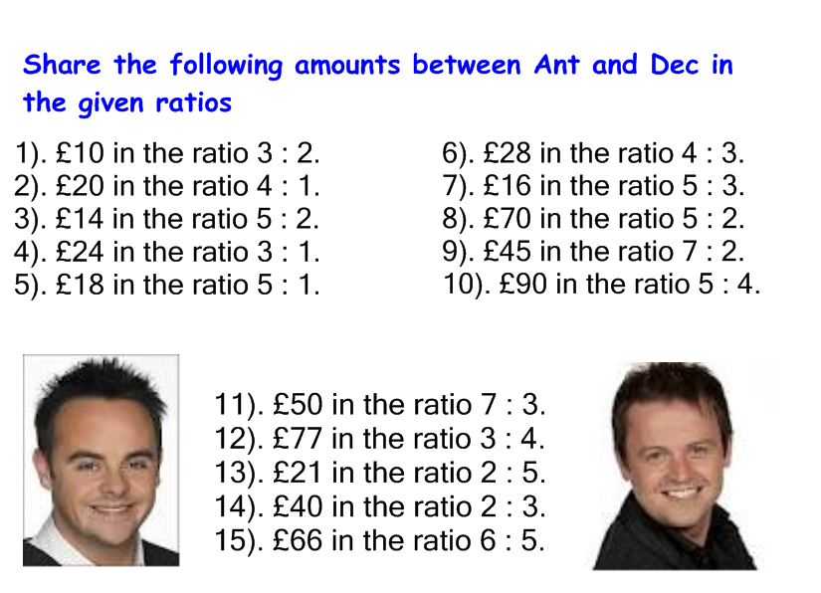
You have 3 mins…..how many can you get right?

Slide 6

1). £6:£4
2). £16:£4
3). £10:£4
4). £18:£6
5). £15:£3
6). £16:£12
7). £10:£6
8). £50:£20
9). £35:£10
10). £50:£40
11). £35:£15
12). £33:£44
13). £6:£15
14). £16:£24
15). £36:£30

Slide 7
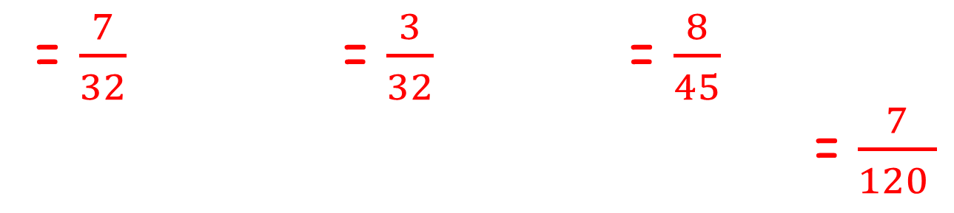
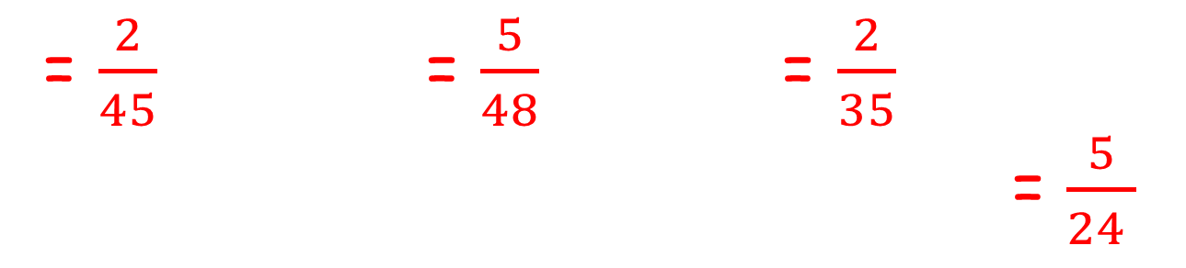
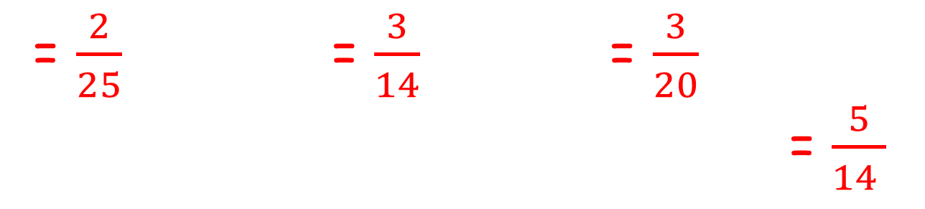
FRACTION X FRACTION
= $\frac{2}{25}$ = $\frac{3}{14}$ = $\frac{3}{20}$
= $\frac{5}{14 }$
= $\frac{2}{45}$ = $\frac{5}{48}$ = $\frac{2}{35}$
= $\frac{5}{24 }$
= $\frac{7}{32}$ = $\frac{3}{32}$ = $\frac{8}{45}$
= $\frac{7}{120 }$

Slide 8
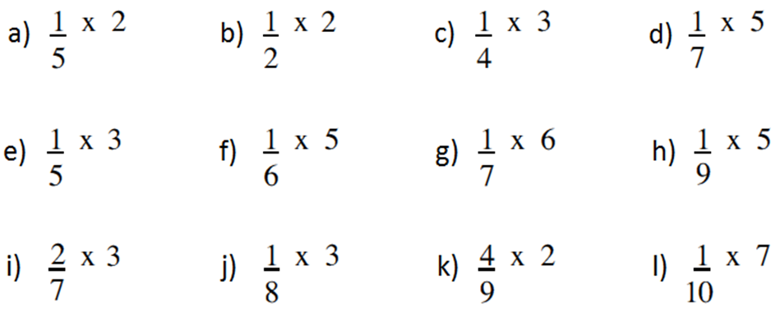
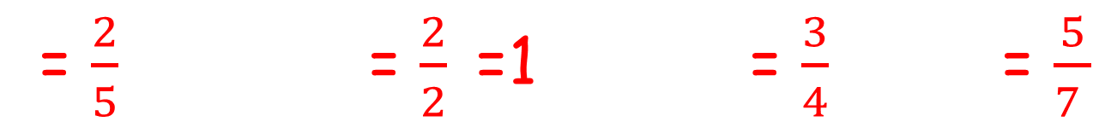
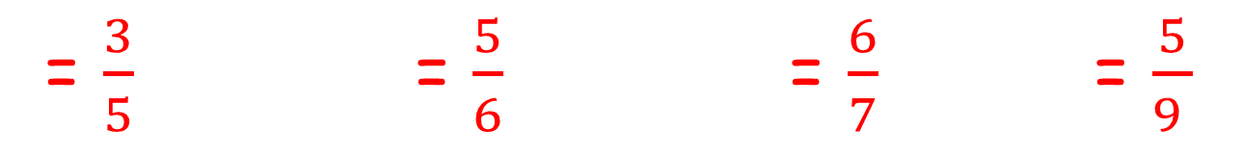
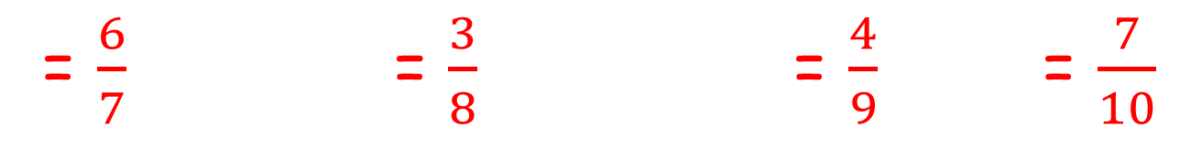
FRACTION X INTEGER
= $\frac{2}{5}$ = $\frac{2}{2}$=1 = $\frac{3}{4}$ = $\frac{5}{7 }$
= $\frac{3}{5}$ = $\frac{5}{6}$ = $\frac{6}{7}$ = $\frac{5}{9 }$
= $\frac{6}{7}$ = $\frac{3}{8}$= $\frac{4}{9}$ = $\frac{7}{10}$

Slide 9



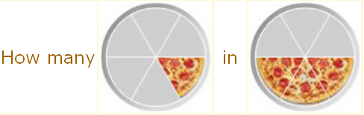
What does it mean to divide 2 fractions???

Slide 10
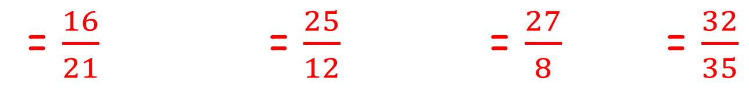
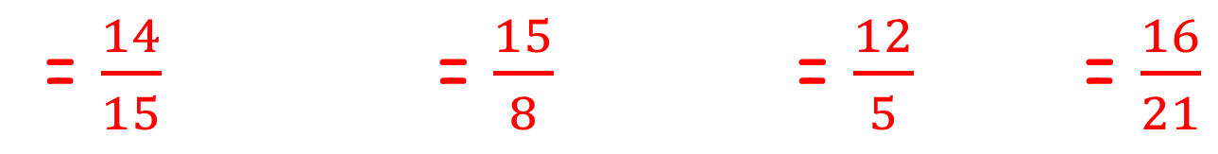
FRACTION ÷ FRACTION
Keep, Change, Flip
= $\frac{14}{15}$ = $\frac{15}{8}$ = $\frac{12}{5}$ = $\frac{16}{21}$
= $\frac{16}{21}$ = $\frac{25}{12}$ = $\frac{27}{8}$ = $\frac{32}{35}$

Slide 11
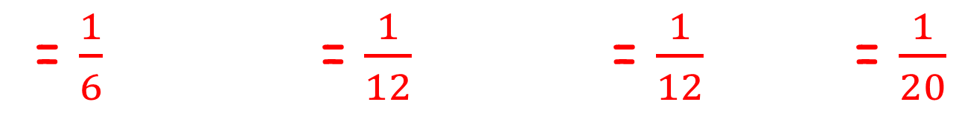
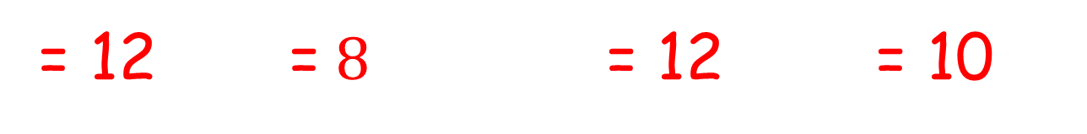
INTEGER ÷ FRACTION
Still Keep, Change, Flip
= 12 =$8$ = 12 = 10
FRACTION ÷ INTEGER
= $\frac{1}{6}$ = $\frac{1}{12}$ = $\frac{1}{12}$ = $\frac{1}{20}$

Slide 12





What do we do if we have a mixed number?

Slide 13



Choose which question you want to try:
Bronze
Silver
Gold

Slide 14











Answers:
Bronze
Silver
Gold

Slide 15
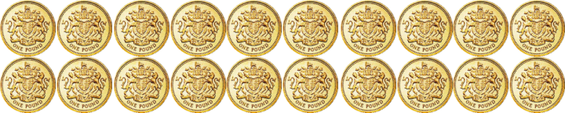

Finding a fraction of an amount
3
What is
of £20?
10
3
of £20
= £20 ÷ 10 × 3
= £6
10
Notes:
When the diagram appears say:
Here is £20.
1/10 of 20 is £2. Click to reveal.
2/10 of £20 is £4. Click to reveal and continue stating the proportion shaded until you reach 7/10 of £20 is £14.

Slide 16
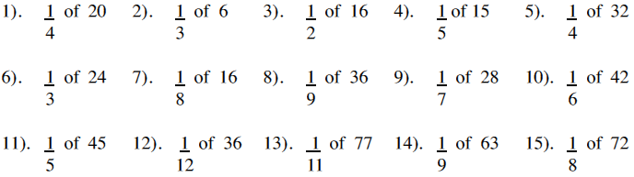
Fractions of an amount
= 5 = 2 = 8 = 3 = 8
= 8 = 2 = 4 = 4 = 7
= 9 = 3 = 7 = 7 = 9

Slide 17
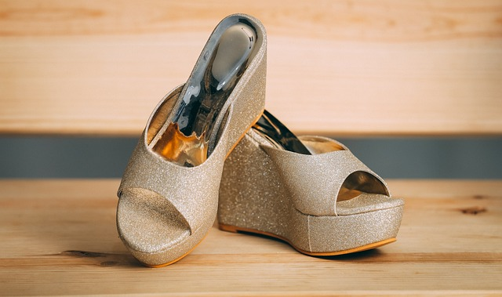
Kiah really wants a new pair of shoes.
Aren’t they fab!!!
Luckily for Kiah there is a 20% off sale.
Her shoes cost £30 originally.
How much do they cost with 20% off?
How much would they be with 35% off?

Slide 18




Liam wants a new outfit for a party.
Luckily for Liam there is a sale and everything is reduced by 15%.
£32
£22
£15
Work out the cost of each item in the sale.
£50
£20

Slide 19

There is a 30% off sale. A shirt costs £25 originally. What’s the new price of the shirt?
Firstly work out 30% of £25.
Then take it off £25.
Alternatively you can do this. £25 x 0.7.
0.7 is the multiplier

Slide 20


WWW/EBI – What can we write?
What topics did you feel confident on?
What do you need to do now?
What topics do you need to work
on/improve?

