Slide 1
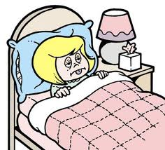
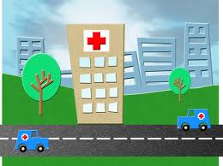

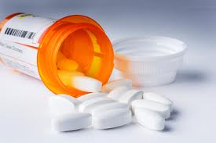
HEALTH

Slide 2
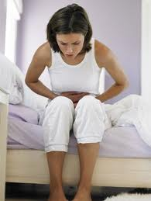
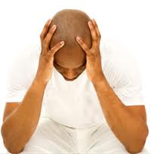
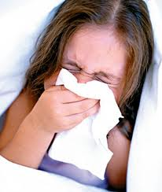
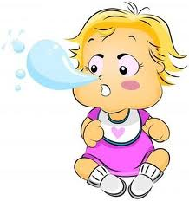
Stomachache
Bellyache
Headache
Flu
Runny nose

Slide 3
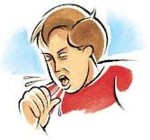
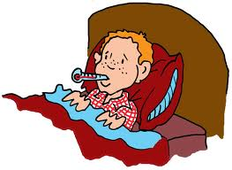
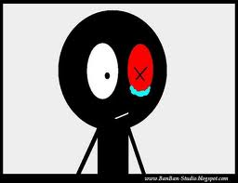
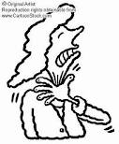
Fever/ Temperature
Cough
Sore throat
Sore eye

Slide 4
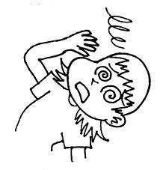
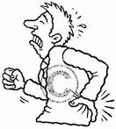
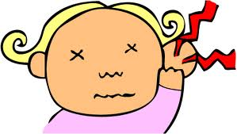
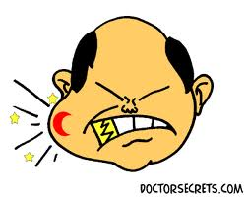
Dizzy
Backache
Earache
Toothache

Slide 5
A headache
A toothache
An earache
A backache
A stomachache/
bellyache
A pain in + N
(my leg/ chest…)
My leg/arm…. hurts (a lot/a bit)
I have

Slide 6
Common misused words
Sickness - general | Disease - serious
Pain - noun – a pain in… | Hurt - noun/verb
Injury - normally in accident | Wound - by sharp weapons
Hurt - verb – to cause pain – physical/mental | Harm - verb – to cause dangerous effects

Slide 7
Symptoms
Illness
A cough, runny nose, sneezing
Dizziness, shivering, headache
Fainting, double vision
High fever, high temperature
Headache, sickness
Rapid heart beat, out of breath
Sickness, stomachache, vomiting
Sore throat, swelling in throat
Spots
Swelling under the ears
Stiff joints
Weak pulse rate, fainting
a. Anaemia
b. The common cold
c. Food poisoning
d. Flu (influenza)
e. High blood pressure
f. Measles
g. Migraine
h. Mumps
i. Pneumonia
k. Rheumatism
l. Shock (mental), a blow (physical)
m. Tonsillitis

