Slide 1

Lesson: Beginning Letters S, M, F

Slide 2
Beginning Letters S, M, F
Objectives
Recognize the letters Ss, Mm, and Ff and their sounds
Name objects beginning with the letters Ss, Mm, and Ff
3. Read aloud words beginning with the letters Ss, Mm, and Ff

Slide 3
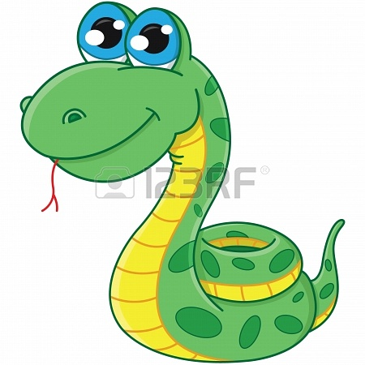
snake

Slide 4
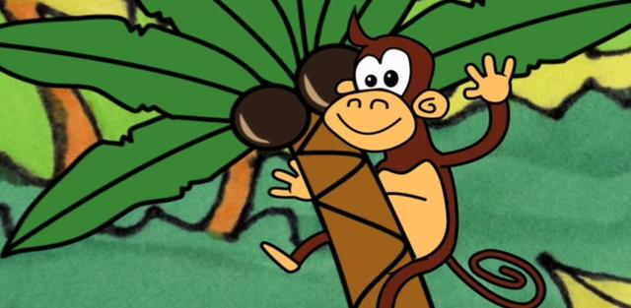
monkey

Slide 5

frog

Slide 6

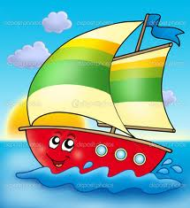

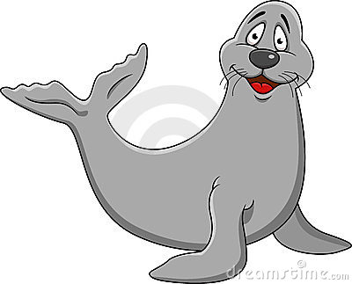



Ss
sun
sailboat
seal
sand
saw
sack

Slide 7




Mm
mailbox
monkey
match
mug
moon

Slide 8

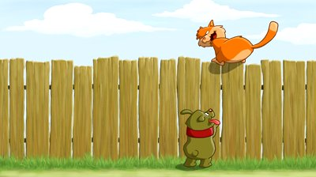
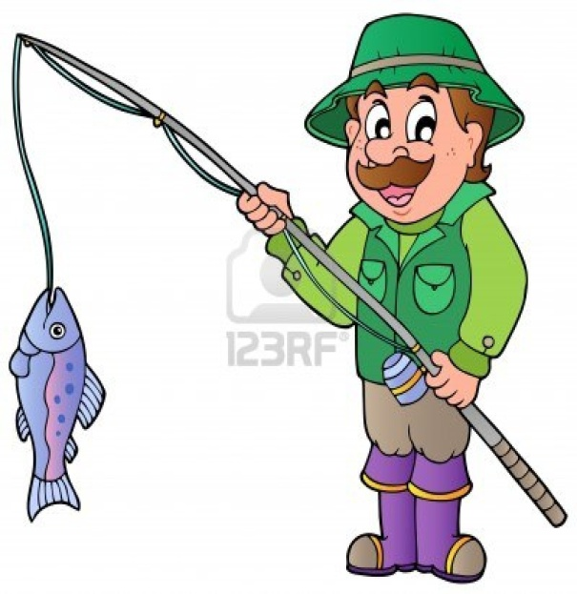


Ff
family
fox
fishing rod
fence
fish
fisherman
fire

Slide 9
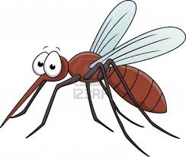
Encircle the letter that gives the beginning sound of the picture
mosquito
s m f

Slide 10
Encircle the letter that gives the beginning sound of the picture
fence
s m f

Slide 11

Encircle the letter that gives the beginning sound of the picture
fireman
s m f

Slide 12

Encircle the letter that gives the beginning sound of the picture
mushroom
s m f

Slide 13
Encircle the letter that gives the beginning sound of the picture
sailboat
s m f

Slide 14
Sun
See
Set
Sam
Sit

Slide 15
Mug
Moon
Man
Mat
Mud

Slide 16
Fish
Fan
Fun
Feet
Fin

