Slide 1
Spanish for kids
GRande v.s. pequeño
www.aimhigheracademic.com (Thany)

Slide 2
instruction
Let children move the jobject to fit the description ‘grande’ and ‘pequeño’
Make it fun and name your character!

Slide 3

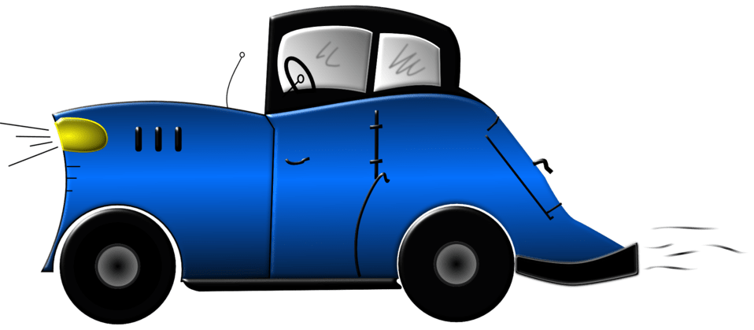
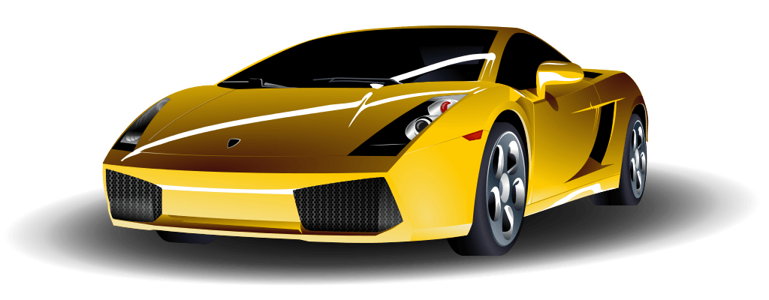
Soy Grande

Slide 4
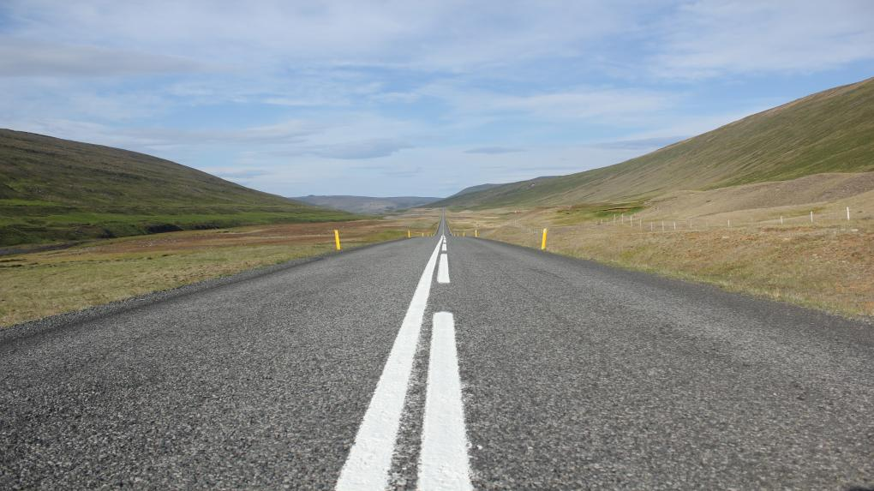

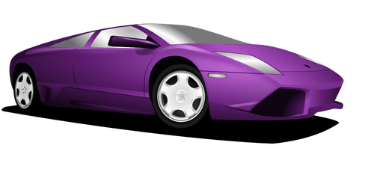
Soy pequeño

Slide 5


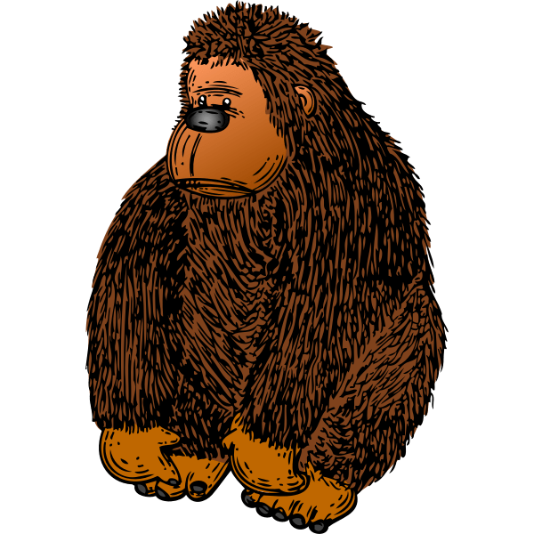
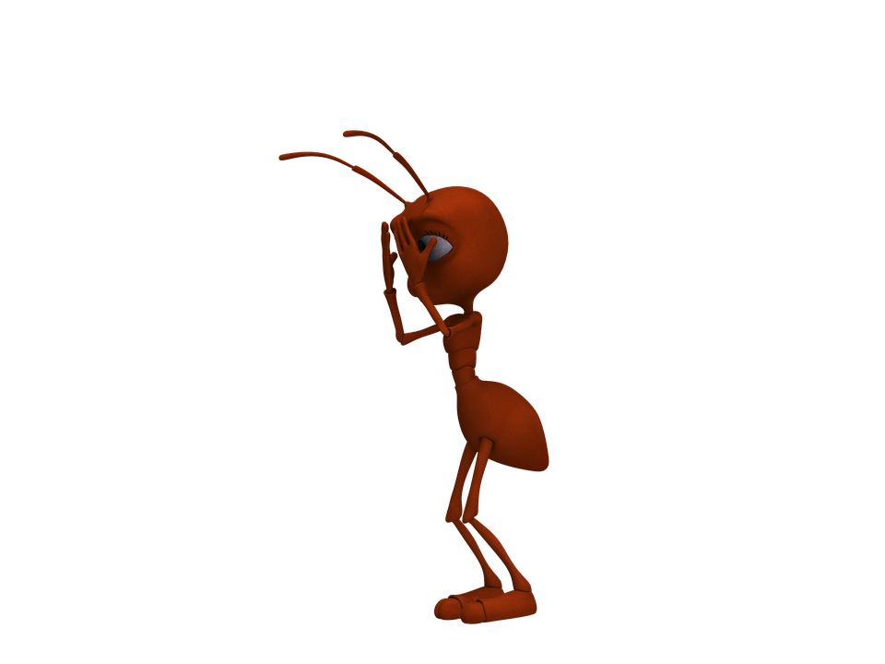


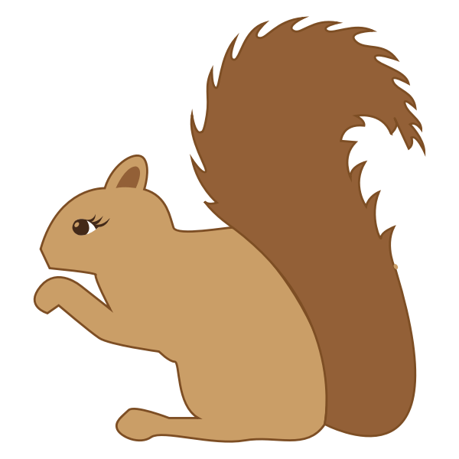

Grande
pequeño

