Slide 1
DIVISION
Year 3 Maths

Slide 2


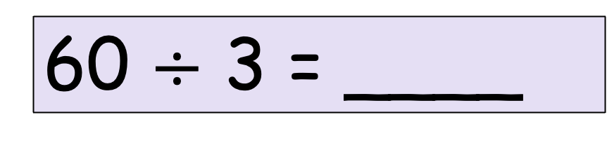
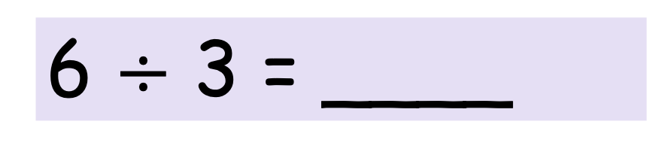
We know that,
6 ones $÷$ 3 = ____ ones
6 $÷$ 3 = ____
and
6 tens $÷$ 3 = ____ tens
60 $÷$ 3 = ____

Slide 3


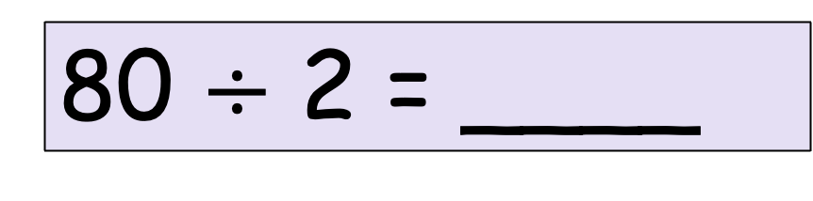

So,
8 ones $÷$ 2 = ____ ones
8 $÷$ 2 = ____
and
8 tens $÷$ 2 = ____ tens
80 $÷$ 2 = ____

Slide 4
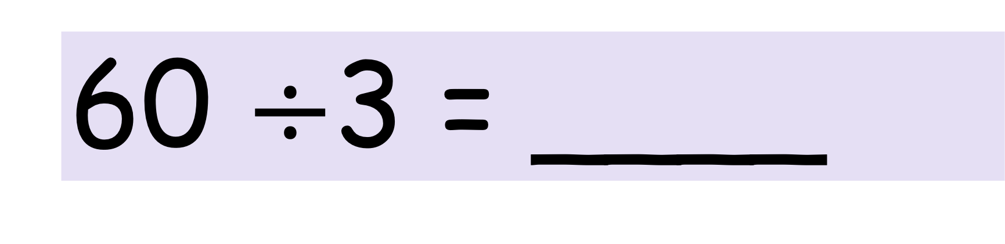
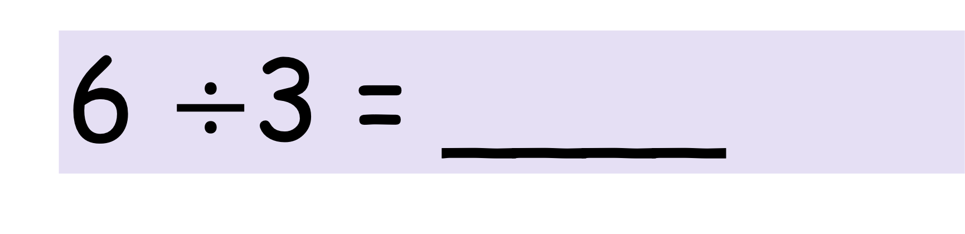
So,
6 $÷$3 = ____
60 $÷$3 = ____

Slide 5
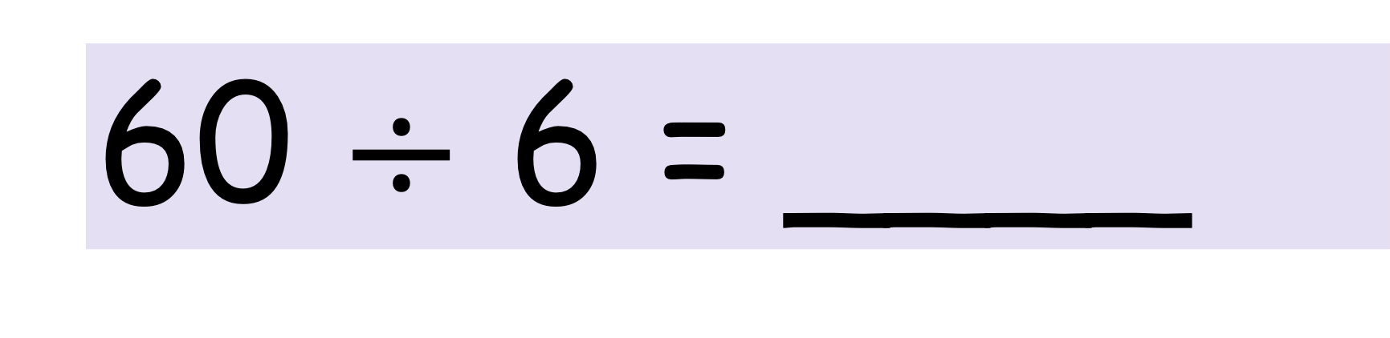
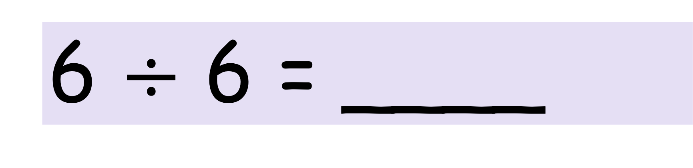
So,
6 $÷$ 6 = ____
60 $÷$ 6 = ____

Slide 6
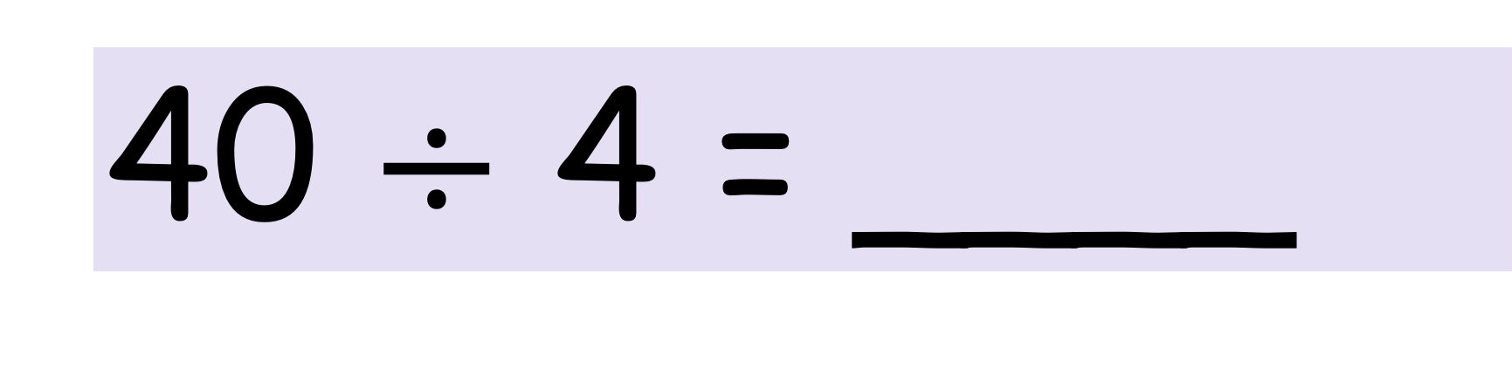
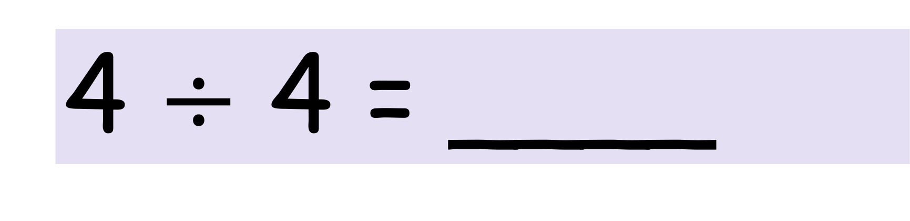
So,
4 $÷$ 4 = ____
40 $÷$ 4 = ____

Slide 7
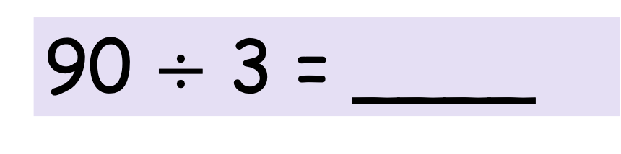
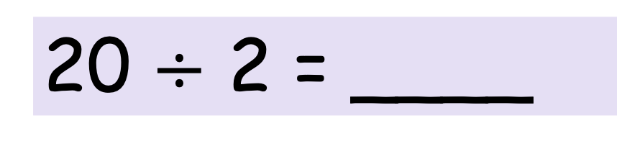
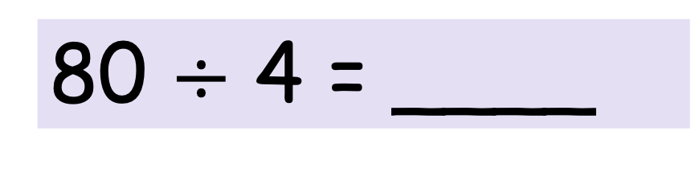
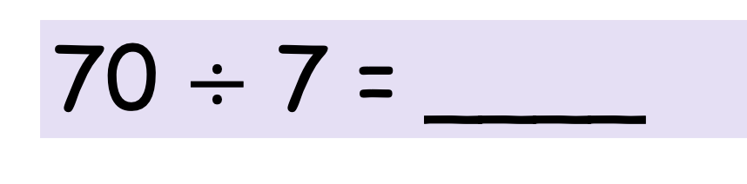


Workout the divisions
80 $÷$ 4 = ____
50 $÷$ 5 = ____
90 $÷$ 3 = ____
70 $÷$ 7 = ____
60 $÷$ 3 = ____
20 $÷$ 2 = ____

Slide 8
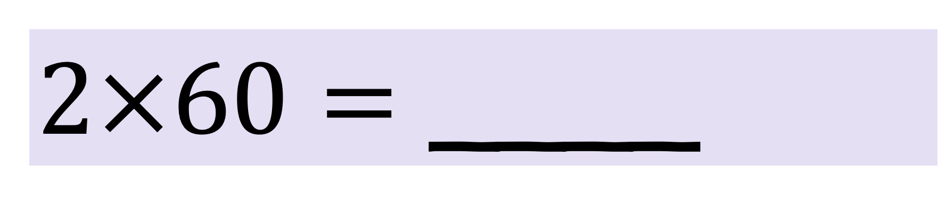
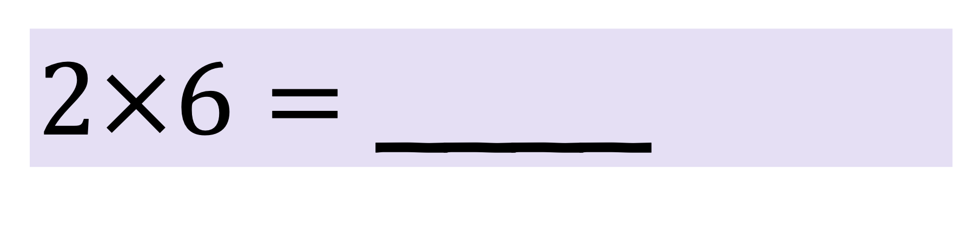
Find the missing numbers
$2×6=$ ____
$2×60=$ ____

Slide 9
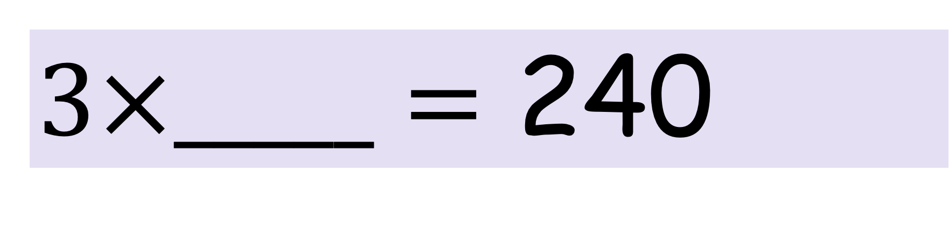
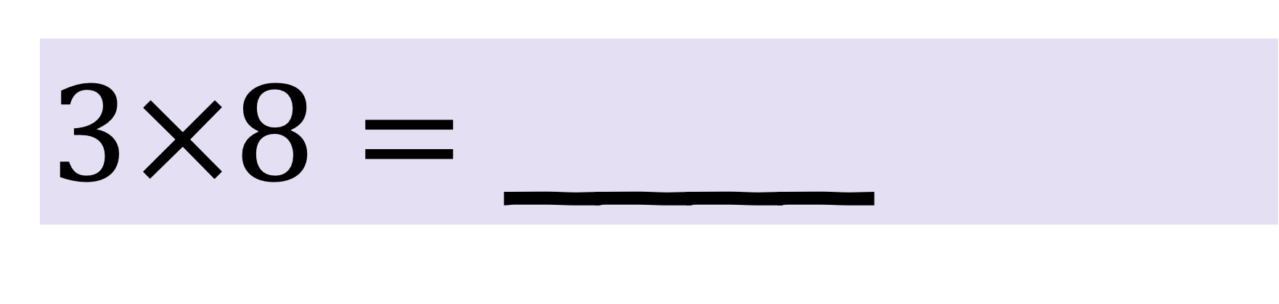
Find the missing numbers
$3×8=$ ____
$3×_____=$ 240

Slide 10
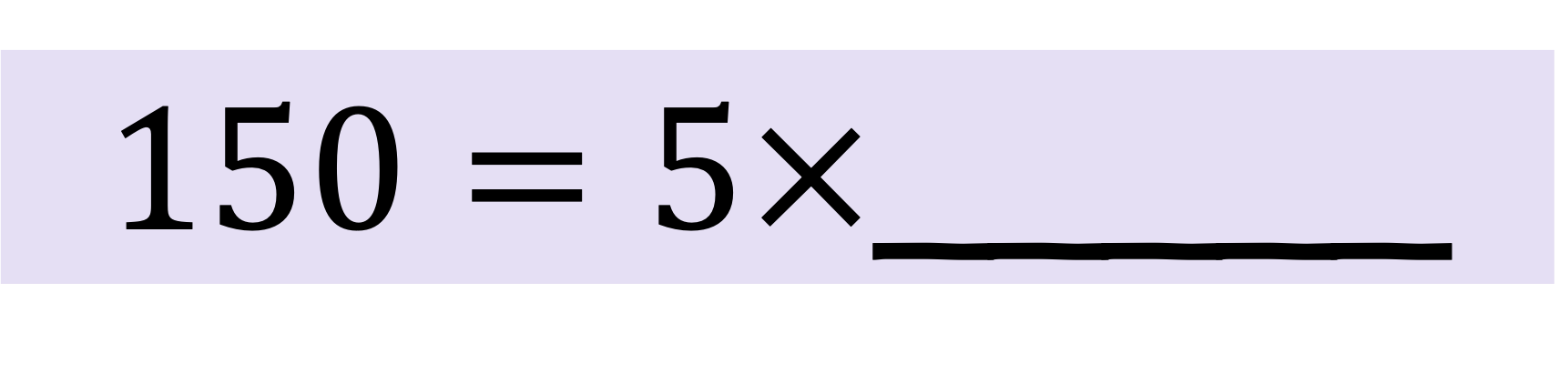
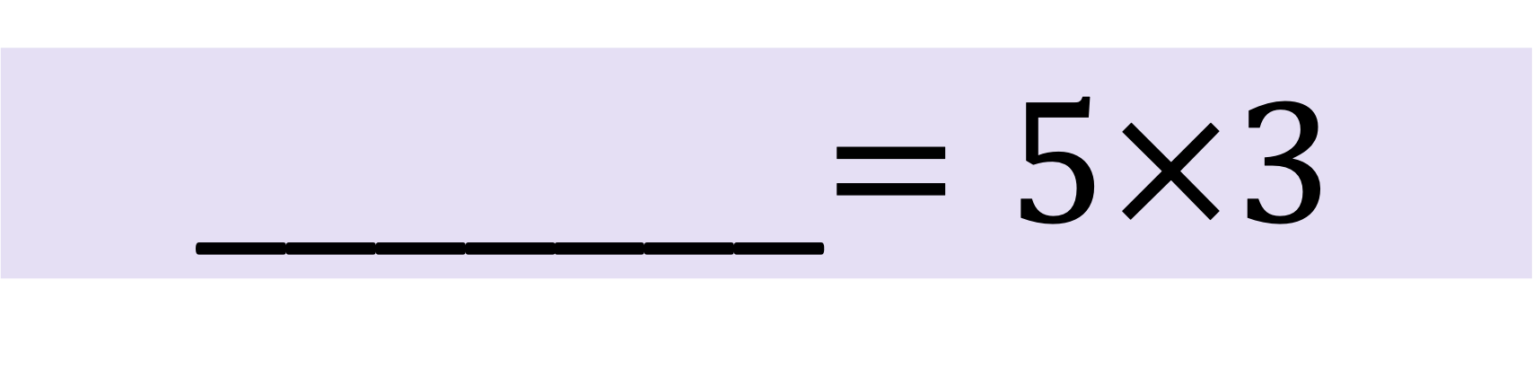
Find the missing numbers
_______$=5×3$
$150=5×$_____

Slide 11
Find the missing numbers

Slide 12
Word Problems:
1 ticket to the zoo costs £20.
How much do 4 tickets cost?
How many tickets you can buy for £180??

Slide 13
Word Problems:
There are 80 children in Year 3
The children are put in pairs. How many pairs are there altogether?

Slide 14
Reasoning and Problem Solving (Multiplication and Division)
Eight friends go to a theme park for the day.
  Ticket to the theme park cost £20 each.
  Lunch costs £10 each.
Four of the friends share the cost between them.
How much do they each pay?

Slide 15
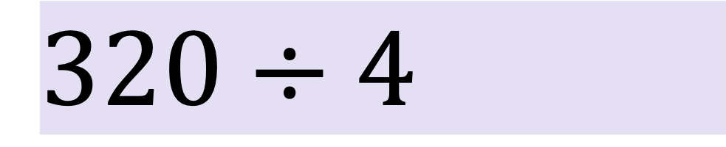
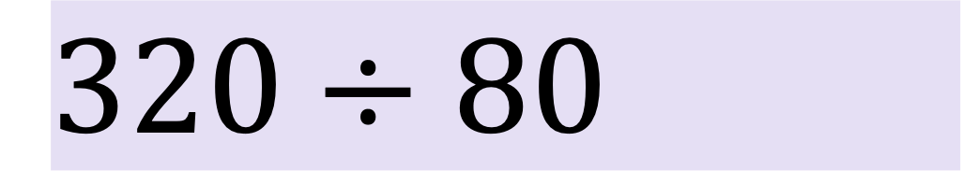
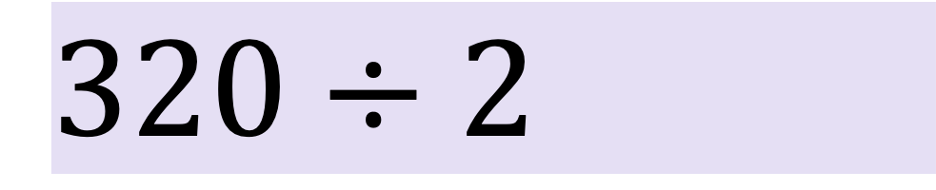
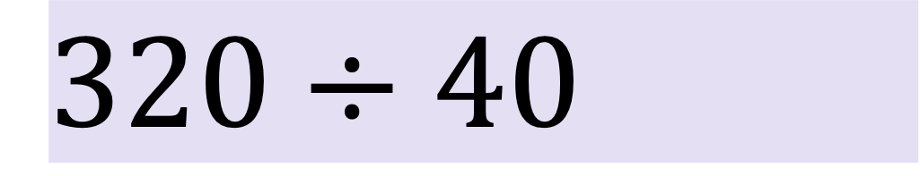
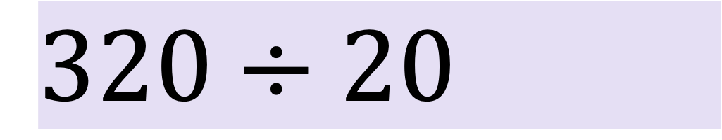
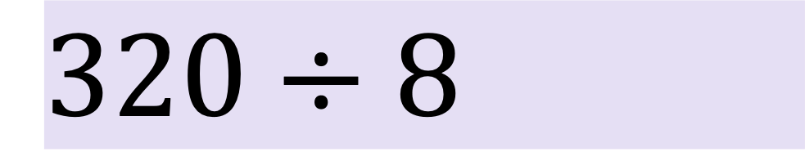
Reasoning and Problem Solving (Multiplication and Division)
Work out the divisions.
$$320÷2$$
$$320÷20$$
$$320÷4$$
$$320÷40$$
$$320÷8$$
$$320÷80$$
What do you notice?

Slide 16

Reasoning and Problem Solving (Multiplication and Division)
Write $<,>$ or $=$ to compare the statements.
$$8÷2$$ |  | $$80÷2$$
$$80÷2$$ |  | $$80÷4$$
$$60×3$$ |  | $$60÷3$$
$$4×8$$ |  | $$8×40$$

Slide 17
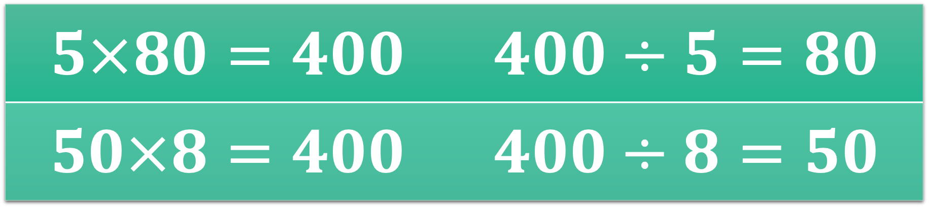
Reasoning and Problem Solving (Multiplication and Division)
Related calculations
$$5×8=40$$
Which facts are correct?
$$5×80=400$$ | $$400÷5=80$$
$$50×8=400$$ | $$400÷8=50$$

Slide 18
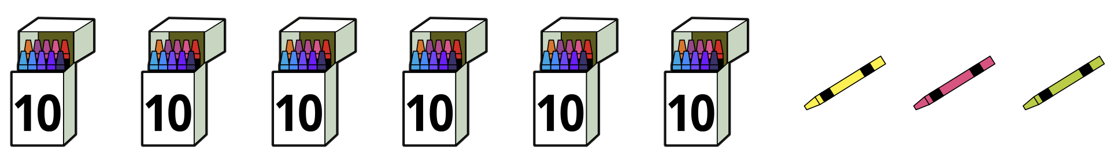
Divide 2-digit number by a 1-digit number – no exchange
There are 63 crayons.
Share the crayons into three equal groups.
Use a place value chart or some counters to help you.

Slide 19

Divide 2-digit number by a 1-digit number – no exchange
Complete the sentences
$$6 tens÷3= ___________tens$$
$$3 ones÷3= ___________one$$
$$63÷3= ___________$$

Slide 20

Divide 2-digit number by a 1-digit number – no exchange
Complete the sentences
$$8 tens÷4= ___________tens$$
$$8 ones÷4= ___________one$$
$$88÷4= ___________$$

Slide 21

Divide 2-digit number by a 1-digit number – no exchange
Complete the sentences
$$6 tens÷2= ___________tens$$
$$8 ones÷2= ___________one$$
$$68÷2= ___________$$

Slide 22

Divide 2-digit number by a 1-digit number – no exchange
Use a place value chart to work out $39÷3$.
Tens | Ones
$$39÷3=________$$

Slide 23

Divide 2-digit number by a 1-digit number – no exchange
Tens | Ones
$$84÷4=________$$

Slide 24

Divide 2-digit number by a 1-digit number – no exchange
Tens | Ones
$$66÷2=________$$

Slide 25

Divide 2-digit number by a 1-digit number – no exchange
Tens | Ones
$$66÷3=________$$

Slide 26

Divide 2-digit number by a 1-digit number – no exchange
Tens | Ones
$$69÷3=________$$

Slide 27



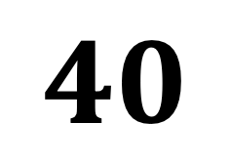
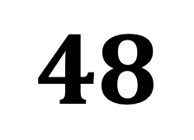

Divide 2-digit number by a 1-digit number – no exchange (using part-whole model)
$$48÷4=________$$
$$48$$
$$40$$
$$8$$
$$÷4$$
$$÷4$$

Slide 28


Work out the divisions.
$$96÷3=________$$
$$64÷2=________$$

Slide 29


Work out the divisions.
$$64÷2=________$$
$$88÷4=________$$

Slide 30
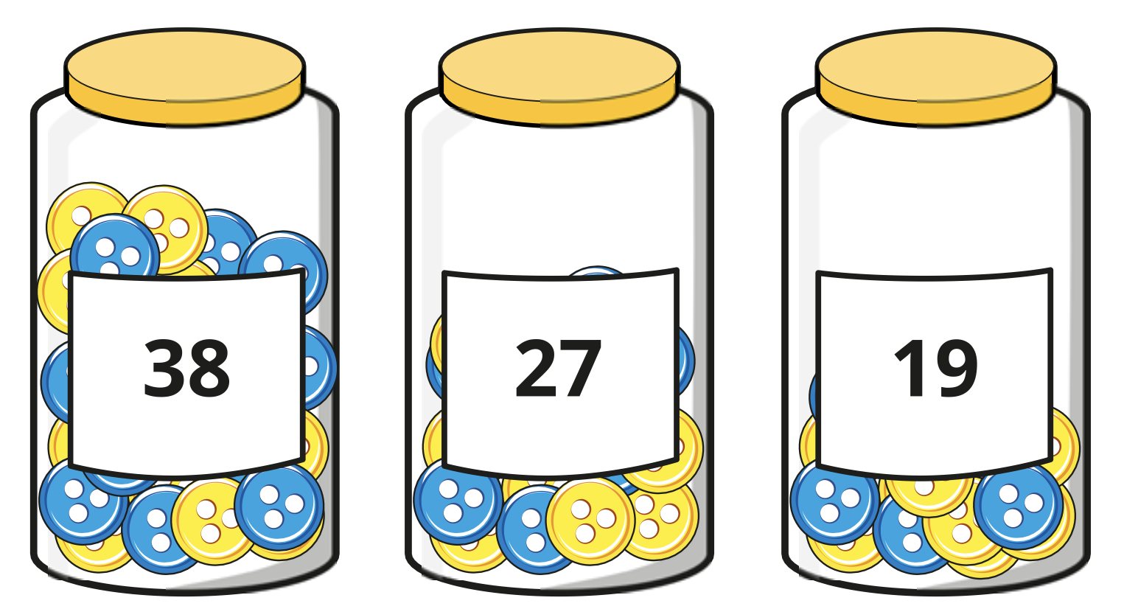
REASONING AND PROBLEM SOLVING
Tommy has 3 jars of buttons.
He shares all the buttons equally between 4 people.
How many buttons will each person get?

