Slide 1

Now let’s talk about the special names for different triangles!
Let’s play a game!

Slide 2
Can you name this triangle?
This triangle has all 3 sides at equal lengths.
All 3 of its angles are 60 degrees.
a) Scalene
b) Equilateral

Slide 3
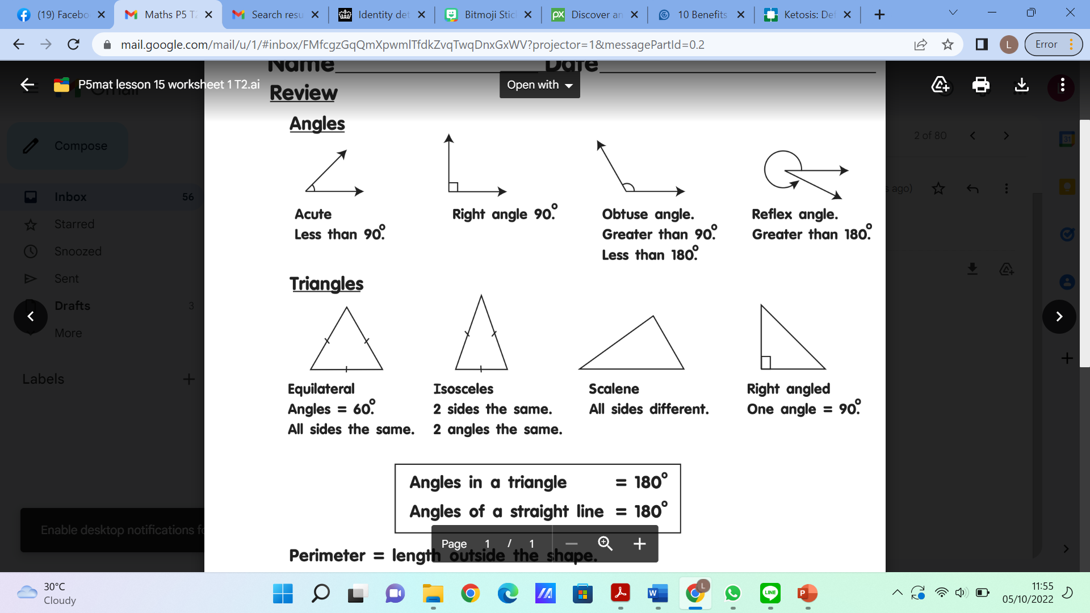

Slide 4
Can you name this triangle?
This triangle has all 3 sides at different lengths.
All 3 of its angles are different.
a) Scalene
b) Right-angle triangle

Slide 6
Can you name this triangle?
This triangle has 2 sides at the same length, and one with a different length.
Two of its angles are the same, and the other is different.
a) Isosceles
b) Equilateral

Slide 8
Can you name this triangle?
This triangle has one angle that is always 90 degrees.
a) Scalene
b) Right angled triangle

Slide 10


