Slide 1

Mathematics Teaching
Equations of straight
line
SINGH KARNDEEP

Slide 2

01
The equation
Let’s try to build an equation ourselves!

Slide 3

Introduction
Let say you are a YouTuber. At this moment,
you have 0 subscribers. Every 20 days, you
gain 20 subscribers. How many subscribers
would you have in the coming 60 days?
Days
0
20
40
60
Subscribers

Slide 4
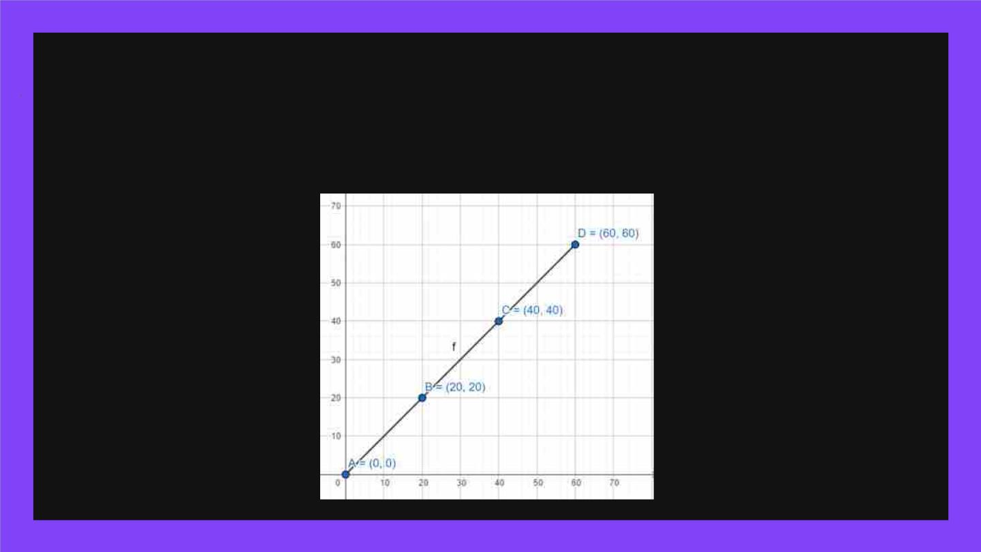
Representing your idea graphically
Can we express the number of subscriber in a regular coordinate plane? If yes,
try to plot a line!

Slide 5

Introduction
Let’s say your friend Tommy has 100
subscribers. YouTube found that he bought
subscribers and he loses 20 subscribers
every 20 days. How many subscribers
would he have after 60 days?
Days
0
20
40
60
Subscribers

Slide 6
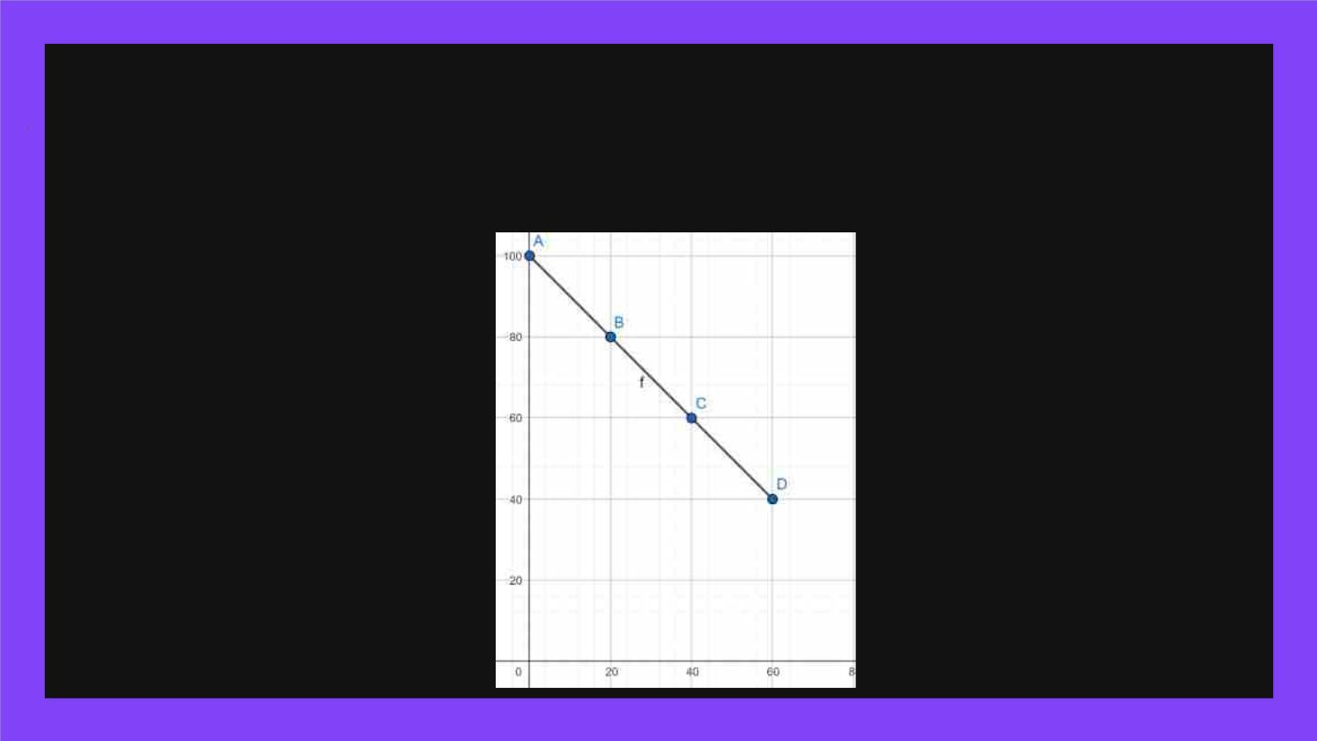
Representing your idea graphically
Can we express the number of subscriber in a regular coordinate plane? If yes,
try to plot a line!

Slide 7
Introduction
Chris and Tommy created a channel
together. Now, their channel has 10000
subscribers. However, the subscriber count
remains unchanged. How many subscribers
would he have in the coming 60 days?
Days
0
20
40
60
Subscribers

Slide 8
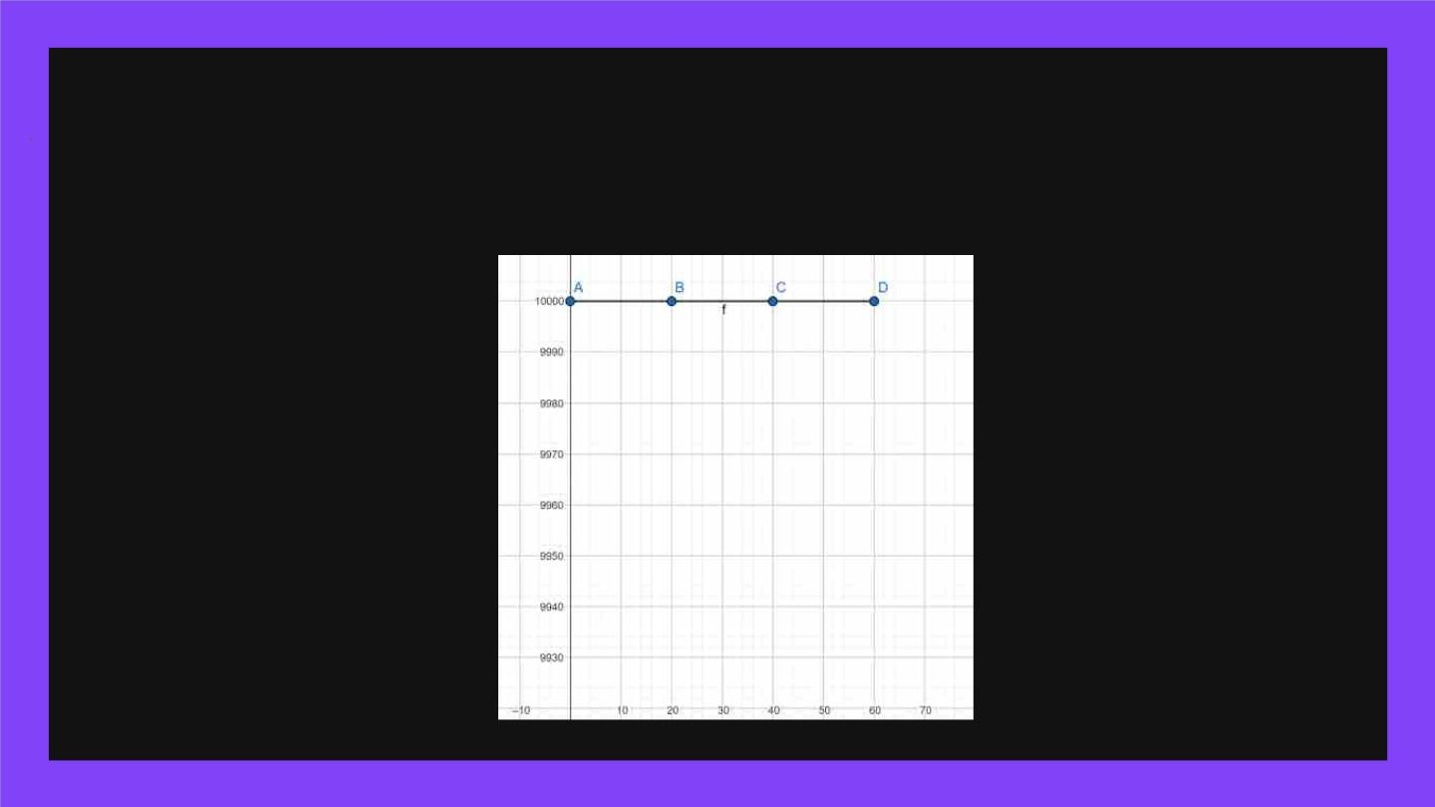
Representing your idea graphically
Can we express the number of subscriber in a regular coordinate plane? If yes,
try to plot a line!

Slide 9
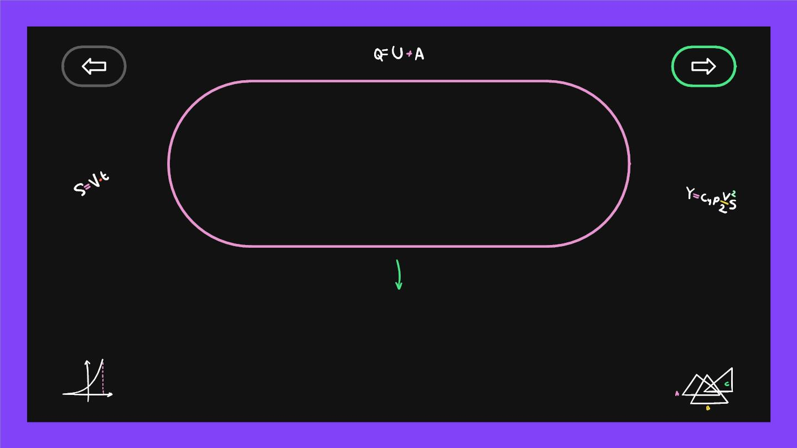
The y and the x
intercept
The y-axis is the vertical plane and the x-axis is
the horizontal plane.

Slide 10

The similarities
The y-
The x-axis is always
the amount of days.
The
slope
axis
The y-axis is always
the amount of
subscribers.
The x-
axis
The slope shows if
something is increasing,
decreasing or constant.

Slide 11

The slope
Steepness
Vertical Distance
Recall
Horizontal Distance
Vertical Distance
= Slope
Horizontal Distance

Slide 12

Graphical Representation
The rate at which you
gain subscribers, in
subscribers per day.
The initial number of
subscribers you had when
you started your channel.
Y = mx + b
The total number of
The number of days since
subscribers after x days. you started your YouTube
channel.

Slide 13

Graphical Representation
Let say you are a YouTuber. At
this moment, you have 0
subscribers. Every 20 days, you
gain 20 subscribers. How many
subscribers would you have in
the coming 60 days?
The rate at which
you gain subscribers,
in subscribers per
day.
The initial number of
subscribers you had
when you started your
channel.
Y = (20/20)x + 0
Day
0
20
40
60
Subscribers
The number of days
since you started your
YouTube channel.
The total number of
subscribers after x days.

Slide 14
Graphical Representation
Let’s say your friend Tommy has
The rate at which
you gain subscribers,
in subscribers per
day.
The initial number of
100 subscribers. YouTube found
that he bought subscribers and
he loses 20 subscribers every 20
days. How many subscribers
would he have after 60 days?
subscribers you had
when you started your
channel.
Y = (-20/20)x + 100
Month
0
20
40
60
Subscribers
The number of days
since YouTube started
deleting his subscribers.
The total number of
subscribers after x days.

Slide 15

Graphical Representation
Chris and Tommy created a
channel together. Now, their
channel has 10000 subscribers.
However, the subscriber count
remains unchanged. How many
subscribers would he have in the
coming 60 days?
The rate at which
you gain subscribers,
in subscribers per
day.
The initial number of
subscribers you had
when you started your
channel.
Y = (0)x + 10000
Month
0
20
40
60
Subscribers
The number of days since you
started your YouTube
channel.
The total number of
subscribers after x days.

Slide 16

Vertical Lines
X = h
To understand x = h, let’s
graph it on GeoGebra

Slide 17
Vertical Lines
X = h
The x-coordinate always
remains the same!

Slide 18
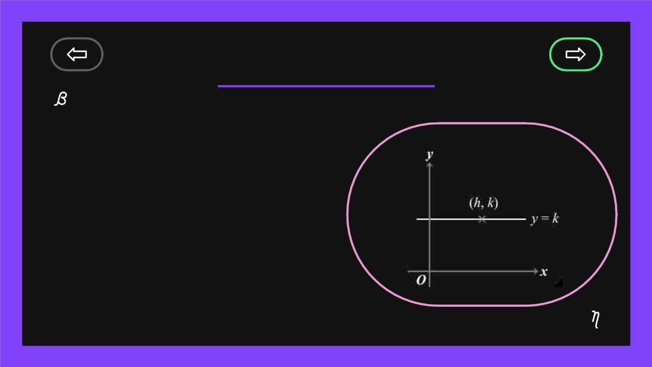
Horizontal Lines
Y = k
To understand y = k, we
can also try to graph it on
GeoGebra

Slide 19
Horizontal Lines
Y = k
The y-coordinate always
remains the same!

Slide 20
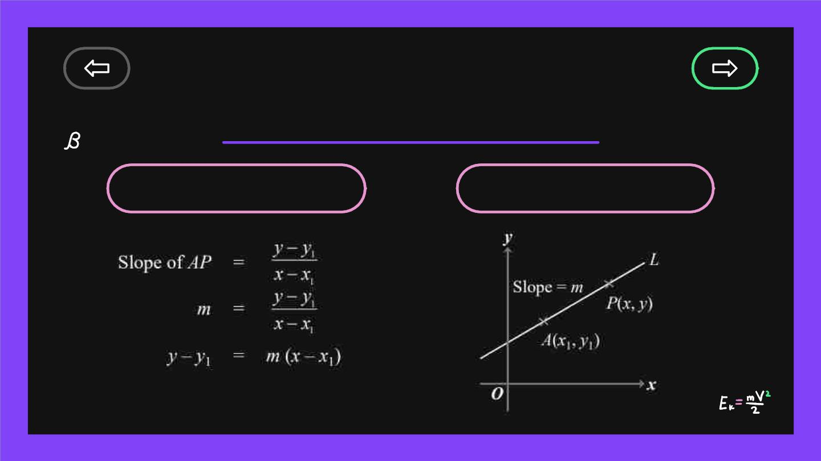
Learning Equations
of a straight line
+
A point
The slope
point-slope form

Slide 21

Example
Equation of the straight line:
y – (–2) = –1 (x – 3)
y + 2 = –x + 3
y = –x + 1
Letting the students
try to imagine what
it would look like!

Slide 22
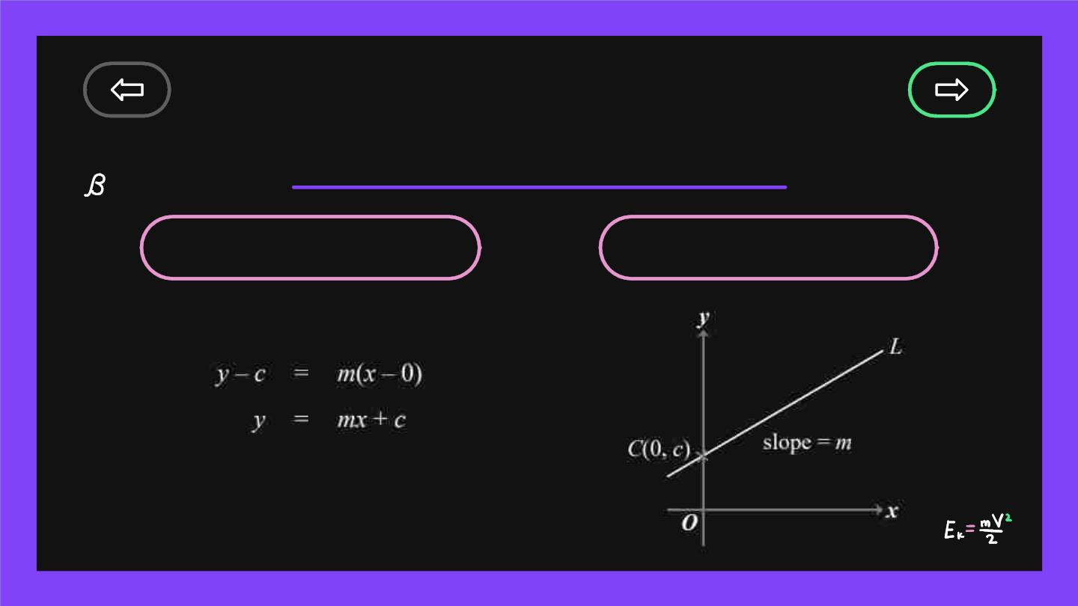
Learning Equations
of a straight line
+
y-intercept
The slope
Slope-intercept form

Slide 23
Example
Find the equation of the
straight line with y-intercept
5 and slope 3.
ANS: y = 3x + 5

Slide 24
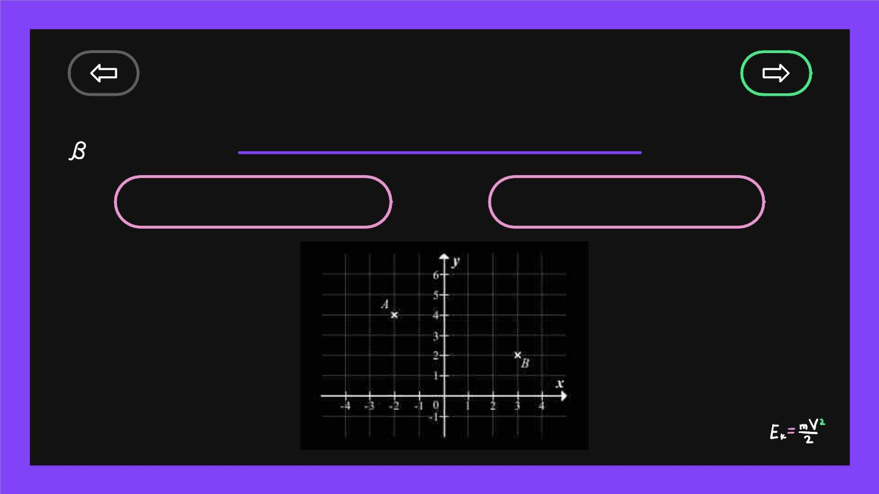
Learning Equations
of a straight line
+
Point A
Point B
A(-2,4)
B(3,2)

Slide 25
Step-by-step
To find the equation of a
straight line, we need:
i) a y-intercept + the slope; OR
ii) a point + the slope

Slide 26

Step-by-step
In this question we only have 2
points!
A(-2,4)
B(3,2)
Let’s draw some
lines

Slide 27
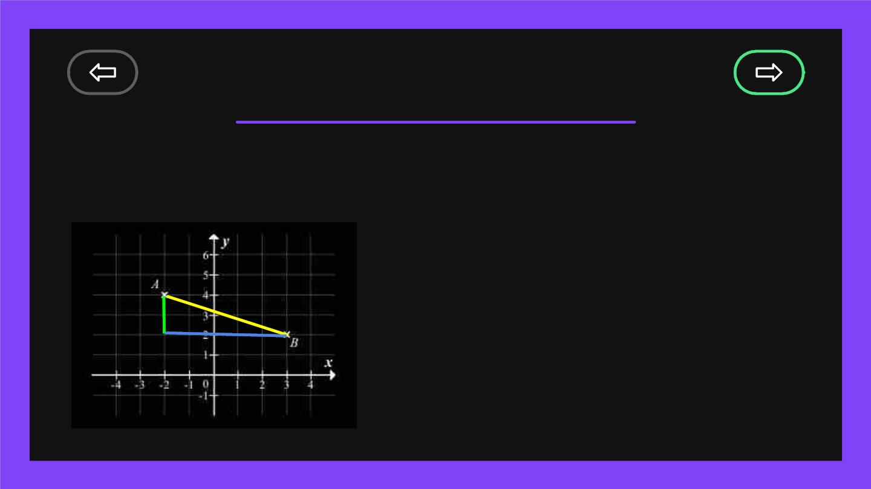
Step-by-step
In this question we only have 2
points!
A(-2,4)
Can we find the
slope?
B(3,2)

Slide 28
Step-by-step
The slope can be found as follows:
Slope:
4-2 2
-2-3 5
Slope:
A(-2,4)
___ _ 2-4
2
5
B(3,2)
____
=
-
-–
=
3-(-2)

Slide 29
Step-by-step
Now we have the follow conditions:
Slope: -2
A(-2,4)
Point A: A(-2,4)
Point B: B(3,2)
B(3,2)

Slide 30

Recall
To find the equation of a
straight line, we need:
i) a y-intercept + the slope; OR
ii) a point + the slope
We fit this
criterion

Slide 31
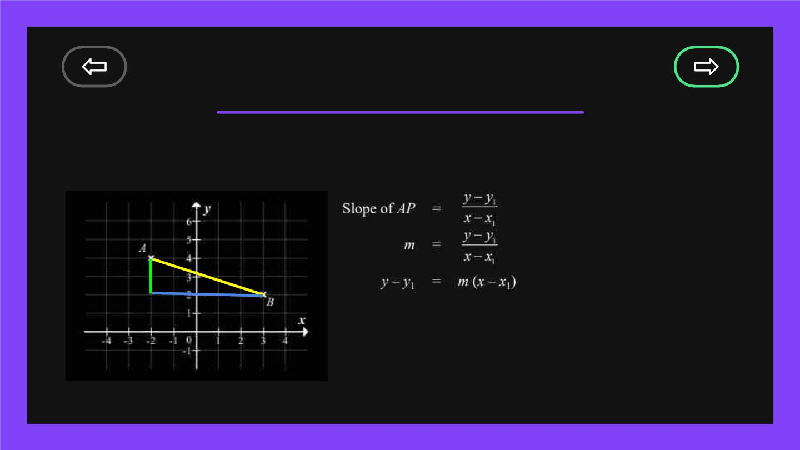
Step-by-step
Let’s find the equation!
Slope: -2/5
Point A: A(-2,4)
Point B: B(3,2)
A(-2,4)
B(3,2)
y - 2 = (-⅖)(x-3)
y -2 = -(⅖)x + 6/5
y = -(⅖)x + 3(⅕)

Slide 32
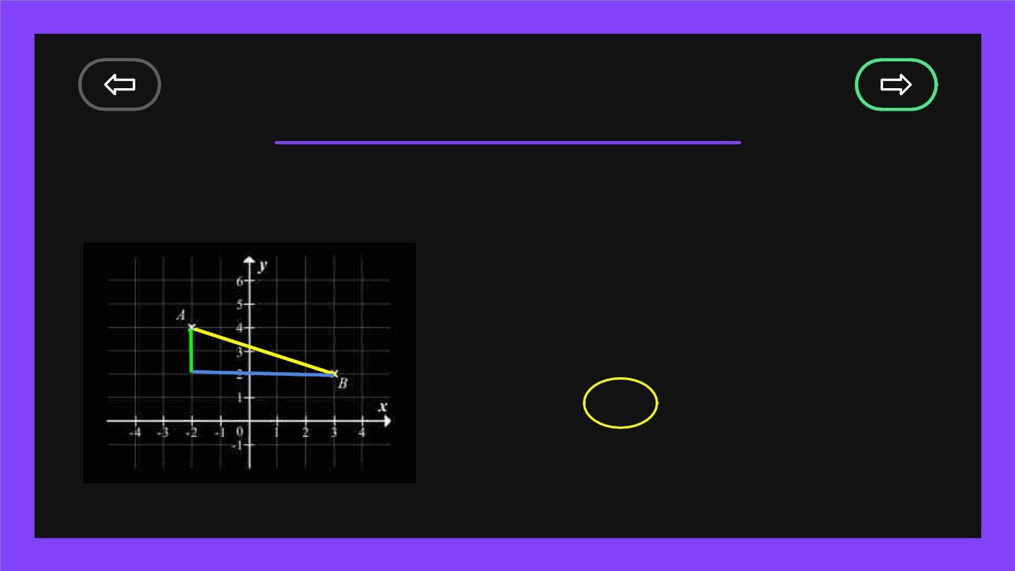
Step-by-step
Notice something?
A(-2,4)
y - 2 = (-⅖)(x-3)
y -2 = -(⅖)x + 6/5
y = -(⅖)x + 3(⅕)
B(3,2)
Downward sloping slope

Slide 33
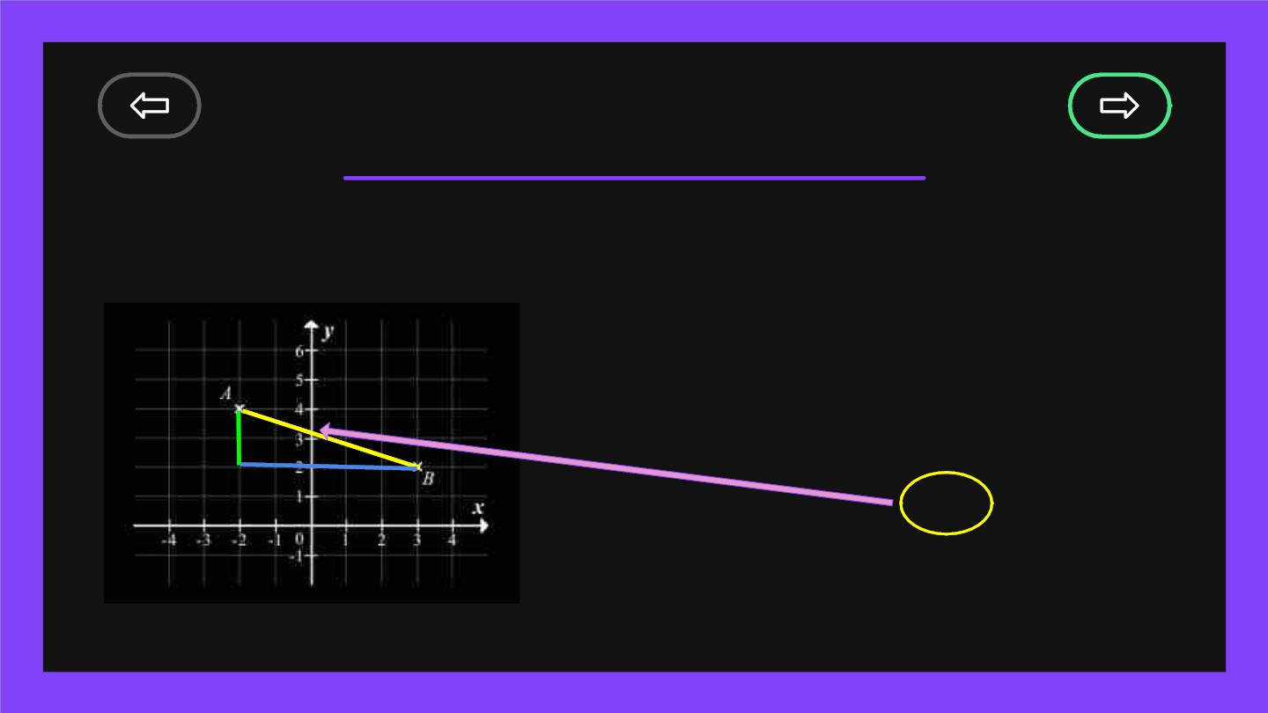
Step-by-step
Notice something?
A(-2,4)
y - 2 = (-⅖)(x-3)
y -2 = -(⅖)x + 6/5
y = -(⅖)x + 3(⅕)
B(3,2)
The y-intercept

Slide 34

Follow-up lessons
Finding x-
coordinate
of a point
with only the
y-coordinate,
vice versa.
Finding the
intersection
of two
Parallel Lines
How to check if two
straight lines are
parallel?
straight
lines.

