Slide 1
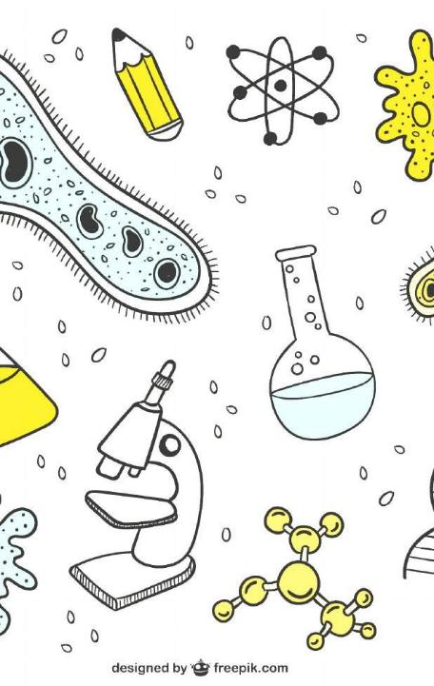
INTRODUCTION TO BIOLOGY AND CELL BIOLOGY

Slide 2

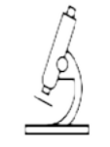
Learn biology
Biology
with
Fozia
Scientific study of life
Present era is most exciting in biology
Scientists are trying to solve biological puzzles like:
How a single microscopic cell develops into complex animals and plants?
How plants convert solar energy to chemical energy of food?
How human mind works?
How various forms of diverse life on earth evolve from first microbe?

Slide 3
Biology
Learn
biology
with
Fozia
Evolution makes sense of the knowledge we have about living organisms
Organisms living on Earth are modified descendants of the common
ancestors
Biology is a quest, on ongoing inquiry about the nature of life
Modern biology is as important as it is inspiring
Research breakthroughs in genetics and cell biology are transforming medicine and agriculture
Molecular biology is providing new tools to anthropology and criminal science(Forensics)
Neuroscience and evolutionary biology are reshaping psychology and sociology
New models in ecology are helping societies to evaluate environmental issues i-e. causes and biological consequence of global warming
That’s how biology weaves into the fabric of our culture more than before.
This is a better time to explore life

Slide 4
Learn biology with
Biotechnology
Fozia
Biotechnology is the use of new techniques in biology for the betterment of humanity
Use of biotechnology to study biology is the well adapted from the beginning.
Now molecular biological techniques have brought revolution in the science of biology
21st century is known the century of biotechnology.
With the help of high throughput most advanced techniques scientists are exploring many unknown phenomenon of life such as; memory, regeneration of brain cell, stem cell technology, gene therapy, evolution and many more.

Slide 5
Biological Hierarchy
Learn
biology
with
Fozia
New properties emerge at each level in the biological hierarchy
Life can be studied at different levels from atoms and molecules to the entire living planet
The study of life can be divided into different levels of biological organization

Slide 6
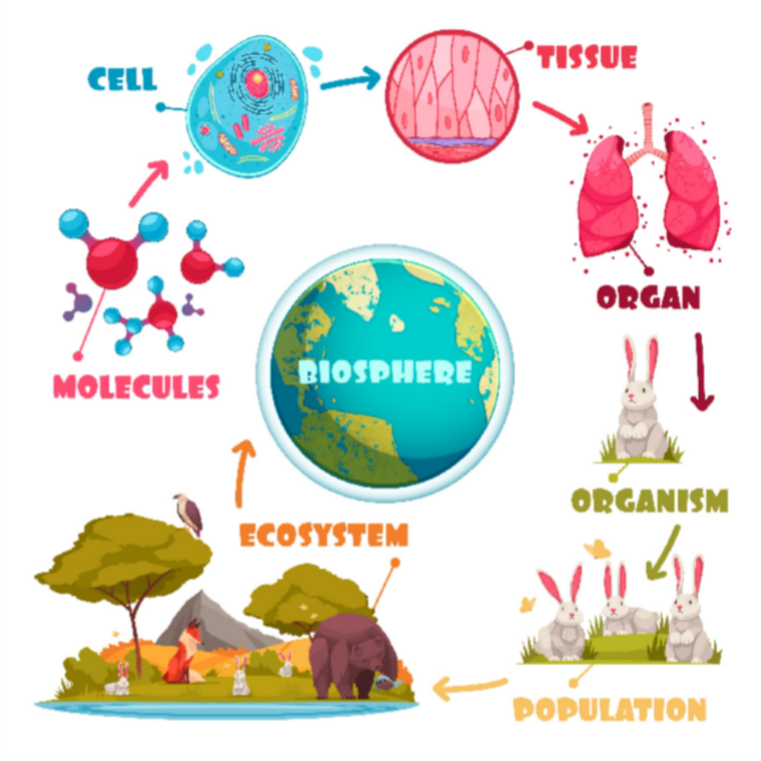
Biological Hierarchy
Learn
biology
with
Fozia
Designed by Freepik.com

Slide 7
Cell
Learn
biology
with
Fozia
Cell is fundamental unit to biology as atom is to chemistry
All organisms are made of cells.
In the hierarchy of biological organization, the cell is the simplest collection of matter that can live.
Single celled organisms are of diverse form
Complex organisms: Plants and animals are multicellular;
  Have many kinds of specialized cells
  These cells can be survived on their own
  Tissues and organs can not survive on their own either.
Cell is a basic unit of structure and function.

Slide 8
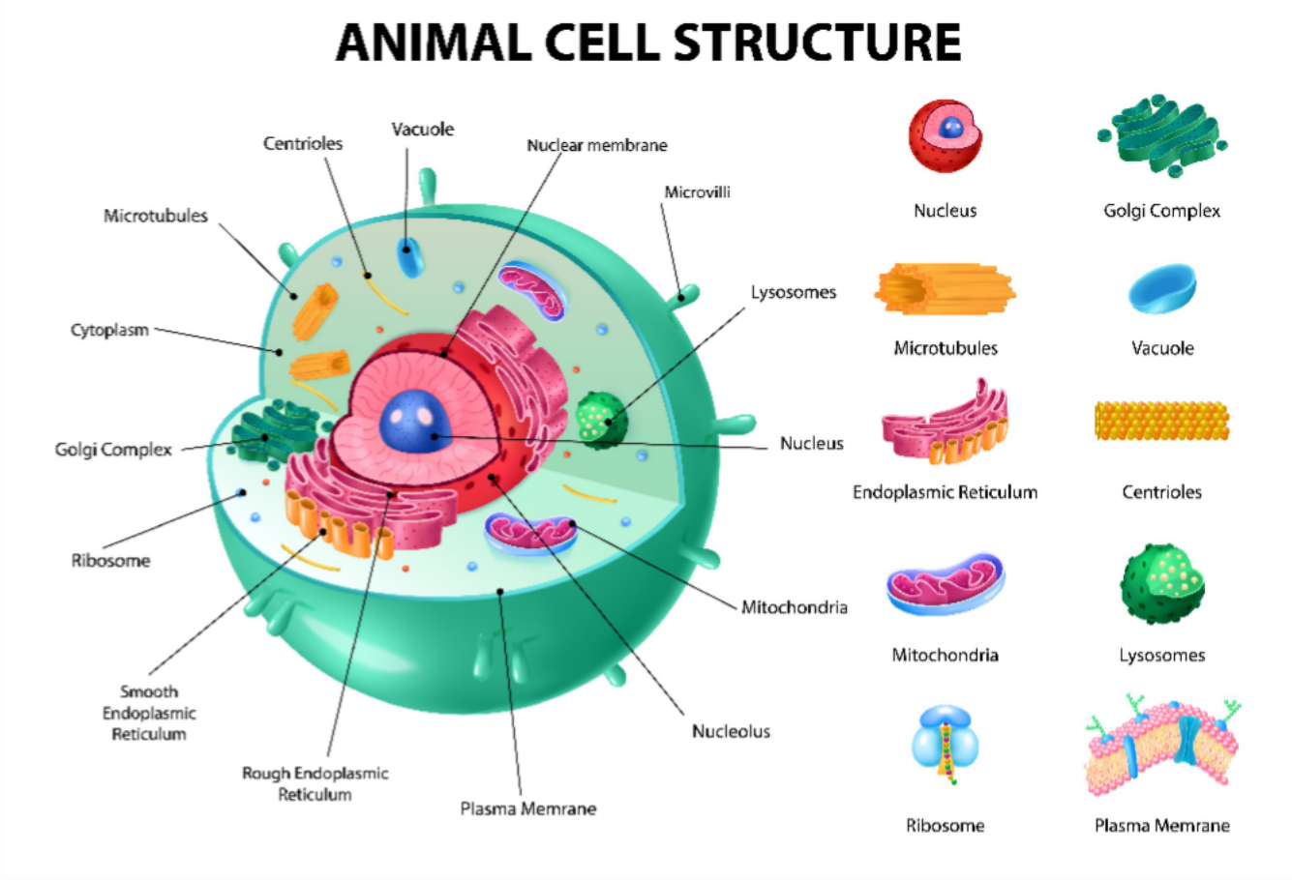
Animal
Learn
Cell
biology
with
Fozia
Designed by Freepik.com

Slide 9
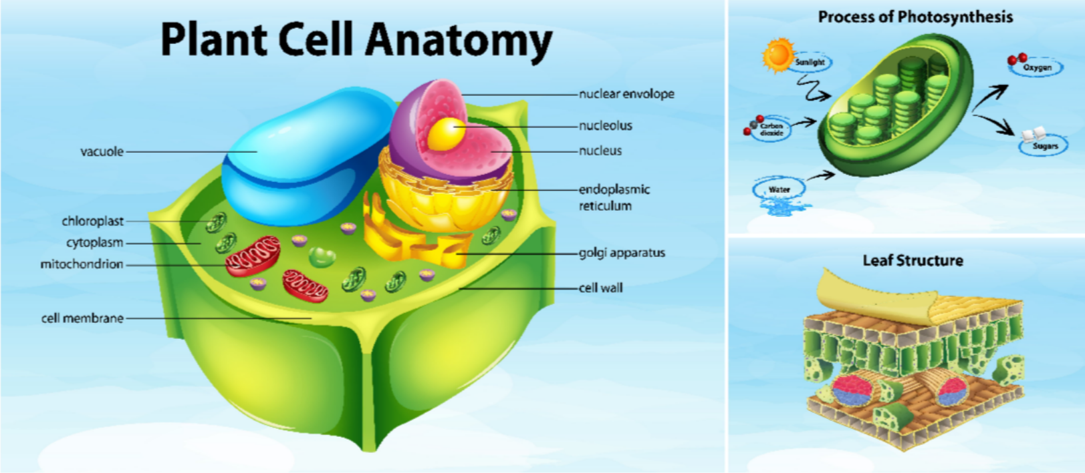
Plant Cell
Learn
biology
with
Fozia
Designed by Freepik.com

Slide 10
History of Cell Biology
Learn
biology
with
Fozia
The word cell comes from the Latin cella, meaning "small room”. The cell was discovered after the invention of microscope.
Hans and Zacharias Janssen: Dutch lens grinders, father and son invented first compound microscope (2 lenses).
Robert Hooke (1665) : English scientist published in his book Micrographia that a thin slice of cork (oak cork) observed through a compound microscope has tiny, hollow, room like structures called these structures 'cells' because they reminded him of the rooms that monks lived in.

Slide 11
History of Cell Biology
Learn
biology
with
Fozia
Cells emerged on Earth at least 3.5 billion years ago.
Anton van Leeuwenhoek, Dutch fabric merchant and amateur scientist looked at blood, rainwater, scrapings from teeth through a simple microscope (1 lens) observed living cells; called 'animalcules‘ some of the small 'animalcules' are now called bacteria
Matthias Schleiden (1838)
German botanist viewed parts of the plant under a microscope and discovered the plant cells
Theodor Schwann (1839)
German zoologist viewed parts of the animal under a microscope and discovered animal cells
Rudolph Virchow (1855)
German physician stated that all living cells come only from other living cells

Slide 12
Learn biology with Fozia
THANKS

