Slide 1
HYPOTHESIS TESTING

Slide 2
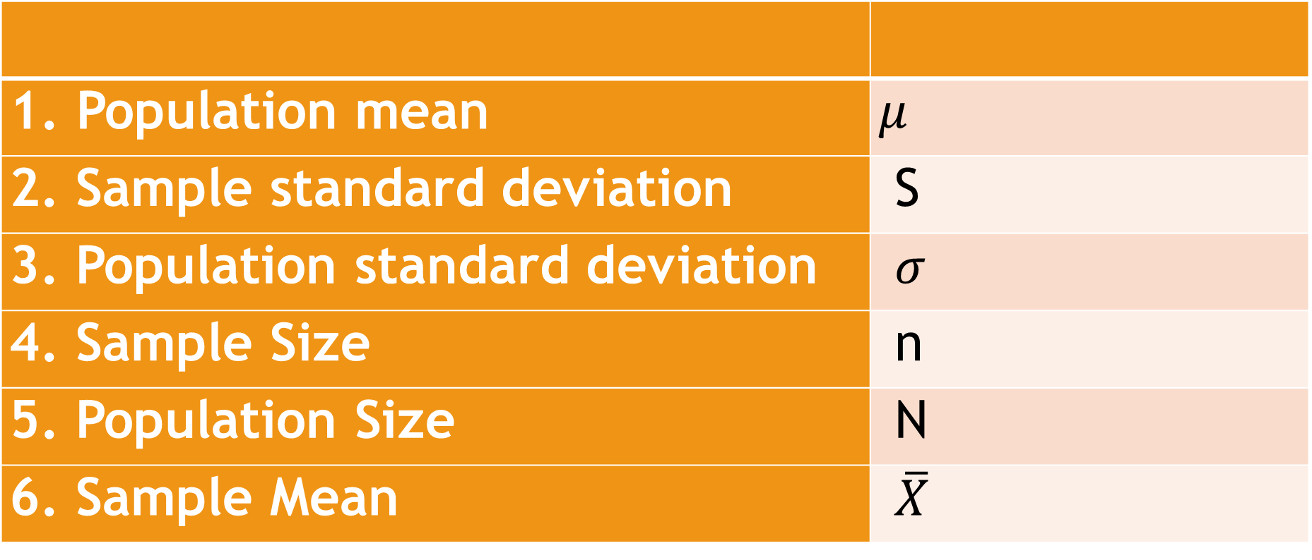
REVIEW
Population mean | $μ$
2. Sample standard deviation | S
3. Population standard deviation | $σ$
4. Sample Size | n
5. Population Size | N
6. Sample Mean | $\overline{X}$

Slide 3
OBJECTIVE
Illustrates: (a) null hypothesis, (b) alternative hypothesis, and (c)type of test.

Slide 4
A researcher claim that students who drink coffee can perform better in class than those who are not.
Are you going to believe the researcher? Why?
Notes:
We make decision every day. Some of these are important while others are not. In decision-making, we usually follow certain processes: weigh alternatives, collect evidence, and make a decision. After a decision is made, an appropriate interpretation is made (or an action is undertaken). We follow these basic process in testing hypothesis in Statistic.

Slide 5
STATISTICAL HYPOTHESIS
statement about the numerical value of a population parameter. It is a statement or tentative assertion which aims to explain facts about a certain phenomenon.

Slide 6
HYPOTHESIS TESTING
procedure used in statistical hypothesis.

Slide 7

TYPES OF HYPOTHESIS
NULL HYPOTHESIS ($H_{0}$) – statement that there is no difference between a parameter and a specific value.
ALTERNATIVE HYPOTHESIS ($H_{1}$) – is the opposite or negation of null hypothesis. It is a statement that there exist a difference between a parameter and a specific value.

Slide 8


EXAMPLE
1. The average monthly income of Filipino families who belongs to low income bracket is Php8,000.
$$H_{0}:There is no difference in the average monthly$$
$income of Filipino$ who belong to low income bracket.
$$H_{1}:There is a difference in the average monthly$$
$income of Filipino$ who belong to low income bracket.

Slide 9


EXAMPLE
2. The average number of hours that it takes a ten-year-old child to learn a certain task in a specific subject is less than 0.52 hours.
$$H_{0}:The average number of hours for a ten year old child$$
to learn a task in a specific subject is 0.52 hours.
$$H_{1}:The average number of hours for a ten year old child$$
to learn a task in a specific subject is less than 0.52 hours.

Slide 10


EXAMPLE
3. The average cost of a DVD player is greater than Php1500.
$$H_{0}:The average cost of a DVD player is equal$$
$$to Php1500$$
$$H_{1}:The average cost of a DVD player is greater$$
$$than Php1500$$

Slide 11
TYPE OF TEST
DIRECTIONAL TEST – a test of any statistical hypothesis where the alternative hypothesis is expressed using less than or greater than since the critical or rejection region lies entirely in one tail of the sampling distribution.
NON-DIRECTIONA TEST –a test of any statistical hypothesis where the alternative hypothesis is written with a not equal sign since the critical or rejection region is split into two equal parts, one in each tail of the sampling distribution.

Slide 12

EXAMPLE
1. The average monthly income of Filipino families who belongs to low income bracket is Php8,000.
$$H_{0}:There is no difference in the average monthly$$
$income of Filipino$ who belong to low income bracket.
$$H_{1}:There is a difference in the average monthly$$
$income of Filipino$ who belong to low income bracket.

Slide 13


EXAMPLE
2. The average number of hours that it takes a ten-year-old child to learn a certain task in a specific subject is less than 0.52 hours.
$$H_{0}:The aveage number of hours for a ten year old child$$
to learn a task in a specific subject is 0.52 hours.
$$H_{1}:The aveage number of hours for a ten year old child$$
to learn a task in a specific subject is less than 0.52 hours.

Slide 14
EXAMPLE
3. The average cost of a DVD player is greater than Php1500.
$$H_{0}:The average cost of a DVD player is equal$$
$$to Php1500$$
$$H_{1}:The average cost of a DVD player is greater$$
$$than Php1500$$

Slide 15
PRACTICAL APPLICATION
Give/Write at least one research question and identify the null and alternative hypothesis.

Slide 16
GENERALIZATION
Differentiate null and alternative hypothesis.
Explain the difference between a one-tailed test and a two-tailed test.

Slide 17
EVALUATION
A. Illustrate the null and alternative hypothesis for each of the following. Identify if it is a one-tailed or two-tailed test. Symbol only.
1. The average age of community college students is 24.6 years.
2. The average income of accountants is Php51,497.
3. The average age of attorneys is greater than 25.4 years.
4. The average score of 50 high school basketball games is less than 88.
5. The average pulse rate of male marathon runners is less than 70 beats per minute.

Slide 18

Answers
$H_{0}: μ=24.6$
$H_{1}: μ≠24.6$
Two-tailed

Slide 19

Answers
2. $H_{0}: μ=51,497$
$H_{1}: μ≠51,497$
Two-tailed

Slide 20

Answers
3. $H_{0}: μ=25.4$
$H_{1}: μ>25.4$
One-tailed

Slide 21

Answers
4. $H_{0}: μ=88$
$H_{1}: μ<88$
One-tailed

Slide 22

Answers
5. $H_{0}: μ=70$
$H_{1}: μ<70$
One-tailed

Slide 23
THANK YOU AND GOD BLESS

