Slide 1










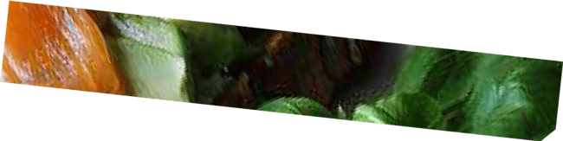

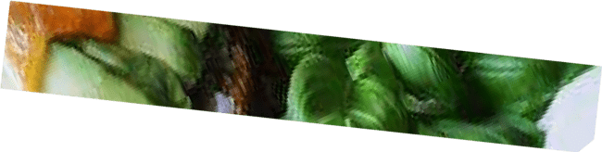






Copyright © 2019 Lesson Plans For Millions | ESL. All rights reserved .

Slide 2
Would you say you lead a healthy lifestyle?
What is more important, a healthy mind or a healthy body?
What are the best ways to keep fit? How do you keep fit?

Slide 3


1. Avoid
a) to make someone remember someone or something.
2. Gain
b) To make something larger in size or amount.
Many times; often.
Stop something from happening or stop someone from doing something.
3. Lose
4. Remind
e) Very important
5. Frequently
f) Stay away from someone or something.
6. Unhealthy
g) to have less of something than you had before.
7. Essential
h) Not healthy
8. Prevent
Copyright © 2019 Lesson Plans For Millions | ESL. All rights reserved .

Slide 4






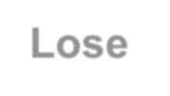






Avoid
Water is for living things. We can’t live without it.
I am so skinny. I want to weight.
Please me to call her today. I might forget.
You can find asked questions on the website.
Lose
Gain
Remind
Frequently
5. Eating healthy meals can help you many diseases.
Unhealthy
Burger and Pizza are considered foods.
I need to weight. I’m gaining weight because I eat a lot of junk
Essential
food.
Prevent
8. I want to
Jessica at school because I don’t want to talk to her.
Copyright © 2019 Lesson Plans For Millions | ESL. All rights reser

Slide 5


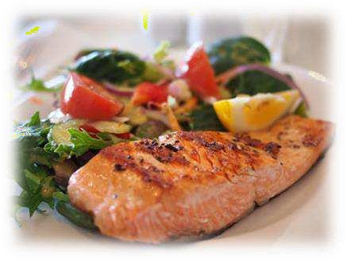
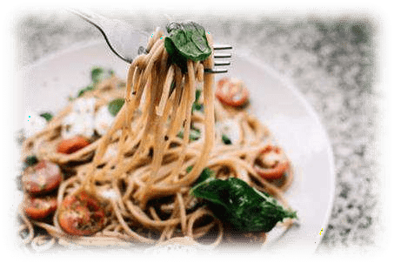


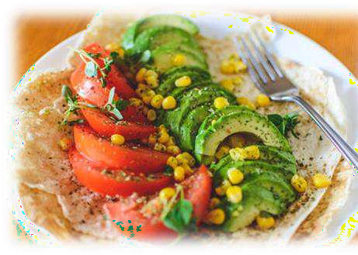
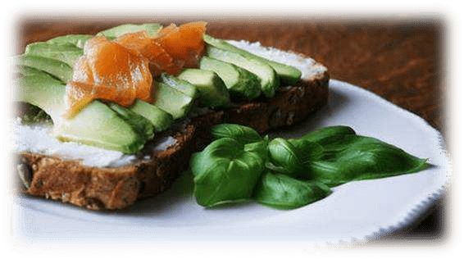


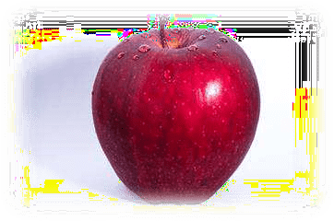


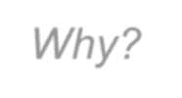

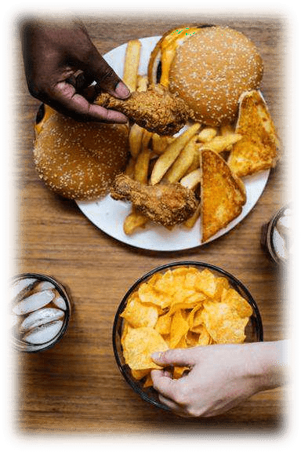

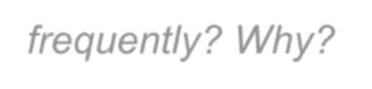
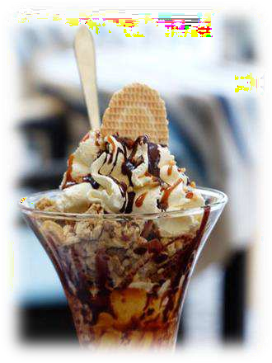



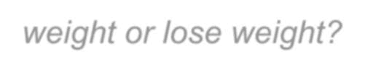
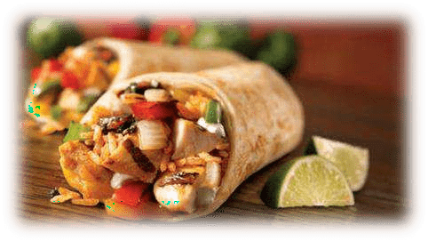
Answer the questions
Which foods are essential for good health?
Which foods should we avoid? Why?
Which foods should we eat frequently? Why?
Does eating pizza, burger, chips, and ice cream make us gain weight or lose weight?
Copyright © 2019 Lesson Plans For Millions | ESL. All rights reserved .

Slide 6

Passive voice
I am eating healthy food.
This sentence is in the active voice.
This means that a person is doing some action - eating healthy food
In this sentence there is :
Subject : I
Verb : am eating
Object : healthy food
We can change this sentence to the passive voice where we start the sentence with the object:
Object : healthy food
Verb : being eaten
Subject : me
Healthy food is being eaten by me

Slide 7
Let’s practice changing the sentences
using the passive voice
I am eating healthy foods to make me stronger.
2. Some healthy foods which are needed by our body are
fruits and vegetables.
3. I eat bananas and apples.
4. She is having lunch.
5. I eat a healthy breakfast every day.

Slide 8
Fill in the gaps
slim physical gentle energy weight
Everyone nowadays knows the benefits of _________________ exercise but scientists at the University of Maastricht , in the Netherlands , say the key to staying _________________ and keeping fit is to eat less and do _________________ exercise such as walking or cycling. People who exercise too intensively often reward themselves by spending the rest of the day in front of the TV set. At the same time, they have to eat more to give
them _________________ for the next workout. To avoid gaining
_________________ , researchers suggest that going for a longer walk or riding a bike for a few hours may actually be better than high-energy exercise.
.

Slide 9


Is it possible to have a healthy lifestyle in the modern world?
What are some of the things we must do to lose
weight?
3. Is physical activity an important part of a healthy
lifestyle?
4. Do you have a snack every time you are hungry, or
do you wait for lunch or dinner?

Slide 10
Thank you for your great participation!

