Slide 1

GOOD MORNING!

Slide 2
ENZYME KINETICS:
MICHAELIS – MENTEN EQUATION
MARK SEAN A. MANUBAG, RCh

Slide 3




ENZYME KINETICS
Field of biochemistry concerned with quantitative measurement of the rates of enzyme catalyzed reactions.
REACTION RATE
The measure of the change in concentration of the reactants or the change in concentration of the products per unit time.
Such that:
The rate law is defined as,
$$A+B ↔ P$$
$$\frac{−∆[A]}{t}$$
$$, \frac{−∆[B]}{t}$$
$$\&\frac{∆[P]}{t}$$

Slide 4
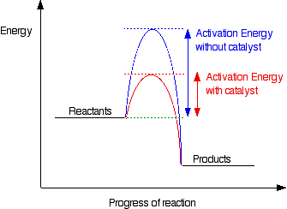

ENZYME KINETICS: MICHAELIS – MENTEN EQUATION
FACTORS AFFECTING REACTION RATES
01
02
Temperature
Reactant Concentration
Raises the Average Kinetic energy of Molecules
Increase in concentration also increase the frequency of collisions
$$Rate ∝\left[A\right][B]$$
03
04
Surface Area
Catalyst
Increasing exposed surface area
Increases collision rate between
reacting particles
Establishes an alternative path with a Lower Activation Energy

Slide 5
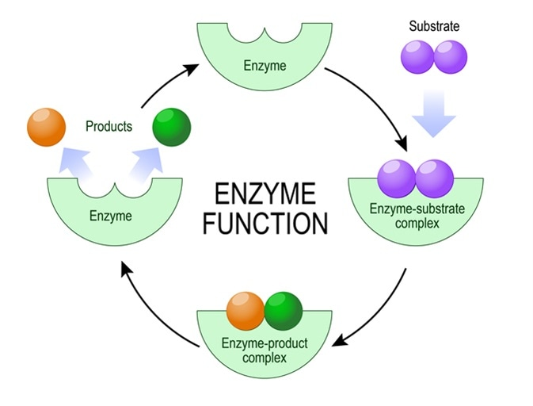

ENZYME FUNCTION at a glance
ENZYME KINETICS: MICHAELIS – MENTEN EQUATION
1. Substrate binds to the enzyme > Stereospecificity
> Conformational Compatibility
3. Formation of Products
2. Formation of complexes at the active site
> Enzyme – substrate
> Enzyme – product
$$E+S ⇔ES →E+P$$

Slide 6
ENZYME KINETICS: MICHAELIS – MENTEN EQUATION
CHALLENGE#1
HOW WILL WE BE ABLE TO QUANTIFY ENZYME ACTIVITY?
“THE RATE (VELOCITY) OF AN ENZYME CATALYZED REACTION IS
DEPENDENT UPON THE SUBSTRATE CONCENTRATION.”
MICHAELIS – MENTEN EQUATION

Slide 7
ENZYME KINETICS: MICHAELIS – MENTEN EQUATION
MICHAELIS – MENTEN EQUATION
Where v_{i} = Initial velocity
V_{max} = Maximum velocity
K_{m} = Michaelis constant
[S] = Substrate Concentration

Slide 8
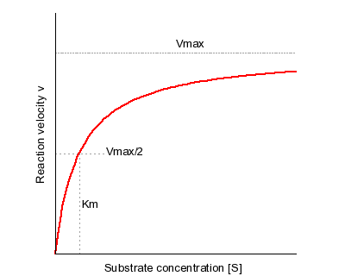
ENZYME KINETICS: MICHAELIS – MENTEN EQUATION
MICHAELIS – MENTEN EQUATION
Where v_{i} = Initial velocity
V_{max} = Maximum velocity
K_{m} = Michaelis constant
[S] = Substrate Concentration
Hyperbolic plot

Slide 9
DEPENDENCE OF RATE ON [S] AND K_{m} CAN BE ESTABLISHED UNDER THE FF:
02
[S] is much greater than K_{m}
01
[S] is much lesser than K_{m}
03
[S] equals K_{m}
ENZYME KINETICS: MICHAELIS – MENTEN EQUATION

Slide 10
ENZYME KINETICS: MICHAELIS – MENTEN EQUATION
CHALLENGE#2
THE DIRECT DETERMINATION OF THE NUMERIC VALUE OF V_{max} , AND THEREFORE K_{m} OFTEN REQUIRES VERY HIGH SUBSTRATE CONCENTRATIONS
“A LINEAR FORM CIRCUMVENTS THIS WHEREIN V_{max} AND K_{m} CAN BE
EXTRAPOLATED AT A LESSER CONCENTRATION.”

Slide 11
ENZYME KINETICS: MICHAELIS – MENTEN EQUATION
MICHAELIS – MENTEN EQUATION
Getting the inverse,
LINEWEAVER – BURK
EQUATION

Slide 12
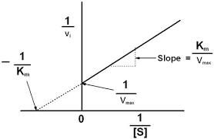
ENZYME KINETICS: MICHAELIS – MENTEN EQUATION
LINEWEAVER – BURK PLOT
Setting y=0,

Slide 13
ENZYME KINETICS: MICHAELIS – MENTEN EQUATION
CHALLENGE#3
WHAT IS THE SIGNIFICANCE OF K_{M} (MICHAELIS CONTENT)?
“K_{M} IS A RELATIVE MEASURE OF THE AFFINITY OF A SUBSTRATE FOR AN ENZYME. IT IS UNIQUE FOR EACH ENZYME – SUBSTRATE PAIR”

Slide 14
ENZYME KINETICS: MICHAELIS – MENTEN EQUATION

Slide 15
ENZYME KINETICS: MICHAELIS – MENTEN EQUATION
SMALLER K_{M}, HIGHER AFFINITY
REACHES (V_{max}/2 ) AT A LOWER [S]

Slide 16
SUMMARY
> MICHAELIS-MENTEN EQUATION DESCRIBES KINETIC BEHAVOR OF ENZYMES
> IT FURTHER DESCRIBES THE RELATIONSHIP OF RATE OF AN ENZYME
CATALYZED REACTION TO SUBSTRATE CONCENTRATION.
> THE LINE WEAVER – BURK PLOT DETERMINES THE K_{M} AT LOW [S]
> K_{M} MEASURES BINDING AND AFFINITY OF SUBSTRATE TO ENZYME.

Slide 17

END OF PRESENTATION

