Slide 1
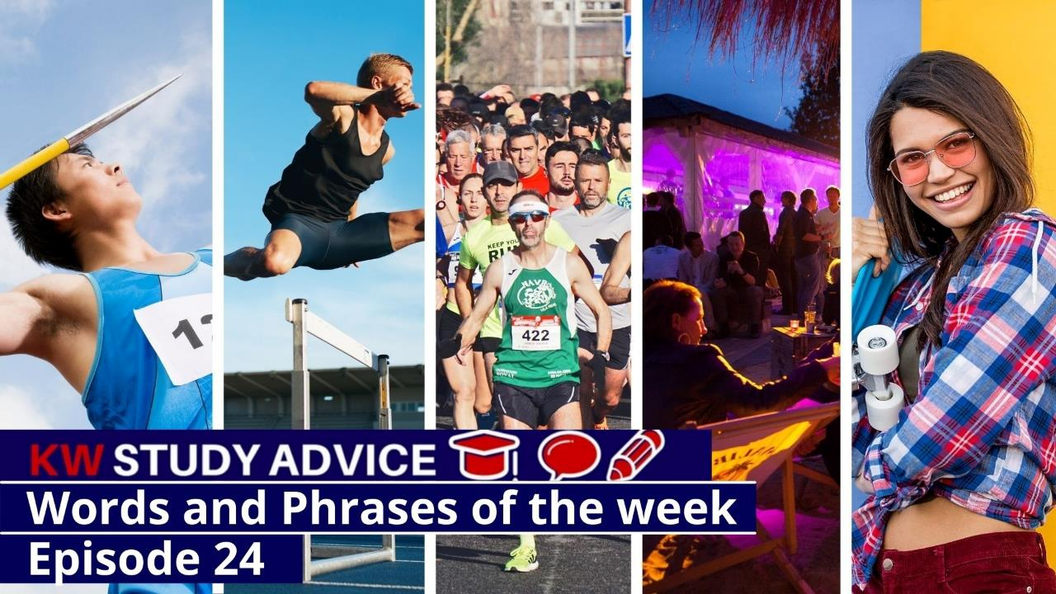
Equestrian
Fringe Event
Skater Girl
Marathon
Hurdles
Javelin

Slide 2
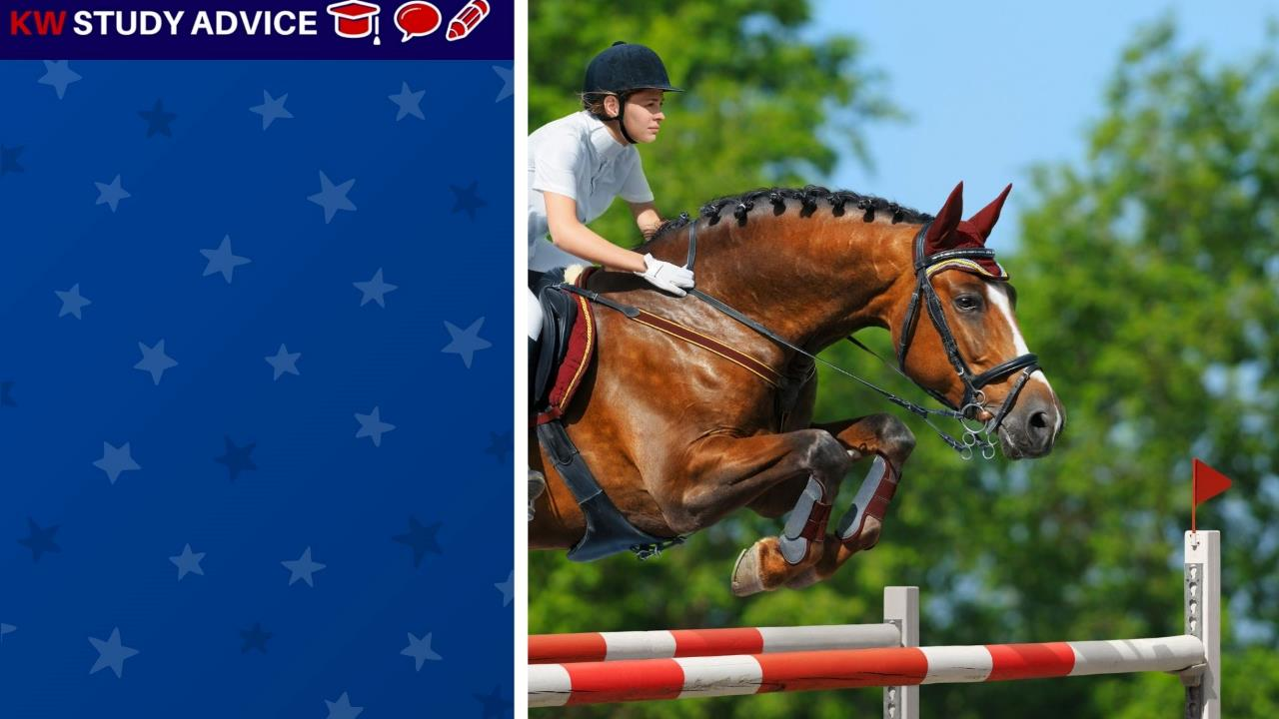
Equestrian
A sport which is carried out by riding horses. It is often done by a horse rider guiding a horse over a series of jumps
The horse rider took part in an equestrian event during the summer. They were lucky enough to finish second and win a medal.

Slide 3
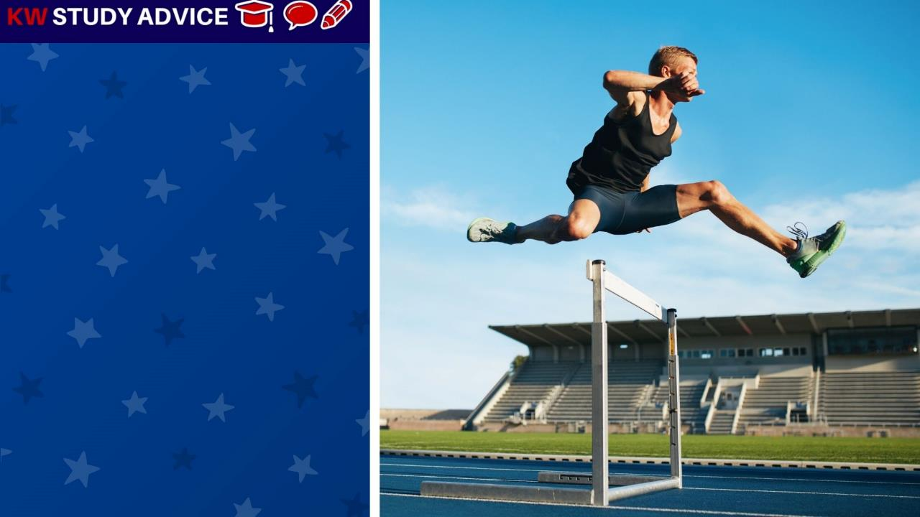
Hurdles
These are obstacles which runners must jump over in a hurdles race. Hurdle events are key parts of all athletic events.
The runner had practiced hurdling for the past six months before his race. He ran in the 110 metre race and came eighth.

Slide 4
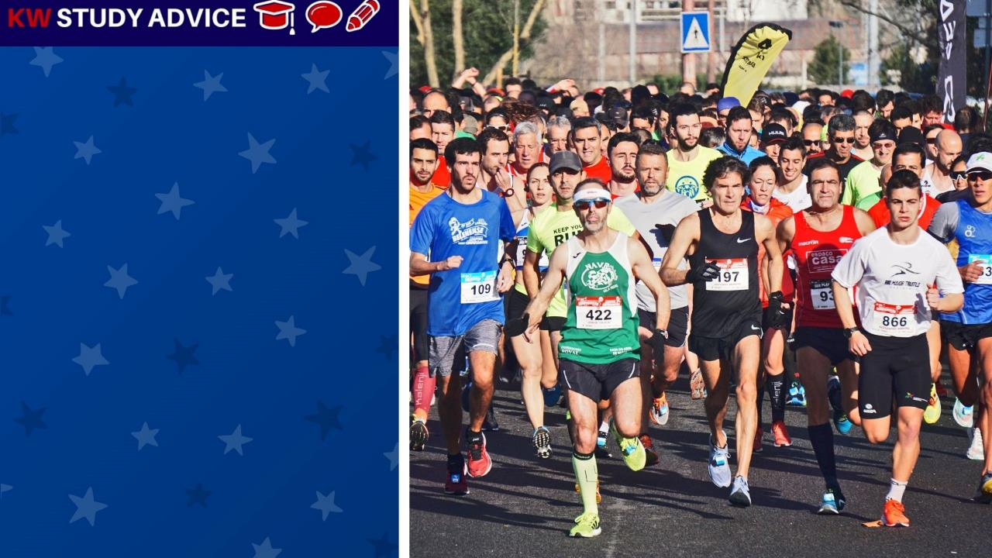
Marathon
This is a long distance race which is 42.195 KM in length. Marathons often take place annually in the world’s largest cities.
The marathon runners began their race on a cool and bright autumn morning. The runners had all practiced for many months.

Slide 5
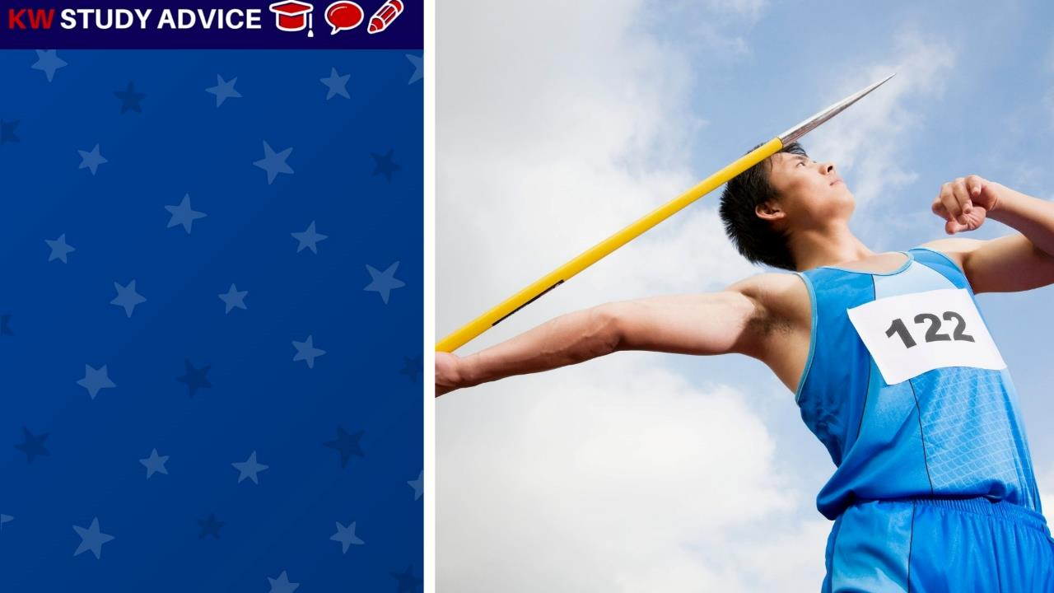
Javelin
A very long, thin and sharp object which sports people throw to see who can throw it the furthest in a competition.
The man threw his javelin first at the athletics competition. He was able to throw it 50 meters. This was a good score.

Slide 6
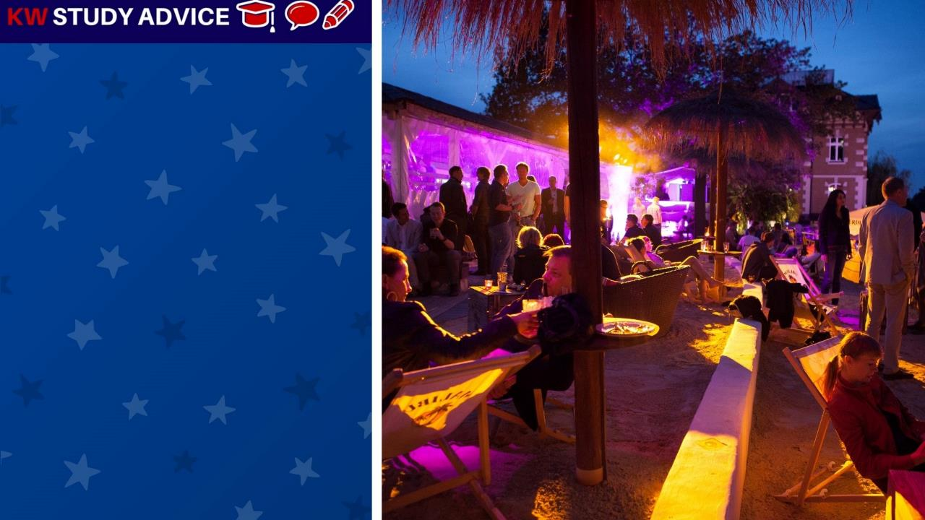
Fringe Event
This is a side event which is smaller than the main event taking place. They often have less popular, but interesting events
The music fans enjoyed the fringe event before waiting for the main event. Many enjoyed the smaller band’s songs.

Slide 7

Skater Girl
This is an informal term used for a girl who enjoys to skateboard. This is usually a positive name given to someone.
The skater girl enjoyed going down to the skatepark at the weekend to enjoy a few hours of skating with other skater girls.

Slide 8
