Slide 1




Environmental Nuisance:
Balancing Development and Environmental
Protection
Tutor: Okwudili O. ONWURAH, LL.B. (Nigeria); BL (Abuja, Nigeria); LLM (Exeter, UK); LLM (Qingdao, PRC); LLM (Shanghai, PRC)
PhD in Law (Hong Kong)
Dr Okwudili O. Onwurah
1

Slide 2

The purpose of the online lesson is to encourage you to participate actively in achieving your needs and simplifying your legal education. I want you to be the best!
Minor House Keeping
Will make the learning process more interactive discussions and feel free to ask any question or you can speak.
You have the right to choose whether to turn on your video or not.
Participation prepares you for your exam and learning needs with ease.
2

Slide 3

Introduction
Environmental nuisance, a critical concept in environmental law, addresses the delicate balance between societal progress and ecological preservation. This presentation explores the multifaceted nature of environmental nuisance, its legal framework, and the ongoing challenges in reconciling development with environmental protection. We will examine landmark cases, analyze various types of pollution, and discuss the roles of different stakeholders in shaping environmental policy. Join us on this journey through the complex landscape of environmental nuisance law, as we uncover its historical roots, current applications, and future trends.

Slide 4
Introduction to Environmental Nuisance
Definition
Environmental nuisance refers to any activity or condition that interferes with the use and enjoyment of property or causes harm to public health and the environment. This legal concept encompasses various forms of pollution and environmental degradation, including air, water, and noise pollution.
Importance
Understanding environmental nuisance is crucial for maintaining ecological balance, protecting public health, and ensuring sustainable development. It provides a legal framework for addressing conflicts between industrial progress and environmental conservation, helping to safeguard natural resources for future generations.
Legal Implications
Environmental nuisance law plays a vital role in regulating industrial activities, urban development, and resource management. It empowers communities and individuals to seek legal recourse against polluters and holds businesses accountable for their environmental impact.

Slide 5
Historical Background
1
Early Cases (19th Century)
The concept of environmental nuisance emerged from common law principles. In 1856, the landmark case of St. Helen's Smelting Co. v. Tipping established the principle that industrial activities causing harm to neighboring properties could be considered a nuisance, even if they were economically beneficial.
2
Mid-20th Century Developments
The post-World War II industrial boom led to increased pollution and environmental degradation. This period saw the rise of environmental awareness and the emergence of cases like Rylands v. Fletcher (1868), which established the rule of strict liability for environmental damage.
3
Modern Era (Late 20th - 21st Century)
Environmental nuisance law has evolved to address complex global issues such as climate change and biodiversity loss. Cases like Massachusetts v. Environmental Protection Agency (2007) have expanded the scope of environmental protection, recognizing new forms of environmental harm and the need for comprehensive regulatory frameworks.

Slide 6
Legal Framework
National Legislation
In the United States, key laws include the Clean Air Act (1970), Clean Water Act (1972), and Noise Control Act (1972). These provide the foundation for regulating environmental nuisances at the federal level.
State and Local Laws
Many states and municipalities have enacted their own environmental protection laws, often more stringent than federal regulations. For example, California's Environmental Quality Act (CEQA) sets high standards for environmental impact assessments.
Common Law Principles
Traditional tort law concepts like nuisance, trespass, and negligence continue to play a crucial role in environmental litigation, offering remedies where statutory law may be insufficient.
International Perspectives
International agreements such as the Paris Agreement and the Convention on Biological Diversity influence domestic environmental policies and provide a global framework for addressing transboundary environmental issues.

Slide 7
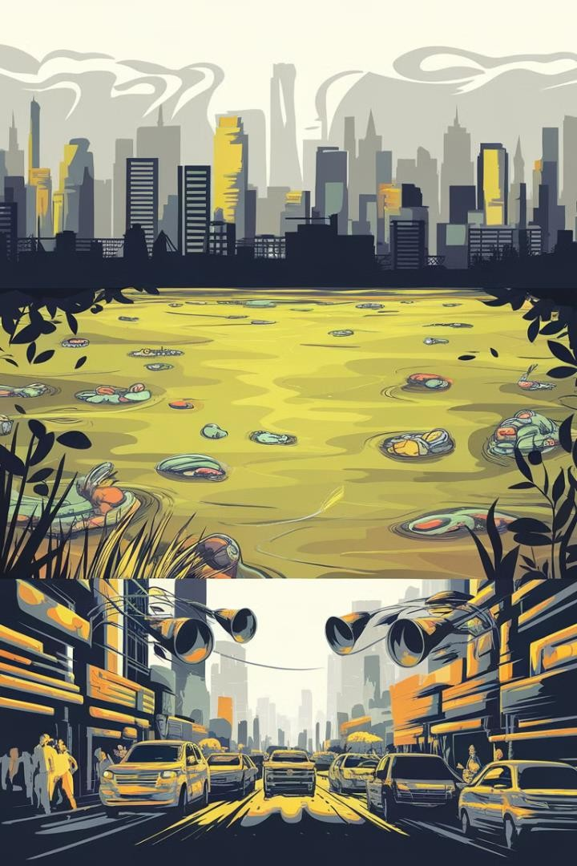



Types of Environmental Nuisance
Air Pollution
Includes emissions from industrial facilities, vehicles, and other sources that degrade air quality. Major pollutants include particulate matter, sulfur dioxide, and greenhouse gases. Air pollution can lead to respiratory issues and contribute to climate change.
Water Pollution
Encompasses contamination of water bodies by chemicals, microorganisms, or physical alterations. Sources include industrial discharge, agricultural runoff, and improper waste disposal. Water pollution threatens aquatic ecosystems and human health.
Noise Pollution
Refers to excessive or unwanted sound that disrupts the environment. Common sources include transportation, construction, and industrial activities. Chronic exposure to noise pollution can lead to hearing loss and other health issues.

Slide 8
Case Study: Air Pollution
Court Decision
The Supreme Court ruled 5-4 in favor of the petitioners, holding that greenhouse gases fit within the Clean Air Act's definition of air pollutant. The Court directed the EPA to reconsider its refusal to regulate these emissions.
Background
In the landmark case of Massachusetts v. Environmental Protection Agency (2007), 12 states and several cities challenged the EPA's refusal to regulate greenhouse gas emissions from motor vehicles under the Clean Air Act.
1
2
3
4
Legal Arguments
The petitioners argued that greenhouse gases are air pollutants under the Clean Air Act and that the EPA had a duty to regulate them. The EPA contended that it lacked authority to regulate greenhouse gases and that such regulation would conflict with other administrative priorities.
Impact
This decision was a turning point in U.S. climate change policy, effectively requiring the EPA to regulate greenhouse gases unless it could provide a scientific basis for not doing so. It set the stage for future climate change litigation and regulation.

Slide 9
Case Study: Water Pollution
1
Case: Los Angeles Waterkeeper v. Pruitt
(2018)
This case addressed the issue of stormwater pollution in Los Angeles County. Environmental groups sued the EPA for failing to address water quality violations in the Los Angeles River watershed.
2
Legal Challenge
The plaintiffs argued that the EPA had a duty under the Clean Water Act to address ongoing water quality violations caused by stormwater runoff. They contended that the agency's inaction was arbitrary and capricious.
3
Court Ruling
The U.S. District Court for the Central District of California ruled in favor of the plaintiffs, ordering the EPA to develop a plan to address water quality violations in the Los Angeles River watershed within 13 months.
4
Significance
This case highlighted the importance of enforcing water quality standards and the role of citizen suits in environmental protection. It set a precedent for holding regulatory agencies accountable for implementing environmental laws effectively.

Slide 10
Case Study: Noise Pollution
Case: Southwark LBC
v. Ince (1989)
This UK case dealt with noise pollution from a nightclub in London. Local residents complained about excessive noise disrupting their sleep and quality of life.
Legal Proceedings
The local council sought an injunction to restrict the nightclub's operations. The case centered on balancing the rights of businesses to operate with the residents' right to quiet enjoyment of their homes.
Court Decision
The court granted an injunction, limiting the nightclub's hours of operation and requiring sound insulation improvements. This decision emphasized the importance of considering community well-being in urban development.
Impact
The case set a precedent for addressing urban noise pollution and influenced subsequent noise control regulations in the UK and beyond. It highlighted the need for businesses to mitigate their environmental impact in densely populated areas.

Slide 11
Balancing Development and Protection
Legal Challenges
Balancing economic development with environmental protection presents complex legal challenges. Courts must often weigh competing interests, such as job creation and industrial growth against environmental preservation and public health. The concept of "sustainable development" has emerged as a guiding principle in this balancing act.
Case Example: Whanganui
River
In 2017, New Zealand passed legislation granting legal personhood to the Whanganui River, recognizing its importance to the indigenous Māori people. This innovative approach demonstrates how legal systems can evolve to better protect natural resources while respecting cultural values and development needs.
Future Directions
As environmental challenges become more acute, legal frameworks are likely to evolve further. Concepts like the "rights of nature" and the integration of environmental impact assessments into development planning processes are gaining traction globally, pointing towards a more holistic approach to balancing development and environmental protection.

Slide 12
Role of Government
Regulatory Bodies
Government agencies like the Environmental Protection Agency (EPA) in the U.S. play a crucial role in setting and enforcing environmental standards. These bodies conduct research, develop regulations, and monitor compliance across various sectors.
Enforcement Mechanisms
Governments employ a range of tools to enforce environmental regulations, including fines, permit requirements, and legal action against violators. The Clean Air Act's New Source Review program, for instance, requires industries to install modern pollution control equipment when upgrading facilities.
Policy Development
Governments are responsible for crafting environmental policies that address current and future challenges. This includes setting emissions targets, establishing protected areas, and developing incentives for sustainable practices in industry and agriculture.
International Cooperation
Many environmental issues transcend national boundaries, requiring governments to engage in international agreements and collaborations. The Paris Agreement on climate change is a prime example of global governmental cooperation on environmental protection.

Slide 13
Role of NGOs and Activists
1
Advocacy and Awareness
Non-governmental organizations (NGOs) and environmental activists play a crucial role in raising public awareness about environmental issues. They conduct research, organize campaigns, and lobby governments for stronger environmental protections. Organizations like Greenpeace and the World Wildlife Fund have been instrumental in shaping public opinion and policy on issues ranging from climate change to biodiversity conservation.
2
Legal Action
Many environmental NGOs have legal teams that bring lawsuits against polluters or government agencies failing to enforce environmental laws. For example, the Environmental Defense Fund's lawsuit against the EPA led to the nationwide ban on DDT in 1972, marking a significant victory for environmental protection in the United States.
3
Collaborative Efforts
NGOs often collaborate with governments and businesses to develop sustainable solutions. The Nature Conservancy, for instance, works with landowners and governments to establish conservation easements, protecting millions of acres of land worldwide. These partnerships demonstrate the potential for multi-stakeholder approaches in addressing environmental challenges.

Slide 14




Technological Solutions
Renewable Energy
Advancements in solar, wind, and other renewable energy technologies are reducing reliance on fossil fuels, thereby decreasing air pollution and greenhouse gas emissions. For example, the Ivanpah Solar Electric Generating System in California uses advanced mirror technology to generate clean electricity for over 140,000 homes.
Air and Water Purification
Innovations in filtration and purification technologies are helping to combat pollution. The Smog Free Tower in Rotterdam, designed by Daan Roosegaarde, uses ion technology to clean 30,000 cubic meters of air per hour, demonstrating the potential for large-scale air purification in urban areas.
Waste Management
Advanced recycling technologies and biodegradable materials are revolutionizing waste management. For instance, the plastics-to-fuel technology developed by companies like Renewlogy is converting non- recyclable plastics into diesel fuel, addressing both waste and energy challenges simultaneously.
Monitoring and Data Analysis
Satellite technology and AI- powered data analysis are enhancing our ability to detect and respond to environmental threats. NASA's Orbiting Carbon Observatory-3 provides precise carbon dioxide measurements, aiding in climate change research and policy development.

Slide 15

Future Trends in Environmental Nuisance Law
Expansion of Legal Standing
Future environmental nuisance law is likely to see an expansion of legal standing, allowing more parties to bring environmental claims. This could include granting legal personhood to natural entities, as seen in New Zealand's recognition of the Whanganui River.
Integration of Scientific Advancements
Courts are expected to increasingly rely on advanced scientific evidence, including AI-driven environmental modeling and big data analysis, to assess environmental impacts and determine liability in nuisance cases.
Global Harmonization of Standards
As environmental issues become increasingly global, there may be a trend towards harmonizing environmental standards and legal frameworks across jurisdictions, facilitating more effective responses to transboundary environmental challenges.
Emphasis on Preventative Measures
Future environmental law is likely to place greater emphasis on preventative measures, potentially introducing more stringent requirements for
environmental impact assessments and pre-emptive action against potential nuisances.

Slide 16
Practical Tips for Compliance
1
Conduct Regular Environmental Audits
Businesses should implement a system of regular environmental audits to assess their compliance with current regulations and identify potential areas of improvement. This proactive approach can help prevent environmental nuisances before they occur.
2
Invest in Clean Technologies
Investing in clean technologies and sustainable practices not only ensures compliance but can also lead to long- term cost savings and improved public image. This could include adopting energy-efficient systems, implementing waste reduction strategies, or utilizing renewable energy sources.
3
Engage with Stakeholders
Maintaining open communication with local communities, environmental groups, and regulatory bodies can help businesses address concerns proactively and develop mutually beneficial solutions to potential environmental issues.
4
Stay Informed on Regulatory Changes
Environmental regulations are constantly evolving. Businesses and individuals should stay informed about changes in environmental laws and adjust their practices accordingly to ensure ongoing compliance.

Slide 17
Conclusion
Balancing Act
Environmental nuisance law plays a crucial role in balancing the needs of development with the imperative of environmental protection. It provides a framework for addressing conflicts and ensuring responsible resource management.
Evolving Landscape
As our understanding of environmental issues deepens and new challenges emerge, environmental nuisance law continues to evolve. The integration of scientific advancements and the expansion of legal concepts are shaping its future direction.
Collaborative Approach
Addressing environmental nuisances effectively requires collaboration among governments, businesses, NGOs, and individuals. Each stakeholder has a crucial role to play in creating a sustainable and environmentally responsible future.
Looking Ahead
The future of environmental nuisance law lies in its ability to adapt to new challenges, incorporate technological innovations, and foster a global approach to environmental protection. By staying informed and proactive, we can all contribute to a healthier, more sustainable world.

