Slide 1
Rules for counting Significant figures

Slide 2
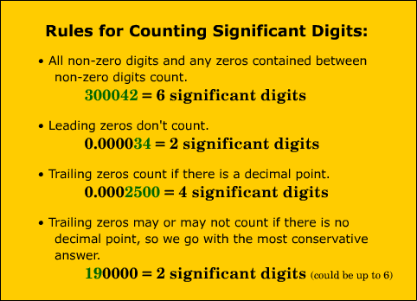
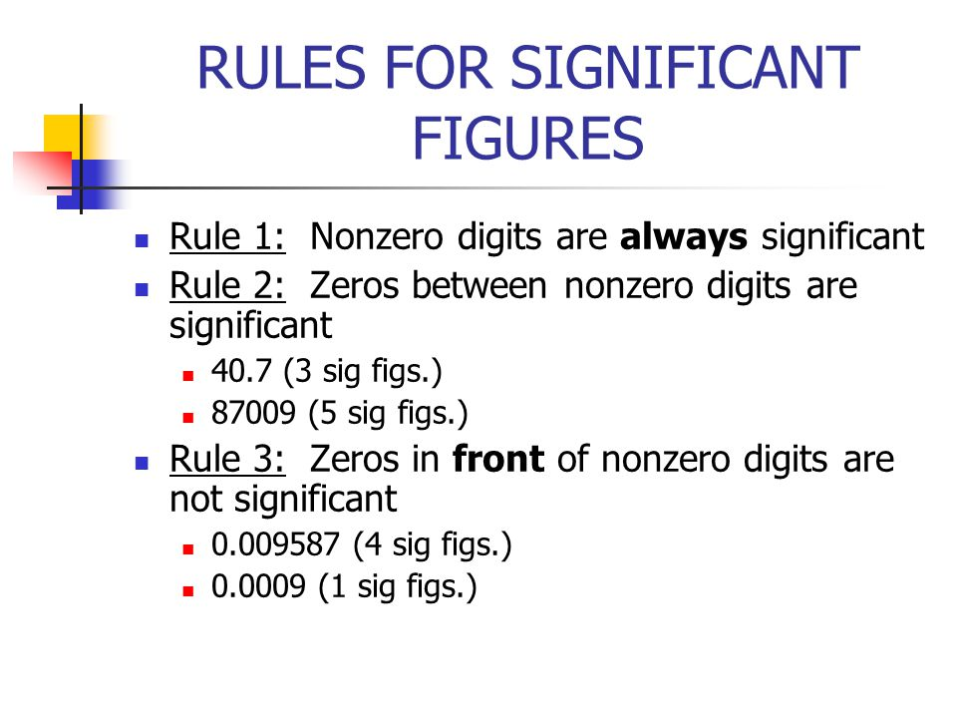
Rules for counting significant numbers-

Slide 3
Rules for counting significant numbers-

Slide 4
Rules for counting significant numbers-

Slide 5
Rules for counting significant numbers-

Slide 6
Scientific Notation and Significant Figures
Scientific notation…
is a way to express very small or very large numbers.
is most often used in "scientific" calculations where the analysis must be very precise.
consists of two parts:
A Number and a Power of 10. Ex: 1.22 x 10³

Slide 7
Scientific Notation and Significant Figures
For a number to be in correct scientific notation
only one digit may be to the left of the decimal.
So,
1.22122×10³ is correct
12.2122×10² is not
Exponential digits in scientific notation are not significant; 1.12x10⁶ has three significant digits, 1, 1, and 2.

Slide 8
How to convert non-exponential numbers to exponential numbers:FOR LARGE NUMBERS
Example 1------234,999
This is a large number and the implied decimal point is at the end of the number.
2.34999 (five numbers)
…and thus the exponent we place on the power of 10 is 5. The resulting exponential number is then:
2.34999×10⁵

Slide 9
How to convert non-exponential numbers to exponential numbers:FOR SMALL NUMBERS
Example 1------0.000556
The first non-zero digit is 5 so the number becomes 5.56
and we had to pass the decimal point by 4 digits to get it to the point where there was only one non-zero digit at the front of the number.
The resulting exponential number is then:
5.56×10⁻⁴

Slide 10

Convert the following into scientific notations
21
16600.01
455
0.0104
0.0000099800
0.1234

Slide 11

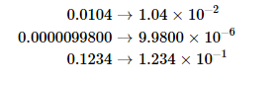
Answers-

Slide 12
Rounding significant figure
Rounding to decimal place

Slide 13
Significant Figures and Rounding
Example- Round 53,879 to 1 significant figure
To round to a significant figure:
look at the first non-zero digit if rounding to one significant figure
draw a vertical line after the place value digit that is required
look at the next digit.
5|3879

Slide 14
Significant Figures and Rounding
Example- Round 53,879 to 1 significant figure
5|3879
if it's 5 or more, increase the previous digit by one
if it's 4 or less, keep the previous digit the same,fill any spaces to the right of the line with zeros,
5|3879 to 1 significant figure is 50,000

Slide 15
Significant Figures and Rounding
Example- Round 53,879 to 2 significant figure
draw a vertical line after the place value digit that is required
look at the next digit.
53|879
Look at the digit after vertical line, if more than five increase the previous digit by one followed by zeros
53|879 to 2 significant figures is 54,000

Slide 16
Significant Figures and Rounding
Example- Round 0.005089 to 1 significant figure
To round to a significant figure:
look at the first non-zero digit if rounding to one significant figure
draw a vertical line after the place value digit that is required
look at the next digit.
0.005|089

Slide 17
Significant Figures and Rounding
Example- Round 0.005089 to 1 significant figure
0.005|089
To round to a significant figure:
Look for first non-zero digit, vertical line after it
if it's 5 or more, increase the previous digit by one
if it's 4 or less, keep the previous digit the same
0.005|089 to 1 significant figure is 0.005

Slide 18
Significant Figures and Rounding
Example- Round 0.005089 to 2 significant figures.
0.0050|89
To round to a significant figure:
if it's 5 or more, increase the previous digit by one
if it's 4 or less, keep the previous digit the same
0.0050|89 to 2 significant figures is 0.0051

Slide 19

Question
What is 98,347 rounded to
1 significant figure, then
2 significant figures?
ANSWER-
9|8347 to 1 significant figure is 100,000
98|347 to 2 significant figures is 98,000

Slide 20
Question
What is 3.5175 rounded to
1 significant figure, then
2 significant figures?
ANSWER-
3|.5175 to 1 significant figure is 4
3.5|175 to 2 significant figures is 3.5

Slide 21
Rounding to decimal places
Example- Round 248.561 to 1 decimal place
draw a vertical line to the right of the place value digit that is required
248.5|61
look at the next digit, if it's 5 or more, increase the previous digit by one
248.5|61
248.5|61to 1 decimal place is 248.6

Slide 22
Rounding to decimal places
Example- Round 248.561 to 2 decimal place
draw a vertical line to the right of the place value digit that is required
248.56|1
look at the next digit, if it's 4 or less, keep the previous digit the same and remove the numbers after.
248.56|1
248.56|1 to 1 decimal place is 248.56

Slide 23
Question
Round 0.08513
1 decimal place, then
2 decimal place?
ANSWER-
0.0|8513 to 1 decimal place is 0.1
0.08|513 to 2 decimal places is 0.09

Slide 24
Question
Round 249.5046
1 decimal place, then
2 decimal place?
ANSWER-
249.5|046 to 1 decimal place is 249.5
249.50|46 to 2 decimal places is 249.50

Slide 25
Question
Solve (5.91-2.08) / 0.164 and
Round to 1 significant figure.
Round to 4 decimal place
ANSWER- 23.353658
2|3.353658 to 1 sig fig= 20
23.3536|58 to 4 decimal place=23.3537

