Slide 1
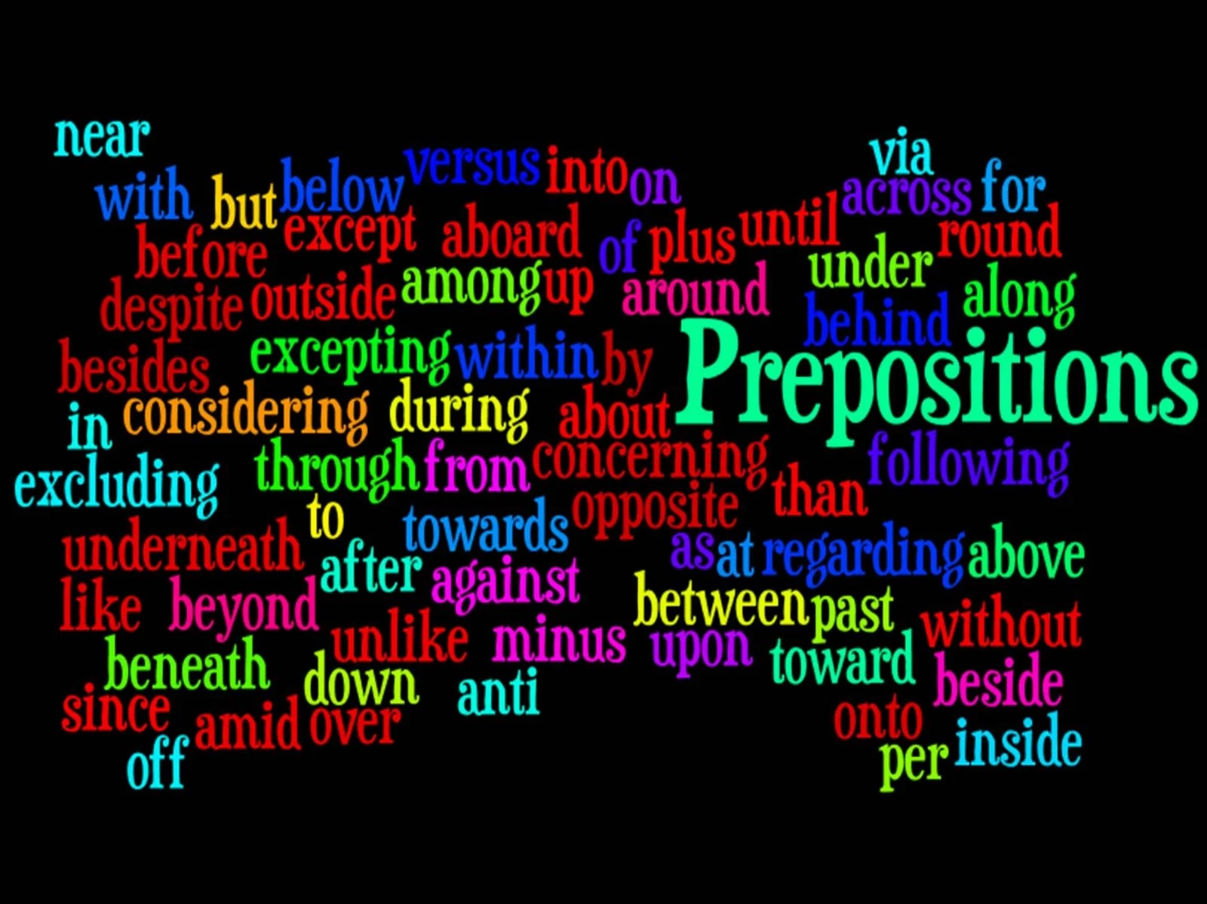

Slide 2
Contents
Slide 1 Title – Prepositions
Slide 2 Contents
Slide 3 – 7 What is a preposition?
Slide 8 – 9 Rules
Slide 10 Types of Preposition
Slide 11 – 15 Time
Slide 16 – 20 Place
Slide 21 – 24 Direction
Slide 25 – 26 Prepositions and Nouns
Slide 27 – 31 Prepositions and Verbs
Slide 32 – 33 Prepositions and Adjectives
Slide 34 – 36 Exercise 1
Slide 37 Exercise 2
Slide 38 Exercise 3
Slide 39 References

Slide 3
Preposition
What is a preposition?
A preposition is a word used to link nouns, pronouns, or phrases to other words within a sentence. They act to connect the people, objects, time and locations of a sentence.

Slide 4
Prepositions are usually short words, and they are normally placed directly in front of nouns. In some cases, you’ll find prepositions in front of gerund verbs.

Slide 5
A nice way to think about prepositions is as the words that help glue a sentence together. They do this by expressing position and movement, possession, time and how an action is completed.

Slide 6
Indeed, several of the most frequently used words in all of English, such as of, to, for, with, on and at, are prepositions.
Explaining prepositions can seem complicated, but they are a common part of language and most of us use them naturally without even thinking about it.

Slide 7
In fact, it’s interesting to note that prepositions are regarded as a ‘closed class’ of words in the English language.
This means, unlike verbs and nouns, no new words are added to this group over time. In a way, it reflects their role as the functional workhorse of the sentence.

Slide 8
Rules
The first rule is that to make sentences clear, specific prepositions are needed. For example, the preposition in means one thing and the preposition on cannot substitute for it in all cases. Some prepositions are interchangeable but not always.
The correct preposition means one particular thing and using a different proposition will give the sentence a very different meaning.
I want to see you in the house now, Bill!
means something very different from,
I want to see you on the house now, Bill!

Slide 9
The second rule for using prepositions is that prepositions are generally followed by nouns or pronouns. There was a time in the past when teachers held strictly to this rule, but it made for some clunky sentences.
I am seeking someone I can depend on.
ends with the preposition on, so people who insisted that sentences shouldn’t end with a preposition would be forced to use convoluted and unnatural phrasing.

Slide 10
Types of Preposition
There are more than 100 prepositions in the English language. In addition, there are endless possibilities for creating prepositional phrases, phrases that begin with a preposition and end with a noun or pronoun.
There are three types of prepositions, including:
time prepositions
place prepositions
direction prepositions

Slide 11
Time Prepositions
Basic examples of time prepositions include: at, on, in, before and after. They are used to help indicate when something happened, happens or will happen. It can get a little confusing though, as many different prepositions can be used.
Prepositions of time examples in the following sentences are in bold for easy identification.
For example:
I was born on July 4th, 1982.
I was born in 1982.
I was born at exactly 2am.
I was born two minutes before my twin brother.
I was born after the Great War ended.

Slide 12
Guidelines
The above makes it seem quite difficult, with five different prepositions used to indicate when something happened. However, there is a set of guidelines that can help decide which preposition to use:
For years, months, seasons, centuries and times of day, use the preposition in.
I first met John in 1987.
It’s always cold in January
Easter falls in spring each year.
The Second World War occurred in the 20th century.
We eat breakfast in the morning.

Slide 13
For days, dates and specific holiday days, use the preposition on.
We go to school on Mondays, but not on Sunday
Christmas is on December 25th.
Buy me a present on my birthday.
For times, indicators of exception and festivals, use the preposition at.
Families often argue at Christmas time.
I work faster at night.
Her shift finished at 7pm.

Slide 14
Before and after should be much easier to understand than the other examples of prepositions of time. Both are used to explain when something happened, happens or will happen, but specifically in relation to another thing.
Before I discovered this bar, I used to go straight home after work.
We will not leave before 3pm.
David comes before Bryan in the line, but after Louise.

Slide 15
Other prepositions of time could include:
during, about, around, until and throughout.
The concert will be staged throughout the month of May.
I learned how to ski during the holidays.
He usually arrives around 3pm.
It was about six in the morning when we made it to bed.
The store is open until midnight.

Slide 16
Prepositions of Place
To confuse matters a bit, the most common prepositions to indicate time – on, at, in – are also the most common prepositions to indicate position. However, the rules are a little clearer as place prepositions are a more rigid concept than time prepositions.

Slide 17
Guidelines
Prepositions of place examples in the following sentences are in bold for easy identification.
The cat is on the table.
The dogs are in the kennel.
We can meet at the crossroads.
The guidelines can be broken down as follows:
On is used when referring to something with a surface:
The sculpture hangs on the wall.
The images are on the page.
The specials are on the menu, which is on the table.

Slide 18
In is used when referring to something that is inside or within confined boundaries. This could be anything, even a country:
Jim is in France, visiting his aunt in the hospital.
The whiskey is in the jar in the fridge.
The girls play in the garden.
At is used when referring to something at a specific point:
The boys are at the entrance at the movie theater.
He stood at the bus stop at the corner of Water and High streets.
We will meet at the airport.

Slide 19
Lot’s of other prepositions of place, such as under, over, inside, outside, above and below are used in English. There is, however, a lot less confusion as they refer to rigid positions rather than abstract ones.
The cat is under the table.
Put the sandwich over there.
The key is locked inside the car.
They stepped outside the house.
Major is ranked above corporal.
He is waving at you from below the stairs.

Slide 20
Prepositions of Movement
Prepositions of movement are quite easy to understand as they are less abstract than prepositions of place and time. Essentially, they describe how something or someone moves from one place to another. The most commonly used preposition of movement is to, which usually serves to highlight that there is movement towards a specific destination.

Slide 21
Prepositions of movement examples in the following sentences are in bold for easy identification.
He has gone on vacation to France.
She went to the bowling alley every Friday last summer.
I will go to bed when I am tired.
They will go to the zoo if they finish their errands.

Slide 22
Other more specific prepositions of movement include:
through, across, off, down and into.
These prepositions can sometimes get mixed up with others. While they are similar, they have individual meanings that add context to the movement.

Slide 23
Across refers to moving from one side to another.
Mike travelled across America on his motorcycle.
Rebecca and Judi are swimming across the lake.
Through refers to moving directly inside something and out the other end.
The bullet Ben shot went through the window.
The train passes through the tunnel.
Into refers to entering or looking inside something.
James went into the room.
They stare into the darkness.

Slide 24
Up, over, down, past and around indicate directions of movement:
Jack went up the hill.
Jill came tumbling down after.
We will travel over rough terrain on our way to Grandma’s house.
The horse runs around the track all morning.
A car zoomed past a truck on the highway

Slide 25
Prepositions with Nouns
There are lots of different nouns that carry specific prepositions to consolidate their meaning. These are called dependent prepositions.
Again, there isn’t a set rule that says a particular type of noun will take a dependent preposition, although they normally follow the noun.
Moreover, there are many possible combinations. Essentially, it’s case of familiarizing yourself with the different possibilities of nouns and dependent prepositions.

Slide 26
He displayed cruelty towards his dog.
She had knowledge of physics.
The trouble with Jack.
21 is the age at which you are allowed to drink.
Bolt made another attempt at the world record.
The police held an inquiry into the murder.

Slide 27
Prepositions with Verbs
Prepositional verbs – the phrasal combinations of verbs and prepositions – are important parts of speech.
The prepositions again act as links between the verb and noun or gerund, giving extra meaning to the sentence.
The prepositions most commonly used with verbs are: to, for, about, of, in, at and from. The good news is that these will always come after the verb in the sentence.

Slide 28
However, it should also be noted that the prepositional verbs can have slightly different meaning compared to the original verb. For example, to relate a story simply means to tell a story, to relate to a story means you identify with it, find some personally meaning in that story.
Verb + to:
He admitted to the charge.
I go to Vancouver on vacation twice a year.
William can relate to the character in the play.

Slide 29
Verb + for:
He must apologize for his actions.
We searched for ages before we found the perfect apartment.
I provide for my family by working two jobs.
Verb + with:
I don’t agree with your claim.
The lawyer said he will meet with your representatives.
They began with a quick warm-up.

Slide 30
Verb + of:
I dream of a better life.
Have you heard of Shakespeare?
The bread consists of dough, raisins and a little honey.
Verb + in:
Does Rick believe in miracles?
Fallon lives in New York.
The bus accident resulted in my being late to work.

Slide 31
Verb + at
We arrived at our destination.
Ilene excels at singing.
Will the baby smile at her mother?
Verb + on:
We should really concentrate on our studies now.
Helen insisted on Brenda’s company.
Morris experimented on some canvas.
Verb + from:
Since turning 80, she suffers from lapses in concentration.
Dad retired from the navy in the 1970s.
Billy Bob, please refrain from doing that.

Slide 32
Prepositions with Adjectives
Prepositions can form phrases with adjectives to give further context to the action, emotion or thing the adjective is describing. Like verbs and nouns, adjectives can be followed by: to, about, In, for, with, at and by.
I am happily married to David.
Ellie is crazy about this movie.
Michelle is interested in politics.
We are sorry for your loss.
Jane will be delighted with her results.
Is he still angry at the world?
The entire room was astonished by the election results.

Slide 33
There can sometimes be a pattern in deciding which prepositions go with adjectives, for example, when adjectives have the same or very similar meaning to each other, they might take the same preposition:
Frightened of, afraid of, scared of, terrified of
Indeed, when adjectives have opposite meaning they might also take the same preposition:
Good at, great at, superb at, wonderful at
Bad at, terrible at, woeful at, inept at

Slide 34
Exercise 1
The following exercises will help you gain greater understanding about how prepositions work. Choose the best answer to complete each sentence.
1. The bone was _______ the dog.
a. About
b. For
c. After
d. Considering
2. We are going on vacation _______ August.
a. On
b. At
c. In
d. Since

Slide 35
3. Please put the vase ________ the table.
a. In
b. On
c. For
d. Over
4. I received a present ________ Janet.
a. From
b. Of
c. By
d. About
5. School begins ________ Monday.
a. In
b. On
c. From
d. Since

Slide 36
The boy ran ___________the bridge and ______________ the fountain.
in/ under
over/ around
through/ over
over/ under
The students tried to hide __________ their desks.
In
around
under
Through
I will meet you _____________ Thursday_____________7 o’clock.
in/ on
on/ in
at/ at
on/ at

Slide 37
Exercise 2
Choose the right preposition of place:
_________ the picture, I can see a family _________ a kitchen.
There is a dish full of fruits___________ the worktop.
The mother is standing ____________ her son and daughter.
She is holding a vase___________ in her hand.
The son and the daughter are sitting __________ the worktop smiling ____________ each other.
There are beautiful cupboards _____________ the wall.
There is a window ____________the mother.
The woman is looking ___________ her daughter.

Slide 38
Exercise 3
Choose the right preposition of time:
What are you doing _________Saturday?
I am going to the countryside __________ the weekend.
I haven't been to the countryside __________ December.
What time are you leaving?
I am leaving ________ the afternoon. Maybe ________ three o'clock pm.
I am coming back ________ Sunday evening. I'll catch the half _________ seven train _________ Sunday. I'll be there ________ nine o'clock.
5. So you'll be there ________ the whole weekend. I'll be missing you!

