Slide 1
IELTS WRITING TASK
Essay Structure
Thesis Statement
Coherence
Cohesion
Idea Development

Slide 2
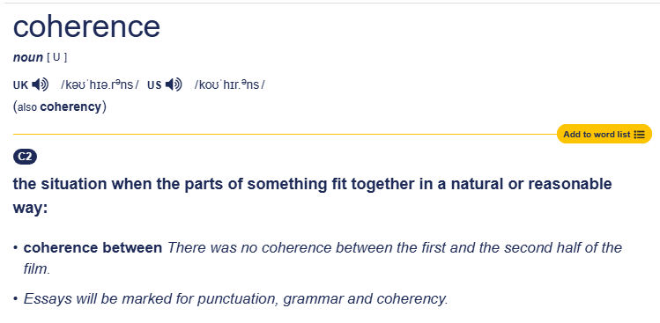
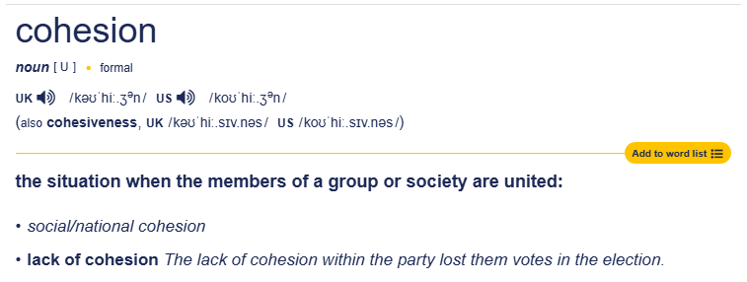
Coherence
Cohesion

Slide 3
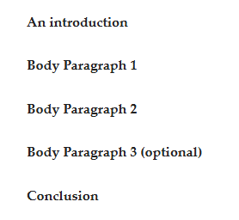
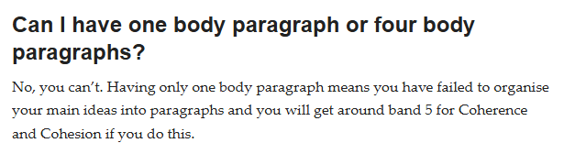
Writing is a means of communicating your thoughts and ideas to the reader.
All we have to do is to answer the question.
Essay Structure
Thesis Statement

Slide 4
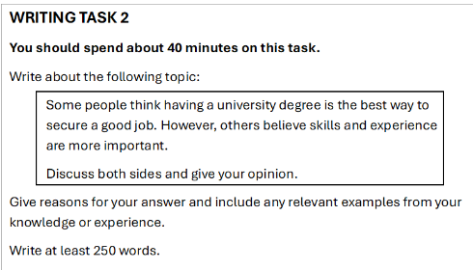
In the introduction we say what we think about the question, if we agree or disagree with the question.
We use words from the question and we add our own opinion.
Many people think that skills and experience are more important than having a degree.
I think that earning a degree will build perseverance, patience and analytical skills.
However, my opinion is that having a degree and also some work experience is the best recipe for success.
1st idea
Thesis Statement
2nd idea

Slide 5
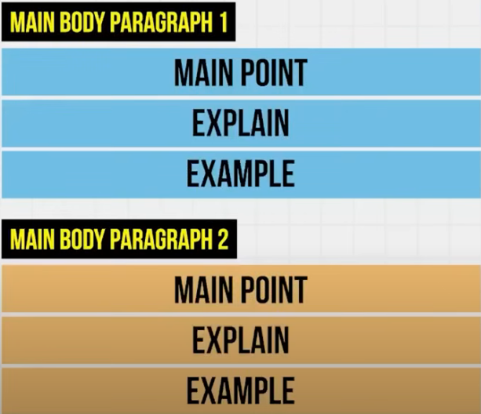
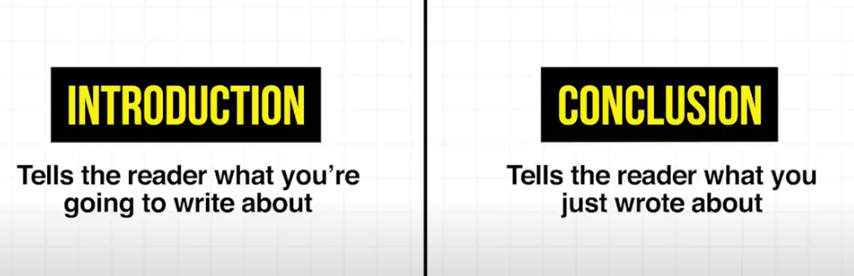
A CLEAR AND LOGICAL STRUCTURE WILL BOOST YOUR GRADE.
INTRODUCTION= WHAT YOU THINK ABOUT THE QUESTION
DEVELOP YOUR 1ST IDEA= 1ST PARAGRAPH
DEVELOP YOUR 2ND IDEA= 2ND PARAGRAPH
CONCLUSION= REPEAT THE KEY POINTS FROM THE INTRODUCTION, REPHRASING THEM

Slide 6
Idea Development

Slide 7
