Slide 1
How to name organic compounds using the IUPAC rules
Here is a simple list of rules to follow
Identify the longest carbon chain. This chain is called the parent chain.
Identify all of the substituents (groups appending from the parent chain).
Number the carbons of the parent chain from the end that gives the substituents the lowest numbers (If two or more side chains are in equivalent positions, assign the lowest number to the one which will come first in the name).
If the same substituent occurs more than once, the location of each point on which the substituent occurs is given. In addition, the number of times the substituent group occurs is indicated by a prefix (di, tri, tetra, etc.).
If there are two or more different substituents, they are listed in alphabetical order using the base name (ignore the prefixes).

Slide 2
If chains of equal length are competing for selection as the parent chain, then the choice goes in series to:
a) the chain which has the greatest number of side chains.
b) the chain whose substituents have the lowest- numbers.
c) the chain having the greatest number of carbon atoms in the smaller side chain.
d)the chain having the least branched side chains.
A cyclic (ring) hydrocarbon is designated by the prefix cyclo- which appears directly in front of the base name.

Slide 3
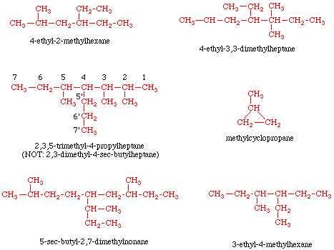
Here are some examples:

Slide 4

Here are some examples:
Alkyl halides
The halogen is treated as a substituent on an alkane chain. The halo- substituent is considered of equal rank with an alkyl substituent in the numbering of the parent chain. The halogens are represented as follows:
F | fluoro-
Cl | chloro-
Br | bromo-
I | Iodo-
Here are some examples

Slide 5
Alkenes and Alkynes - unsaturated hydrocarbons
Double bonds in hydrocarbons are indicated by replacing the suffix -ane with -ene. If there is more than one double bond, the suffix is expanded to include a prefix that indicates the number of double bonds present (-adiene, -atriene, etc.). Triple bonds are named in a similar way using the suffix -yne. The position of the multiple bond(s) within the parent chain is(are) indicated by placing the number(s) of the first carbon of the multiple bond(s) directly in front of the base name.

Slide 6
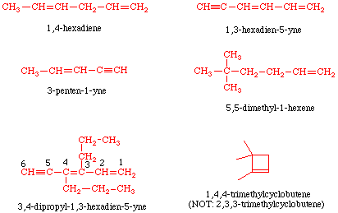
Here are some examples:

Slide 7
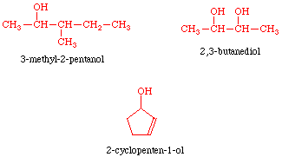
Alcohols
Alcohols are named by replacing the suffix -ane with -anol. If there is more than one hydroxyl group (-OH), the suffix is expanded to include a prefix that indicates the number of hydroxyl groups present (-anediol, -anetriol, etc.). The position of the hydroxyl group(s) on the parent chain is(are) indicated by placing the number(s) corresponding to the location(s) on the parent chain directly in front of the base name (same as alkenes).
Here are some examples:

Slide 8
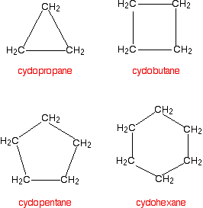

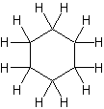

Naming Cycloalkanes
Many organic compounds found in nature or created in a laboratory contain rings of carbon atoms with distinguishing chemical properties; these compounds are known as cycloalkanes.
Cycloalkanes only contain carbon-hydrogen bonds and carbon-carbon single bonds, but in cycloalkanes, the carbon atoms are joined in a ring. The smallest cycloalkane is cyclopropane.

Slide 9







Cycloalkane | Molecular formula | Basic structure
Cyclopropane | C3H6
Cyclobutane | C4H8
Cyclopentane | C5H10
Cyclohexane | C6H12
Cycloheptane | C7H14
Cyclooctane | C8H16
Cyclononane | C9H18
Cyclodecane | C10H20

Slide 10
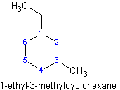
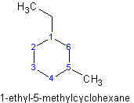


Example
(1+3=4)
(1+5=6)
NOT
2-bromo-1-chloro-3-methylcyclopentane
1-chlorocyclobutane or cholorocyclobutane is acceptable

Slide 11


2-fluoro-1,1,-dimethylcyclohexane
NOT
1,1-dimethyl-2-fluorocyclohexane
(2-bromo-1,1-dimethylcyclohexane)

Slide 12



2,2-dimethylcyclohexanol
3-bromo-2-methylcyclopentanol
1-propylcyclohexane

Slide 13
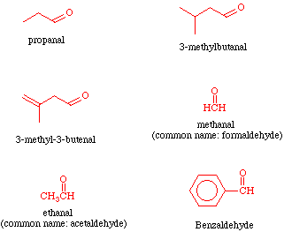
Aldehydes
Aldehydes are named by replacing the suffix -ane with -anal. If there is more than one -CHO group, the suffix is expanded to include a prefix that indicates the number of -CHO groups present (-anedial - there should not be more than 2 of these groups on the parent chain as they must occur at the ends). It is not necessary to indicate the position of the -CHO group because this group will be at the end of the parent chain and its carbon is automatically assigned as C-1.
Here are some examples

Slide 14
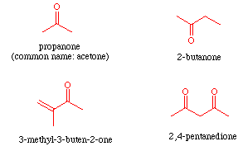
Ketones
Ketones are named by replacing the suffix -ane with -anone. If there is more than one carbonyl group (C=O), the suffix is expanded to include a prefix that indicates the number of carbonyl groups present (-anedione, -anetrione, etc.). The position of the carbonyl group(s) on the parent chain is(are) indicated by placing the number(s) corresponding to the location(s) on the parent chain directly in front of the base name (same as alkenes).

Slide 15
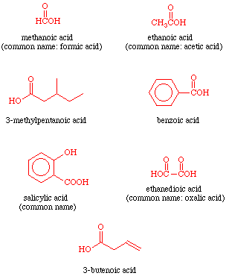
Carboxylic Acids
Carboxylic acids are named by counting the number of carbons in the longest continuous chain including the carboxyl group and by replacing the suffix -ane of the corresponding alkane with -anoic acid. If there are two -COOH groups, the suffix is expanded to include a prefix that indicates the number of -COOH groups present (-anedioic acid - there should not be more than 2 of these groups on the parent chain as they must occur at the ends). It is not necessary to indicate the position of the -COOH group because this group will be at the end of the parent chain and its carbon is automatically assigned as C-1.

Slide 16
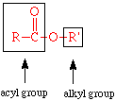
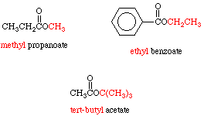
Esters
Systematic names of esters are based on the name of the corresponding carboxylic acid. Remember sters look like this:
The alkyl group is named like a substituent using the -yl ending. This is followed by a space. The acyl portion of the name (what is left over) is named by replacing the -ic acid suffix of the corresponding carboxylic acid with -ate.

