Slide 1

Understanding the Triangle Inequality Theorem: Foundations and Applications

Slide 2

Introduction to Triangle Inequality
is essential in geometry. This theorem states that the sum of the lengths of any two sides of a triangle must be greater than the length of the third side. This principle helps in determining the feasibility of constructing a triangle with given side lengths.

Slide 3







The Triangle Inequality Theorem
The Triangle Inequality Theorem can be expressed as: , , and . Here, , , and represent the lengths of the triangle's sides. This theorem is fundamental in understanding the properties of triangles.

Slide 4
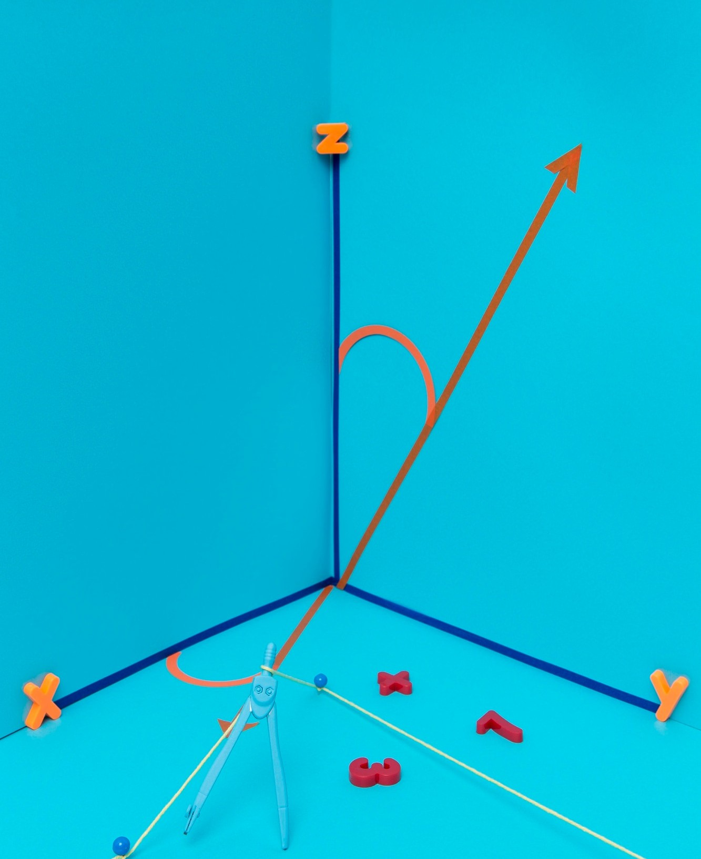
Proof of the Theorem
A simple proof of the Triangle Inequality involves . By
drawing a triangle and extending one
side, you can visualize how the sum of the two shorter sides must always exceed the length of the longest side. This visual proof solidiﬁes the theorem's validity.

Slide 5

Applications in Geometry
The Triangle Inequality Theorem is used in various . It helps in
determining whether three given lengths can
form a triangle. This theorem is also crucial in solving problems related to triangle congruence and similarity.

Slide 6




Applications in Real Life
In real life, the Triangle Inequality Theorem has
applications in ﬁelds like
, and
,
. For example, it
helps engineers ensure that structures are stable and can withstand forces acting on them by analyzing the lengths of supports.

Slide 7

Common Misconceptions
A common misconception is that the Triangle Inequality only applies to
. In reality, it applies to all types of triangles.
Understanding this theorem helps clarify these misconceptions and reinforces the fundamental principles of triangle properties.

Slide 8


Real-World Examples
Consider a scenario in
where three points form a triangle. The Triangle Inequality Theorem ensures that the direct path between two points is shorter than the path taken through the third point, optimizing routes in various applications.

Slide 9
Conclusion and Key Takeaways
The Triangle Inequality Theorem is a fundamental concept in geometry with broad applications. Its principles are crucial not only in mathematical theory but also in practical situations.
Understanding this theorem enhances problem-solving skills and logical reasoning.

Slide 10
Thanks!
Do you have any questions? youremail@email.com
+91 620 0000 838
www.yourwebsite.com @yourusername

