Slide 1
IB AA SL
Details and assessment ( example answer to paper 1 (May 2023)
A guide for students

Slide 2
IB Maths offer 4 choices
Mathematics: applications and interpretation SL
Mathematics: applications and interpretation HL
Mathematics: analysis and approaches SL * (What we are talking in this PPT)
Mathematics: analysis and approaches HL

Slide 3
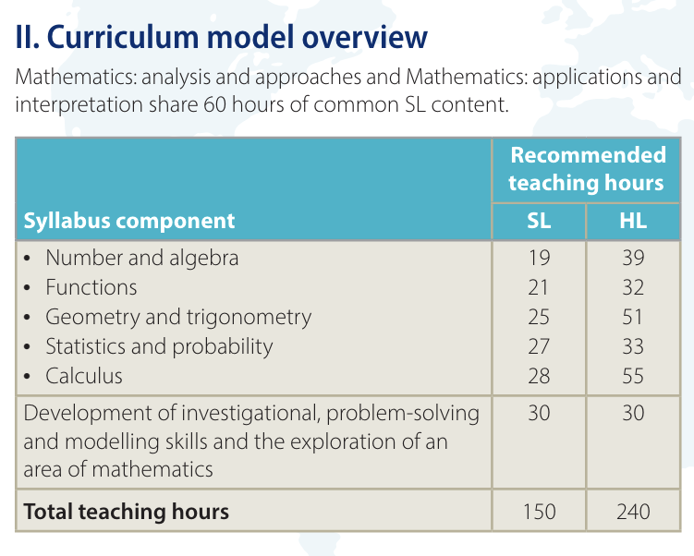

Slide 4
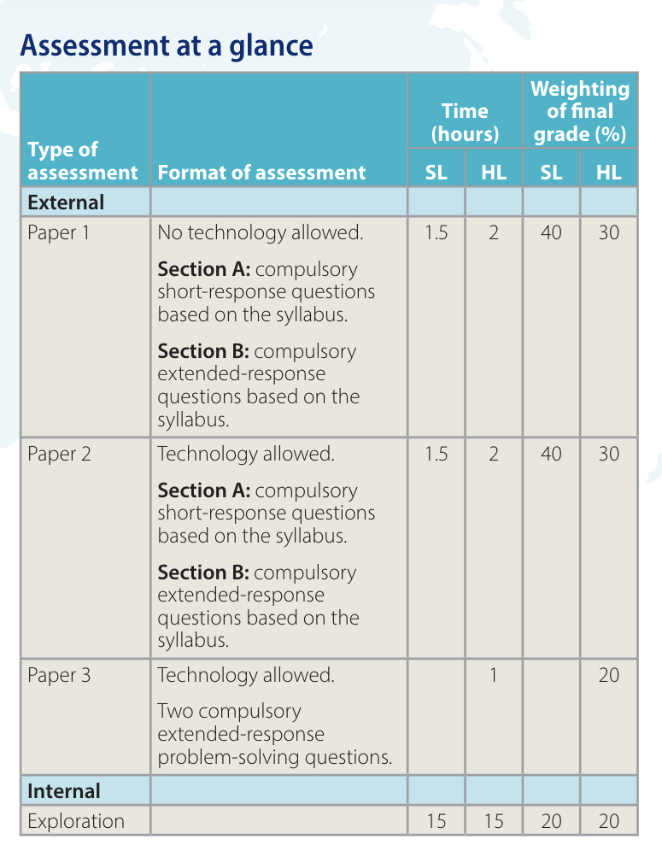
No calculator allowed
Calculator allowed
Calculator allowed

Slide 5
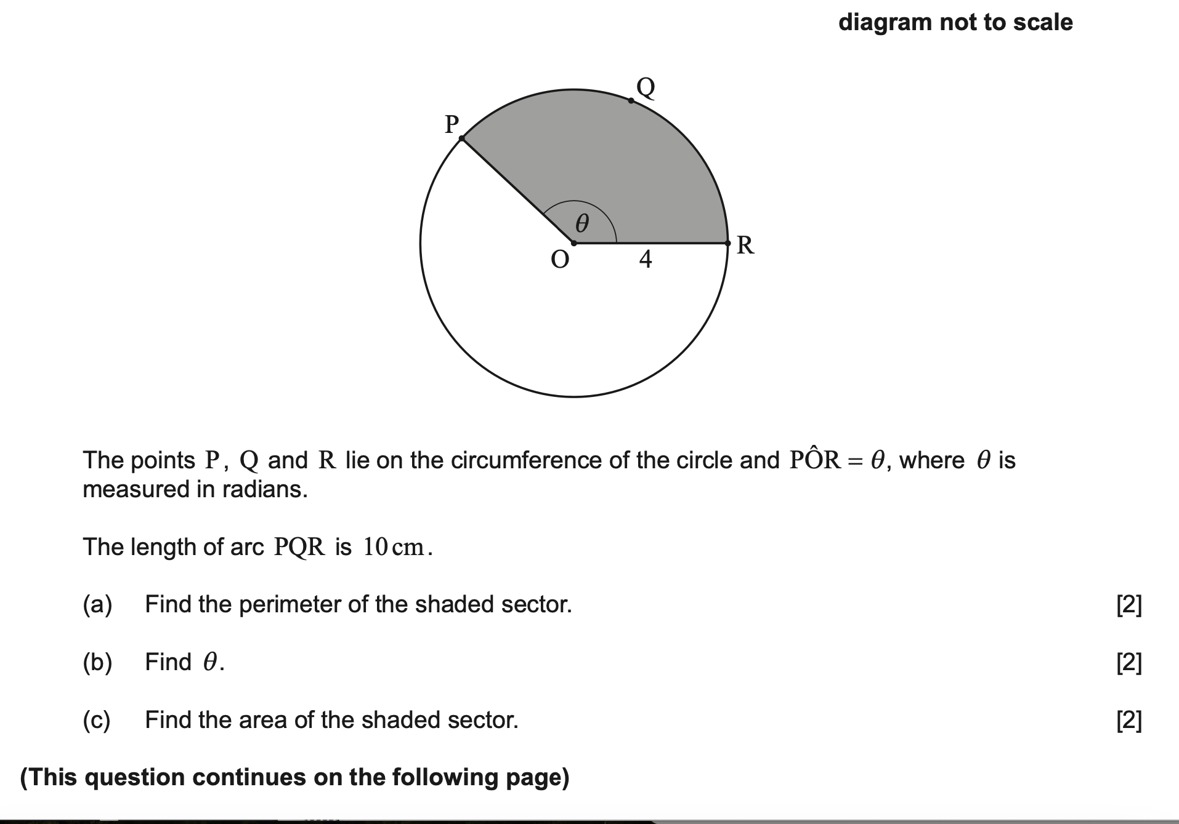
Paper 1 Q 1 (May, 2023)

Slide 6
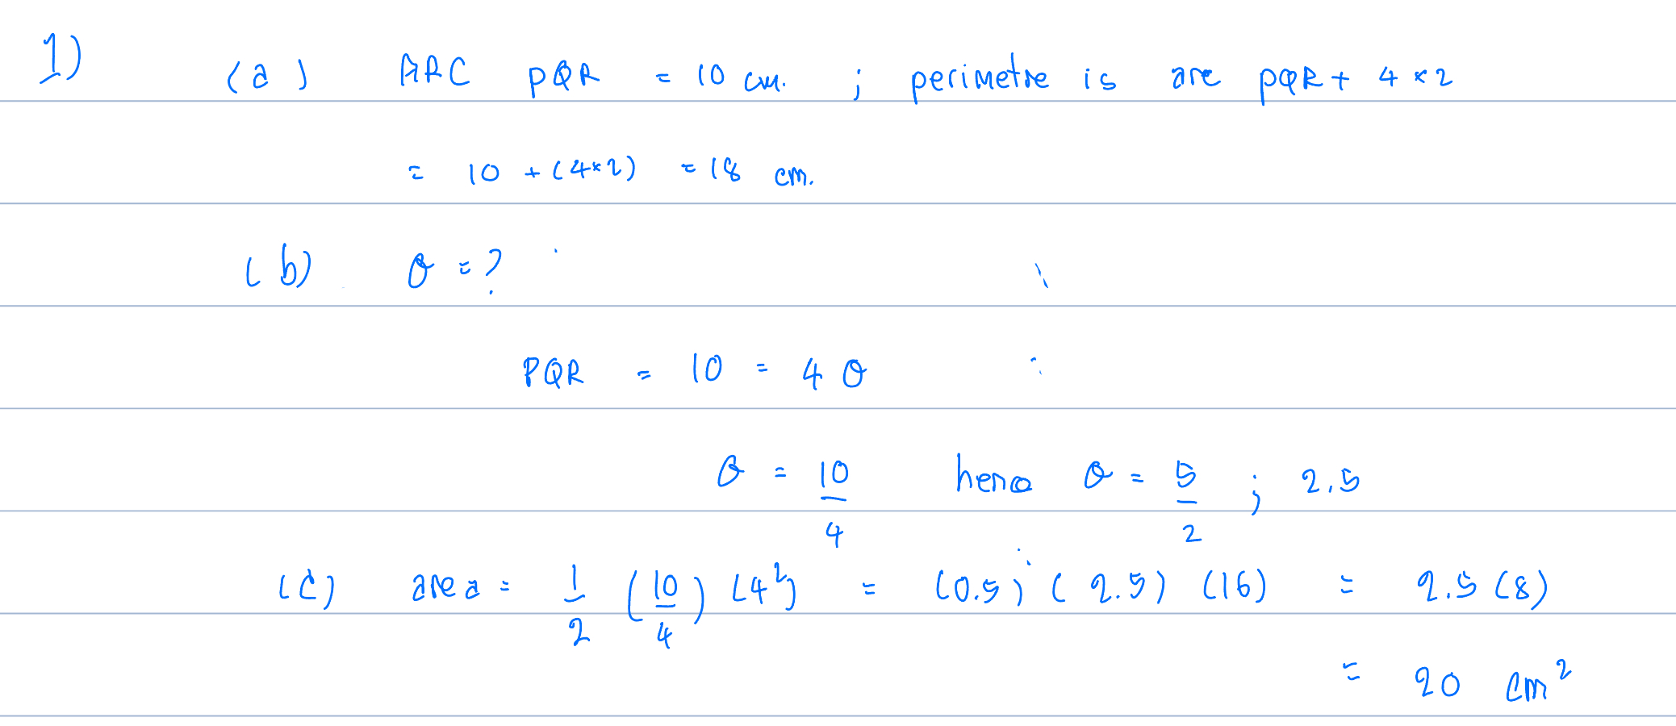

Slide 7
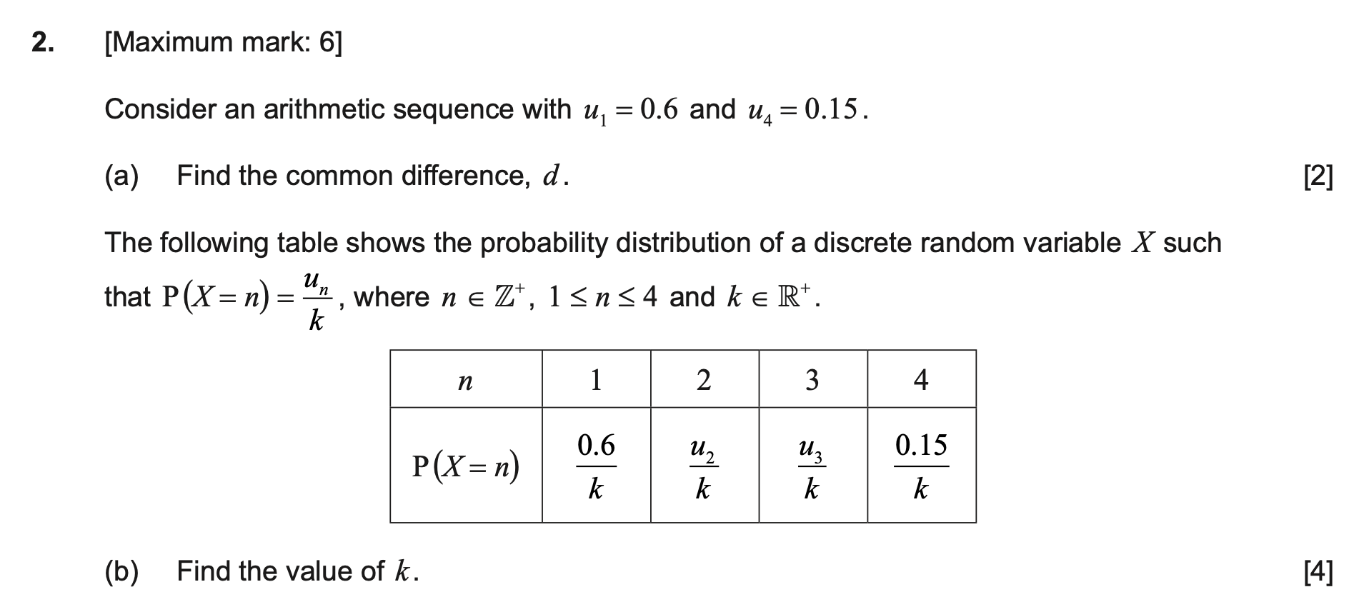

Slide 8
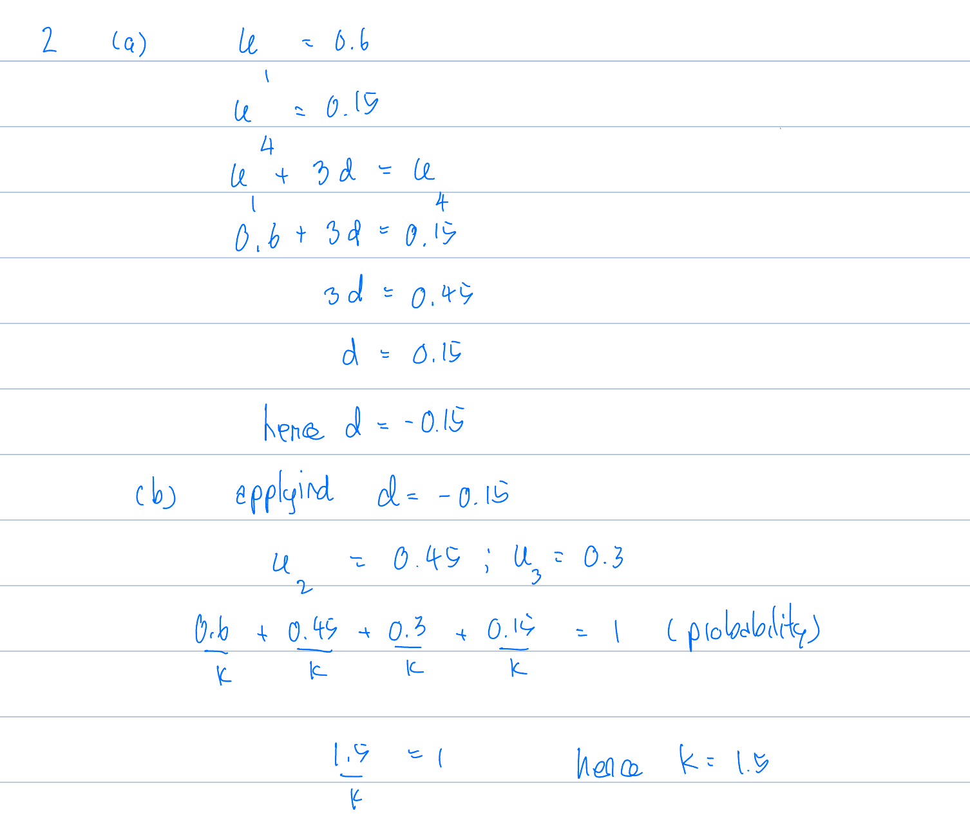

Slide 9
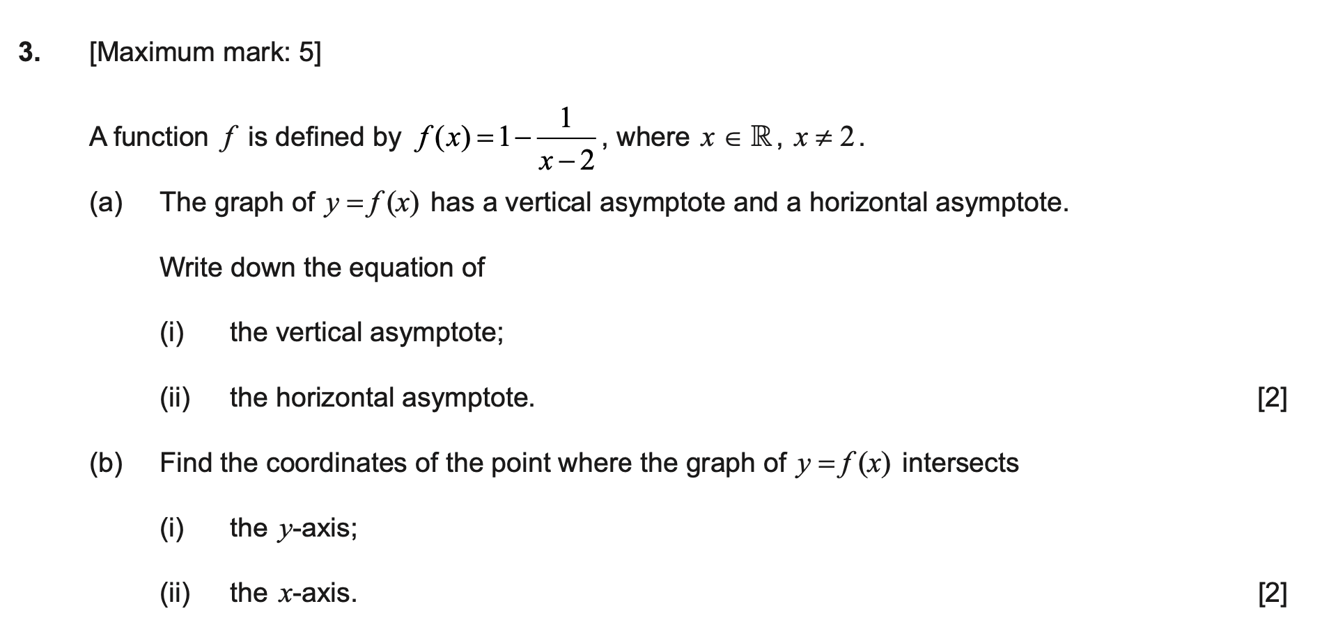

Slide 10
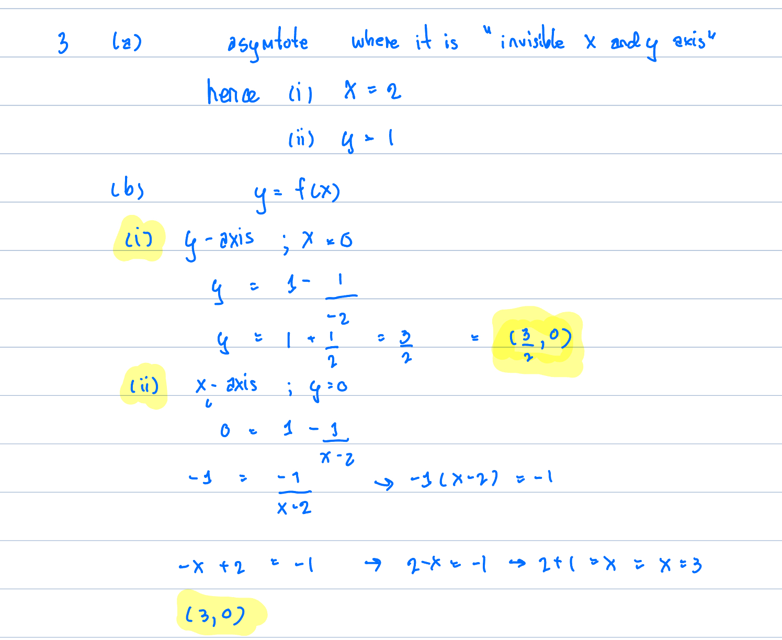

Slide 11
For more keys
Please contact me

