Slide 1
The Circulatory system
Lesson 1
Components of the circulatory system
Lesson 2
Functions of different components of blood & blood related diseases
Lesson 3
The Heart → Structure and the directions of blood flow (Cardiac cycle)
Lesson 4
Heart Beat, exchange of material via blood

Slide 2
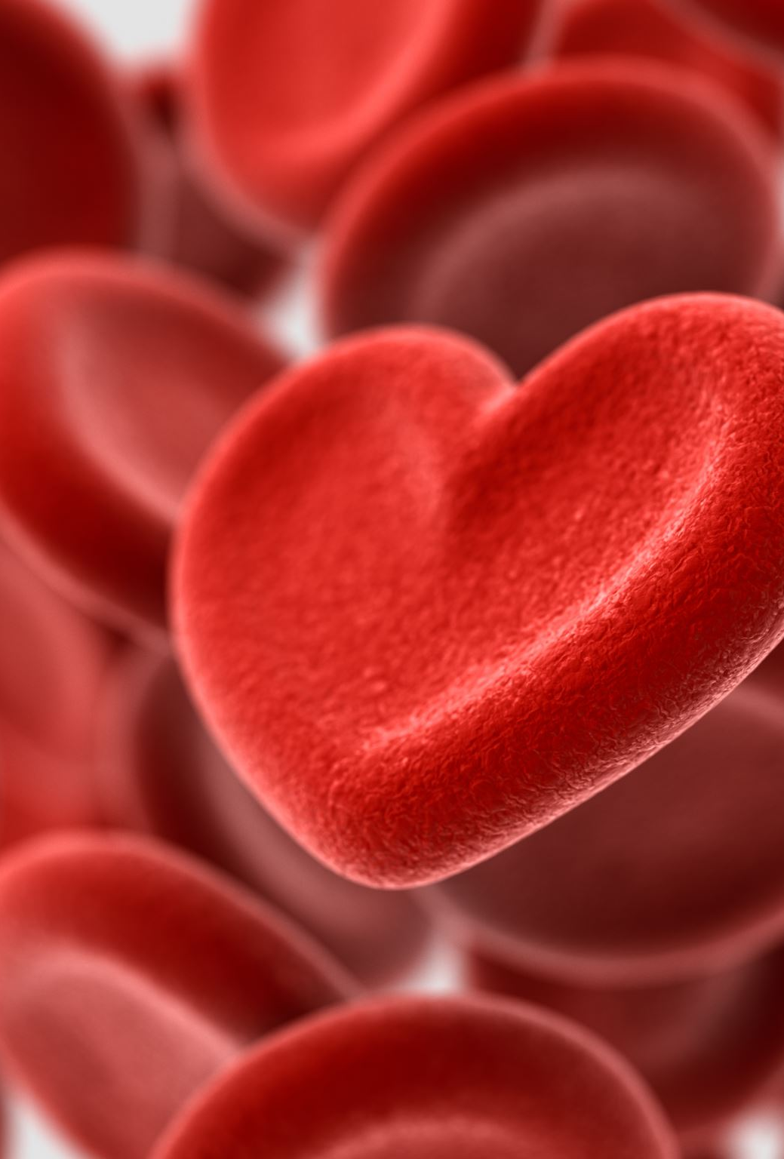
Learning Objectives
Knowledge
Identify different structures of the heart
Illustrate the correct direction of blood flowing in and out of the heart
Attitude
Appreciate the work of scientists over the centuries contributing to the advancement in scientific knowledge

Slide 3
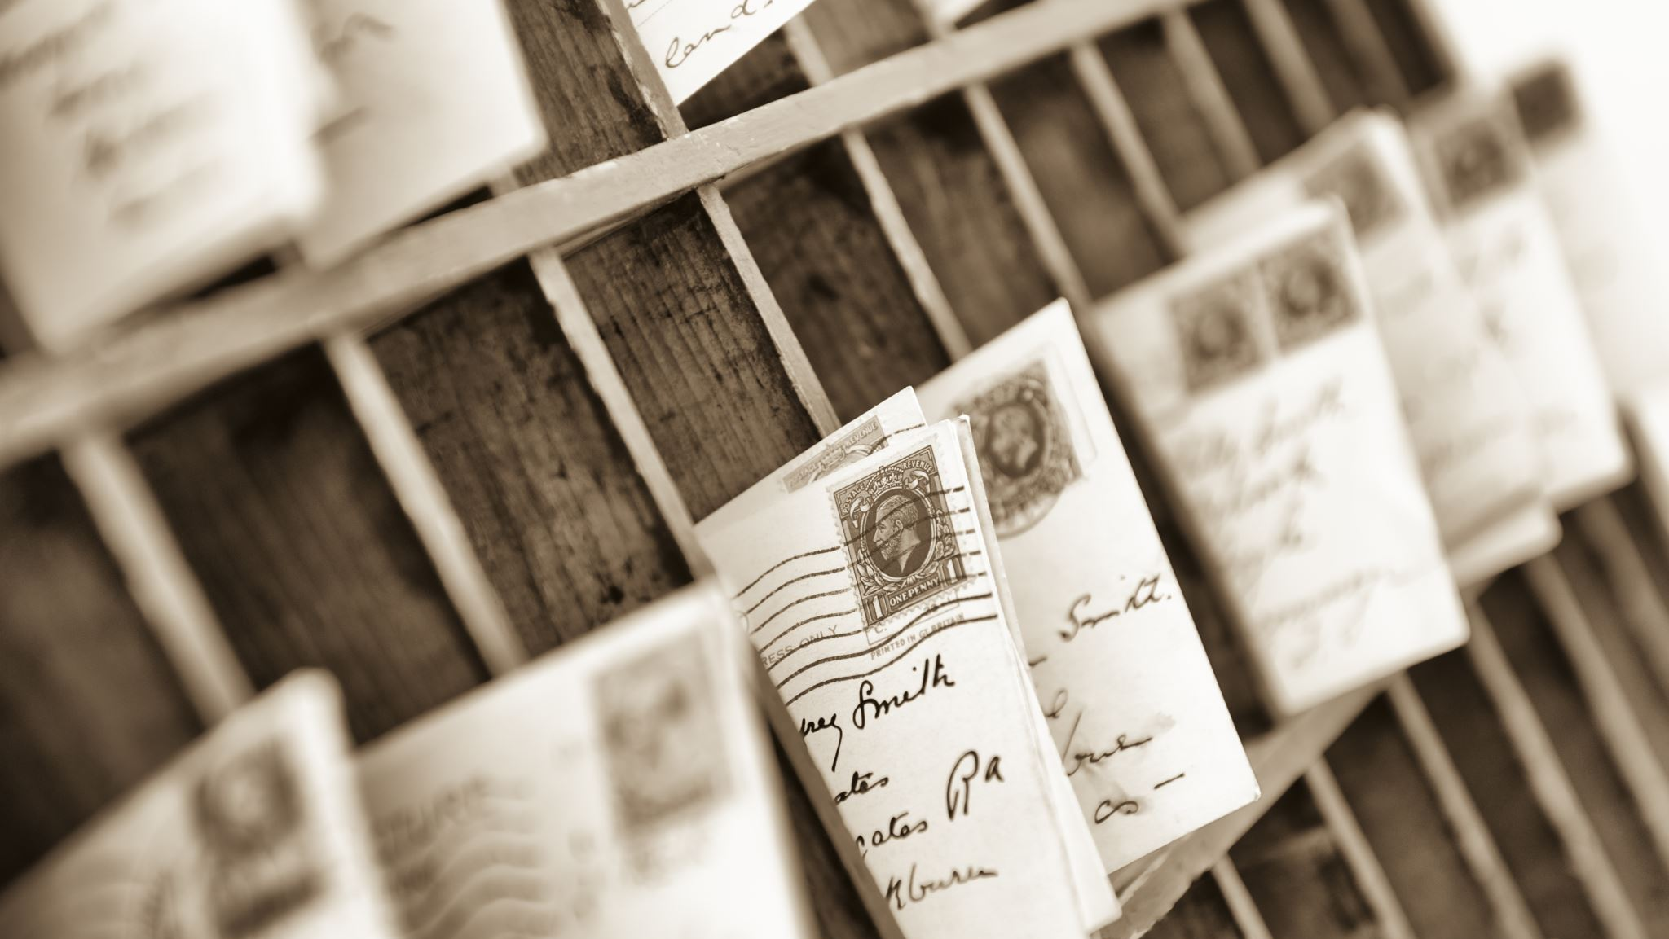
A little History – myths
In ancient Roman history, it was believed that the ring finger had a vein leading directly to the heart (Now scientifically disapproved)
  This influenced the modern wedding ring custom
    Charas
In Ancient Egypt, heart was believed to be the organic motor of the body and the seat of Intelligence
- Alen

Slide 4

A little history –Before the mid 15th Century
No one knew the actual function of heart
Heart is the source of body’s heat
Blood is originated in the liver and heart and consumed by the rest of the body

Slide 5

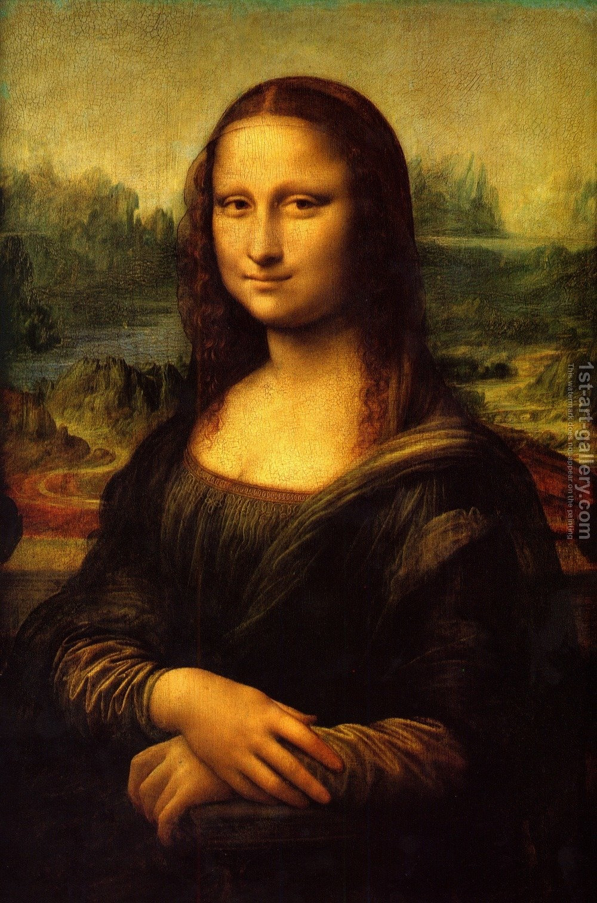
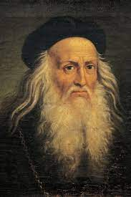
A little History – Mid 15th Century
Dissected over 30 human dead bodies
heart had four chambers all with different functions
Valves in heart are crucial to its function
Mona Lisa
Leonardo Da Vinci (1452 – 1590)
a painter, draughtsman, engineer, scientist, theorist, sculptor and architect

Slide 6
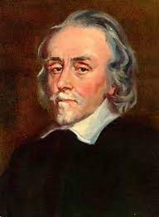
A little History – 17th Century
Known as the founder of Cardiovascular system
Performed Vivisections on dogs
blood went through the heart every time it pumped
heart beats 1 000 times every half hour (5 kg of blood in a half hour )
This proved the theory that the body consumed blood was incorrect
William Harvey (1578 – 1657)
Which nature of science is displayed in this example?
Scientific knowledge is subject to modification as new information challenges prevailing theories

Slide 7
Questions
What is the pathway for circulation of the blood?
How many pathways are there for the blood to enter and exit the heart?
How is the oxygenated and deoxygenated blood kept from mixing in the heart?

Slide 8
The key words
Dorsal / Posterior side
(Towards the back side of the body/ near to lower body)
Ventral/ anterior side
(Towards the front side of the body/ near the upper body)
Pulmonary
(related to lungs)
Cardiac
(Related to heart)

Slide 9
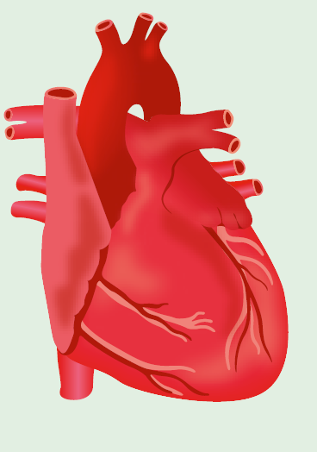
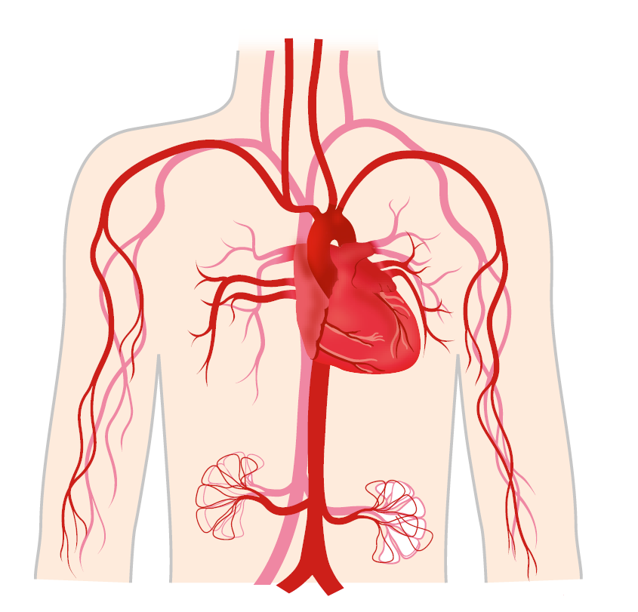
Structure of the heart
anterior vena cava
aorta
pulmonary arteries
(to right lung)
pulmonary arteries
(to left lung)
pulmonary veins
pulmonary veins
posterior vena cava
ventral side
Right
Left

Slide 10
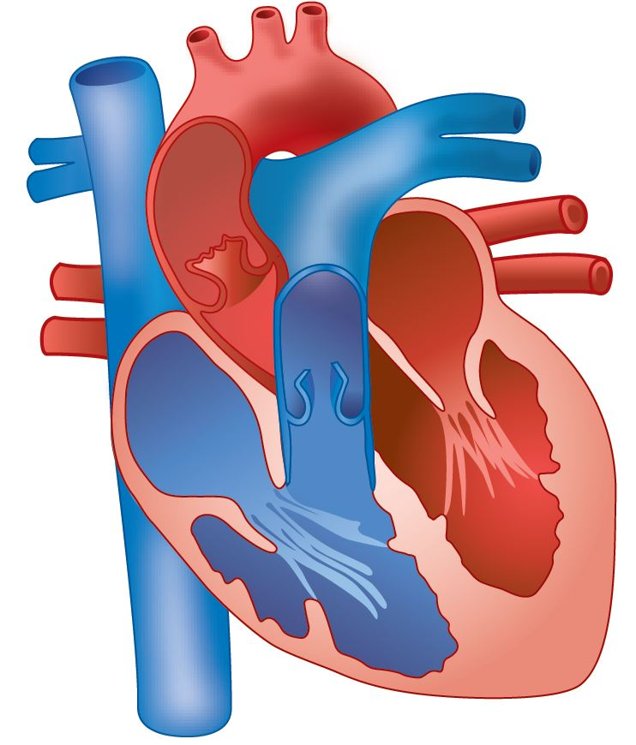
Structure of the heart – 4 Chambers
DROL
Red – Oxygenated Blood
Blue – Deoxygenated Blood
left atrium
right atrium
Receives Blood from the lungs
Receives Blood from the rest of the body
left ventricle
right ventricle
Contracts to Pump oxygenated Blood
Contracts to Pump deoxygenated Blood

Slide 11
Structure of the heart – 7 pathways
Arteries – Away from heart
Veins – Towards the heart
aorta
Oxygenated blood from heart to rest of the body
pulmonary arteries (Left and Right)
Deoxygenated blood from heart to lungs
anterior vena cava
pulmonary veins
Deoxygenated blood from head and arms to heart
Oxygenated blood from lungs to heart
posterior vena cava
Deoxygenated blood from legs and abdomen to heart

Slide 12
Structure of the heart -- valves
Valves – Prevents the backflow of blood
semilunar valves
bicuspid valve
tricuspid valve
Septum
Prevents mixing of blood

Slide 13
Summary
anterior vena cava
aorta
pulmonary arteries
(to right lung)
pulmonary arteries
(to left lung)
pulmonary veins
pulmonary veins
posterior vena cava
Right
Left

