Slide 1
Chapter 14 cost of capital
Corporate finance – FIN420
Spring 2024

Slide 2
Learning objectives
Determine a firm’s cost of equity capital
Determine a firm’s cost of debt
Determine a firm’s overall cost of capital and how to use it to value a company
Explain how to correctly include flotation costs in capital budgeting projects
Describe some of the pitfalls associated with a firm’s overall cost of capital and what to do about them

Slide 3
Chapter outline
The Cost of Capital: Some Preliminaries
The Cost of Equity
The Costs of Debt and Preferred Stock
The Weighted Average Cost of Capital
Divisional and Project Costs of Capital
Company Valuation with the WACC
Flotation Costs and the Weighted Average Cost of Capital

Slide 4
Required return versus cost of capital
The terms required return, appropriate discount rate, and cost of capital essentially mean the same thing:
  If the required return on an investment is 10%, we mean the investment will have a positive NPV only if its return exceeds 10%
  Also, the firm must earn 10% on the investment to compensate investors for the use of the capital needed to finance the project
  Furthermore, 10% is the cost of capital associated with the investment
Cost of capital associated with an investment depends on the risk of that investment, not how and where the capital is raised

Slide 5
Financial policy and cost of capital
The particular mixture of debt and equity a firm chooses to employ—its capital structure—is a managerial variable
In this chapter, we will assume the firm has a fixed debt-equity ratio that it maintains
  This ratio reflects the firm’s target capital structure
Recall, a firm’s overall cost of capital will reflect the required return on the firm’s assets as a whole
  Thus, a firm’s cost of capital will reflect both its cost of debt capital and its cost of equity capital

Slide 6


The cost of equity: dividend growth model approach
Cost of equity is the return that equity investors require on their investment in the firm
  No way to directly observe the return the firm’s equity investors require, so we must estimate the firm’s overall cost of equity
Dividend growth model approach is the easiest way to estimate the cost of equity capital
If we assume the firm’s dividend will grow at a constant rate, g, allow D₀ to represent the dividend just paid and D₁ to represent the next period’s projected dividend, the price per share of the stock, P₀, can be written as:
We can rearrange this to solve for R_{E}, the required return on the stock (i.e., firm’s cost of equity capital), as follows:

Slide 7
dividend growth model approach
We need three pieces of information to estimate R_{E}:
  P₀ and D₀ can be observed directly for publicly traded, dividend-paying firms
  g must be estimated
Suppose Greater States Public Service, a large public utility, paid a dividend of $4 per share last year. The stock currently sells for $60 per share. You estimate that the dividend will grow steadily at a rate of 6% per year into the indefinite future. What is the cost of equity capital for Greater States?
We can calculate the expected dividend for the coming year, D₁, is:
    D₁ = D₀ × (1 + g)
    = $4 × 1.06 = $4.24
Given this, the cost of equity, R_{E}, is:
    R_{E} = D₁/P₀ + g
    = $4.24/$60 + .06 = .1307, or 13.07%

Slide 8
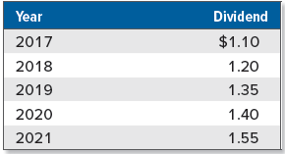
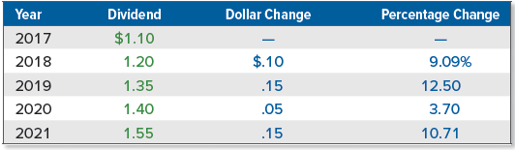
dividend growth model approach: estimating the growth rate
To estimate the growth rate, we can use historical growth rates or analysts’ forecasts of future growth rates
Suppose we observe the following for some company:
We can calculate the percentage change in the dividend per year and then average the four growth rates to derive an estimate for g, (.0909 + .1250 + .0370 + .1071)/4 = .09, or 9%:

Slide 9
dividend growth model approach: advantages and disadvantages
Primary advantage of dividend growth model is its simplicity
Several associated practical problems and disadvantages:
  Applicable only to firms that pay dividends, and even for those companies that pay dividends, a key underlying assumption is that the dividend grows at constant rate
  Estimated cost of equity is very sensitive to estimated growth rate
  Does not explicitly consider risk

Slide 10

The sml approach
Recall, the required or expected return on a risky investment depends on three things:
  Risk-free rate, R_{f}
  Market risk premium, E(R_{M}) − R_{f}
  Systematic risk of the asset relative to the average, which we called its beta coefficient, β
Using SML, we can write the expected return on the company’s equity, E(R_{E}), as follows, where β_{E} is the estimated beta:
  E(R_{E}) = R_{f} + β_{E} × [E(R_{M}) − R_{f}]
Dropping the Es denoting expectations, the required return form the SML, R_{E}, can be written as:

Slide 11
Implementing The sml approach
To use the SML approach, we need the following:
  A risk-free rate, R_{f}
    U.S. T-bills were paying about 1.53% as this chapter was being written, so we will use this as our risk-free rate
  An estimate of the market risk premium, E(R_{M}) − R_{f}
    Recall from Chapter 12 that one estimate of the market risk premium (based on large common stocks) is about 7%
  An estimate of the relevant beta, β_{E}
    Beta coefficients for publicly traded companies are widely available
In Chapter 13, we saw Walt Disney had an estimated beta of 1.11 (Table 13.8). We could estimate Walt Disney’s cost of equity as:
    R_{Walt Disney} = R_{f} + β_{Walt Disney} × (R_{M} − R_{f})
    = .0153 + 1.11 × .07
    = .0930, or 9.30%

Slide 12
Advantages and disadvantages of The sml approach
SML approach has two primary advantages:
  It explicitly adjusts for risk
  It is applicable to companies other than just those with steady dividend growth
Disadvantages include the following:
  SML approach requires that two things be estimated (the market risk premium and the beta coefficient) and if those estimates are poor, the resulting cost of equity will be inaccurate
  As with the dividend growth model, we essentially rely on the past to predict the future when we use the SML approach

Slide 13
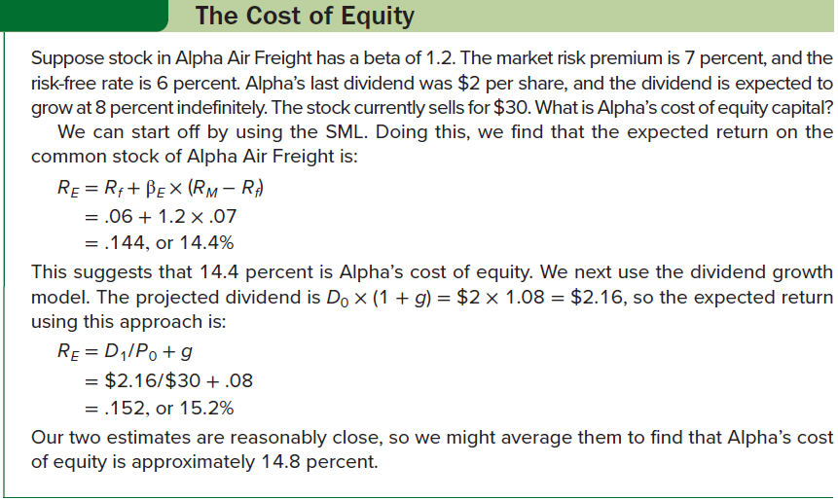
The cost of equity

Slide 14
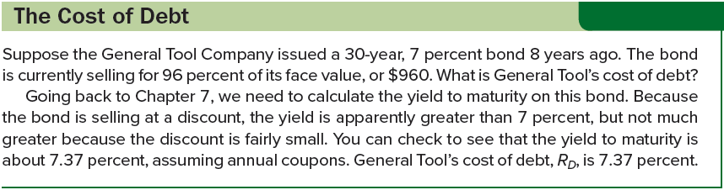
The cost of debt
Cost of debt is the return that lenders require on the firm’s debt
No need to estimate a beta for the debt because the cost of debt can normally be observed either directly or indirectly:
  Cost of debt, R_{D}, is interest rate firm must pay on new borrowing, and we can observe interest rates in the financial markets
Note the coupon rate on the firm’s outstanding debt is irrelevant, as this rate tells us what the firm’s cost of debt was back when the bonds were issues, not what the cost of debt is today

Slide 15

The cost of preferred stock
Preferred stock has a fixed dividend paid every period forever, so a share of preferred stock is essentially a perpetuity. The cost of preferred stock, R_{P}, is thus:
  D is the fixed dividend
  P₀ is the current price per share of the preferred stock
Cost of preferred stock is equal to the dividend yield on the preferred stock
Preferred stocks are rated in much the same way as bonds, so the cost of preferred stock can be estimated by observing the required returns on other, similarly rated shares of preferred stock

Slide 16


The weighted average cost of capital
Use E to represent market value of firm’s equity, calculated by multiplying number of shares outstanding and price per share
Use D to represent market value of firm’s debt, calculated by multiplying market price of single bond and bonds outstanding
  If there are multiple bonds issues, repeat this calculation of D for each and then add up the results
  If there is debt that is not publicly traded, observe the yield on similar publicly traded debt and then estimate the market value of the privately held debt using this yield as the discount rate
Use V to represent combined market value of the debt and equity:
Dividing both sides by V, we can calculate percentages of the total capital represented by the debt and equity (i.e., capital structure weights), which can be interpreted just like portfolio weights:

Slide 17
Taxes and the weighted average cost of capital
Recall the interest paid by a corporation is deductible for tax purposes, but payments to stockholders, such as dividends, are not
In determining an aftertax discount rate, we need to distinguish between the pretax and the aftertax cost of debt
Suppose a firm borrows $1 million at 9% interest. The corporate tax rate is 21%. What is the aftertax interest rate on this loan?
  Total interest bill will be $90,000 per year, but this amount is tax deductible, so the $90,000 interest reduces the firm’s tax bill by .21 × $90,000 = $18,900
  Aftertax interest bill is $90,000 − 18,900 = $71,100
  Aftertax interest rate is $71,100/$1 million = .0711, or 7.11%
Generally, aftertax interest rate equals pretax rate multiplied by 1 minus tax rate
  If we use the symbol T_{C} to stand for the corporate tax rate, then the aftertax rate can be written as R_{D} × (1 − T_{C})

Slide 18

Taxes and the weighted average cost of capital 2
To calculate the firm’s overall cost of capital, we multiply the capital structure weights by the associated costs and add them up, with the total being the weighted average cost of capital (WACC):
WACC has straightforward interpretation:
  It is the overall return the firm must earn on its existing assets to maintain the value of its stock
  It is also the required return on any investments by the firm that have essentially the same risks as existing operations
If a firm uses preferred stock in its capital structure, and we define P/V as the percentage of the firm’s financing that comes from preferred stock and R_{P} as the cost of preferred stock, the WACC is:

Slide 19
The warehouse problem
Suppose you have just become the president of a large company, and the first decision you face is whether to go ahead with a plan to renovate the company’s warehouse distribution system. The plan will cost the company $50 million, and it is expected to save $12 million per year after taxes over the next six years.
  Need to find an alternative in the financial markets that is comparable to warehouse renovation (i.e., has same level of risk)
Suppose the firm has a target debt-equity ratio of 1/3, which implies that E/V is .75 and D/V is .25. The cost of debt is 10%, and the cost of equity is 20%. Assuming a 21% tax rate, the WACC will be:
    WACC = (E/V) × R_{E} + (D/V) × R_{D} × (1 − T_{C})
    = .75 × . 20 + .25 × . 10 × ( 1 − .21)
    = .1698, or 16.98%

Slide 20
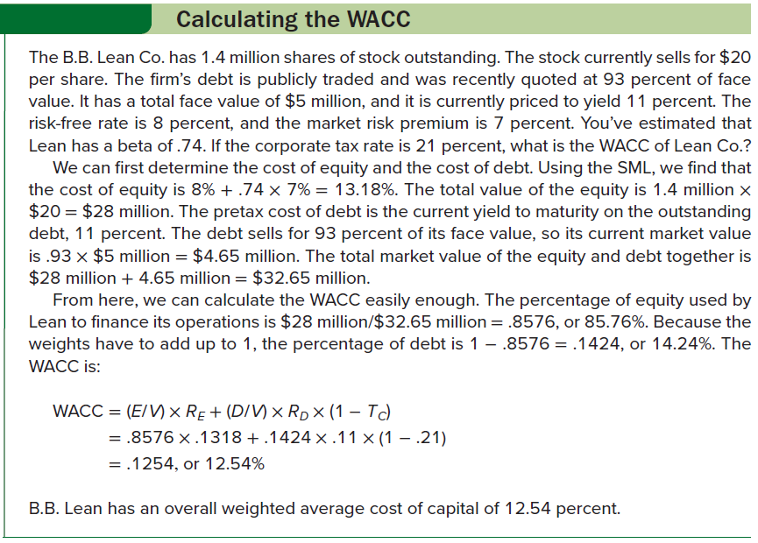
Calculating the wacc

Slide 21

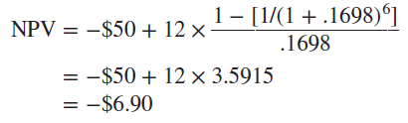
The warehouse problem 2
Warehouse project has a cost of $50 million and expected aftertax cash flows (the cost savings) of $12 million per year for six years.
The NPV (in millions) is:
Because cash flows are in the form of an ordinary annuity, we can calculate NPV using 16.98% (the WACC) as the discount rate:
Should the firm take on the warehouse renovation?
  No; the project has a negative NPV using the firm’s WACC

Slide 22
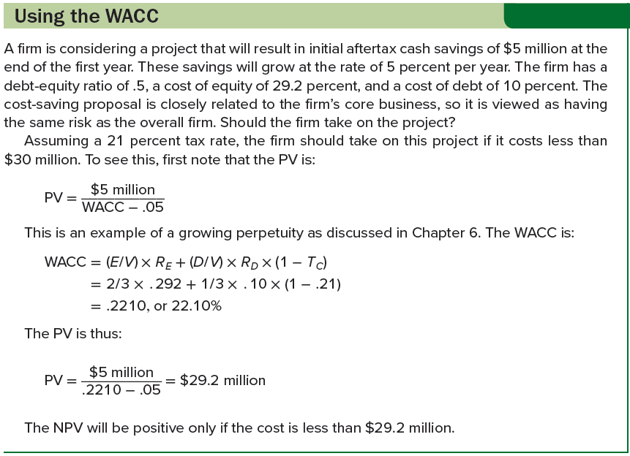
using the wacc

Slide 23
Performance evaluation
Performance evaluation is another use of the WACC
  Best-known approach in this area is the economic value added (EVA) method
  Others include market value added (MVA) and shareholder value added (SVA)
Suppose we have $100 million in capital (debt and equity) tied up in our firm, and our overall WACC is 12%. If we multiply these together, we get $12 million. If our cash flow from assets is less than this, we are, on an overall basis, destroying value; if cash flow from assets exceeds $12 million, we are creating value
Evaluation strategies suffer to a certain extent from problems with implementation (e.g., many companies make extensive use of book values for debt and equity in computing cost of capital)

Slide 24
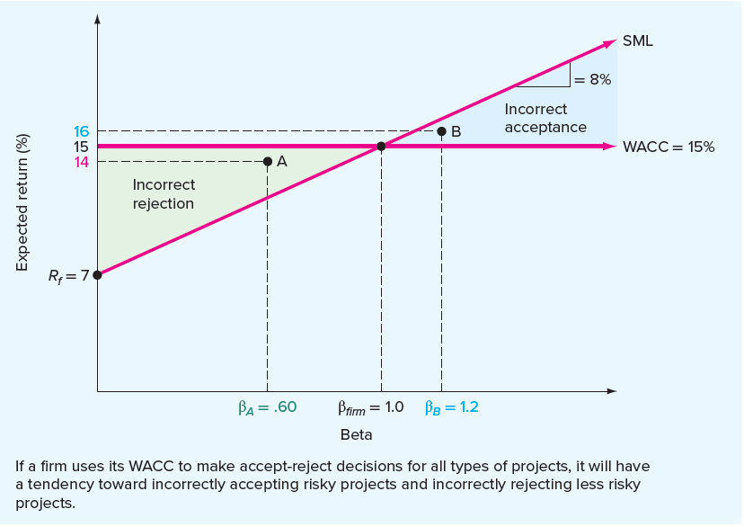
The sml and the wacc
Using WACC could lead to poor decisions when evaluating investments with risks that are substantially different from those of the overall firm
In the graph, we have plotted an SML corresponding to a risk-free rate of 7% and a market risk premium of 8%
  Consider an all-equity company with a beta of 1
  WACC and cost of equity are equal to 15% for this company because there is no debt

Slide 25
The sml and the wacc 2
Suppose our firm uses its WACC to evaluate all investments (i.e., any investment with a return of greater than 15% will be accepted and any investment with a return of less than 15% will be rejected)
  Recall that a desirable investment is one that plots above the SML
Consider Point A. This project has a beta of β_{A} = .60, as compared to the firm’s beta of 1.0. It has an expected return of 14%. Is this a desirable investment? Yes, because its required return is only:
    Required return = R_{f} + β_{A} × (R_{M} − R_{f})
    = .07 + .60 × .08
    = .118, or 11.8%
If we use the WACC as a cutoff, this project will be rejected because its return is less than 15%
  A firm that uses its WACC as a cutoff will tend to reject profitable projects with risks less than those of the overall firm

