Slide 1

Fun with
Exploring Essential Functions
for Young Learners
Dr. Jyotsna Sharma

Slide 2
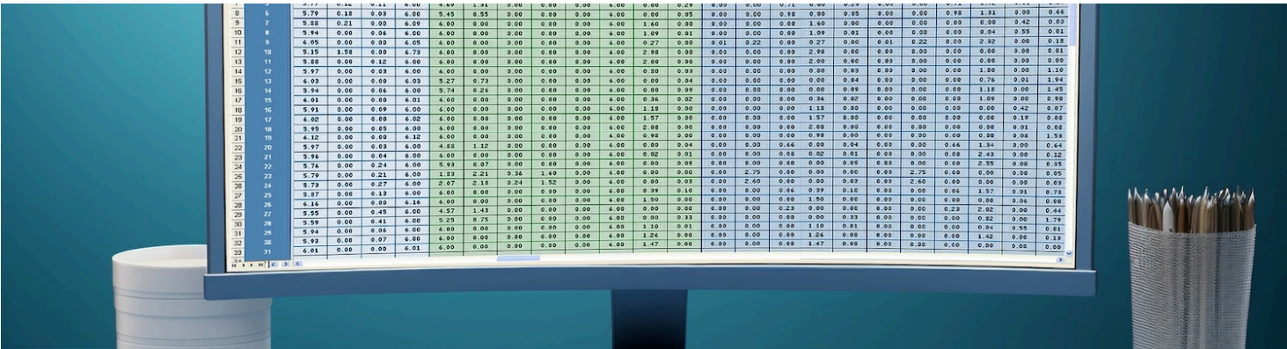

Introduction to Fun with Excel
Welcome to Fun with Excel! In this presentation, we'll explore essential functions that make learning Excel enjoyable for young learners.
Excel is not just a tool; it's a way to unlock creativity and problem-solving skills.

Slide 3

Excel Functions
Sum
Average
The SUM function is one of the most useful tools in Excel. It allows you to add up a range of numbers quickly. T
The AVERAGE function helps to find the mean of a set of numbers. This can help you to gain insights into their data and make informed decisions based on your findings.
Count
The COUNT function is perfect for counting numeric entries in a dataset. This is particularly useful when you want to track items or occurrences.

Slide 4
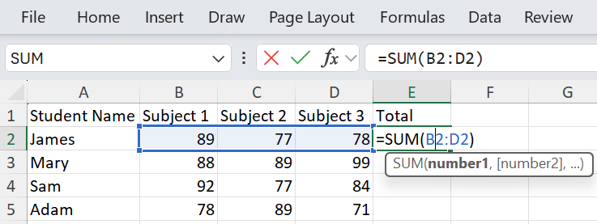
SUM Function

Slide 5
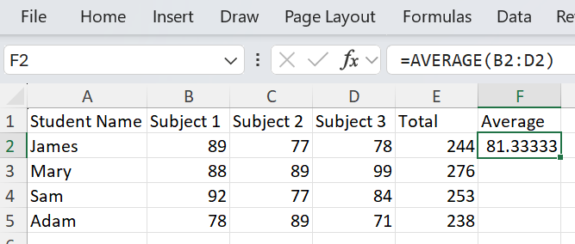
Average Function

Slide 6
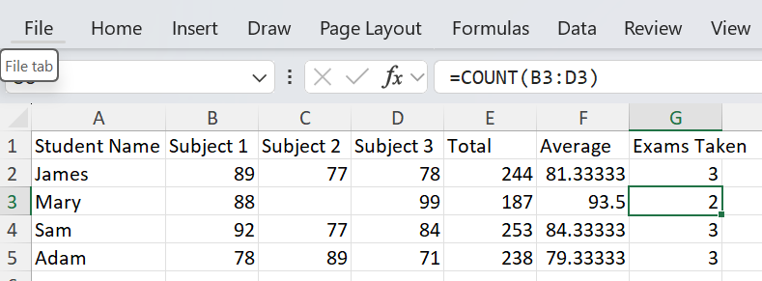
COUNT Function

