Slide 1
Literary devices
IGCSE FIRST LANGUAGE

Slide 2
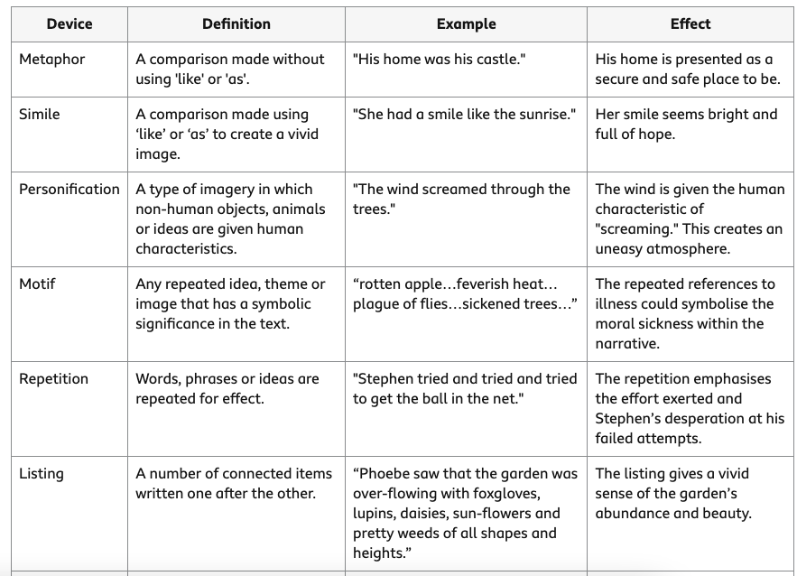

Slide 3
Device | example | effects
inclusive pronouns, | Use we our ourselves us, “We must respect ourselves“ | Stress the union between speaker and others
imperative verbs, | Command verbs “ stop eating that burger” | Stress the urgency, different position between speaker and listener
direct address, | “ you are one of us” | Show the importance of the words, emphasis
tripling | three words or groups of words with the same grammatical structure “He is smart, handsome and strong.” | Listing enough and adequate item to illustrate qualities that is meant to convey
colloquial language, | Use words the is not that formal “That's cap man.” | Show closeness or position of speaker with listener
symbolism | uses symbols, be they words, people, marks, locations to represent an abstract idea “The butterfly is often chosen for its symbolism of beauty “ | Use imagery to illustrate a point to reader

Slide 4
Device | example | effects
inclusive pronouns, | Use we our ourselves us, We must respect ourselves | Stress the union between speaker and others
rhetorical questions | A question is rhetorical if and only if its goal is to produce an effect on the listener, rather than to obtain information. | “It’s too hot today, isn’t it?“
anecdotes | a story that's short and self-contained. | I remember when I used to sit on my dad's lap while he drove around town delivering mail.
Juxtaposition | Two opposite meaning | Happy and sad, black and white เอาไอเดียมาเขียน
Paradox | a statement or idea that seems to contradict itself and is often confusing; | The statement “I always lie” is paradoxical because even though it's stated as a truth, in reality it's a lie
Oxymoron | combines contradictory words with opposing meanings, | “old news,” “deafening silence,” or “organized chaos.”

Slide 5
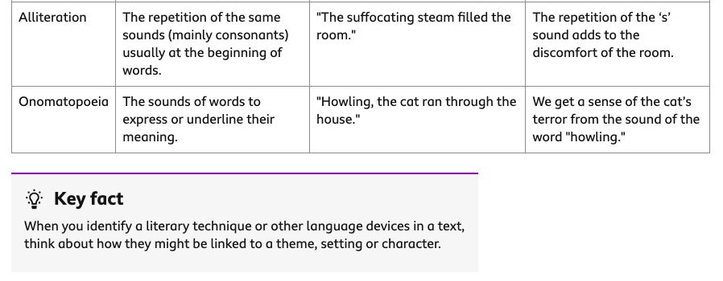

Slide 6
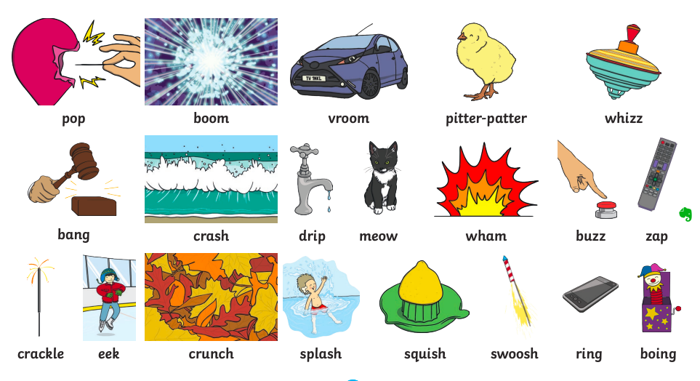
Onomatopoeia
Clanking, clattering, rattling

Slide 7
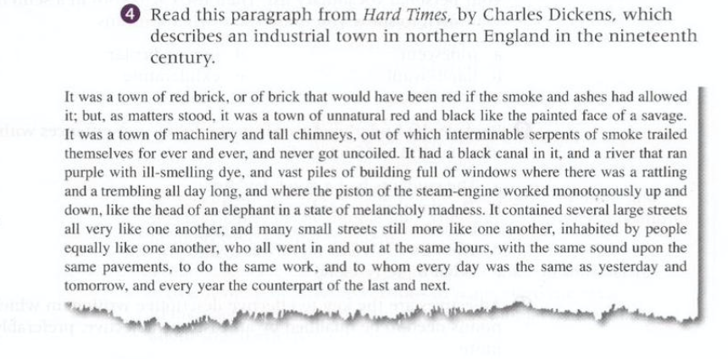
How does the use of language represent an undesirable city?
Powerful words
Sensory language
onomatopoeia
symbol
list
repetition

