Slide 1
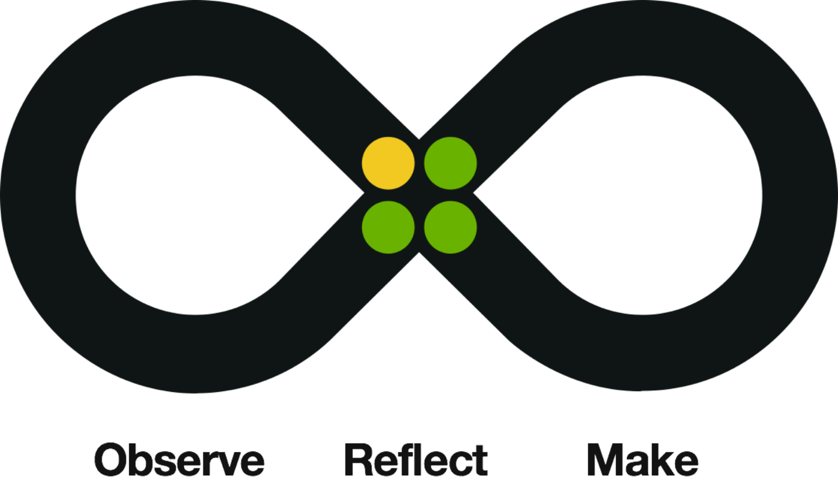
IBM Design Thinking: Driven by the Loop
Dr. Stephen KERWICK
Notes:
The next section is the Loop. It’s at the heart of IBM Design Thinking and it’s a behavioral model for discovering user needs and envisioning a better future. Increasing our understanding of a problem and its solutions ensures better outcomes. Therefore the Loop is made for understanding open-ended problems. The Loop consists of three sections – observe, reflect, and make. Let’s break these down further.
First is observe. Observing immerses us in our users’ world. It helps us to get to know our users, uncover their needs, learn the landscape and test our ideas. When we observe, we make sure to set aside our assumptions and take it in without judgment. This is about objectively discovering your users’ world instead of seeking validation for your existing ideas and assumptions.
Next up is reflect. Reflecting helps align our various points of view. If we slow down just enough to reflect, we move faster when we’re aligned. Reflecting is about coming together and converging on a point of view. It helps us to find common ground, uncover insights, align with your team and plan ahead. When you reflect, make sure to reflect together to stay in sync. Reflecting individually is important but reflecting as a team is fundamental to great collaboration.
The third aspect of the Loop is make. Making gives form to our ideas. Making is about getting your hands dirty to communicate concepts, explore ideas, prototype possibilities and drive to outcomes. We can’t know everything, but we do know something, so jump right in. The earlier we make, the faster we learn.
Now at this point, many of you may be saying, well, what about my artifacts? Rest assured the activities and artifacts that we all associate with IBM Design Thinking are still essential. Empathy map, storyboards, paper prototypes are all part of IBM Design Thinking, but remember, these are just artifacts and techniques. Use the artifacts your team needs to succeed, but don’t limit yourselves either. With that said, the artifacts don’t do the thinking for you. Instead, we ask that you consider these questions as a team as you move through the Loop. For observe, they’re simple – who are our users, what are their needs, what ideas do they have for us. For reflect, do we agree on our intent, did we make the leap to insight, are we ready to commit? And while making, what’s possible, what’s our concept, what’s our story? We recommend starting every journey by reflecting first to converge as a team on what your intent is. After that, go in any order you like. Observe, reflect, then make. Or make, reflect, and observe. What’s important is that you find your team’s momentum, do all three and that you keep moving.

Slide 2

The Loop: Observe
Observe
Immerse yourself in real world to get to know your users, uncover needs, learn the landscape, and test ideas.
Ask
Who are our users?
What are their needs?
What feedback do they have?

Slide 3

The Loop: Reflect
Reflect
Come together and form a point of view to find common ground, uncover new insights, align your team, and come up with a plan.
Ask
What have we learned?
Do we have an insight?
Are we aligned?

Slide 4

The Loop: Make
Make
Give form to abstract ideas to explore ideas, communicate stories, prototype possibilities, and drive real world outcomes.
Ask
What’s possible?
What’s our concept?
What’s our story?

Slide 5
Reflect Again
Come together and form a point of view to find common ground, uncover new insights, align your team, and come up with a plan.
Ask
What have we learned?
Do we have an insight?
Are we aligned?

