Slide 1



Parts of Speech
Let's go to the beach!

Slide 2

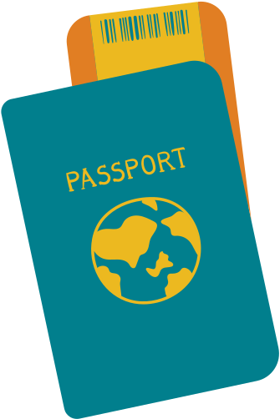


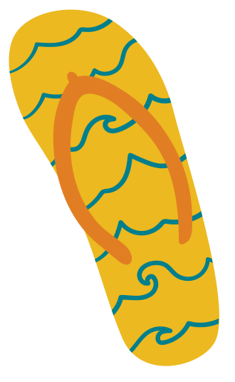



Let's discuss 8 different parts of speech.
Can you name any of them?

Slide 3
Adjective
noun
AdVerb
preposition
Interjection
Pronoun
Conjunction
Verb

Slide 4
Adjective
describes or modifies a noun
yellow, wavy, sandy

Slide 5
Adverb
describes an adjective, ends in -ly
lazily, sleepily, restfully

Slide 6
interjection
word or phrase to show emotion
Yay!, Woa!, Cowabunga!

Slide 7
conjunction
a word that connects clauses
but, and, or

Slide 8
Noun
person, place, thing, or idea
umbrella, chair, beach

Slide 9
preposition
shows relationship like when & where
in, on, through

Slide 10

pronoun
replaces a noun
she, we, they, you

Slide 11
verb
expresses action or being
float, swim, surf

Slide 12
Activities

Slide 13
Match the word to the part of speech.
float
pronoun
yellow
adverb
they
adjectvie
lazily
verb

Slide 14
Match the word to the part of speech.
umbrella
preposition
and
interjection
Yay!
conjunction
on
noun

Slide 15
label the parts of speech.
Susie photographed the long, sandy, shoreline.

Slide 16
label the parts of speech.
Wow! A boat sailed quickly past us in the marina.

Slide 17
label the parts of speech.
Josie swims with flippers and goggles.

Slide 18
Answer key

Slide 19
label the parts of speech.
Susie photographed the long, sandy, shoreline.
noun
verb
adjectives
noun

Slide 20
label the parts of speech.
Wow! A boat sailed quickly past us
in the marina.
interjection
noun
verb
adverb
pronoun
preposition
noun

Slide 21
label the parts of speech.
Josie swims with flippers and goggles.
noun
verb
preposition
noun
conjunction
noun

Slide 22
Match the word to the part of speech.
float
pronoun
yellow
adverb
they
adjectvie
lazily
verb

Slide 23
Match the word to the part of speech.
umbrella
preposition
and
interjection
Yay!
conjunction
on
noun

Slide 24
Resource Page

Slide 25


