Slide 1


Understanding Homonyms
Exploring Words with Multiple Meanings in English

Slide 2


Key Vocabulary
Important Words to Know
Homonyms: Words that have the same spelling or pronunciation but different meanings.
Context: The words and sentences around a word that help explain its meaning.
Homophones: Words that sound the same but have different spellings and meanings (e.g., 'two' and 'too').
Homographs: Words that are spelled the same but have different meanings and may have different pronunciations (e.g., 'tear' as in crying and 'tear' as in ripping).

Slide 3
What Are Homonyms?
Definition
Homonyms are words that can have the same spelling or pronunciation but hold different meanings. They make English fun and tricky to learn!
Example
Consider the word bat:
Bat (an animal): A small flying mammal.
Bat (sports equipment): A stick used to hit a ball in games like baseball.

Slide 4
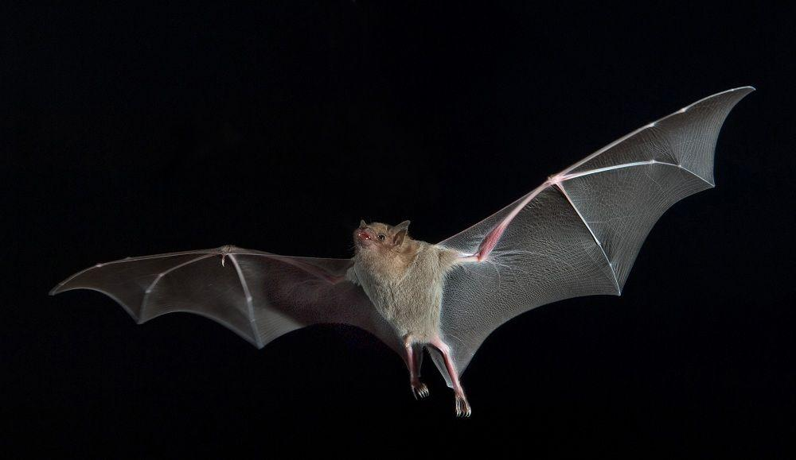

How Context Helps
Context is like a clue! It helps us figure out which meaning of a homonym is being used in a sentence.
Example: 'The bat flew into the cave.' (animal)'He hit the ball with a bat.' (sports equipment)

Slide 5
Homonyms vs. Homophones vs. Homographs
Homonyms
Same spelling or sound
Different meanings
Example: bat (animal, sports equipment)
Homophones
Same sound
Different spelling and meaning
Example: two vs. too
Homographs
Same spelling
Different meaning and sometimes pronunciation
Example: tear (rip, crying)

Slide 6
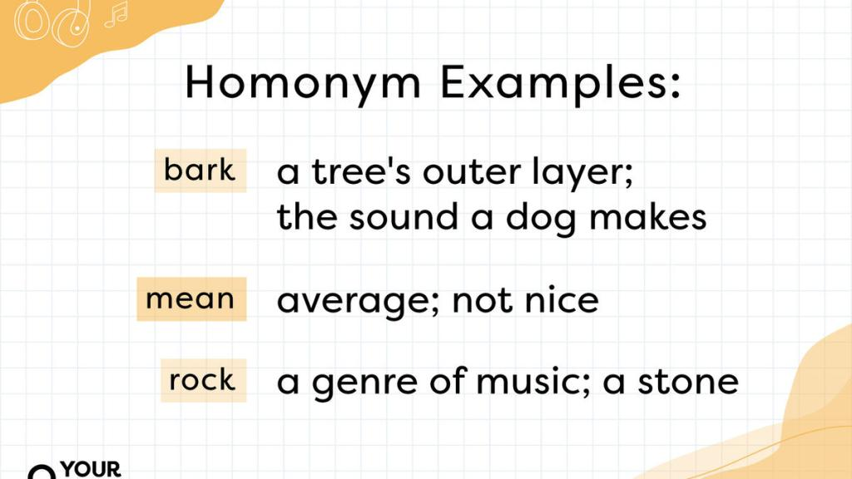
Real-World Examples
Everyday Homonyms
Bank
Right
Ring

Slide 7
Activity: Identifying Homonyms
Instructions
Read the sentences below.
Identify the homonym and its two meanings.
Example:
'The duck swam in the pond.'
'Duck when the ball comes your way!'
Sentences
The leaves fall in autumn.
She will book a table for dinner.
Can you light the candle?
Discuss your answers with a friend!

Slide 8
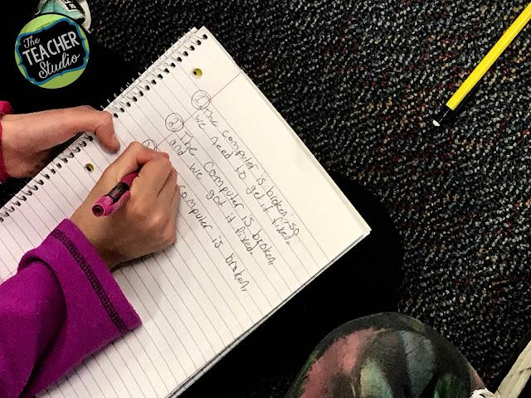
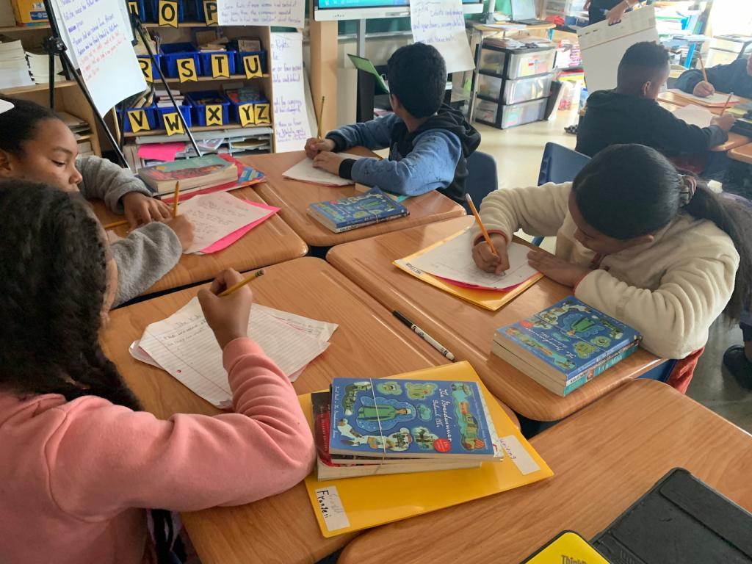

Activity: Create Sentences
Step 1
Choose a homonym: bat, bank, or ring.
Step 2
Write two sentences using the homonym with different meanings.
Step 3
Share your sentences with the class!

Slide 9

Why Homonyms Matter
Applications in Real Life
Improving Communication: Understanding homonyms helps us avoid confusion in conversations.
Reading Comprehension: Context clues make reading easier and more enjoyable.
Creative Writing: Homonyms add fun and depth to stories and poems.

Slide 10
Exploring Homonyms
Name: ​
Variety worksheet ​🍭​
Page 1 of 3
Read the sentences below carefully and fill in the gaps with the correct word or term.
1. The _____ flew into the cave and the boy picked up his baseball _____.
2. She looked at the _____ after she placed a bet at the _____.
3. Make sure to _____ when the ball comes, and have you seen that white _____ in the pond?
4. The _____ sparkled brightly, and she heard the phone _____.
5. He went to the _____ to withdraw money and later relaxed by the _____.

Slide 11
Variety worksheet ​🍭​
Page 2 of 3
Q6. What is the key characteristic of homonyms?
a) They have the same meaning but different spellings.
b) They are two words that sound exactly the same.
c) They have the same spelling or pronunciation but different meanings.
d) They have synonyms and antonyms.
Q7. Which of the following pairs are homographs?
a) Bear (animal) and Bare (naked)
b) Tear (rip) and Tear (crying)
c) Two and Too
d) Rose (flower) and Rows (lines)
Q8. In 'He hit the ball with a bat,' what is the meaning of 'bat'?
a) A flying mammal.
b) An animal that lives in caves.
c) Sports equipment used to hit balls.
d) A type of bird.
Q9. Context helps us understand a homonym by:
a) Changing the spelling of the word.
b) Explaining which meaning fits the sentence.
c) Making sentences confusing.
d) Replacing homonyms with simpler words.
Q10. Which of these is an example of a homophone?
a) Bat (animal) and Bat (sports)
b) Write and Right
c) Bank (river) and Bank (money)
d) Lead (metal) and Lead (guide)
Q11. What is a homograph?
a) Words that have the same pronunciation but different spellings and meanings.
b) Words that are spelled the same but may have different meanings or pronunciations.
c) Words that have the same spelling and only one meaning.
d) Words that are completely unrelated in all aspects.

Slide 12
Variety worksheet ​🍭​
Page 3 of 3
Question 12:
Define the term 'homonym' in your own words.
Question 13:
Give an example of a sentence where 'bank' is used as money storage.
Question 14:
Write two sentences using the word 'ring' with different meanings.
Question 15:
Why is understanding the context important when interpreting homonyms?

Slide 13
Exploring Homonyms
The Answers!
Variety worksheet ​🍭​
Page 1 of 3
1. The bat flew into the cave and the boy picked up his baseball bat.
2. She looked at the bank after she placed a bet at the bank.
3. Make sure to duck when the ball comes, and have you seen that white duck in the pond?
4. The ring sparkled brightly, and she heard the phone ring.
5. He went to the bank to withdraw money and later relaxed by the bank.

Slide 14
Variety worksheet ​🍭​
Page 2 of 3
Q6. What is the key characteristic of homonyms?
a) They have the same meaning but different spellings.
b) They are two words that sound exactly the same.
c) They have the same spelling or pronunciation but different meanings. ✅
d) They have synonyms and antonyms.
Q7. Which of the following pairs are homographs?
a) Bear (animal) and Bare (naked)
b) Tear (rip) and Tear (crying) ✅
c) Two and Too
d) Rose (flower) and Rows (lines)
Q8. In 'He hit the ball with a bat,' what is the meaning of 'bat'?
a) A flying mammal.
b) An animal that lives in caves.
c) Sports equipment used to hit balls. ✅
d) A type of bird.
Q9. Context helps us understand a homonym by:
a) Changing the spelling of the word.
b) Explaining which meaning fits the sentence. ✅
c) Making sentences confusing.
d) Replacing homonyms with simpler words.
Q10. Which of these is an example of a homophone?
a) Bat (animal) and Bat (sports)
b) Write and Right ✅
c) Bank (river) and Bank (money)
d) Lead (metal) and Lead (guide)
Q11. What is a homograph?
a) Words that have the same pronunciation but different spellings and meanings.
b) Words that are spelled the same but may have different meanings or pronunciations. ✅
c) Words that have the same spelling and only one meaning.
d) Words that are completely unrelated in all aspects.

Slide 15
Variety worksheet ​🍭​
Page 3 of 3
Question 12:
Define the term 'homonym' in your own words.
Homonyms are words that are written or pronounced the same but have different meanings. ✅
Question 13:
Give an example of a sentence where 'bank' is used as money storage.
Example: I deposited some cash at the bank yesterday. ✅
Question 14:
Write two sentences using the word 'ring' with different meanings.
Example: She received a gold ring on her birthday. / I could hear the school bell ring from afar. ✅
Question 15:
Why is understanding the context important when interpreting homonyms?
Context clarifies which specific meaning of a homonym is intended in a sentence, reducing confusion. ✅

