Slide 1
Basic English Lesson KIDS
🎯 Objectives:
By the end of the lesson, students will be able to:
Say basic greetings (Hello, Hi, Goodbye)
Introduce themselves (“My name is ___”
Ask someone’s name (“What’s your name?”)
Respond appropriately
Daniela May Dabasol

Slide 2
CAN YOU
Introduce Yourself?

Slide 3
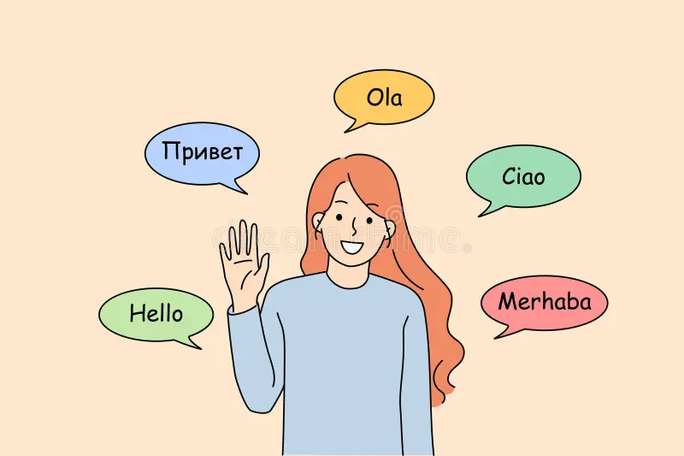
How Are You Today ?
Hello! My Name is Dani , your English Tutor
Say it with me
Hello My Name is,
What is Your name ?
Try greeting everyone who you meet today

